Slide 1
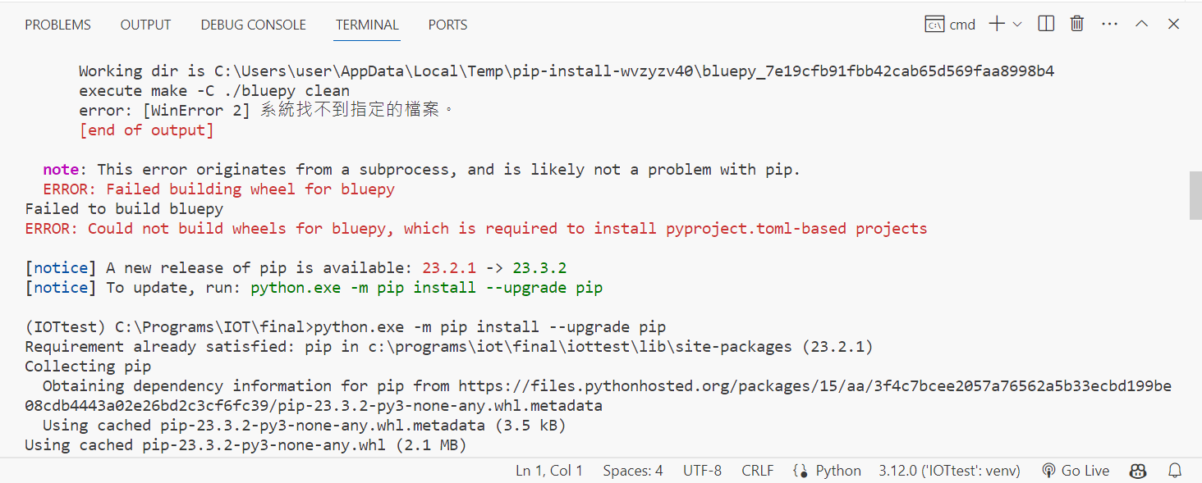

Slide 2
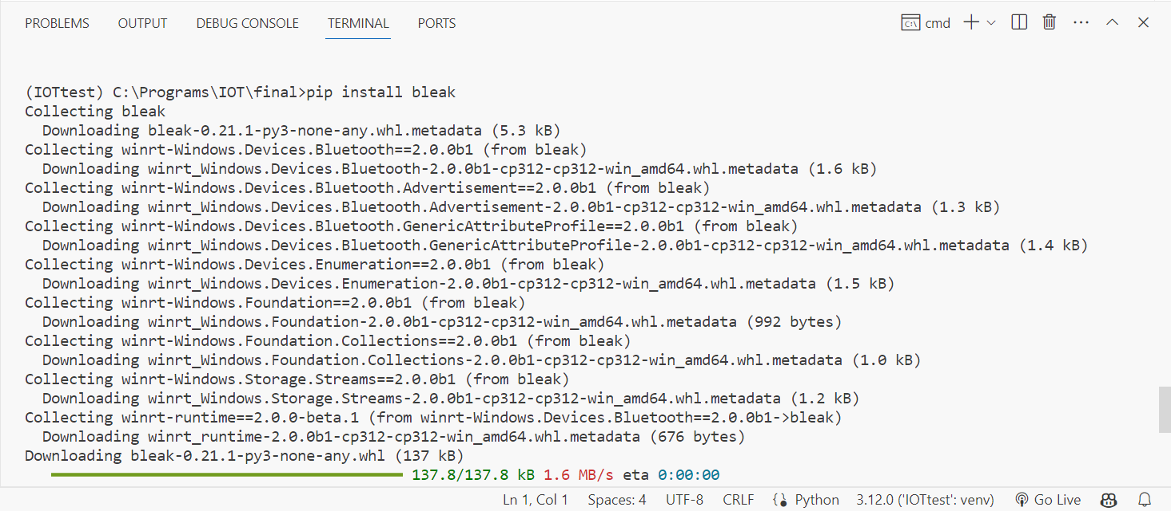
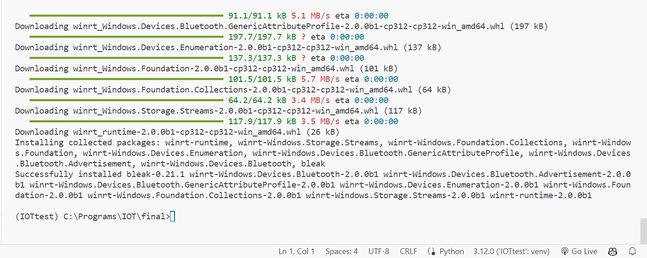

Slide 3
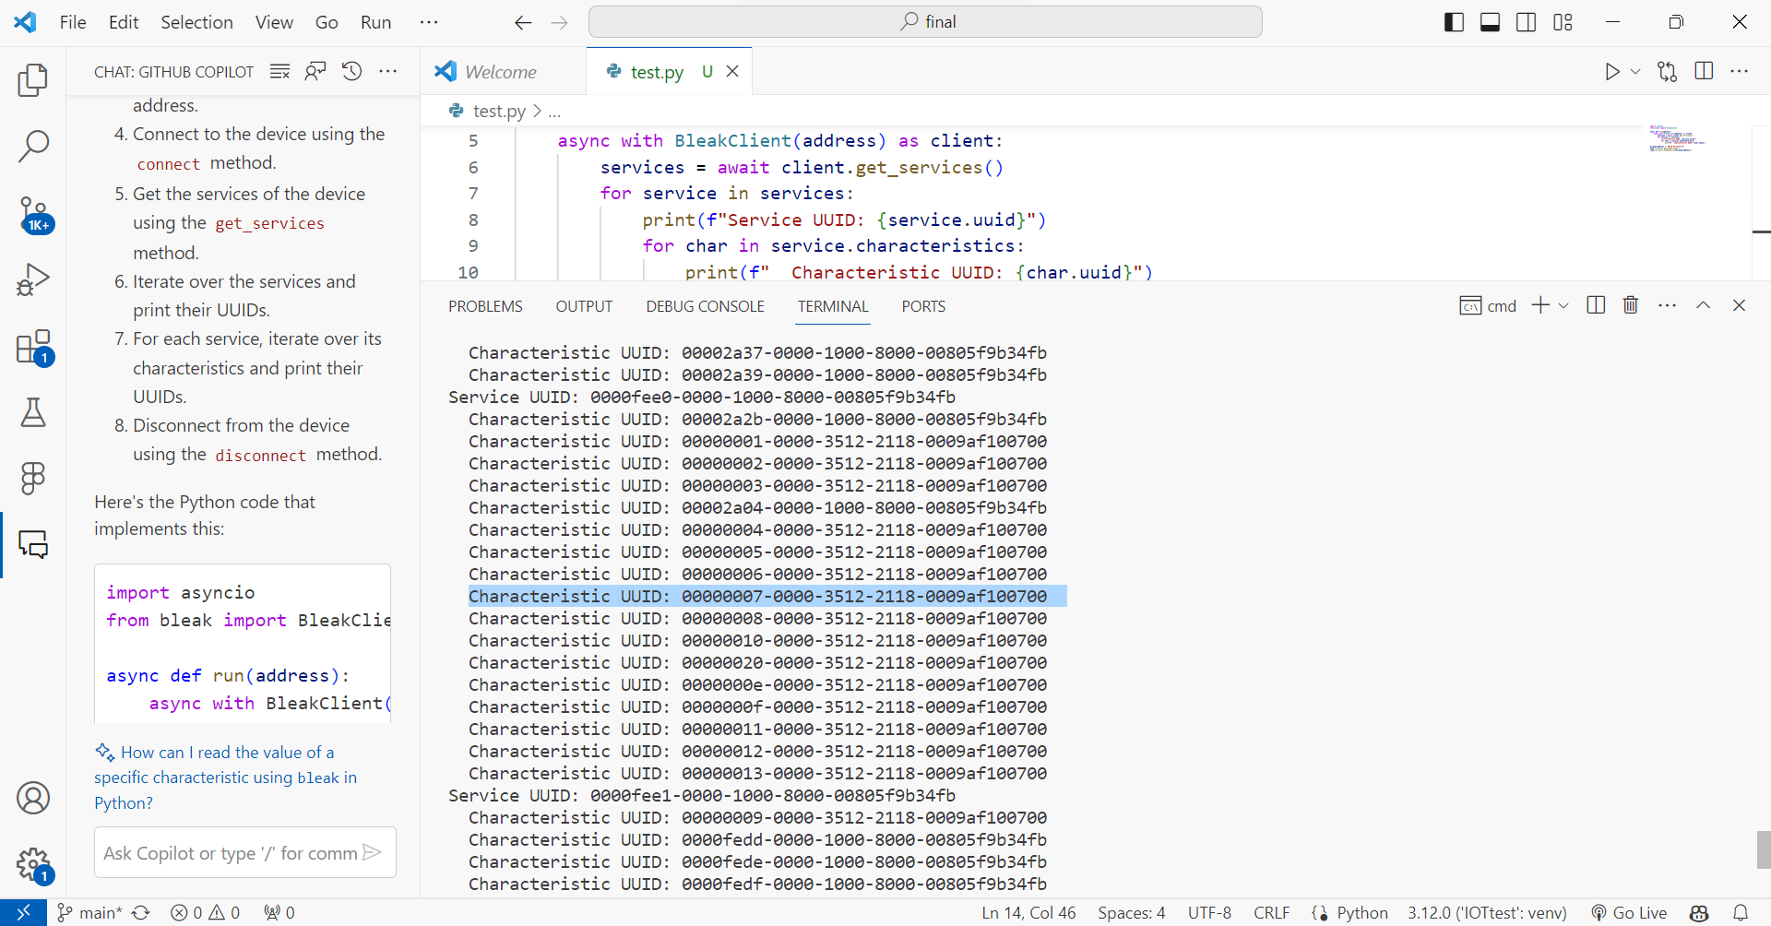
import asyncio
from bleak import BleakClient
async def run(address):
async with BleakClient(address) as client:
services = await client.get_services()
for service in services:
print(f"Service UUID: {service.uuid}")
for char in service.characteristics:
print(f" Characteristic UUID: {char.uuid}")
mi_band_address = 'D0:4E:AD:C0:AF:7D'
loop = asyncio.get_event_loop()
loop.run_until_complete(run(mi_band_address))

Slide 4
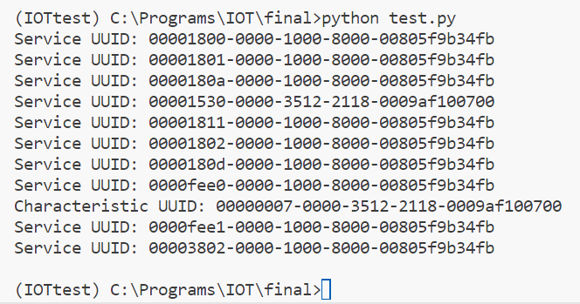
import asyncio
from bleak import BleakClient
async def run(address):
async with BleakClient(address) as client:
services = client.services
for service in services:
print(f"Service UUID: {service.uuid}")
for char in service.characteristics:
if str(char.uuid) == "00000007-0000-3512-2118-0009af100700":
print(f"Characteristic UUID: {char.uuid}")
mi_band_address = 'D0:4E:AD:C0:AF:7D'
asyncio.run(run(mi_band_address))

Slide 5
import asyncio
from bleak import BleakClient
async def run(address):
async with BleakClient(address) as client:
services = client.services
for service in services:
for char in service.characteristics:
if str(char.uuid) == "00000007-0000-3512-2118-0009af100700":
print(f"Attributes of characteristic {char.uuid}:")
descriptors = char.descriptors
for descriptor in descriptors:
print(descriptor)
# attributes = vars(char)
# for name, value in attributes.items():
# print(f" {name}: {value}")
# data = await client.read_gatt_char(char)
# print(f" Data: {data}")
mi_band_address = 'D0:4E:AD:C0:AF:7D'
asyncio.run(run(mi_band_address))

Slide 6
use python's bleak to crab uuid and characteristic
I just care about "Characteristic UUID: 00000007-0000-3512-2118-0009af100700" this UUID, Can I just print the information for this?

Slide 7
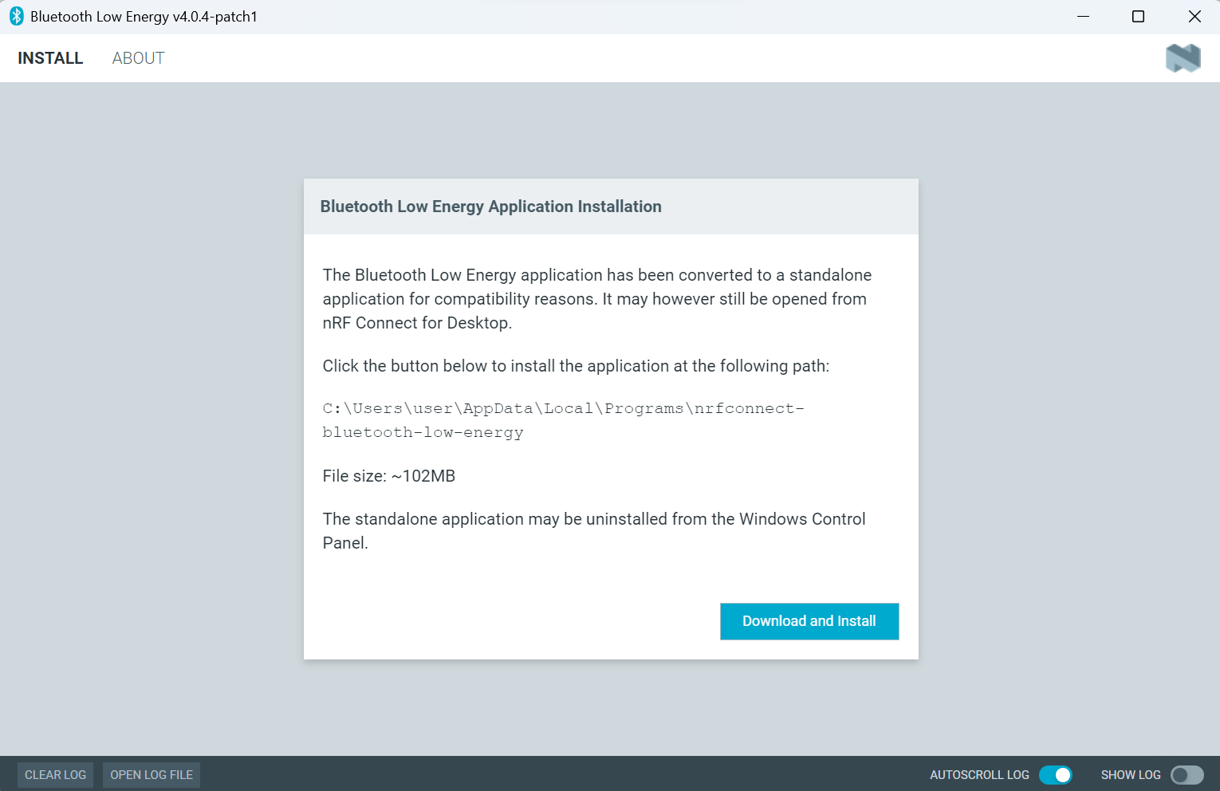

Slide 9
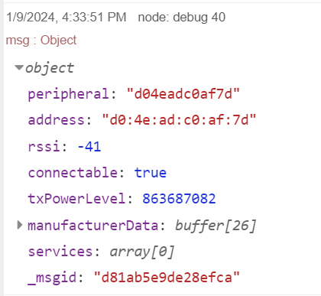

Slide 11
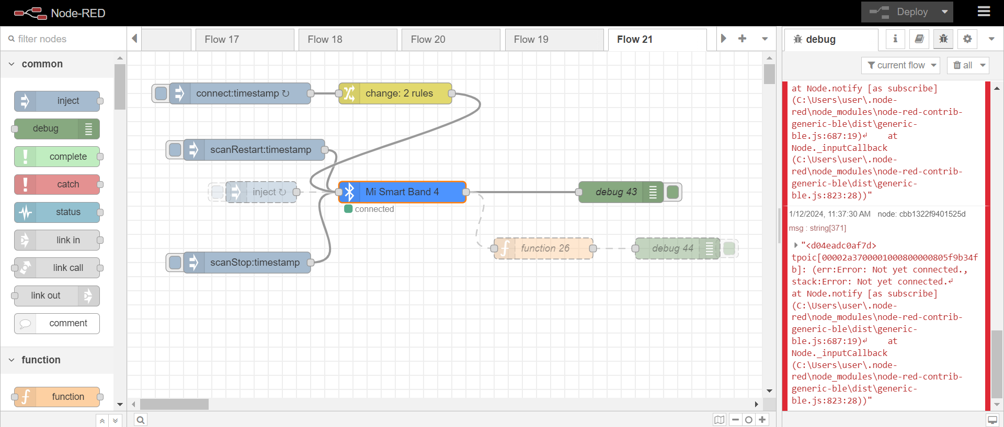

Slide 12
小米手環上傳到firebase

Slide 13
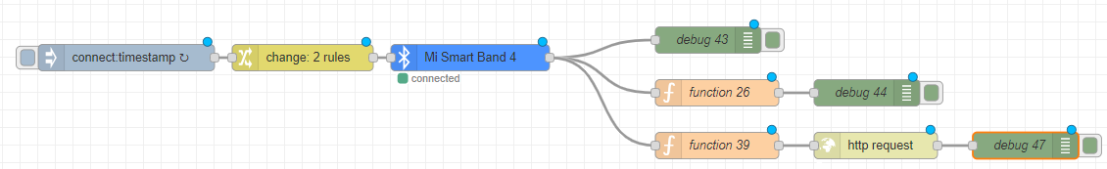
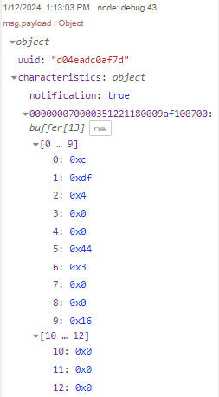
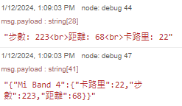

Slide 14
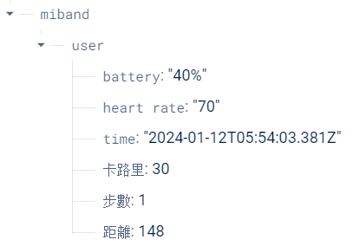
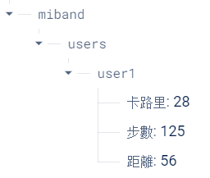
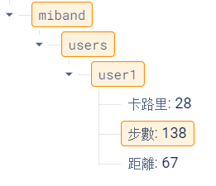
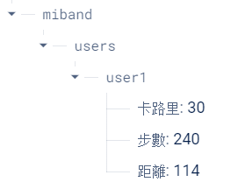

Slide 15
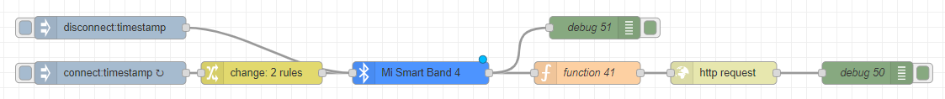

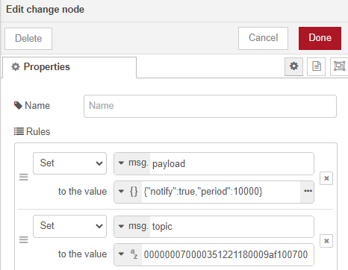

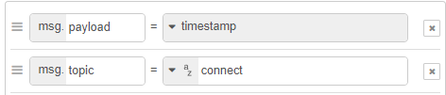

Slide 16

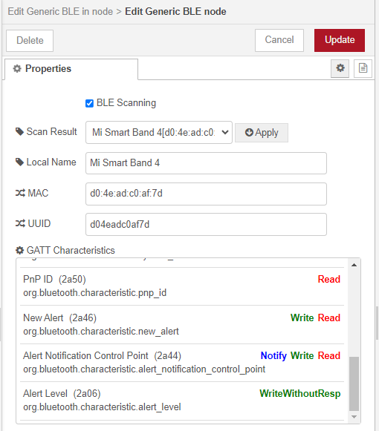
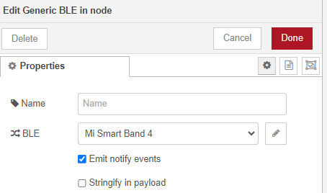

Slide 17


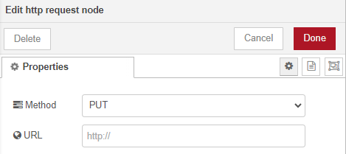
var data = msg.payload.characteristics["000000070000351221180009af100700"];
var d = new Date();
msg.url = "https://aiotdemo-f60d9-default-rtdb.firebaseio.com/miband/users.json";
msg.payload = { "步數": 7500, "距離": data[5], "卡路里": data[9], "time":d, "heart rate": 30, "battery":"60%" };
return msg;

Slide 18

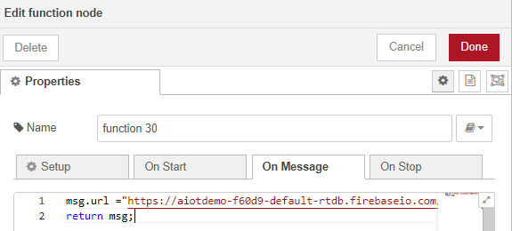
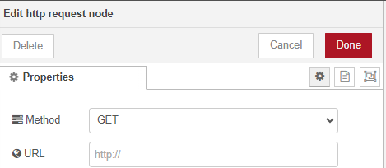

var result=msg.payload;
var obj=JSON.parse(result);
msg.payload=obj;
return msg;

Slide 19
battery

Slide 20
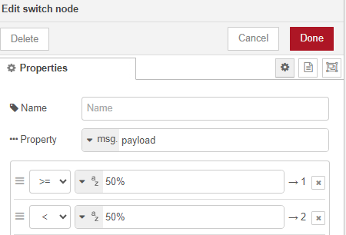
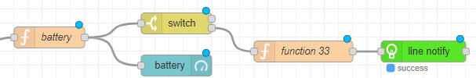
電量小於50%時，會發送充電通知。
msg.payload = msg.payload["battery"];
return msg;

Slide 21
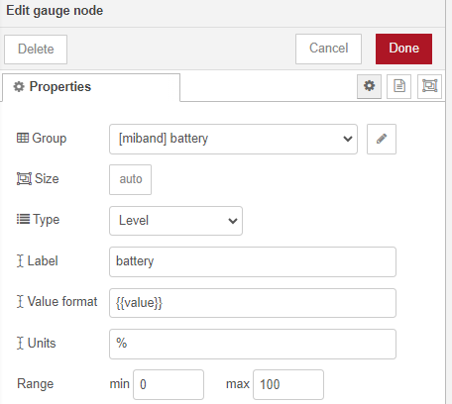
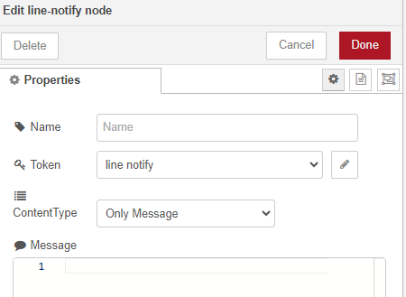
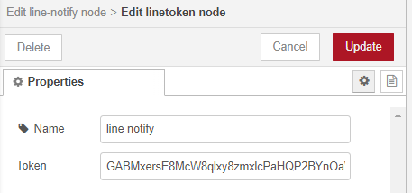
var message = "Need to charge! \n battery level:" + msg.payload ;
msg.payload = message;
return msg;
自己創建line帳號的token

Slide 22
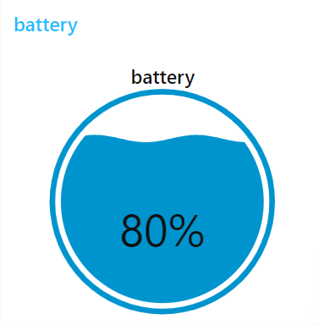
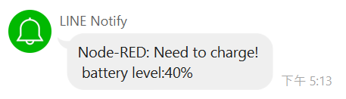
Result
Dashboad顯示電量

Slide 23
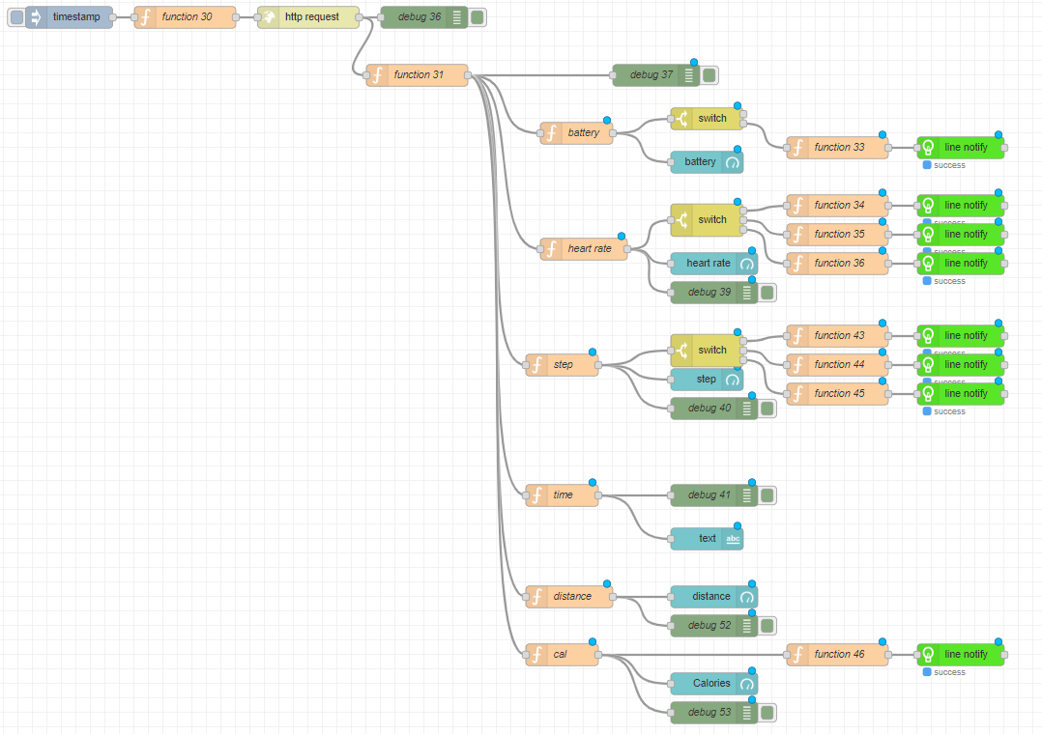

Slide 25
disconnect

Slide 26
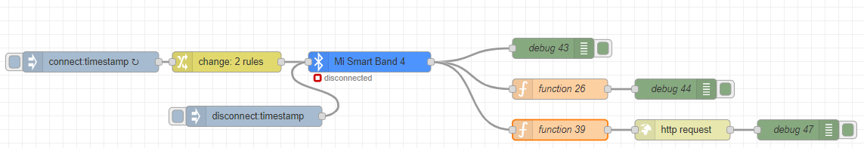

Slide 27
step

Slide 28
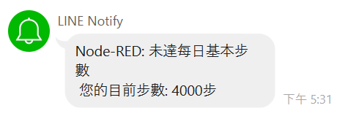
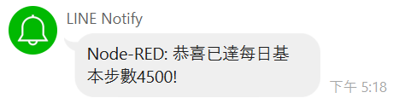

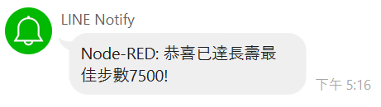

Slide 29
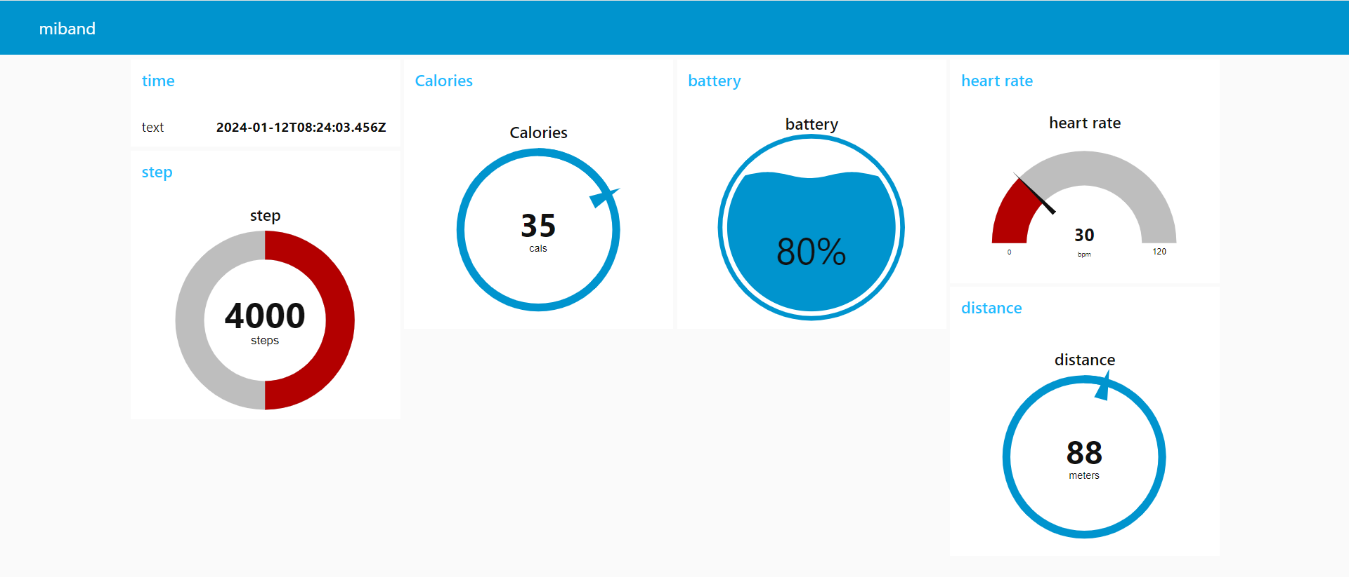

Slide 30
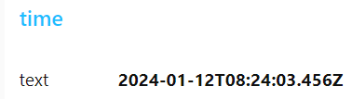
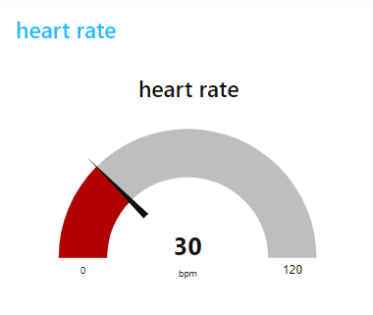
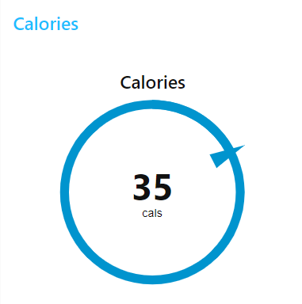
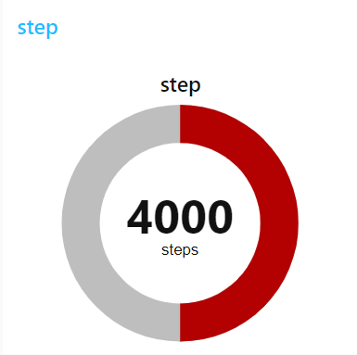
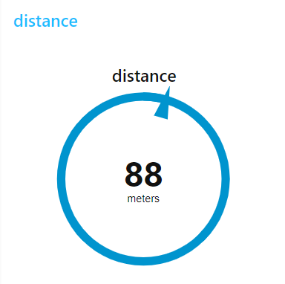

Slide 31
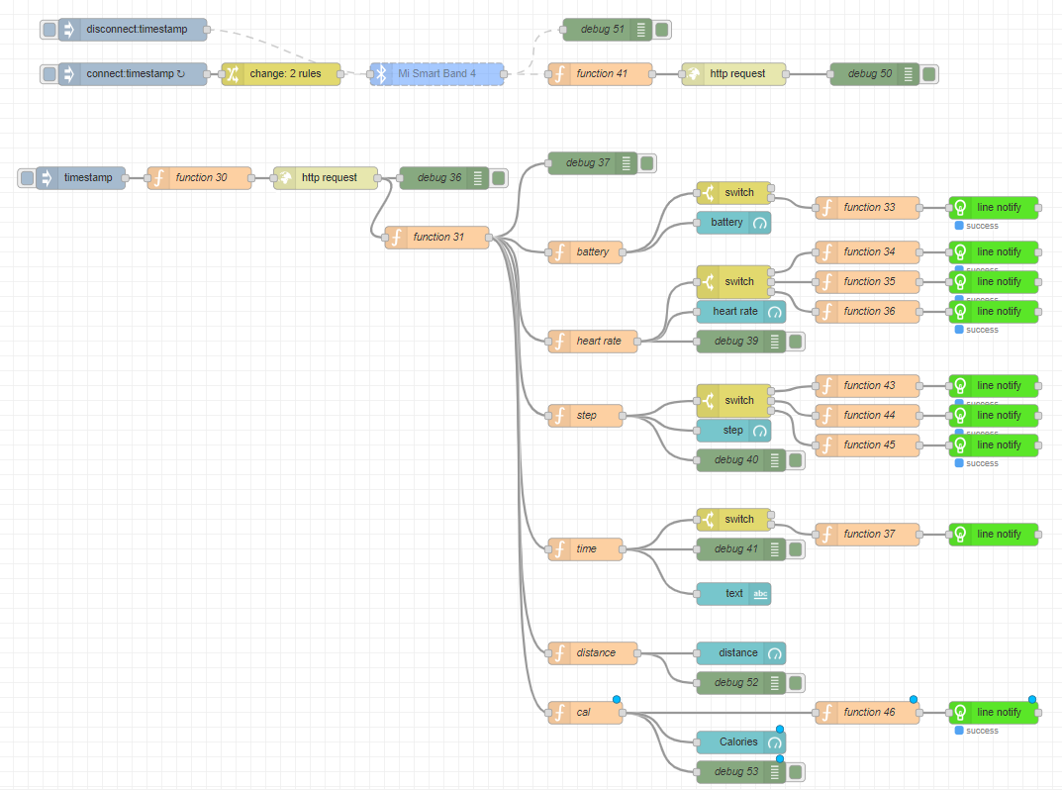

Slide 32
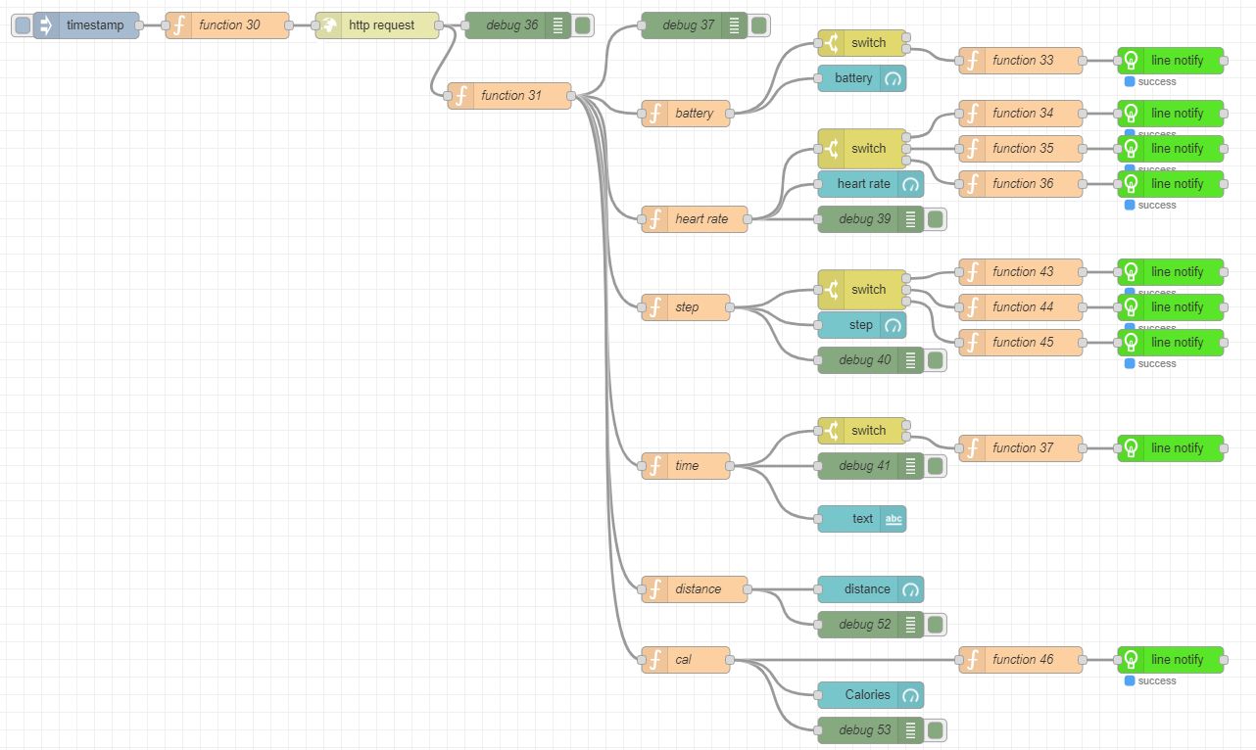

Slide 33
var message = "High heart rate \n heart rate:" + msg.payload +"bpm";
msg.payload = message;
return msg;
var message = "Normal heart rate \n heart rate:" + msg.payload +"bpm";
msg.payload = message;
return msg;
var message = "Low heart rate \n heart rate:" + msg.payload+"bpm";
msg.payload = message;
return msg;

