Slide 1
Plotting networks with igraph
Plotting parameters

Slide 2
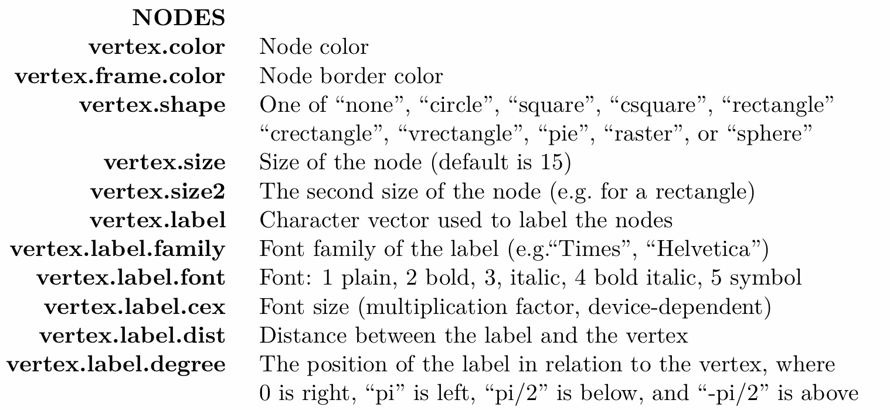
Node

Slide 3
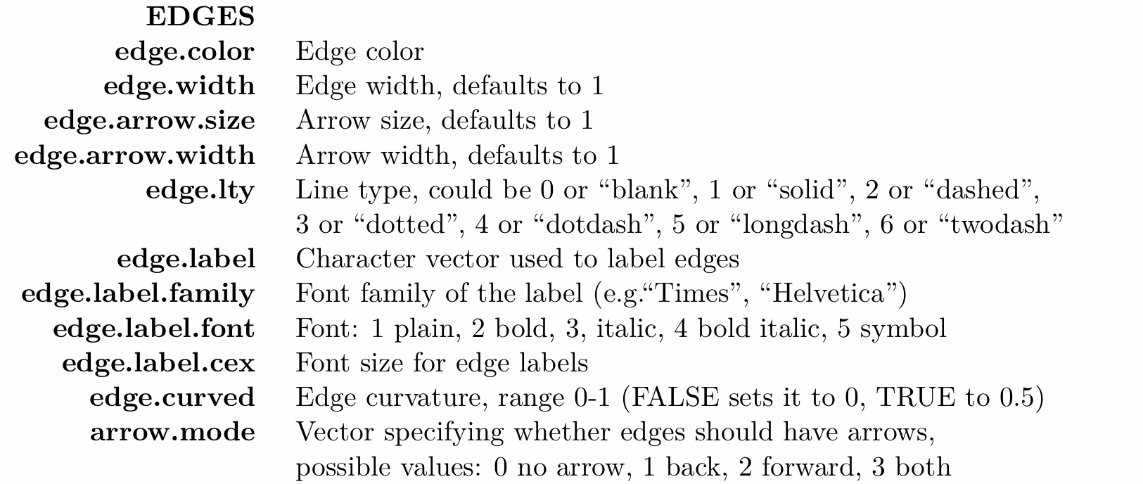
EDGE

Slide 4
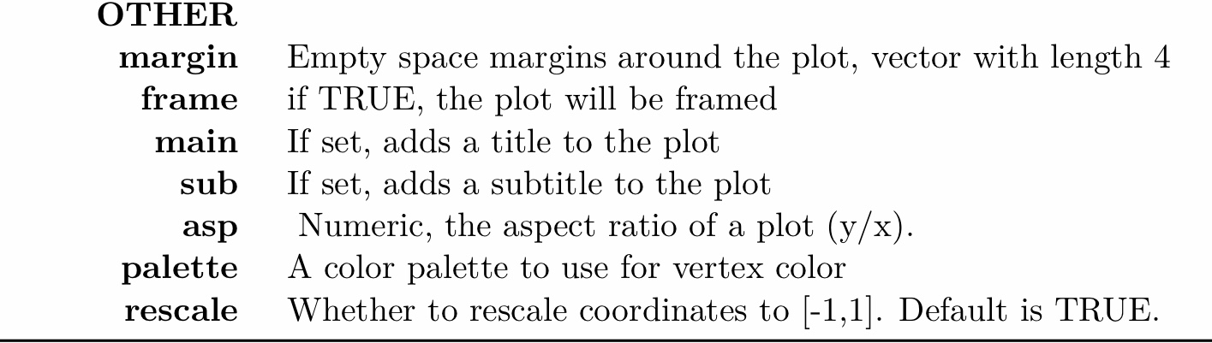
Other

