Slide 1
Network virtualization with R
Linlin Xia

Slide 2
Some tips before start
What are the structural properties that we want to highlight?
What are the key concerns we want to address?
Network maps are far from the only visualization available for graphs.

Slide 3
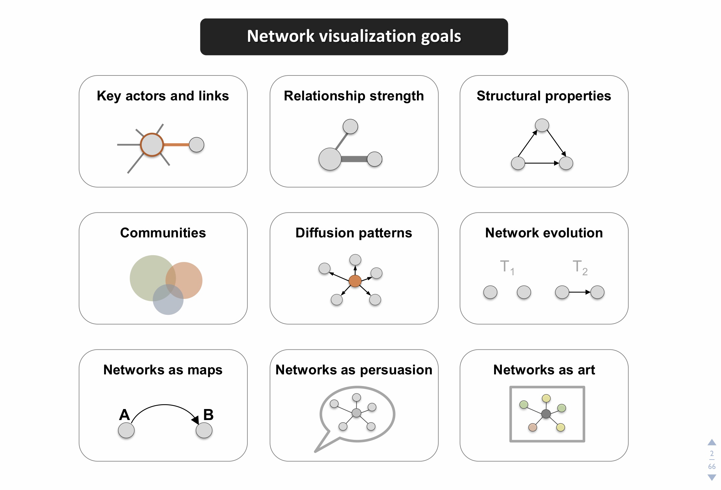

Slide 4
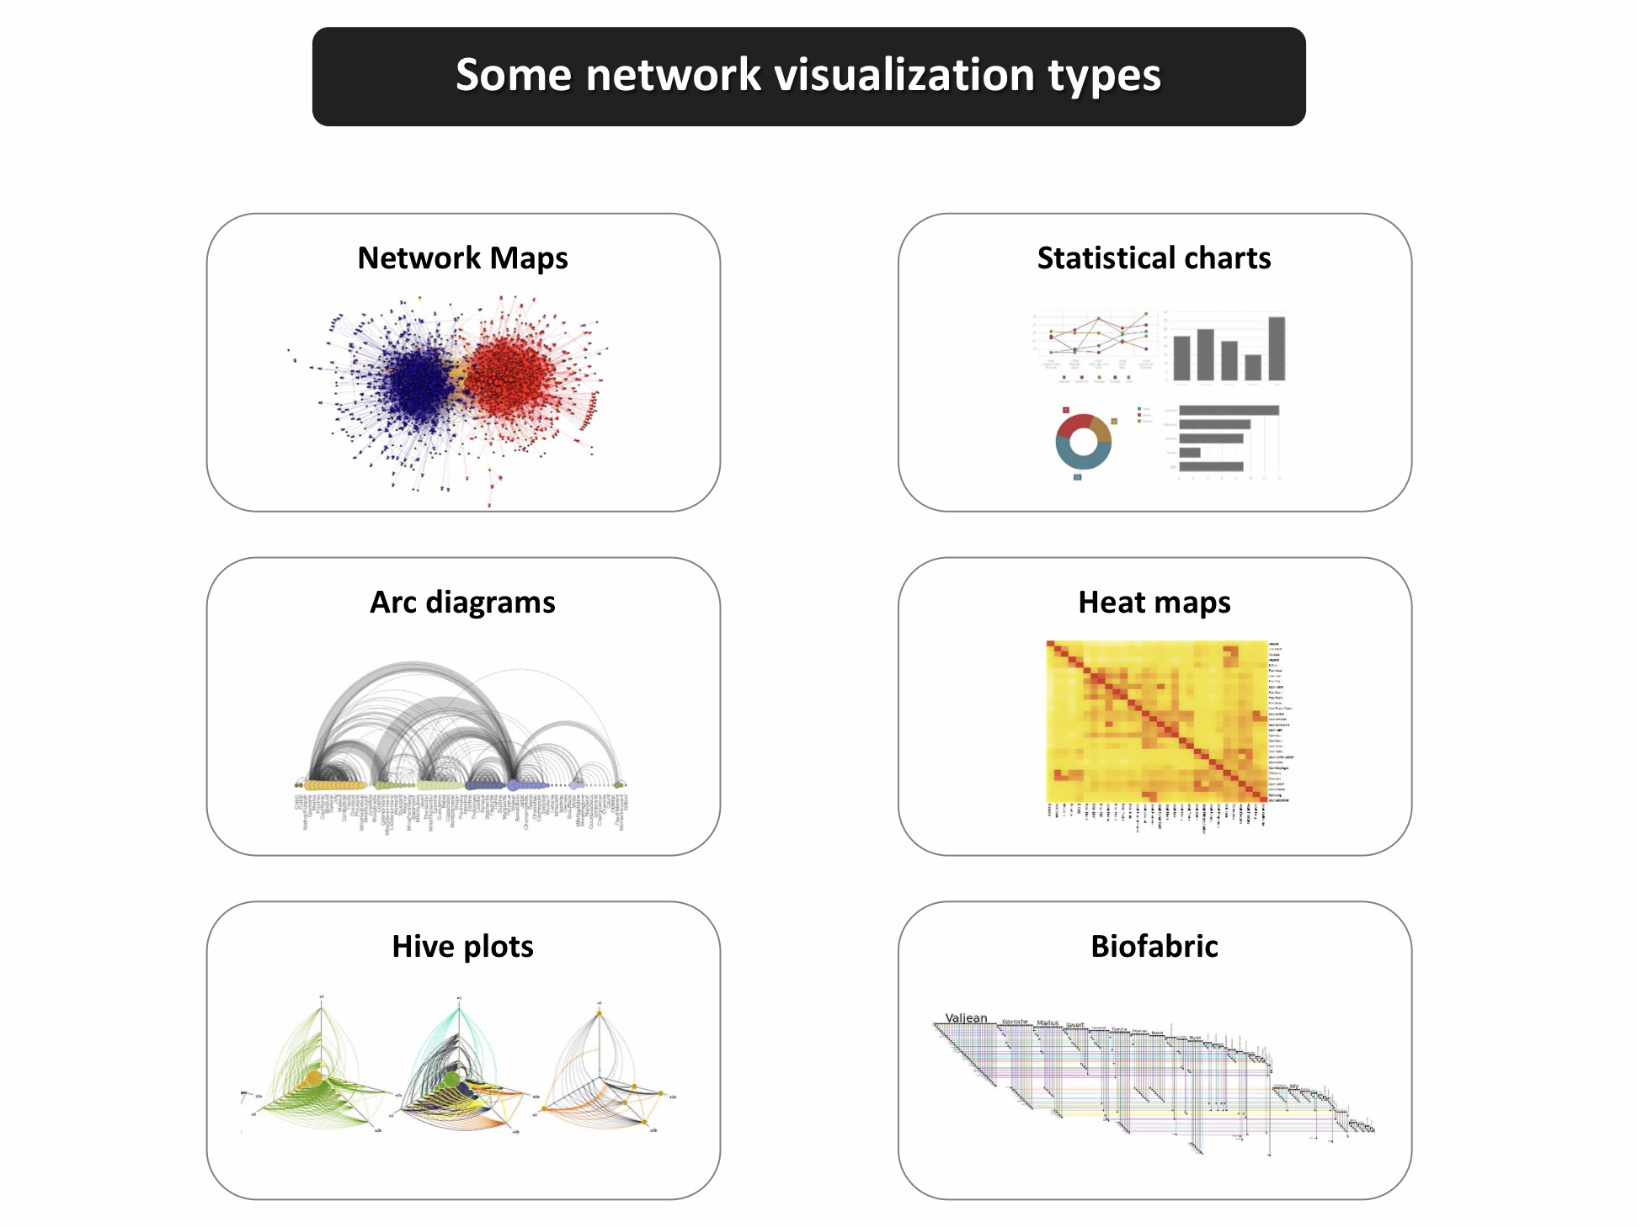

Slide 5
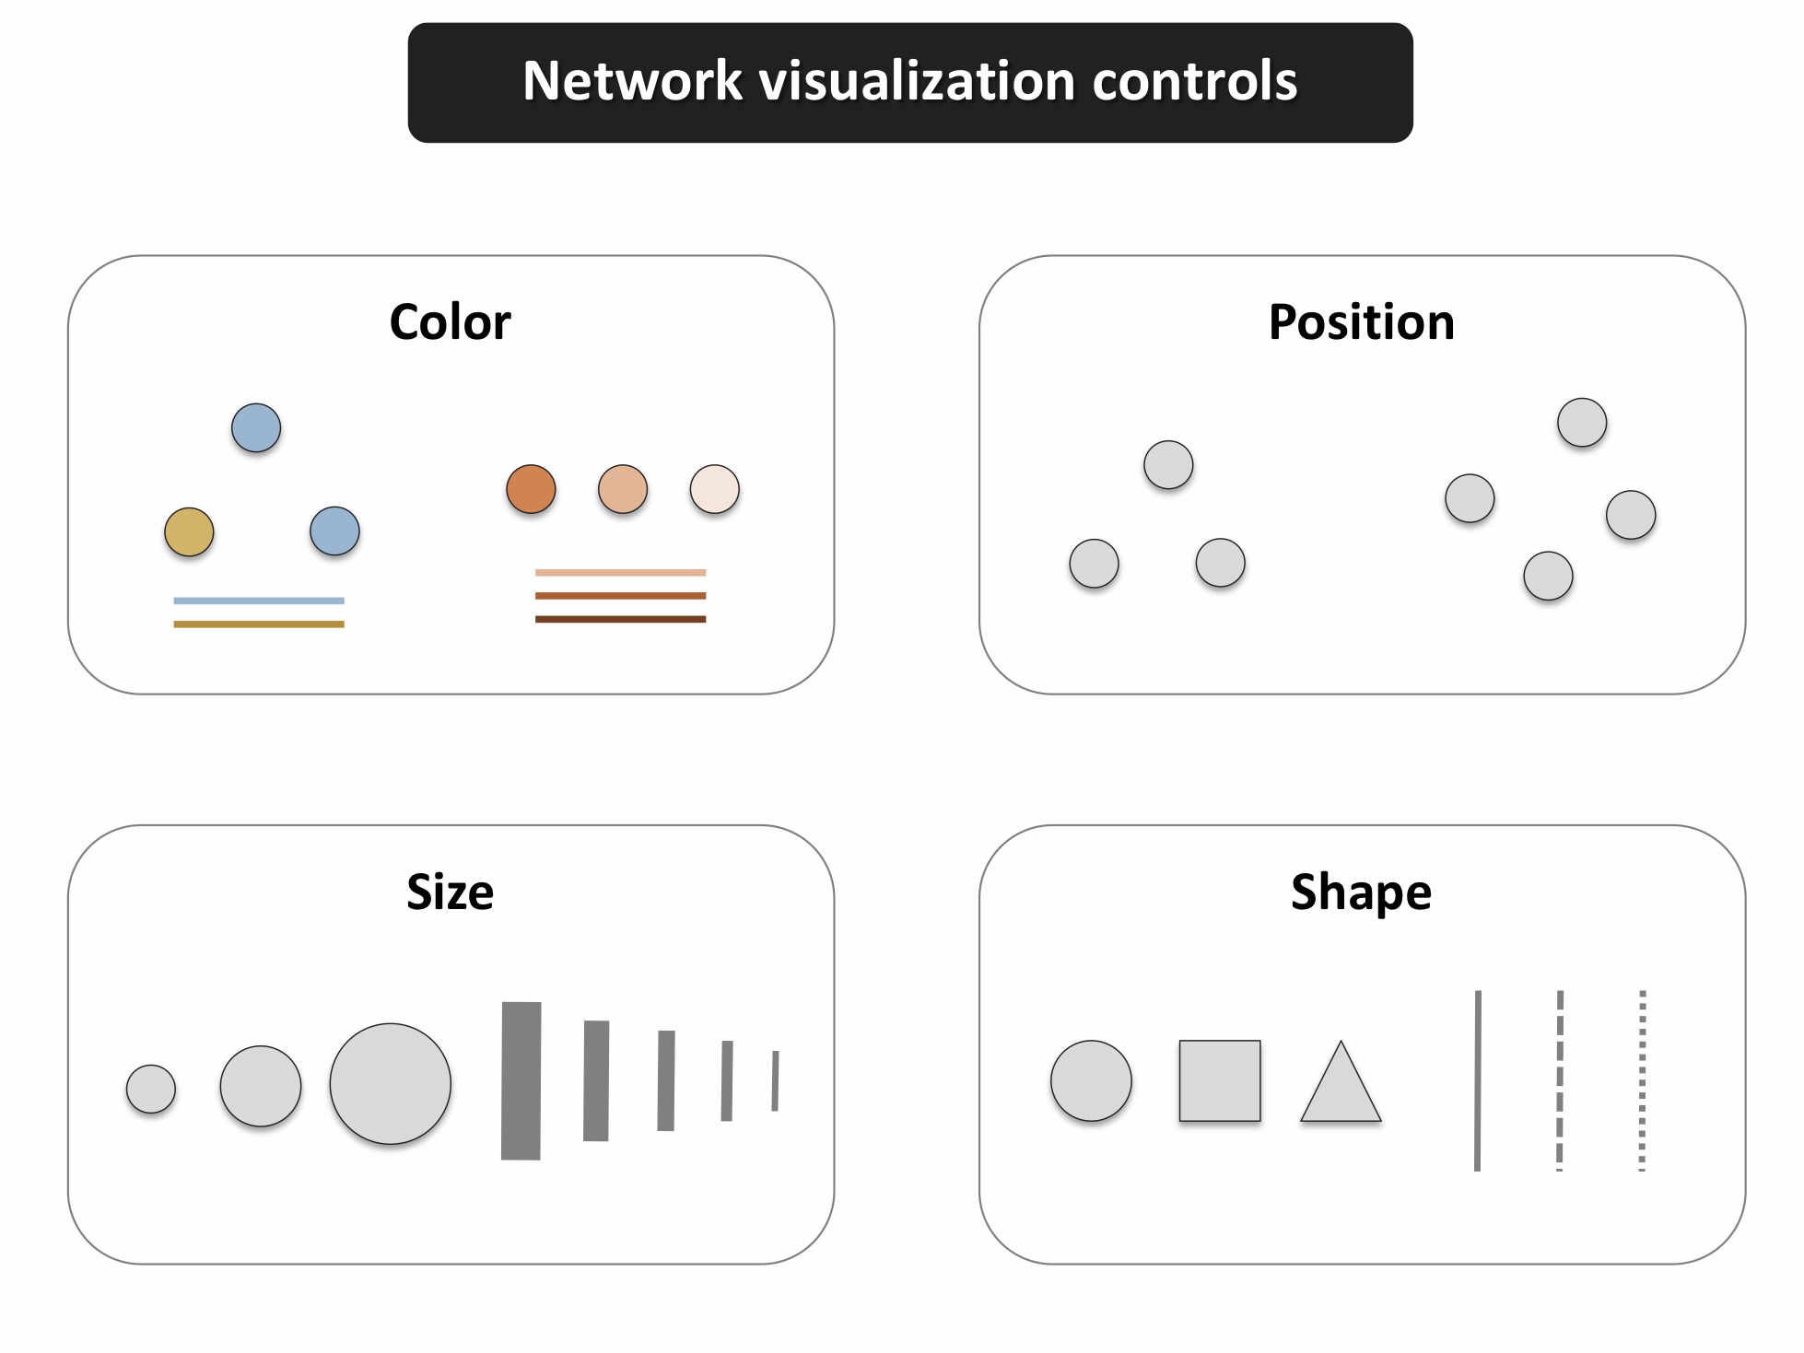
Key elements
color
size
shape
position

Slide 6
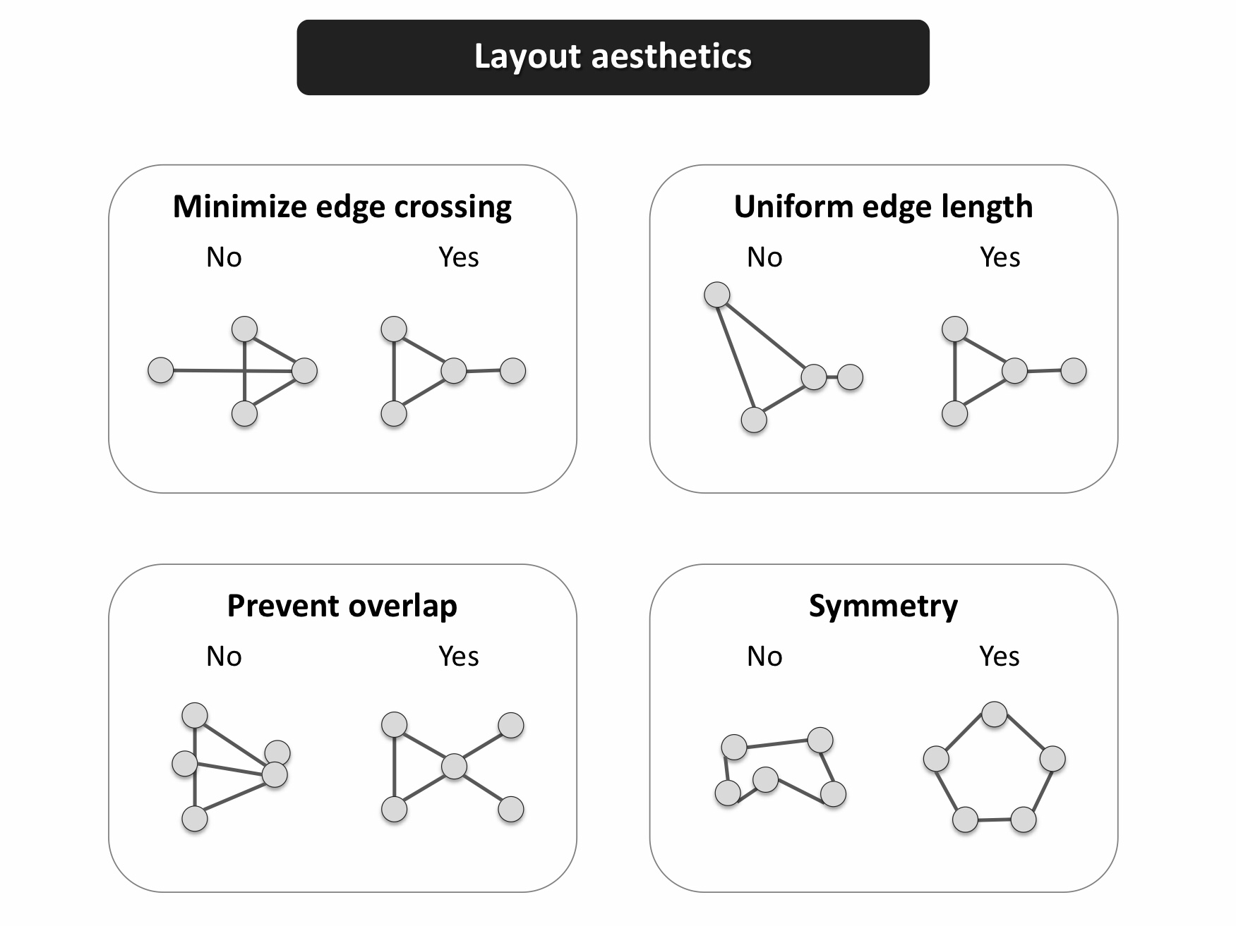
Aesthetic

Slide 7
Color
Colors are pretty, but more importantly, they help people differentiate between types of objects or levels of an attribute.

Slide 8
x and y are the point coordinates, pch is the point symbol shape, cex is the point size, and col is the color. To see the parameters for plotting in base R, check out ?par.

