Slide 1
第四題
10826130 林子溱

Slide 2
Introduction
讀檔
把N跟座標提出來 存進data_v
string inputtxt;
ifstream ifs(inputtxt.c_str(), ios::in);
if (!ifs.is_open()) {
cout << "Failed to open file.\n";
}
else {
string s;
while (getline(ifs, s)) {
cout << s << "\n";
data_v.push_back(namexy(s, length));
length++;
}
ifs.close();
}

Slide 3
把距離跟點存進compare_v
for (int i = 0; i < length; i++) {
for (int j = i + 1; j < length; j++) {
if (i != j) {
pointdistance = distance(data_v[i].x, data_v[j].x, data_v[i].y, data_v[j].y);
compare_v.push_back(tempconnected(data_v[i].name, data_v[j].name, pointdistance, i, j));
comparelength++;
}//if
}//for
}//for
依照距離由小到大排序
quicksort(left, right);

Slide 4
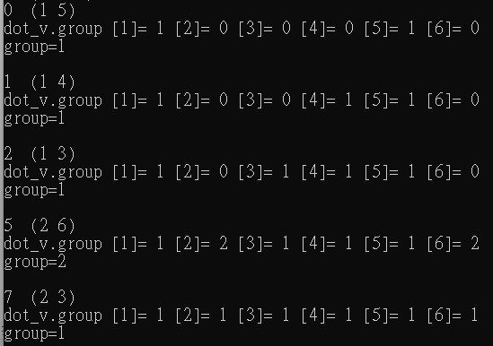
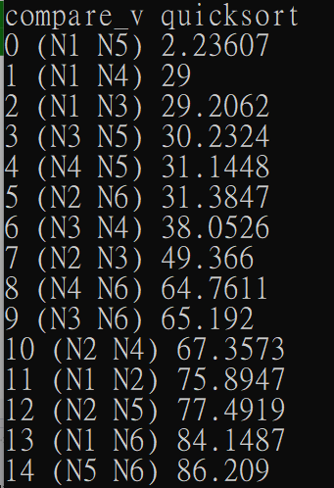
順序
dot1
dot2
距離

Slide 5
1
3
4
5
2
6

Slide 6
if (group_v[replacename1] == group_v[replacename2] &&
group_v[replacename1] != 0 && group_v[replacename2] != 0)
continue;
for (int i = 1; i <= length; i++) {
if (group_v[i] == 0)
groupzero++;
}//for
if (groupzero == 0 && group == 1) //group為1 沒有group=0
break;
if (group_v[replacename1] == 0 && group_v[replacename2] == 0) { //group都是0
group++;
group_v[replacename1] = group; group_v[replacename2] = group;
push = 1;
}//if
else if (group_v[replacename1] == 0 && group_v[replacename2] != 0) { //group一個0一個不是0
group_v[replacename1] = group_v[replacename2];
push = 1;
}//else if
else if (group_v[replacename1] != 0 && group_v[replacename2] == 0) { //group一個0一個不是0
group_v[replacename2] = group_v[replacename1];
push = 1;
}//else if

Slide 7
else if (group_v[replacename1] != group_v[replacename2]) { //group不相同
group--;
temp1 = group_v[replacename1];
temp2 = group_v[replacename2];
for (int j = 0; j <= length; j++) {
if (group_v[j] == temp1) {
group_v[j] = temp2;
}//if
if (group_v[j] > temp1)
group_v[j]--;
}//for
push = 1;
}//else if
groupzero = 0;
}//if
}//for

Slide 8
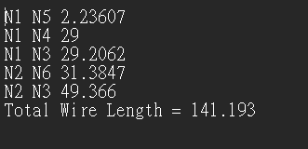

Slide 9
Thank you

