Slide 1
Market Place Demo

Slide 2
Github Repo: https://github.com/LIN251/eventeny-demo
Set Up:
Clone project.
Update all required fields in the .env file.
Run $composer install to install all packages.
Entry (suppose using localhost): http://localhost/eventeny-demo/src/index.php
(When you first access the application, it will automatically
create the necessary database, tables and populate some sample data.)

Slide 3
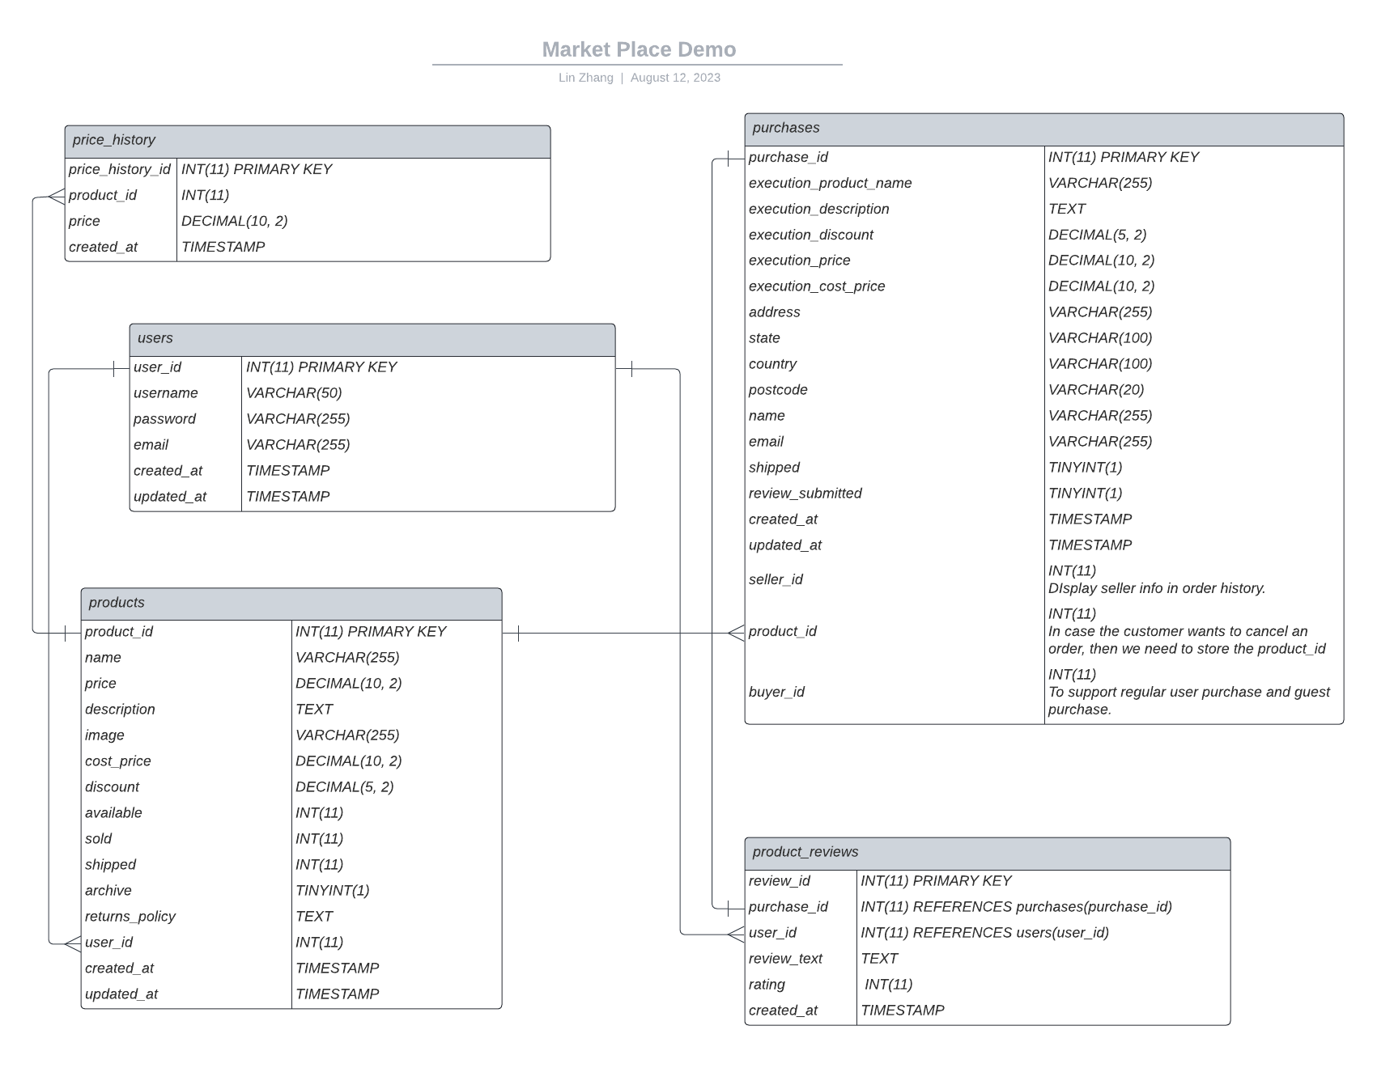
Database
Schema:

Slide 4
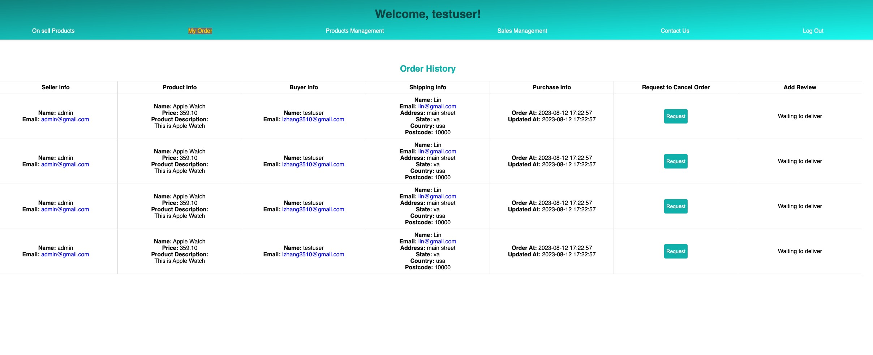
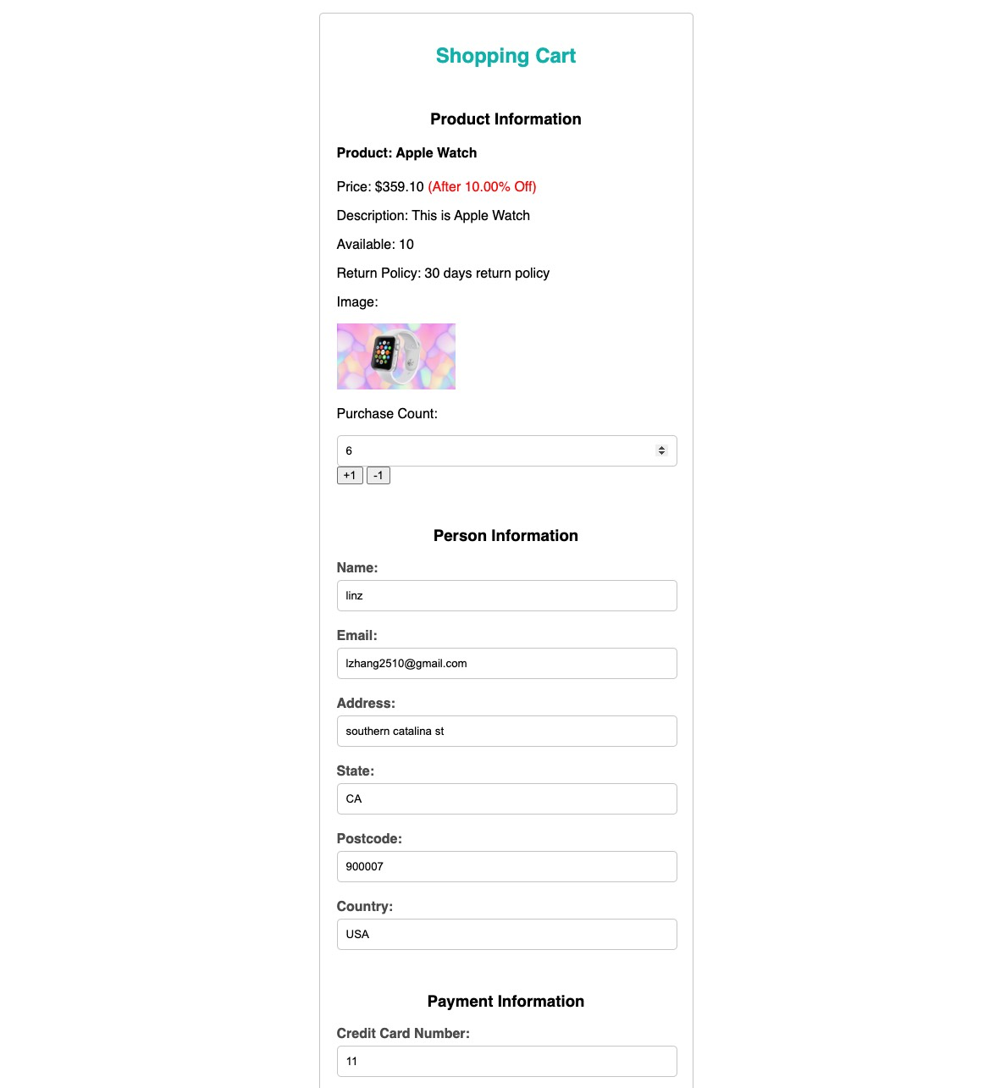
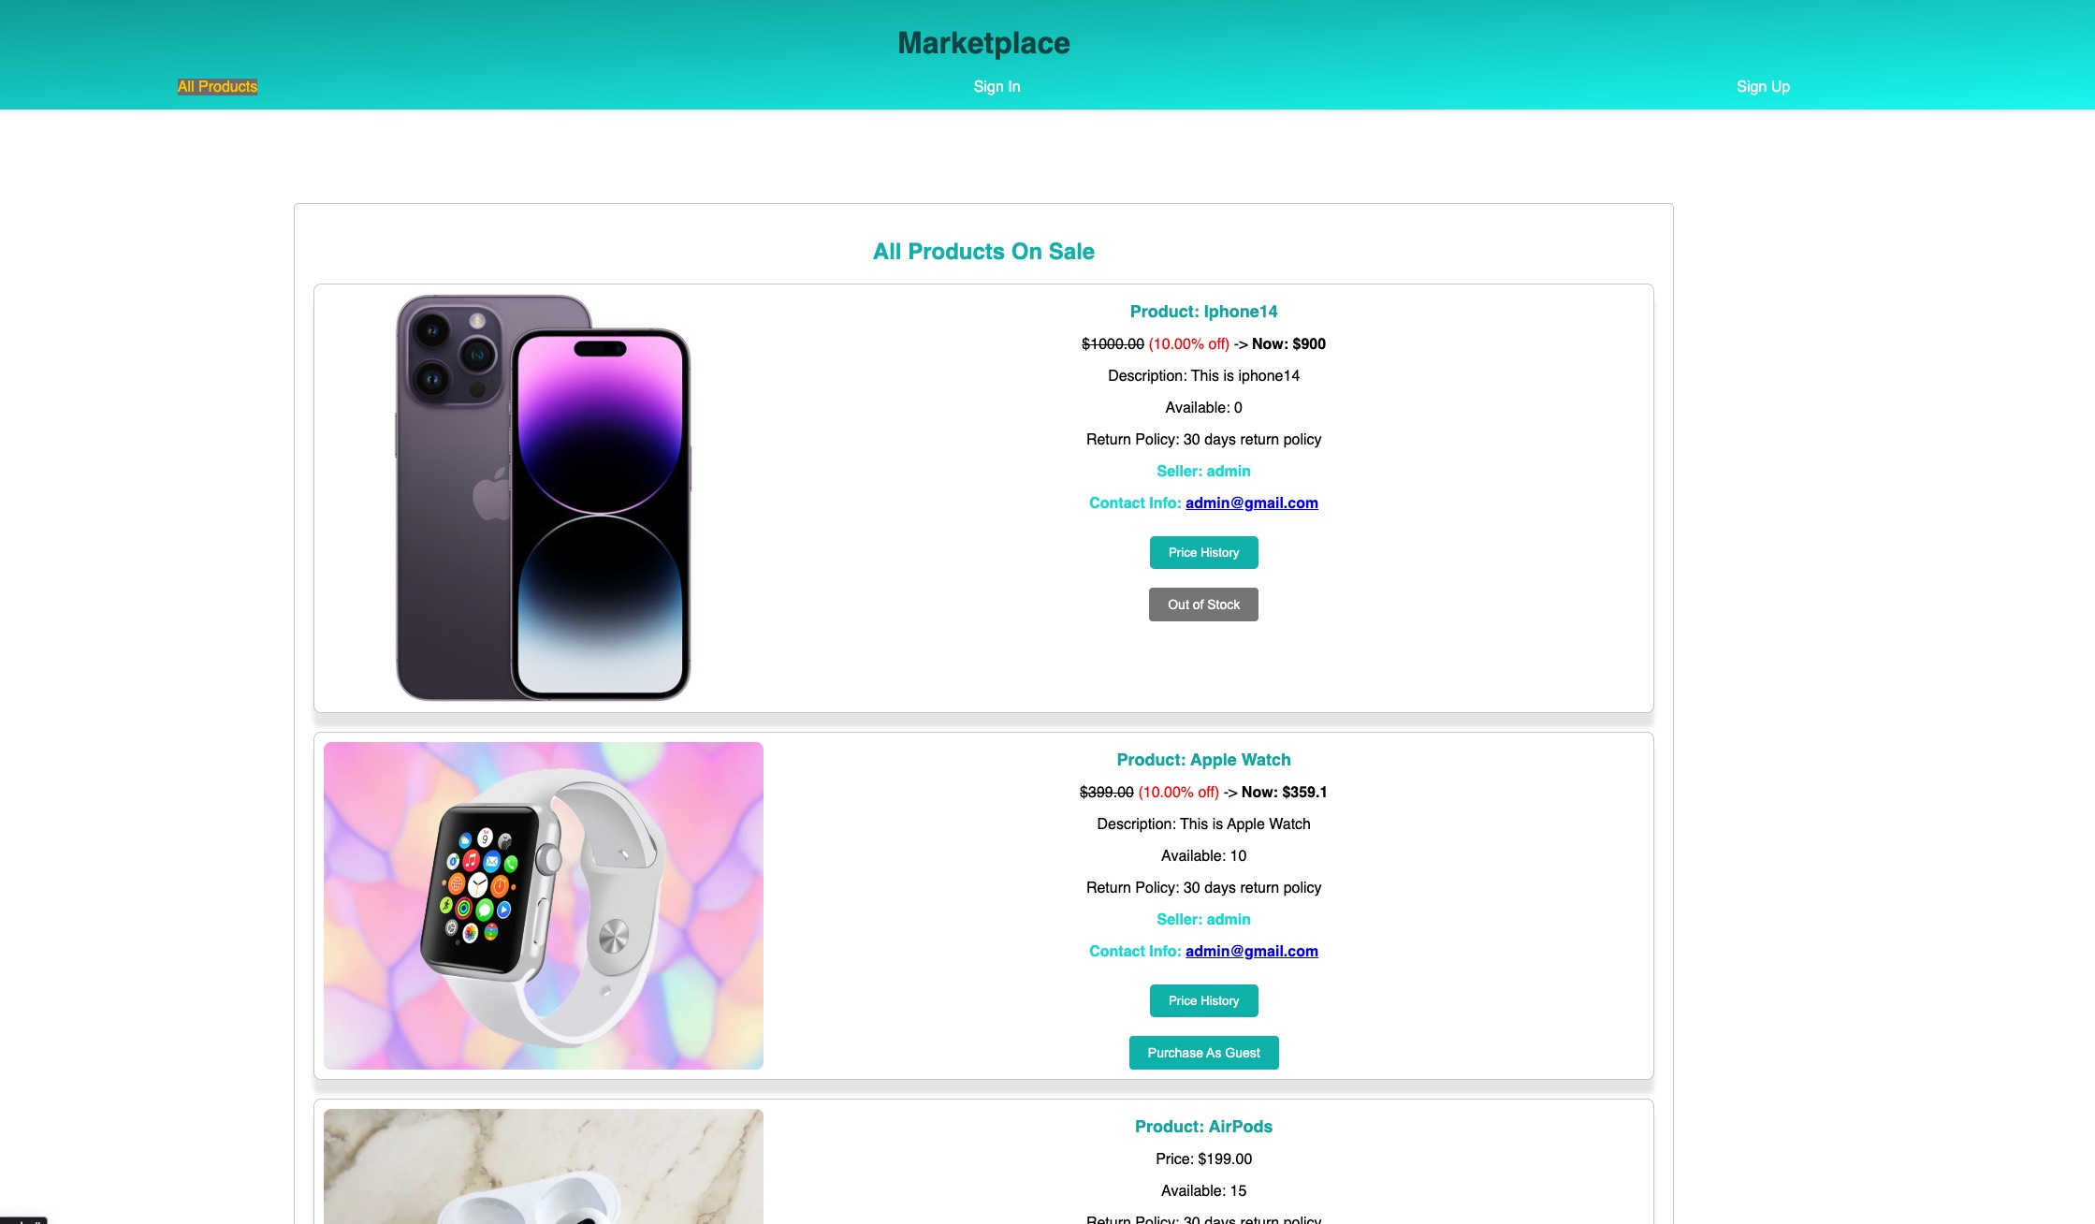
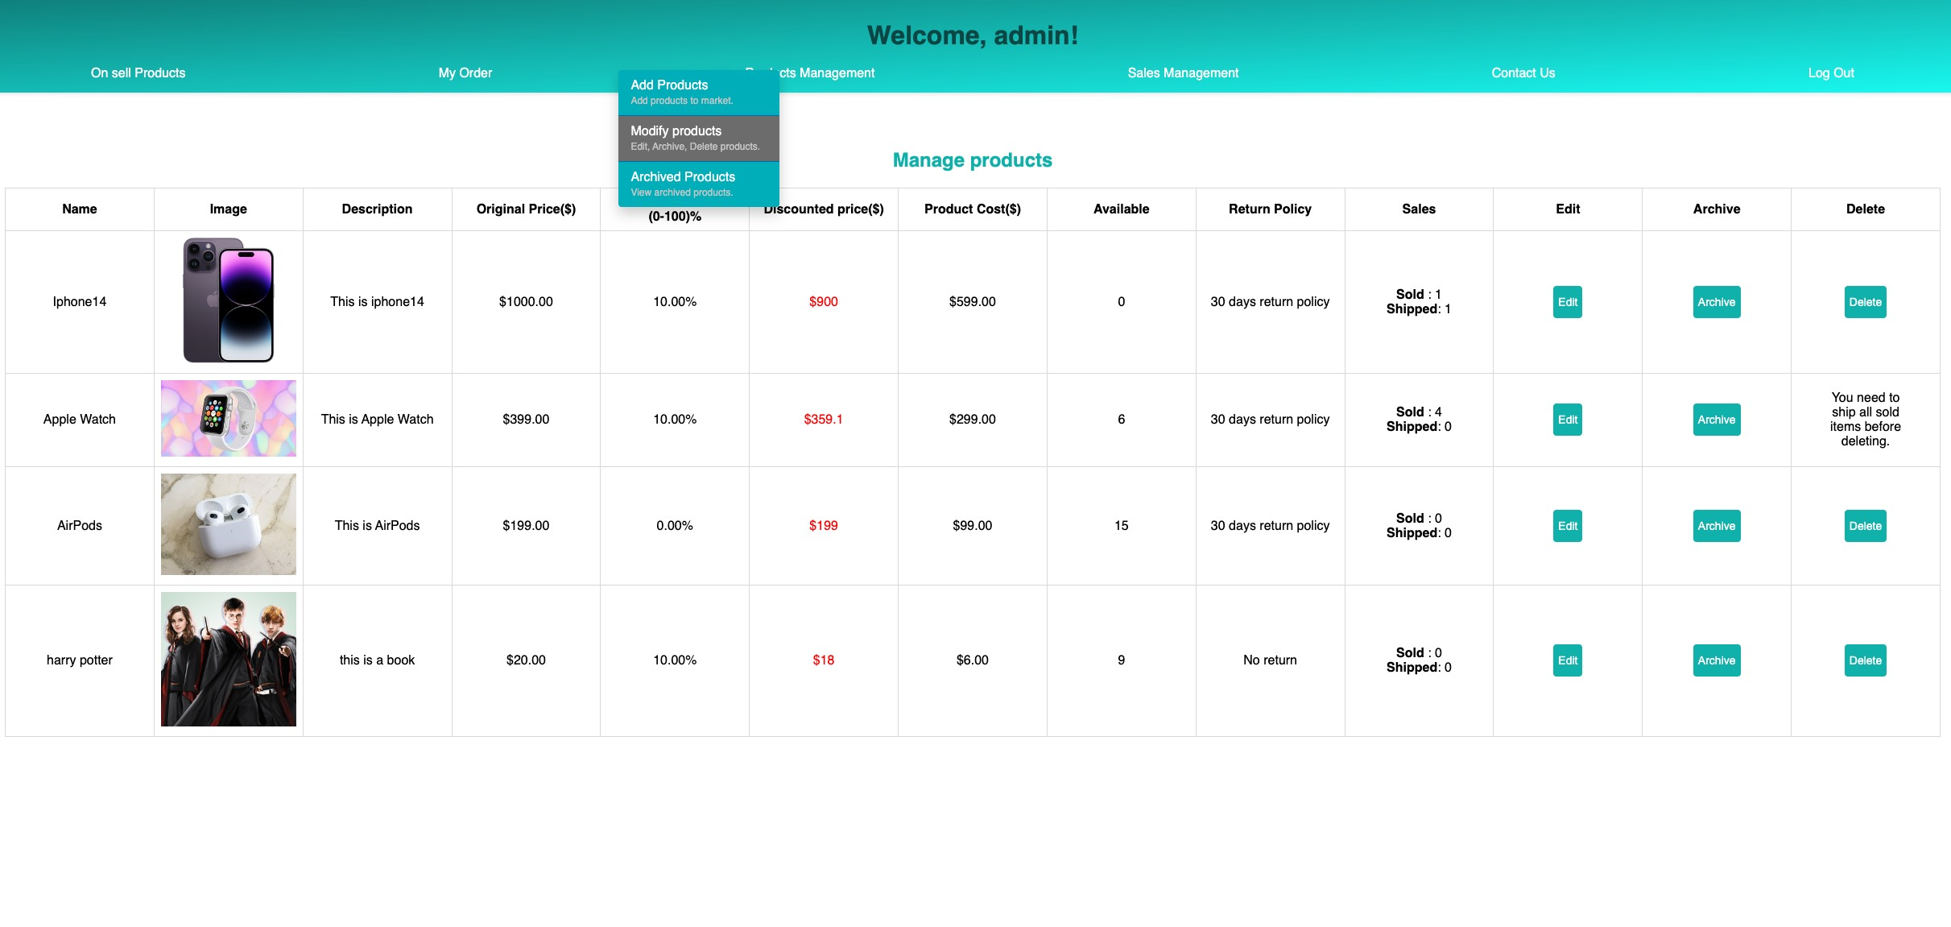
Images:

Slide 5
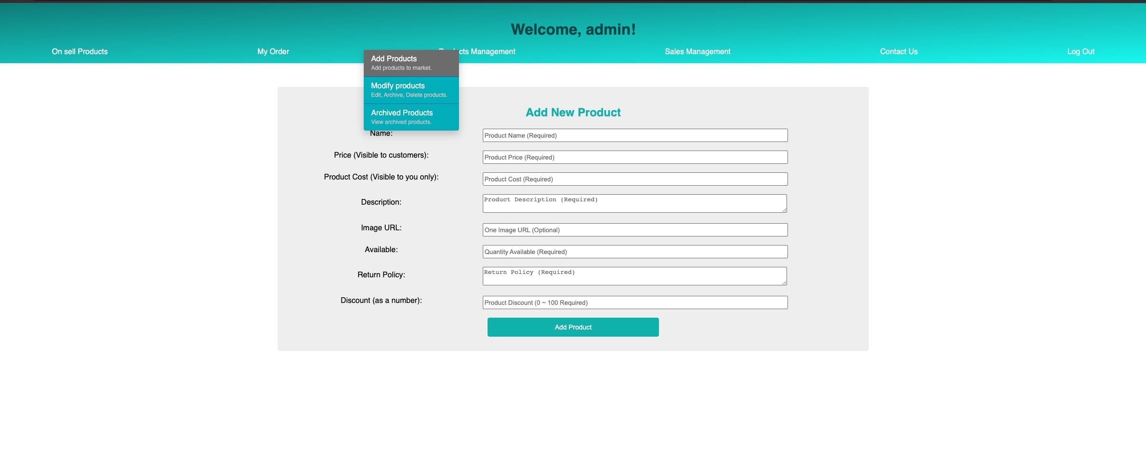
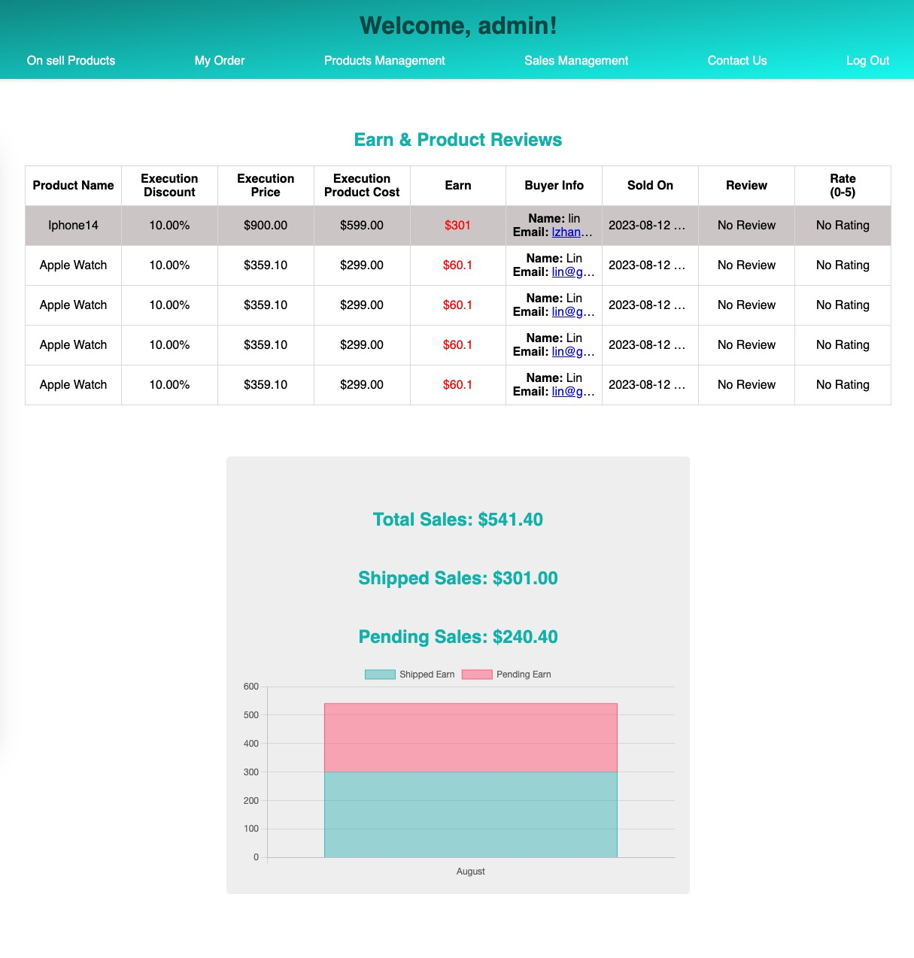
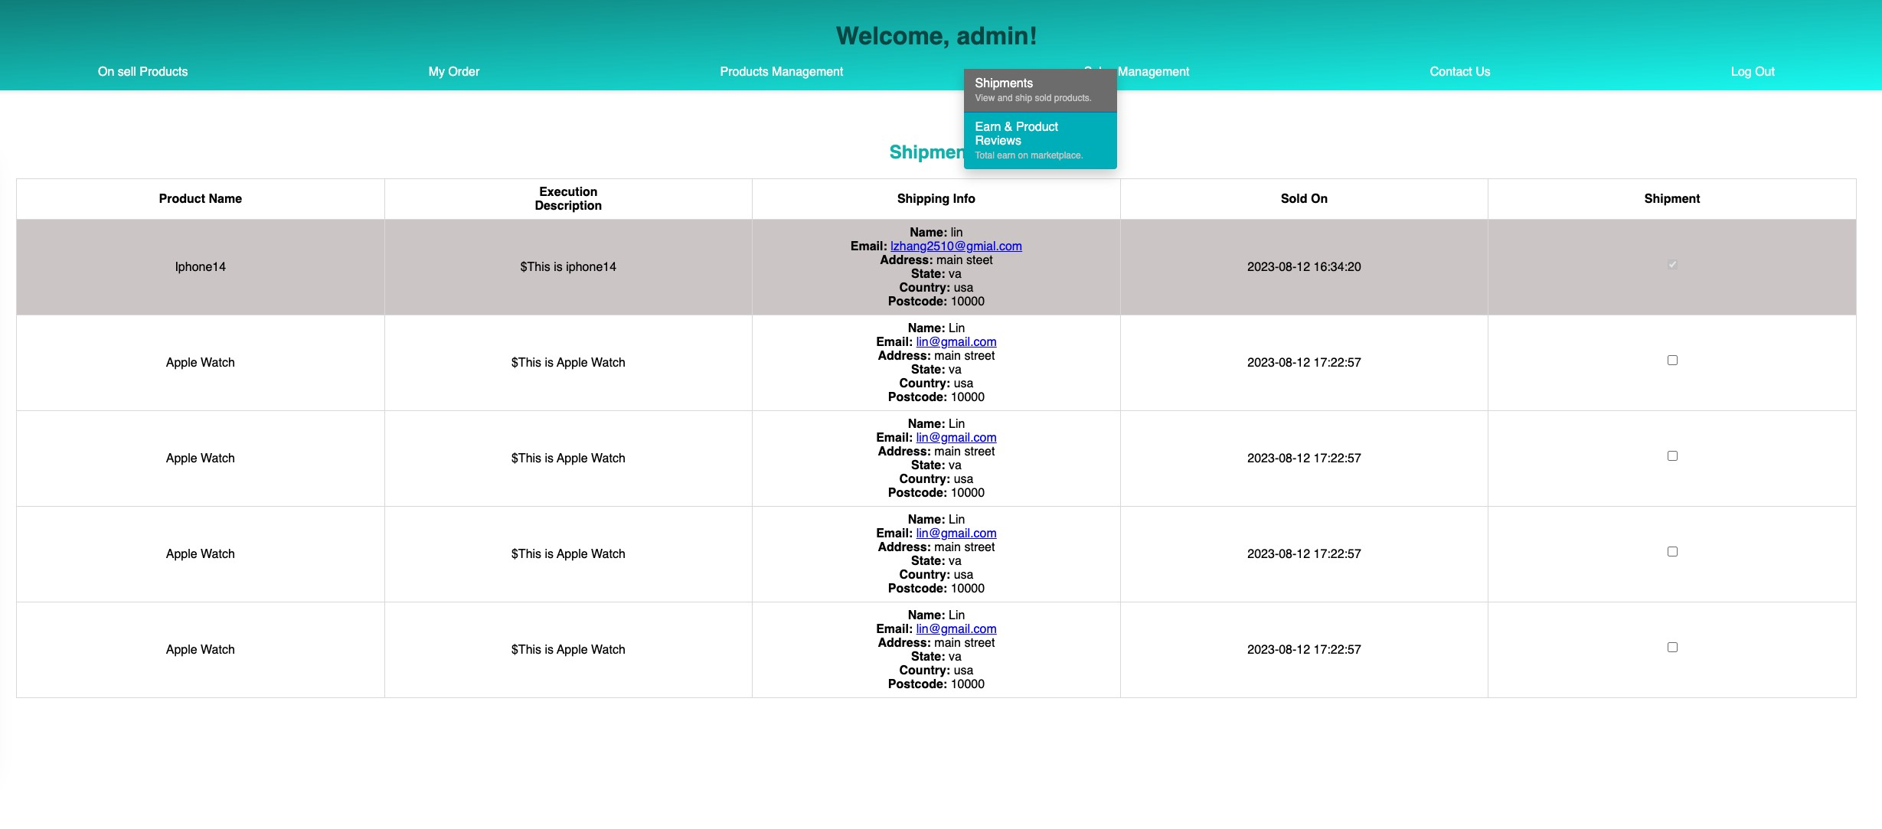
Images:

Slide 6
Key Features:
1. All Products Page
2. Guest Purchase Option
3. Purchase Confirmation Email
4. Price History Tracking
5. Checkout Process (validation)
6. User Login
7. Account validation
8. User Registration
9. Email Verification for Account Registration
10. Personalized On-Sale Items
11. User Account Purchases
12. My Order History
13. Pre-Shipment Order Cancellation
14. Submit Post-Shipment Review
15. Add New Products
16. Modify Products
17. Archive Products
18. Delete Products
19. Offer product discount
20. Display Price History Graph
21. Edit & Delete Archived Items
22. Restore Archived Products
23. Product Shipment
24. Acquire Customer Reviews
25. Earnings Chart
26. Contact Us (via Email)
27. Log Out

Slide 7
Improvements:
Platform Improvements for Sellers:
Improve the Organization of Sales Items with Detailed Listings (such as: size, color, and condition).
Improve Contact Us Feature with another Admin Management System
User-Editable Personal Information (Contact Info)
Support for Multiple Images, Allowing Image Uploads (AWS S3, Firebase Store)
User Experience Enhancements for Buyers:
Ability to Restore Items from Canceled Orders
Recommendations for Similar Items Based on Views and Canceled Orders (ML)
Making Product Offers to Sellers (Price History Chart)
Improve Shopping Cart with Multi-Item Support
Advance Filtering and Keyword Search
Option to Leave Product Comments
Data Analysis:
Price History Analysis (Lowest Price in the Past Month [Buyer])
Sales Data Analysis (Best-Selling Items [Seller])
Data Analysis of Reviews for Sold Products (Average Star Ratings and comments)

Slide 8
Thank You!

