Slide 1


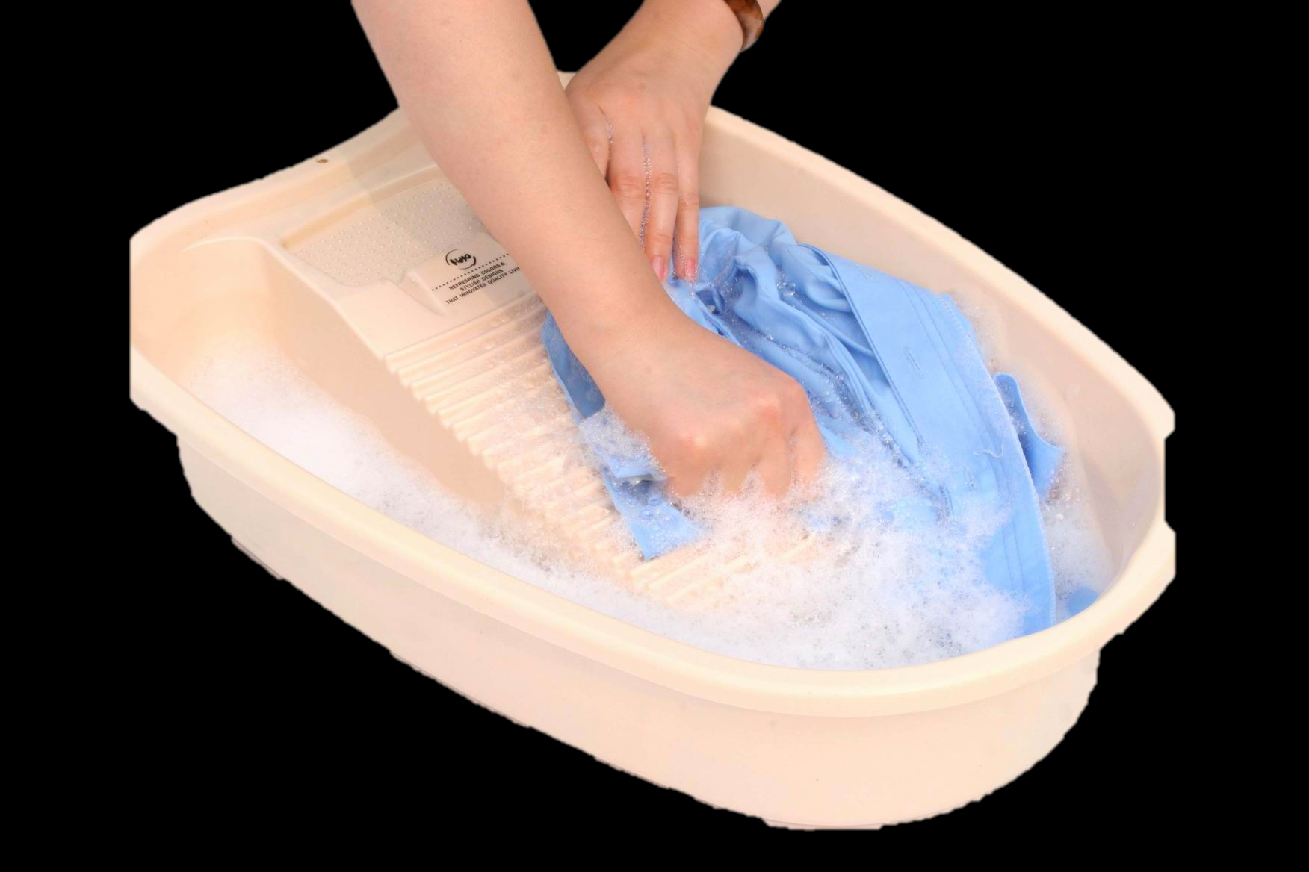

Slide 2
A Lot Of Times, People Don't Know What They Want Until You Show It To Them.
A

