Slide 1

PodWeb
A Decentralized Application powered by
Ethereum Network.
Presented By:
Jay Bibodi
Master’s of Science In Computer Science
Guidance By:
Dr. Jinsong Ouyang
Dr. Ted Krovetz
Department of Computer Science
California State University - Sacramento

Slide 2
Agenda
Introduction
Why Ethereum
Basic Terminologies
Technologies Used
Design
Implementation Demo
Advantages
Future work
Learnings
References

Slide 3

Why Ethereum?
It is permissionless blockchain
It use hash function, DS, public-private key encryption, P2P network, and POW
It provides blockchain platform EVM
Ability to create Decentralized application
Public or Private Network!
Notes:
It provides blockchain platform EVM, in which developers can launch their own blockchain projects, including their own cryptocurrencies.
Hyperledger uses Byzantine Fault Tolerance algo.
https://www.youtube.com/watch?v=tjrvWvX4diA
https://anders.com/blockchain/

Slide 4
Basic Terminologies
Node
Transaction
Block
Mining and block reward
Consensus Algorithm
Proof of Work
Proof of Stake
Smart Contract
Notes:
In Ethereum, ABI it's basically how you can encode Solidity contract calls for the EVM and, backwards, how to read the data out of transactions.
Proof of work is a protocol that has the main goal of prevent the cyber-attacks such as a distributed denial-of-service attack (DDoS).
In fact, PoW idea was originally published by Cynthia Dwork and Moni Naor back in 1993, but the term “proof of work” was coined by Markus Jakobsson and Ari Juels in a document published in 1999.
A trustless and distributed consensus system means that if you want to send and/or receive money from someone you don’t need to trust in third-party services.

Slide 5
Technologies Used
Development IDE
Remix
Visual studio Code
Database
Azure Cosmos DB
Backend Programming Language
Node JS
Solidity
Front end
Angular JS
Stripe API-Payment & Ganache CLI - test Ethereum Network.

Slide 6



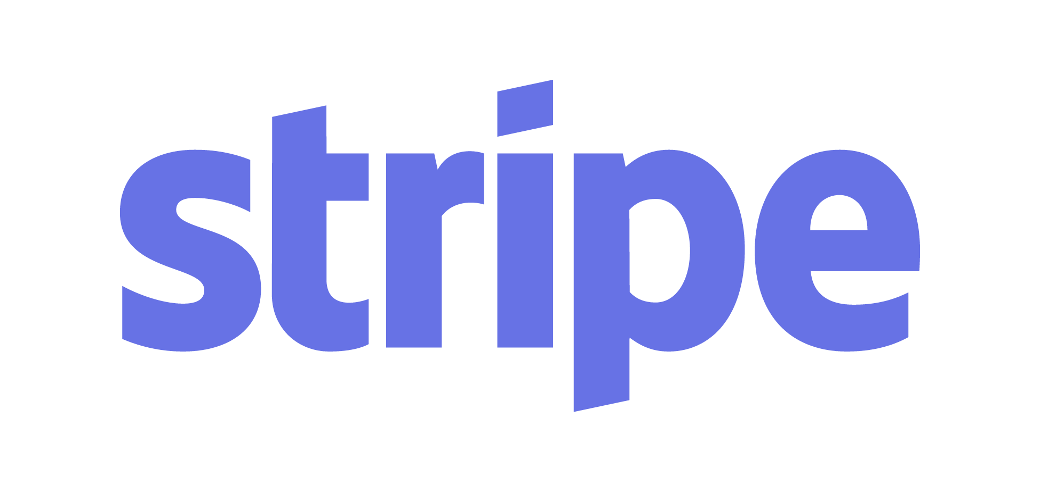
Design
Ethereum Network
Controller
Interacts with all the components
Client
Azure Cosmos DB
Payment API

Slide 7
Demo

Slide 8
Advantages
Anyone could publish the podcast
Elimination of Middlemen
Users get direct credit for the podcast published
Could do transaction in ‘Pods’ token used for this application
Could track the history of podcast purchased by other users, comments and likes to improve future trade.

Slide 9
Future work
Cross-platform support
Integrate Apple/google pay
Notification to publisher for podcast purchased by some other users
Role based control and sending tokens to the people who do marketing on behalf of podcast publisher.

Slide 10
Learnings
Node js, Solidity, MS Visual Code, Remix
Web3 library, Stripe API for payment
Azure cosmos db
Design an application from scratch
Software Development Lifecycle

Slide 11

Any Questions??

Slide 12
References
Angular Icon, available on https://angular.io/presskit
Azure Cosmos DB Icon, available on https://azure.microsoft.com/en-us/services/cosmos-db/
Stripe Icon, available on https://stripe.com/about/resources
Ethereum Icon, available on https://www.ethereum.org/
Ethereum Blockchain Info, available on https://www.youtube.com/watch?v=tjrvWvX4diA and https://anders.com/blockchain/
Solidity Tutorials available on https://ethereumbuilders.gitbooks.io/guide/content/en/solidity_tutorials.html
Node js Tutorials available on https://codeburst.io/25-node-js-tutorials-1db3b1da0260
Notes:
https://blockchainhub.net/blockchains-and-distributed-ledger-technologies-in-general/

Slide 13
References
Stripe tutorials, available on https://stripe.com/docs/checkout/express
Ethereum tutorials, available on Udemy, Ethereum and Solidity: The Complete Developer’s Guide by Stephen Grider
Azure cosmos db tutorials, available on https://docs.microsoft.com/en-us/azure/cosmos-db/
Angularjs tutorials, available on https://docs.angularjs.org/tutorial
Notes:
https://blockchainhub.net/blockchains-and-distributed-ledger-technologies-in-general/

Slide 14
Thank You!!

