Slide 1

A Browser Extension to Detect Malicious PDFs
Presented By:
Jaidipkumar Patel
Master’s of Science In Computer Science
5th April 2019
Guided By:
Dr. Yuan Cheng
Dr. Haiquan Chen
Department of Computer Science
California State University - Sacramento

Slide 2
Agenda
Background
Product Flow
Approach
Technologies Used
Demo
Future Work
Learning
References

Slide 3
Background
Freely available PDF documents may not contain what people expect.
Attackers can add malicious content to PDF file which can badly harm your devices (e.g., redirect you to a fake website, corrupt your operating system).
To address the problem several approaches are used such as static analysis, dynamic analysis, etc. We are using static analysis approach.

Slide 4
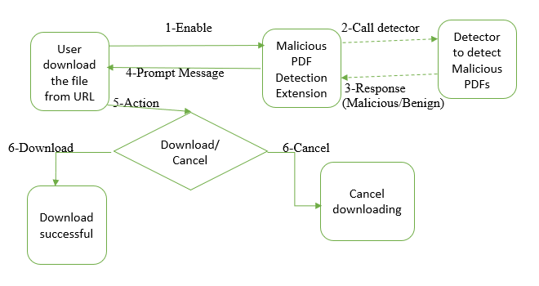
Product Flow

Slide 5
Static Analysis Approach
We are using static analysis approach to detect malicious content from the PDF files.
Parse the PDF files using the pdf-parser tool.
Pdf-parser gets the metadata of the file such as a number of objects, keywords, and we can use that data to detect any malicious JavaScript inside the PDF.
If there is any JavaScript code inside the PDF we are collecting strings of content to analyze it and identify if PDF contains any malicious content or not.

Slide 6
Prepare a Raw Dataset
We first collected 1000 of malicious PDF files which contained JavaScript from VirusShare.com.
Wrote a Python script to automate the PDF files parsing process.
Used “pdf-parser” tool to parse all the available malicious PDF files, and collected the data into a “.csv” file and made a dataset from it.
Following screenshots shows what kind of data we have collected from the “pdf-parser” tool.

Slide 7
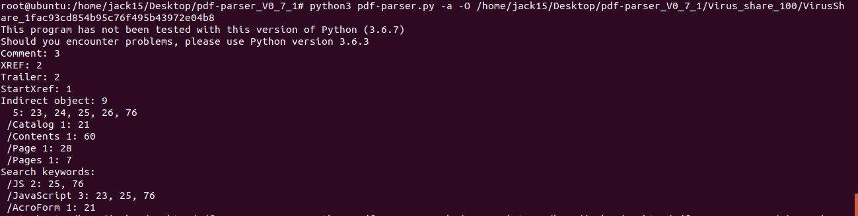
Initial Parsing of PDF File

Slide 8
Detail Parsing on a Specific Object
Collecting /JS object details.

Slide 9
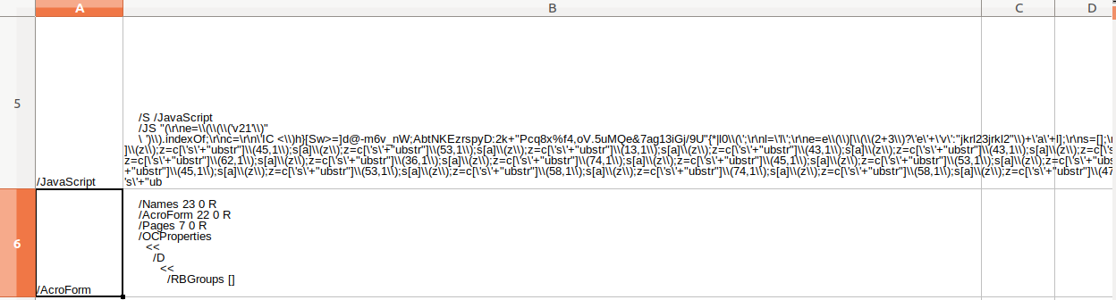
Csv File Data Demo

Slide 10
Processing on Dataset
We write another script to find out what kind of activity JavaScript does.
For example, opening some malicious URL, getting user information, or executing some code.
Collect the information regarding respective JavaScript and store it in the CSV dataset.

Slide 11
Machine Learning Model
Next, use the available dataset to build an ML model.
As the goal of the model is to identify whether PDF file is malicious or benign we are using classification model for training.
We are using the Random Forest algorithm to train our data.
Random Forest can help to handle categorial features, missing values, and features interaction.
Use the trained model to determine PDF file is malicious or not.

Slide 12
Technologies Used
HTML & CSS
JavaScript
Python
Chrome API
Pdf-parser
VS Code
Django – Python web framework
Gunicorn – “Green Unicorn” – Python web server gateway interface

Slide 13
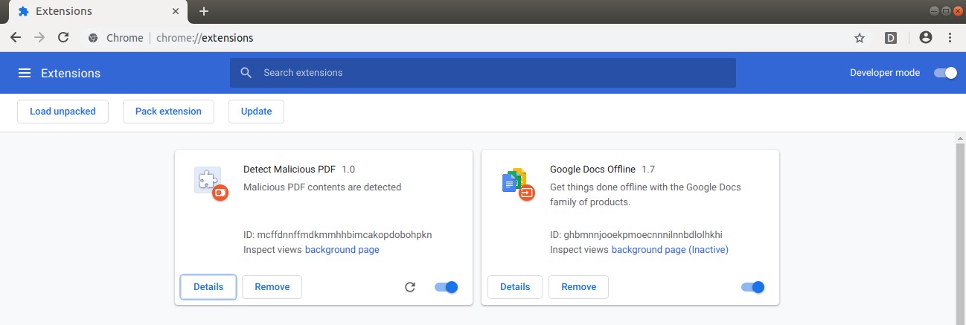
Demo

Slide 14
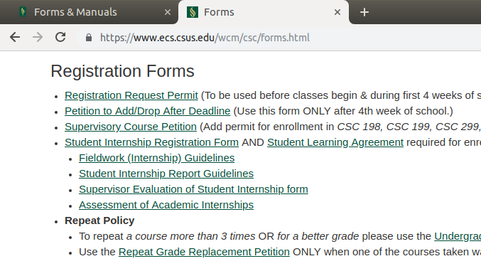
Demo

Slide 15
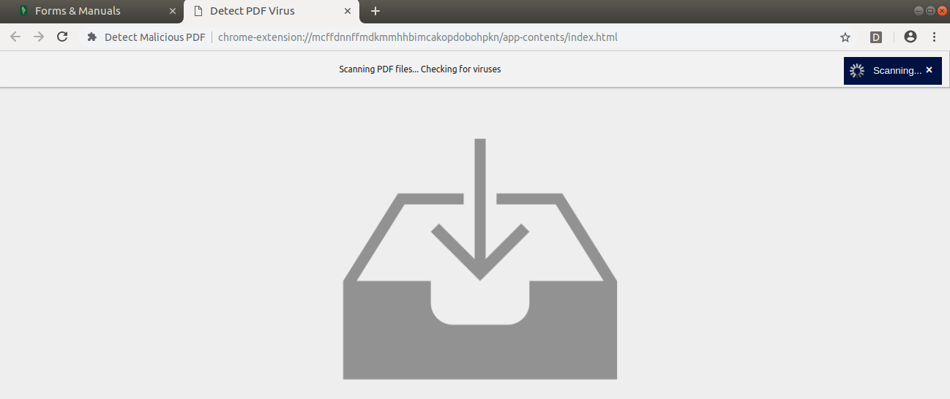

Slide 16
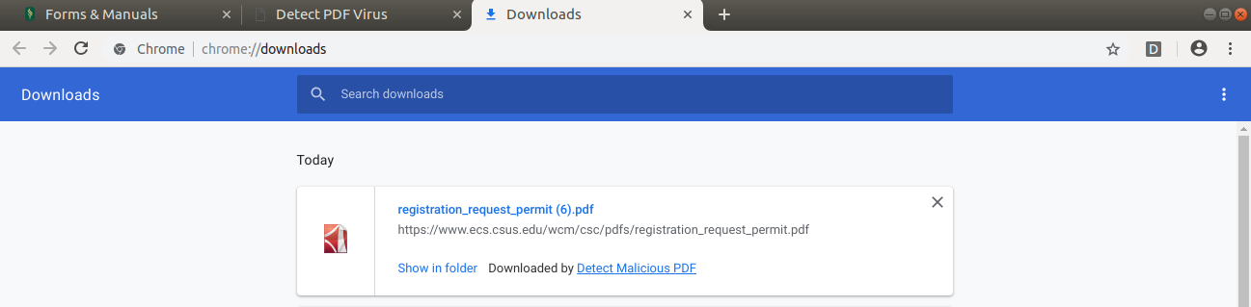

Slide 17
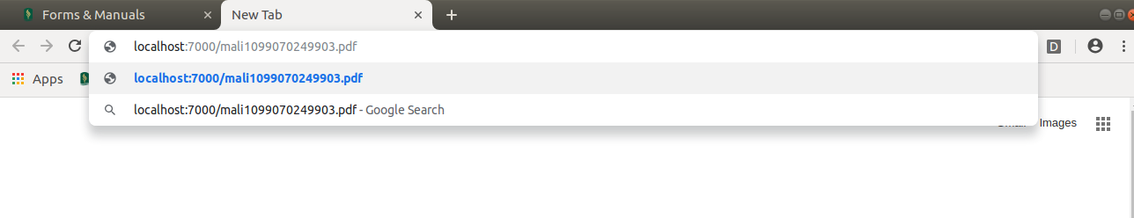

Slide 18
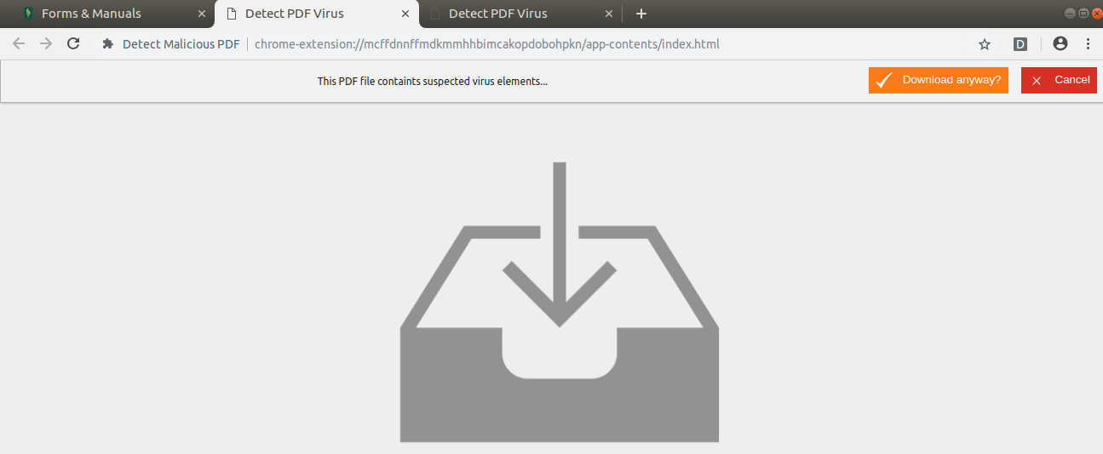

Slide 19
Future Work
We can extend our work with this extension to detect other malicious content such as adware, spyware, and keyloggers.
We can use other techniques such as Deep Learning and AI to analyze malicious content from PDF files.

Slide 20
Learning
PDF structure
Malicious content analysis techniques – dynamic, static
JavaScript, Chrome API
MS Visual Studio Code
Python
Django and Gunicorn
SDLC

Slide 21
References
N. Nissim, A. Cohen, C. Glezer and Y. Elovici, ‘Detection of malicious PDF files and directions for enhancements: A state-of-the art survey’, Computer & Security-Pages 246-266, February 2015.
C. Smutz, A. Stavrou, ‘Malicious PDF detection using metadata and structural features’, ACSAC '12 Proceedings of the 28th Annual Computer Security Applications Conference – Pages 239-248,Orlando, December 03-07,2012.
P. Laskov, N. Srndic, ‘Static Detection of Malicious JavaScript-Bearing PDF Documents’, University of Tubingen, Germany.
J. Kittilsen, ‘Detecting malicious PDF documents’, Department of Computer Science and Media Technology Gjovik University College, Norway, 2011.
Bonan Cuan, Aliénor Damien, Claire Delaplace, Mathieu Valois, ‘Malware Detection in PDF Files Using Machine Learning’, SECRYPT 2018 - 15th International Conference on Security and Cryptography, Jul 2018, Porto, Portugal. 8p., 2018.

Slide 22
References
Extension Developers Guide https://developer.chrome.com/extensions/getstarted
Python Guide available on https://www.python.org/doc/
Gunicorn Guide available on http://docs.gunicorn.org/en/stable/
Django Guide available on https://docs.djangoproject.com/en/2.1/
Pdf-parser guide https://blog.didierstevens.com/2019/03/

Slide 23

Questions ?

Slide 24

Thank you

