Slide 1
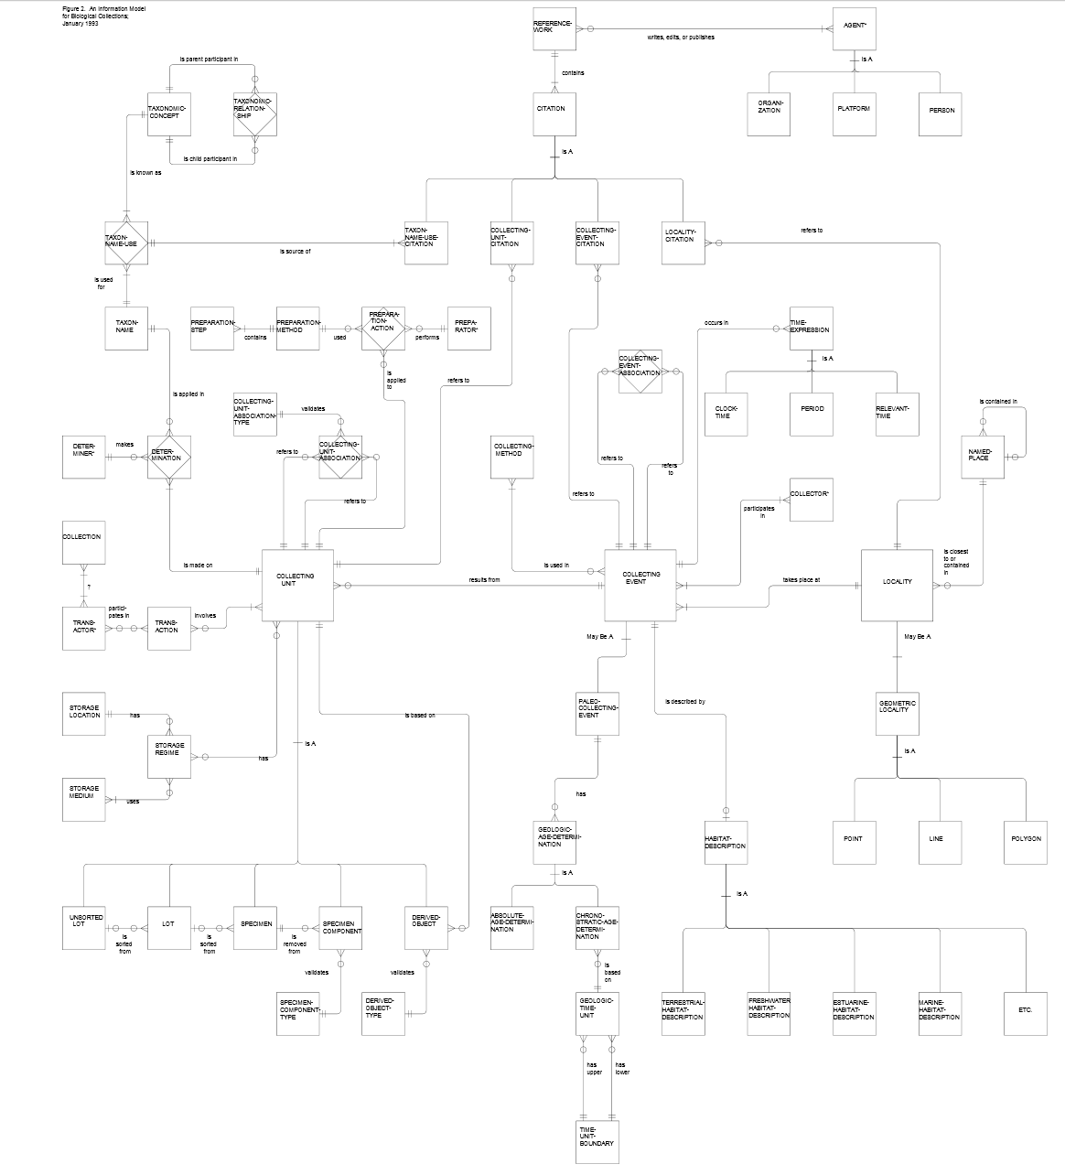
Darwin-SW (DSW) 1.0 ontology
mapped on the 1993
Association of Systematics Collections
(ASC) Model
(some bibo: class?)
foaf:Agent or
dcterms:Agent
dcterms:creator
tc:accordingTo
Steven J. Baskauf – Vanderbilt University
Campbell O. Webb – Arnold Arboretum of Harvard University
Basic class relationships laid out by Richard L. Pyle
http://lists.tdwg.org/pipermail/tdwg-content/2010-October/001703.html
Similarity to ASC model noted by Greg Whitbread
http://lists.tdwg.org/pipermail/tdwg-content/2010-October/001718.html
dwc:Taxon
Key:
tc:hasName
namespace:property property (italicized)
namespace: Class instance of named class
property arc from subject to object
inverse property pair; arrow
with property name shows direction
dwciri:toTaxon
tc:TaxonName
rdfs:Literal
dwc:Identification
dwc:eventDate
gn:Feature
Colors:
foaf:Agent or
dcterms:Agent
ns:X
dsw:idBasedOn→
←dsw:isBasisForId
dwciri:inDescribedPlace
red=Darwin Core sensu RDF Guide
blue=Darwin-SW preferred terms
(non-preferred terms in gray)
yellow=other vocabulary
ns:y
dsw:hasIdentification→
←dsw:identifies
ns:X
ns:y
dsw:Token
dwc:Event
dcterms:Location
ns:X
ns:y
dsw:locatedAt→
←dsw:locates
dsw:hasDerivative→
←dsw:derivedFrom
dsw:atEvent→
←dsw:eventOf
dwc:Organism
dsw:evidenceFor→
←dsw:hasEvidence
dwciri:recordedBy
Namespace abbreviations:
dsw:hasOccurrence→
←dsw:occurrenceOf
dwc:Occurrence
rdfs: http://www.w3.org/2000/01/rdf-schema#
dwc: http://rs.tdwg.org/dwc/terms/
dwciri: http://rs.tdwg.org/dwc/iri/
dsw: http://purl.org/dsw/
tc: http://rs.tdwg.org/ontology/voc/TaxonConcept#
dcterms: http://purl.org/dc/terms/
dcmitype: http://purl.org/dc/dcmitype/
foaf: http://xmlns.com/foaf/0.1/
gn: http://www.geonames.org/ontology#
Sources:
Baskauf, S. and C. O. Webb. In press. Darwin-SW: Darwin Core-based terms for expressing biodiversity data as RDF. Semantic Web Journal. http://www.semantic-web-journal.net/content/darwin-sw-darwin-core-based-terms-expressing-biodiversity-data-rdf-1
Darwin Core RDF Guide from http://rs.tdwg.org/dwc/terms/guides/rdf/index.htm
Describing Taxon Concepts from http://code.google.com/p/tdwg-rdf/wiki/TaxonInRDF which is based on the TDWG TaxonConcept Ontology http://code.google.com/p/tdwg-ontology/source/browse/trunk/ontology/voc/TaxonConcept.rdf
which is based on the TCS Standard http://www.tdwg.org/standards/117/
Darwin-SW version 1.0 from https://github.com/darwin-sw/dsw
The Association of Systematics Collections (ASC) report on: An Information Model for Biological Collections
http://wiki.tdwg.org/twiki/bin/view/TAG/HistoricalDocuments
ASC model diagram from http://wiki.tdwg.org/twiki/bin/viewfile/TAG/HistoricalDocuments?rev=1;filename=Ascfig2.pdf

