Slide 1
Homework1 Presentation
Institute of Biomedical Informatics
You-Lin Lin

Slide 2
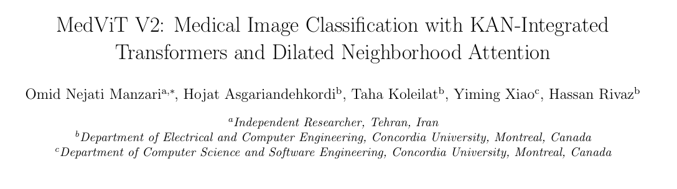
Source

Slide 3
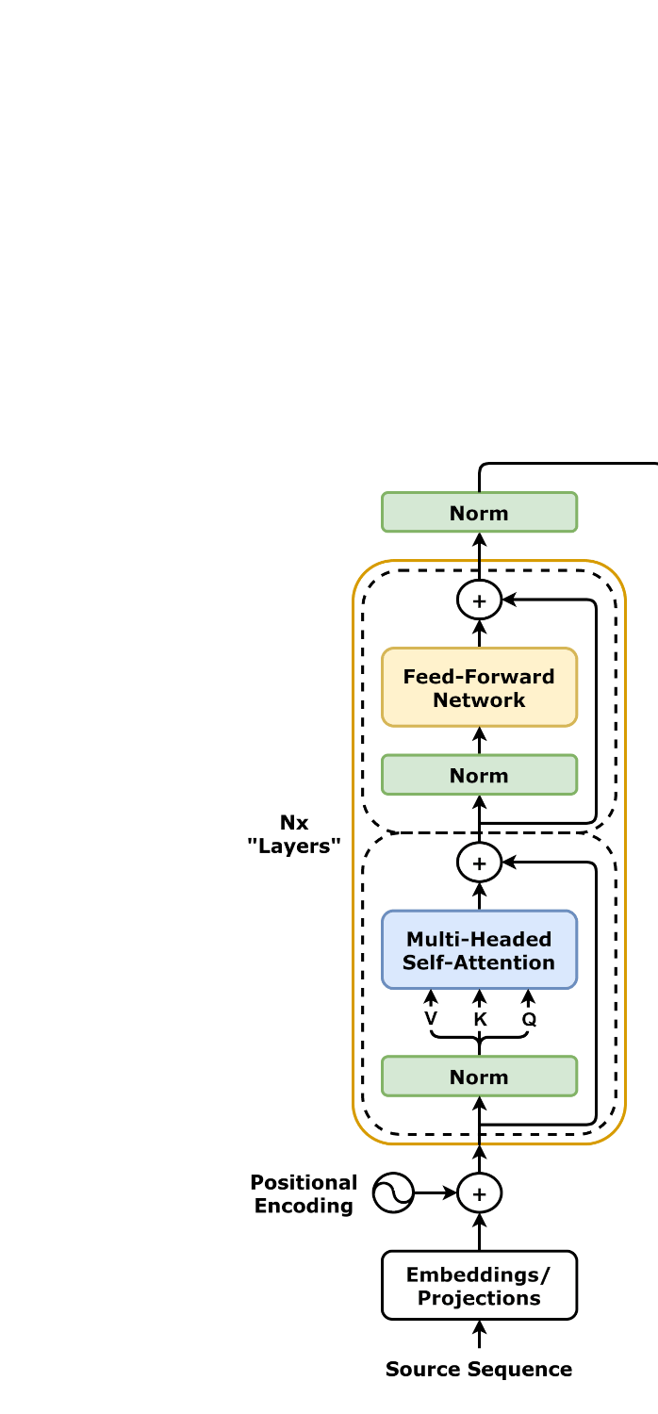
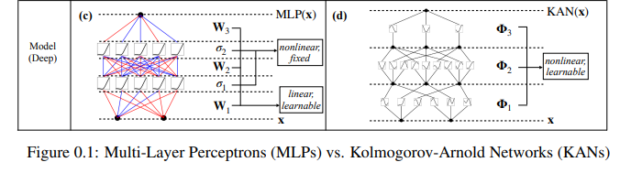
1. Integrating KAN (Kolmogorov-Arnold Network)
It reduces computational complexity (FLOPs) by 44% yet achieves a significant improvement in accuracy.
Transformer architecture

Slide 4
2. DiNA (Dilated Neighborhood Attention)
MedViT V1: Neighborhood Attention
MedViT V2: Dilated Neighborhood Attention

Slide 5
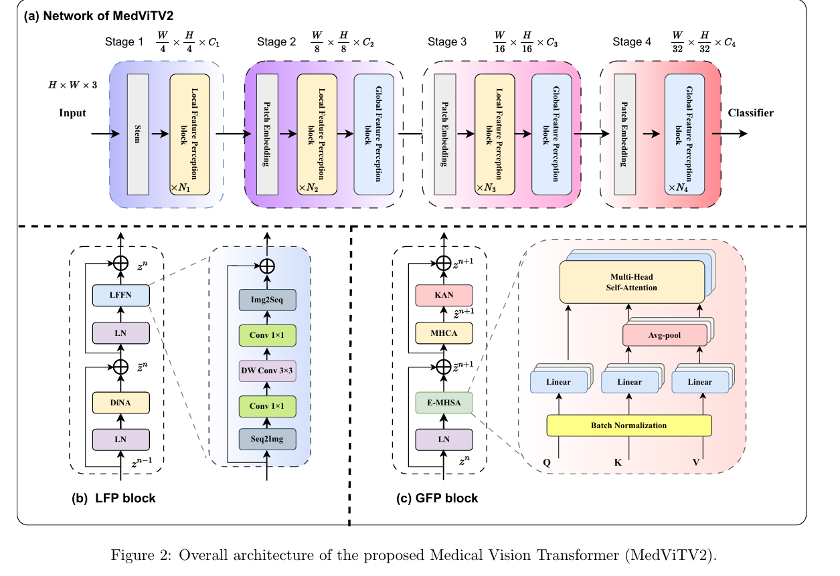
3. Hierarchical Hybrid Strategy
Source

Slide 6
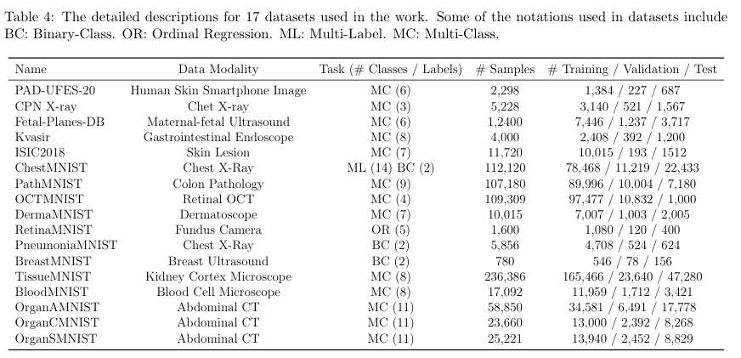
Dataset
Source

Slide 7
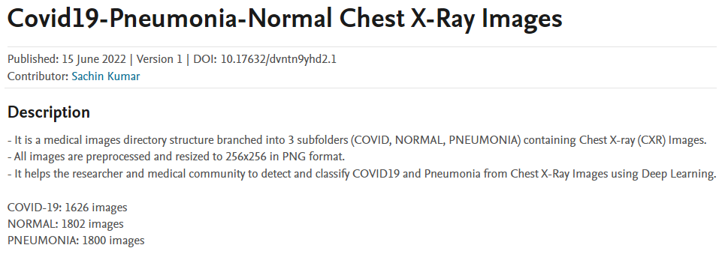
Dataset
Kumar, Sachin (2022), “Covid19-Pneumonia-Normal Chest X-Ray Images”, Mendeley Data, V1, doi: 10.17632/dvntn9yhd2.1

Slide 8
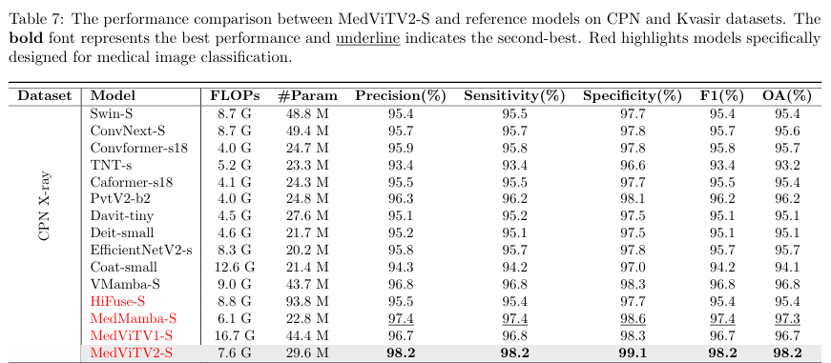
Results (hyperparameters)
Source

Slide 9
Results (hyperparameters)
Replicated using the default configuration.
Hyperparameters
model_name | MedViT_small
batch_size | 24
lr | 0.0001
epochs | 100
pretrained | True
Model Performance
 | Accuracy | Precision | Recall (Sensitivity) | Specificity | F1-Score
My result | 96 | 95.7 | 95.6 | 97.7 | 95.5
Paper result | 98.2 | 98.2 | 98.2 | 99.1 | 98.2
Notes:
4.2 節中，作者明確指出在訓練 NonMNIST 數據集時，使用的 batch_size 是 64 epochs 150

Slide 10
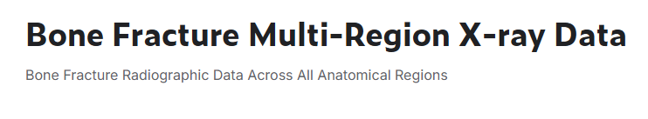
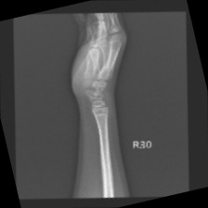
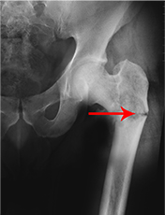
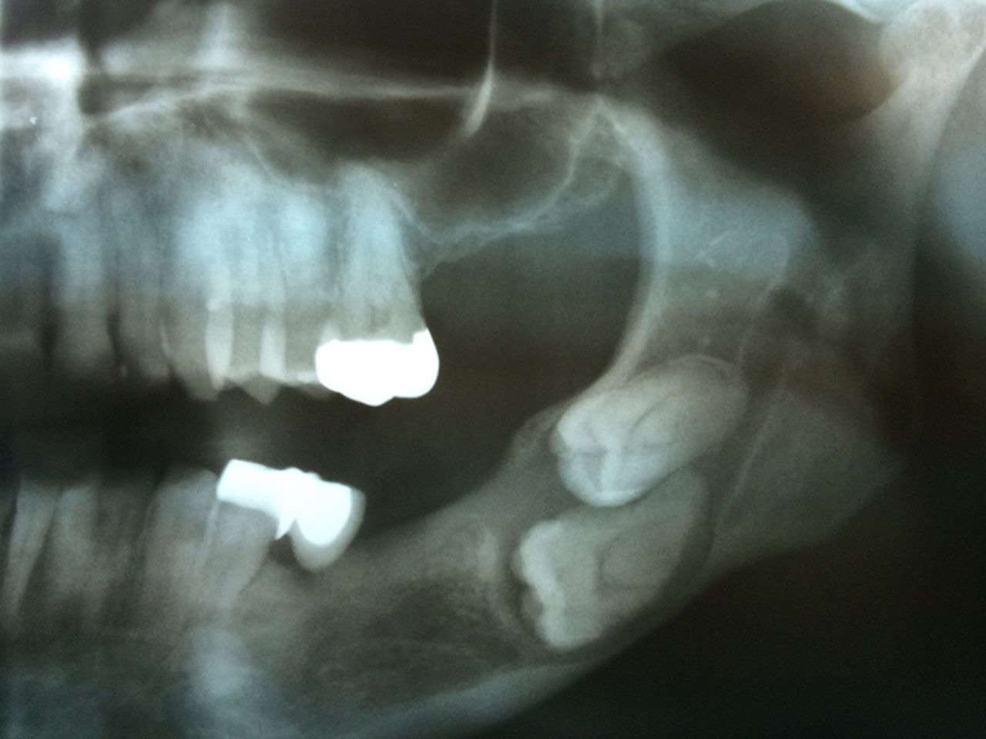
Dataset
https://www.kaggle.com/datasets/bmadushanirodrigo/fracture-multi-region-x-ray-data/data
Split | fractured | not fractured | Total
train | 4606 | 4634 | 9240
val | 337 | 486 | 823
test | 238 | 262 | 500
Total | 5181 | 5382 | 10563
Image rotation augmentation is applied to the training, validation, and test sets.
Number of damaged images: 18

Slide 11
Results (hyperparameters)
Replicated using the default configuration.
Model Performance
Hyperparameters
model_name | MedViT_small
batch_size | 24
lr | 0.0001
epochs | 100
pretrained | True
Metric | Value
Precision | 98.41
Recall | 98.40
Specificity | 98.36
F1-Score | 98.40
Overall Accuracy | 98.40

Slide 12
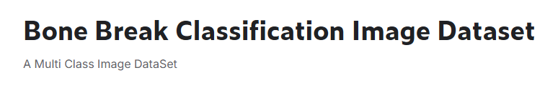
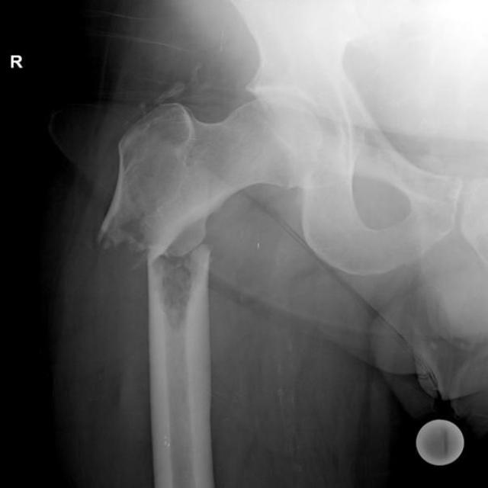
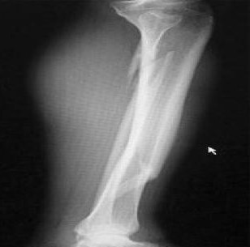
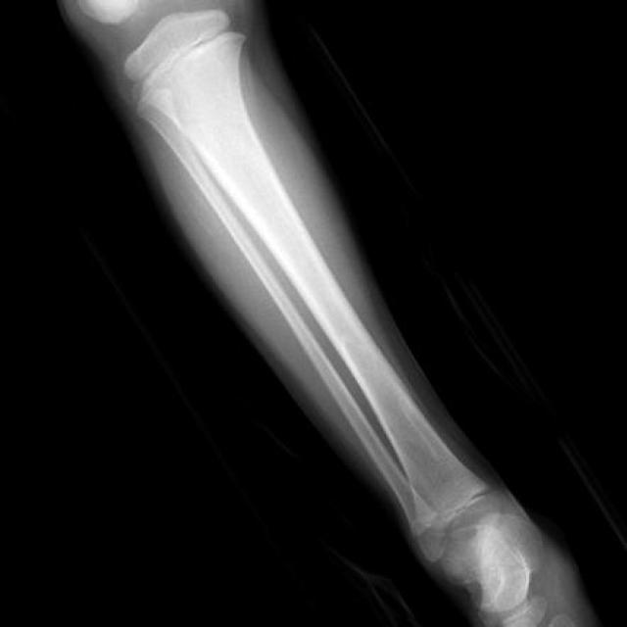
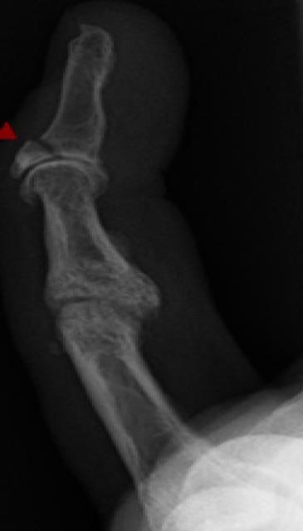
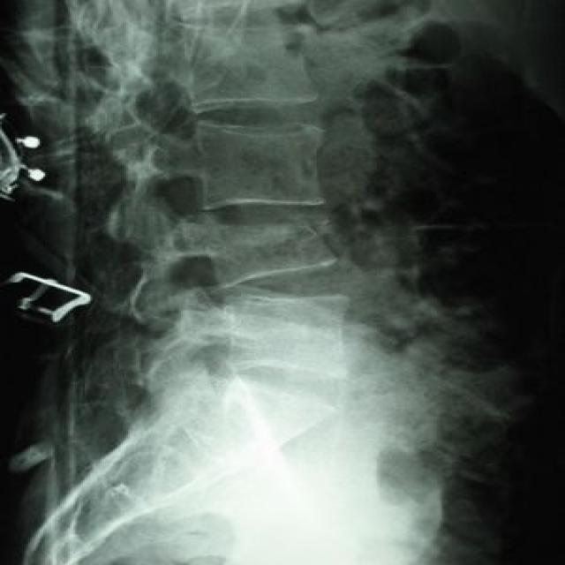
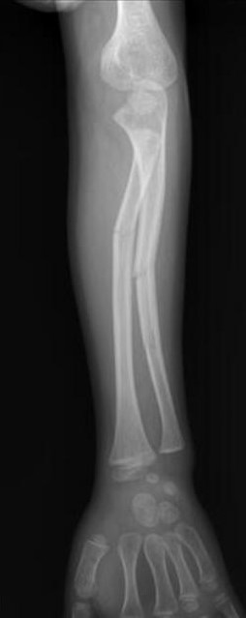
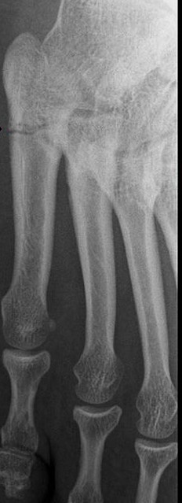
https://www.kaggle.com/datasets/pkdarabi/bone-break-classification-image-dataset?resource=download
A dataset of X-ray images designed classify different types of bone fractures.
For each fracture category, the images are already pre-split into train and test directories.
Fracture Type | Train | Test | Total
Impacted fracture | 75 | 9 | 84
Oblique fracture | 69 | 16 | 85
Avulsion fracture | 109 | 14 | 123
Comminuted fracture | 134 | 14 | 148
Spiral Fracture | 74 | 12 | 86
Greenstick fracture | 106 | 16 | 122
Longitudinal fracture | 68 | 12 | 80
Hairline Fracture | 101 | 10 | 111
Fracture Dislocation | 137 | 19 | 156
Pathological fracture | 116 | 18 | 134
Total | 989 | 140 | 1129

Slide 13
Results (hyperparameters)
Hyperparameters | Experiment 1 | Experiment 2 | Experiment 3 | Experiment 4
model_name | MedViT_small | MedViT_small | MedViT_tiny | MedViT_tiny
batch_size | 24 | 64 | 64 | 64
lr | 0.0001 | 0.001 | 0.0001 | 0.0001
epochs | 100 | 200 | 100 | 300
pretrained | TRUE | True | TRUE | TRUE
Result | --- | --- | --- | ---
Val Accuracy | 28.57% | 15.00% | 29.29% | 37.14%
Precision | 25.45% | 4.01% | 26.95% | 40.38%
Recall | 28.57% | 15.00% | 29.29% | 37.14%
Specificity | 91.97% | 90.31% | 92.03% | 92.95%
F1-Score | 25.36% | 6.29% | 26.26% | 36.62%
AUC | 70.18% | 58.20% | 69.30% | 72.98%

Slide 14
Thank You

