Slide 1
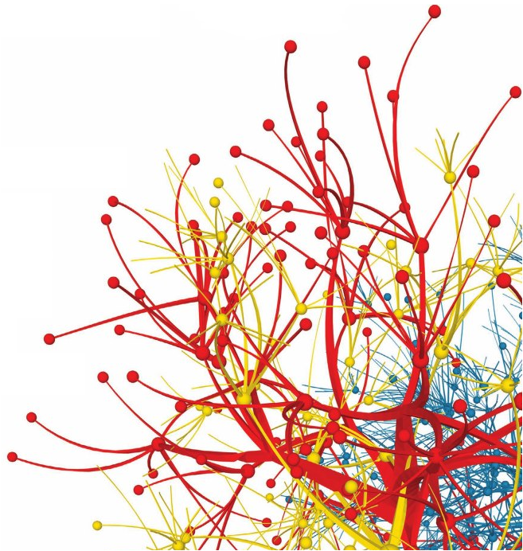
Graph Partitioning
Dr. Frank McCown
Intro to Web Science
Harding University
This work is licensed under Creative Commons Attribution-NonCommercial 3.0

Slide 2
Slides use figures from Ch 3.6 of Networks, Crowds and Markets by Easley & Kleinberg (2010)
http://www.cs.cornell.edu/home/kleinber/networks-book/

Slide 3
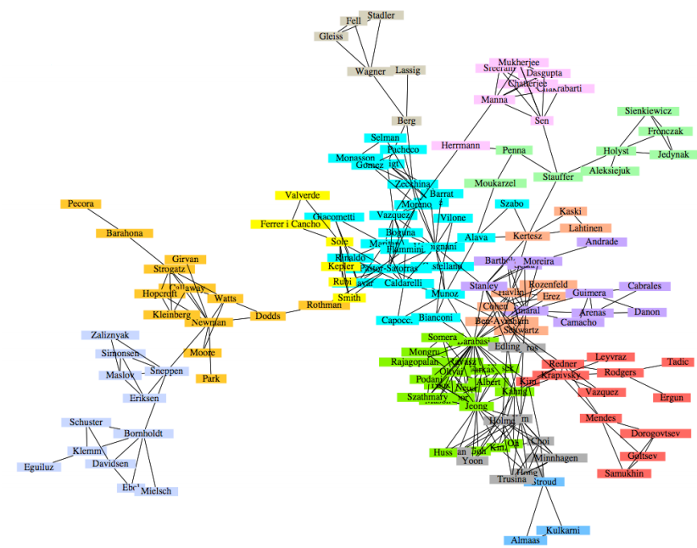
Co-authorship network How can the tightly clustered groups be identified?
Newmam & Girvan, 2004

Slide 4
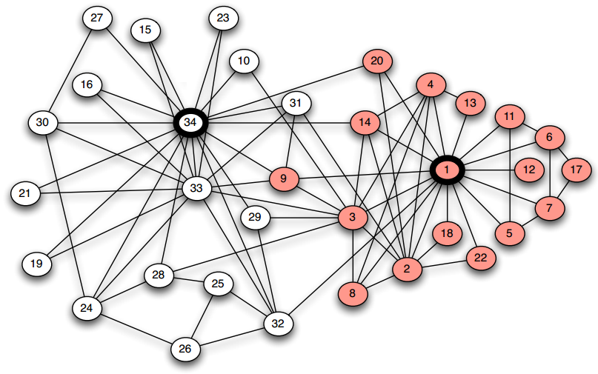
Karate Club splits after a dispute. Can new clubs be identified based on network structure?
Zachary, 1977

Slide 5
Graph Partitioning
Methods to break a network into sets of connected components called regions
Many general approaches
Divisive methods: Repeatedly identify and remove edges connecting densely connected regions
Agglomerative methods: Repeatedly identify and merge nodes that likely belong in the same region

Slide 6
Divisive Methods
1
10
2
3
9
11
7
8
4
6
12
13
5
14

Slide 7
Agglomerative Methods
1
10
2
3
9
11
7
8
4
6
12
13
5
14

Slide 8
Girvan-Newman Algorithm
Divisive method Proposed by Girvan and Newman in 2002
Uses edge betweenness to identify edges to remove
Edge betweenness: Total amount of “flow” an edge carries between all pairs of nodes where a single unit of flow between two nodes divides itself evenly among all shortest paths between the nodes (1/k units flow along each of k shortest paths)

Slide 9
Edge Betweenness Example
1
10
2
3
Calculate total flow over edge 7-8
9
11
7
8
4
6
12
13
5
14

Slide 10
1
10
2
3
One unit flows over 7-8 to get from 1 to 8
9
11
7
8
4
6
12
13
5
14

Slide 11
1
10
2
3
One unit flows over 7-8 to get from 1 to 9
9
11
7
8
4
6
12
13
5
14

Slide 12
1
10
2
3
One unit flows over 7-8 to get from 1 to 10
9
11
7
8
4
6
12
13
5
14

Slide 13
1
10
2
3
9
11
7
8
4
6
12
13
5
7 total units flow over 7-8 to get from 1 to nodes 8-14
14

Slide 14
1
10
2
3
9
11
7
8
4
6
12
13
5
7 total units flow over 7-8 to get from 2 to nodes 8-14
14

Slide 15
1
10
2
3
9
11
7
8
4
6
12
13
5
7 total units flow over 7-8 to get from 3 to nodes 8-14
14

Slide 16
7 x 7 = 49 total units flow over 7-8 from nodes 1-7 to 8-14
1
10
2
3
9
11
7
8
4
6
12
13
5
14

Slide 17
1
Edge betweenness = 49
10
2
3
9
11
7
8
4
6
12
13
5
14

Slide 18
1
10
Calculate betweenness for edge 3-7
2
3
9
11
7
8
4
6
12
13
5
14

Slide 19
1
10
3 units flow from 1-3 to each 4-14 node,
so total = 3 x 11 = 33
2
3
9
11
7
8
4
6
12
13
5
14

Slide 20
1
Betweenness = 33
for each symmetric edge
10
2
3
9
11
33
33
7
8
33
33
4
6
12
13
5
14

Slide 21
1
10
Calculate betweenness for edge 1-3
2
3
9
11
7
8
4
6
12
13
5
14

Slide 22
1
10
Carries all flow to node 1 except from node 2,
so betweenness = 12
2
3
9
11
7
8
4
6
12
13
5
14

Slide 23
1
10
betweenness = 12
for each symmetric edge
12
12
2
3
9
11
12
12
7
8
4
12
6
12
12
13
12
12
5
14

Slide 24
1
10
Calculate betweenness for edge 1-2
2
3
9
11
7
8
4
6
12
13
5
14

Slide 25
1
10
Only carries flow from 1 to 2, so betweenness = 1
2
3
9
11
7
8
4
6
12
13
5
14

Slide 26
1
10
betweenness = 1 for each symmetric edge
1
1
2
3
9
11
7
8
4
6
12
13
1
1
5
14

Slide 27
1
10
Edge with highest betweenness
1
12
12
1
2
3
9
11
12
12
33
33
7
49
8
33
33
4
12
6
12
12
13
1
12
12
1
5
14

Slide 28
Node Betweenness
Betweenness also defined for nodes
Node betweenness: Total amount of “flow” a node carries when a unit of flow between each pair of nodes is divided up evenly over shortest paths
Nodes and edges of high betweenness perform critical roles in the network structure

Slide 29
Girvan-Newman Algorithm
Calculate betweenness of all edges
Remove the edge(s) with highest betweenness
Repeat steps 1 and 2 until graph is partitioned into as many regions as desired

Slide 30
Girvan-Newman Algorithm
Calculate betweenness of all edges
Remove the edge(s) with highest betweenness
Repeat steps 1 and 2 until graph is partitioned into as many regions as desired
How much computation does this require?
Newman (2001) and Brandes (2001) independently developed similar algorithms that reduce the complexity from O(mn²) to O(mn) where m = # of edges, n = # of nodes

Slide 31
Computing Edge Betweenness Efficiently
For each node N in the graph
Perform breadth-first search of graph starting at node N
Determine the number of shortest paths from N to every other node
Based on these numbers, determine the amount of flow from N to all other nodes that use each edge
Divide sum of flow of all edges by 2
Method developed by Brandes (2001) and Newman (2001)

Slide 32
Example Graph
F
B
C
I
A
D
G
K
E
H
J

Slide 33
Computing Edge Betweenness Efficiently
For each node N in the graph
Perform breadth-first search of graph starting at node N
Determine the number of shortest paths from N to every other node
Based on these numbers, determine the amount of flow from N to all other nodes that use each edge
Divide sum of flow of all edges by 2

Slide 34
Breadth-first search from node A
A
B
C
D
E
F
G
H
I
J
K

Slide 35
Computing Edge Betweenness Efficiently
For each node N in the graph
Perform breadth-first search of graph starting at node N
Determine the number of shortest paths from N to every other node
Based on these numbers, determine the amount of flow from N to all other nodes that use each edge
Divide sum of flow of all edges by 2

Slide 36
A
1
B
C
1
D
1
E
1
add
add
F
2
G
1
H
2
add
add
I
3
J
3
add
K
6

Slide 37
Computing Edge Betweenness Efficiently
For each node N in the graph
Perform breadth-first search of graph starting at node N
Determine the number of shortest paths from N to every other node
Based on these numbers, determine the amount of flow from N to all other nodes that use each edge
Divide sum of flow of all edges by 2

Slide 38
A
1
B
C
1
D
1
E
1
F
2
G
1
H
2
I
3
J
3
Work from bottom-up
starting with K
K
6

Slide 39
A
1
B
C
1
D
1
E
1
F
2
G
1
H
2
I
3
J
3
K gets 1 unit; equal, so evenly divide 1 unit
½
½
K
6

Slide 40
A
1
B
C
1
D
1
E
1
F
2
G
1
H
2
1
½
I keeps 1 unit & passes along ½ unit; gets 2 times as much from F
I
3
J
3
½
½
K
6

Slide 41
A
1
B
C
1
D
1
E
1
F
2
G
1
H
2
1
½
½
1
J keeps 1 unit & passes along ½ unit; gets 2 times as much from H
I
3
J
3
½
½
K
6

Slide 42
A
1
B
C
1
D
1
E
1
1
1
F
2
G
1
H
2
1
½
½
1
F keeps 1 unit & passes along 1 unit; equal, so divide evenly
I
3
J
3
½
½
K
6

Slide 43
A
1
B
C
1
D
1
E
1
1
1
2
F
2
G
1
H
2
1
½
½
1
G keeps 1 unit & passes along 1 unit
I
3
J
3
½
½
K
6

Slide 44
A
1
B
C
1
D
1
E
1
1
1
2
1
1
F
2
G
1
H
2
1
½
½
1
H keeps 1 unit & passes along 1 unit; equal, so divide evenly
I
3
J
3
½
½
K
6

Slide 45
B keeps 1 & passes 1
A
2
1
B
C
1
D
1
E
1
1
1
2
1
1
F
2
G
1
H
2
1
½
½
1
I
3
J
3
½
½
K
6

Slide 46
C keeps 1 & passes 1
A
2
2
1
B
C
1
D
1
E
1
1
1
2
1
1
F
2
G
1
H
2
1
½
½
1
I
3
J
3
½
½
K
6

Slide 47
A
D keeps 1 & passes along 3
2
2
4
1
B
C
1
D
1
E
1
1
1
2
1
1
F
2
G
1
H
2
1
½
½
1
I
3
J
3
½
½
K
6

Slide 48
A
E keeps 1 & passes along 1
2
2
4
2
1
B
C
1
D
1
E
1
1
1
2
1
1
F
2
G
1
H
2
1
½
½
1
I
3
J
3
½
½
K
6

Slide 49
No flow yet…
A
2
2
4
2
1
B
C
1
D
1
E
1
1
1
2
1
1
F
2
G
1
H
2
1
½
½
1
I
3
J
3
½
½
K
6

Slide 50
Computing Edge Betweenness Efficiently
Repeat for B, C, etc.
For each node N in the graph
Perform breadth-first search of graph starting at node N
Determine the number of shortest paths from N to every other node
Based on these numbers, determine the amount of flow from N to all other nodes that use each edge
Divide sum of flow of all edges by 2
Since sum includes flow from A → B and B → A, etc.

