Slide 1
Saigon in a Day
1d
One day in Saigon, planned from official sources.
Một ngày Sài Gòn, đúng nguồn, đúng gu.
A bilingual planning assistant for short-stay international visitors to Ho Chi Minh City
Pitch deck for HIST 2026 · Theme: Digital transformation and AI in tourism
Lion, founder · [contact email / phone]
Version 1 · November 2026
Independent student project. Not affiliated with or endorsed by any government body or venue.

Slide 2
Short-stay visitors plan their one day in Saigon from scattered, often outdated information
01 · PROBLEM
1
2
3
Scattered sources
Wrong or outdated details
Lost time, same few sites
Visitors who stay one or two days piece together a route from blogs, social posts and general-purpose AI chatbots.
Opening hours, prices and closures change. Chatbots can confidently suggest places that are closed or do not exist.
Routes cut across heavy traffic, and visitors default to the same famous landmarks. Smaller museums and local experiences are rarely found.
Real examples from our own data research (Nov 2026): the Ho Chi Minh Museum branch at Nhà Rồng has been closed for renovation since 7 May 2026; the Notre-Dame Cathedral interior was reported closed for restoration; and four city museums changed their adult fee to 60,000 VND from 1 October 2026, while older guides still show other hours and prices.

Slide 3
The city is growing fast and has made digital tourism a stated priority
02 · WHY IT MATTERS
~8.6M
~46M
US$10.6B
international visitors to Ho Chi Minh City in 2025, up 40.3%
domestic visitors in 2025, up 20%
tourism revenue (VND 278,566 billion), up 45.8%
City ambition
What this means for us
Become Asia's leading creative tourism hub by 2030, focusing on high-value visitors, green tourism and digital tourism.
At this volume, even a small improvement in trip planning can extend stays, spread spending to more sites and strengthen the city's reputation.
Source: Sai Gon Giai Phong (SGGP), "Ho Chi Minh City welcomes nearly 8.6 million international visitors in 2025", 31 December 2025.

Slide 4
A timed one-day plan built only from places we have verified
03 · SOLUTION
1
Ask. Interests, budget, hotel area, date and time window, mobility, group type, optional evening.
Trust by design
2
Select. Draw only from a curated database built from official public sources. Nothing outside it is ever suggested.
Every stop shows its source link and a "last verified" date.
Warnings for closed days, renovations and conflicting sources.
When we do not have a verified answer, the assistant says so instead of guessing.
A deterministic planning engine does the work. An AI layer is optional and is never allowed to add places, prices or hours.
3
Order. Arrange stops by location, opening hours and travel time into a timed plan with a lunch window.
4
Show. English guidance plus Vietnamese names and addresses on a "show to driver" card.
5
Correct. Visitors report wrong information; we check and fix the database.

Slide 5
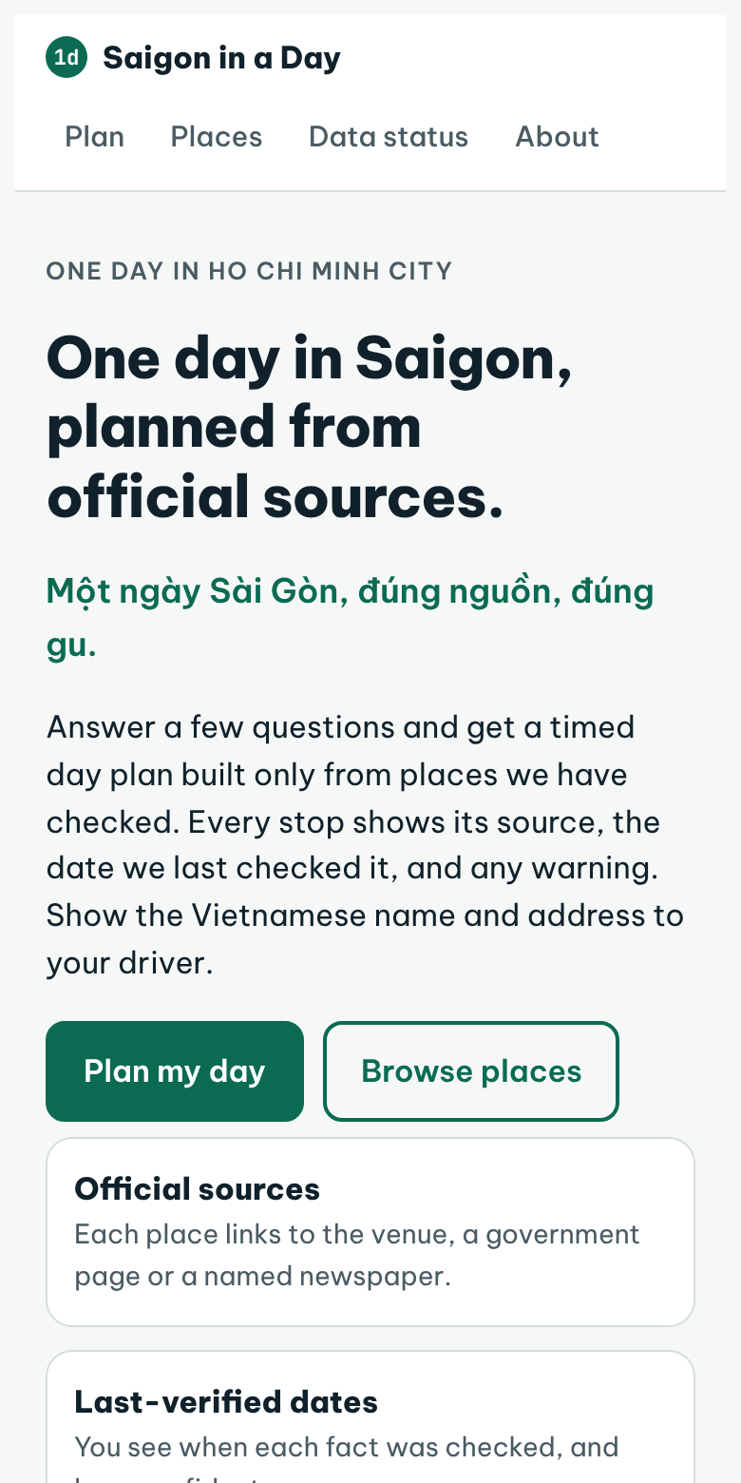
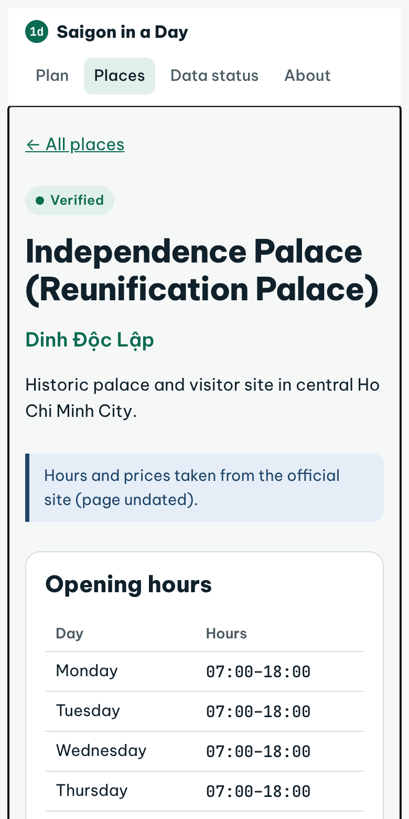
A working mobile-first prototype, built and tested
04 · PRODUCT
What is built (prototype v1, November 2026)
Questionnaire and timed day planner
Place pages with sources, verification status and warnings
"Show to driver" card with Vietnamese name and address
"Report wrong information" button and short anonymous survey
Data status page that shows openly what is and is not verified
Deterministic planning engine with 10 automated tests
Honest status: real plans switch on once at least 8 places have verified coordinates and visit times. Until then, the planner says it does not have enough data, and a preview labelled "fictional test data" shows how a full plan looks.
Demo link: [paste public prototype link after sharing]

Slide 6
Others present information or generate plans. We plan from verified local data.
05 · LANDSCAPE AND ADVANTAGE
OPTION TODAY | TIMED DAY PLAN | VISIBLE SOURCES AND DATES | LIMITS (FROM PUBLIC REPORTS)
Official channels 3D/360 tourism map, reported tourism chatbot | Not observed yet [test] | Official content | Focus on presenting information about sites; planning features not yet tested by us
Global AI planners and chatbots | Yes | No | Reviews point to accuracy and trust gaps; no verified local database
Blogs, social, review sites | Partly | Rarely | Rich but scattered and often outdated
Local human guides | Yes | Personal knowledge | Reliable but costly and fixed in schedule
Saigon in a Day | Yes | Yes, every stop | Hard to copy: the verified local dataset, a correction loop from real visitor feedback, and relationships with sites and hotels built during the pilot
Sources: Tuoi Tre News (3D/360 map, Dec 2023); Doanh Nghiep Hoi Nhap (tourism chatbot, Sep 2023); Hospitality Today (AI travel tools reliability, 21 Aug 2025). We will test the official channels with real questions before the screening round and update this slide.

Slide 7
Start with one clear user in one city, then grow through hotels and tour operators
06 · MARKET
CONTEXT
BEACHHEAD USERS
PAYING CUSTOMERS
~8.6M
Short-stay independent visitors
Hotels and tour operators
First-time international travellers on a one or two-day stay who do not speak Vietnamese.
Businesses that answer "what should I do today?" for their guests every day.
international visitors to HCMC in 2025 (SGGP). This is the wider pool, not our addressable market.
Share of visitors who stay 1–2 days: [find a published source]
Number of hotels / tour operators in central HCMC: [find a published source]
Secondary beneficiaries: museums, cultural sites, small local businesses and evening experiences gain visibility. Later, city tourism bodies could gain anonymised, privacy-respecting insight into visitor interests. Market sizing will be filled only with sourced figures; we do not estimate without data.

Slide 8
Free for travellers. Hotels and tour operators pay.
07 · BUSINESS MODEL
TRAVELLERS
MAIN REVENUE
SECONDARY
LATER
Free
B2B white-label plans
Featured listings
Anonymised insights
The full planner, driver cards and sources at no cost. Trust is the product; no paywall between a visitor and correct information.
Hotels and tour operators offer the planner to guests under their own brand, by QR code at reception or in pre-arrival messages.
Verified local businesses can pay for visibility, always clearly labelled as featured and never ranked above the visitor's own needs.
Aggregate trends on visitor interests for partners. No personal data collected or sold.
First step: pilot with 3–5 hotels
Prices to validate in the pilot (assumptions):
White-label: 1.5M VND per partner per month + 2M setup fee
Featured listing: 500k VND per month
Pilot hotels confirmed: [0 of 3–5 so far — update]
Offer the planner free during the pilot, measure guest use and satisfaction, then agree a paid plan with the hotels that see value.

Slide 9
Early stage, stated honestly: product built, data started, users next
08 · TRACTION
1
15
1
0
working prototype with a tested planning engine
places researched from official and news sources, with links and dates
place fully verified so far (Independence Palace); 5 partly verified
real users or partners yet. The pilot starts next.
Data status of the 15 places (2 Nov 2026)
1 verified
5 partial
7 need data
1 exterior only
1 temporarily closed
Pilot results to add (only real numbers):
Visitors surveyed: [n] · found one-day planning difficult: [x%] · met wrong information online: [y%] · rated our plan realistic: [z%] · NPS: [ ]
Partner progress to add:
Hotels contacted / interested / piloting: [ ] / [ ] / [ ]
Places verified on site: [ ] · Error reports fixed: [ ]

Slide 10
A founder who works directly with the target user
09 · TEAM
L
Lion
Founder
How the work gets done
Product and code built with AI-assisted development, reviewed by the founder
Data verified by the founder from official pages and on tours
Built in small, fixed weekly blocks alongside study
First-year student, Computer Science (AI for Business, honours programme)
Coursework in programming, databases, statistics, machine learning, marketing and entrepreneurship
Works guiding foreign tourists in English: direct access to the people the product is for, and to on-the-ground checks of places
Strong English; learning Chinese (HSK), a future second language for the product
People we are looking for
Co-founder or advisors (e.g. hospitality, tourism, business development): [add names if any, or state "seeking"]
University name: [ ] · Guiding since: [month/year] · Contact / LinkedIn: [ ]

Slide 11
Lean to run. Every figure below is an untested assumption, not a result.
10 · FINANCIALS
BASE SCENARIO · ASSUMPTIONS · VND, BEFORE TAX
ASSUMED PRICES AND COSTS
 | 2027 | 2028 | 2029
Paying hotel / tour-operator partners (avg) | 1 | 6 | 15
Labelled featured listings (avg) | 0 | 8 | 20
Anonymised insight reports | 0 | 1 | 2
Revenue | 20M | 181M | 528M
Costs | 4.9M | 79.5M | 326.6M
Operating result | 15.1M | 101.5M | 201.4M
Revenue in USD (≈26,280 VND/USD) | ~$0.8k | ~$6.9k | ~$20.1k
Travellers: free (a design decision)
White-label: 1.5M VND/month (2.0M from 2029) + 2M setup fee per new partner
Featured listing: 500k VND/month · insight report: 15M VND
Founder unpaid in 2027; stipend 3M/month in 2028, 8M/month in 2029; part-time help from 2029
AI cost is a placeholder (300 VND/plan); the planner also works with AI switched off
Funding ask: [amount] for [use] over [months]. Leave out if not raising.
Low and High scenarios scale all volumes by 0.5× and 1.5×. Full model: saigon-in-a-day-financial-model.xlsx.
Traction today: no users, partners, revenue or pilot. All prices and volumes will be validated in partner interviews and the hotel pilot. Exchange rate derived from SGGP, 31 Dec 2025.

Slide 12
From prototype to a real pilot with visitors and hotels
11 · PLAN AND NEXT STEPS
NOV 2026
DEC 2026
AFTER EXAMS, EARLY 2027
AFTER LAUNCH
Data and rules
Small blocks
Public MVP
Pilot
Read HIST rules; verify places with coordinates and visit times; test official channels.
Reach 8+ plannable places so real plans switch on. Limited time during exams.
Deploy publicly; 12–20 verified plannable places; privacy page and disclaimer live.
Survey real visitors (aim n ≥ 30); pilot with 3–5 hotels; report results with counts.
Targets we will report against
What we ask from HIST 2026
20, then 40 verified plannable places
100% of plannable places re-checked within 90 days
At least 70% of surveyed users rate the plan realistic
Mentoring on B2B sales to hotels and tour operators
Introductions to hotels and venues for the pilot
Feedback from tourism experts on the data approach
Targets are proposals, not promises.
[Edit to match your real ask] · Contact: [email]

