Slide 1
Live Wagon Tracking & Reporting Dashboard
SAIL Durgapur Steel Plant · Pravartanam Digital Transformation Programme
Real-time visibility of iron ore, coal, flux and empty rakes across the DSP rail network
Liquidmind Product Consulting Pvt. Ltd. · Bengaluru · August 2026
Notes:
Introduce Liquidmind: agentic AI for trade and materials movement; DPIIT recognized, Karnataka Elevate grantee, MSTC MoA, active with SAIL RSP.

Slide 2
What blind spots cost DSP today
Manual tracking of rail movements leaves value on the table every shift
1
Demurrage & detention
2
Tippler starvation
IR rakes exceed free time because no one sees the countdown until the bill arrives
Unloading points idle while a loaded rake waits two yards away, unseen
3
Slow empty turnaround
4
Manual MIS
Empties await formation with no live view, stretching rake cycles
Shift and monthly reports compiled by hand from registers and VHF logs
Every one of these is a timestamp problem. Capture the timestamps automatically and the costs become manageable.

Slide 3
One platform, eight capabilities
Everything the Traffic control room needs, in a single live view
Live plant rail map
Rake lifecycle tracker
Dwell & demurrage console
ETA & congestion prediction
Every rake on a georeferenced DSP track schematic, colour-coded by commodity
IR handover to return — every stage timestamped automatically
Free-time countdown and live cost exposure per rake
ML-based arrival forecasts for inbound and internal moves
Automated MIS
Alert engine
Ask in plain language
Admin & masters
Shift, daily and monthly reports generated, not compiled
Abnormal halts, free-time breach, tippler starvation — pushed to the right role
“Which ore rakes crossed 6 hours dwell this shift?” — answered instantly
Wagon registry, geofence editor, plant SSO and role-based access

Slide 4
How we actually track wagons
GPS alone fails inside a plant — wagons carry no power. Four sources, fused into one truth.
RFID AEI gantries
Wagon identity at every choke point, riding on Indian Railways' own wagon-tagging programme
Why fusion matters
No single sensor covers a steel plant. Tags fail, GPS shadows exist under sheds, cameras get dusty.
All four sources emit the same event shape, so the platform cross-validates them continuously.
Result: a position and identity for every rake that survives any single point of failure.
GNSS on locomotives
Loco position + rake composition = continuous rake position, even between gantries
Wagon-number OCR
Cameras read the stencilled number on untagged IR wagons — nothing slips through
Existing systems
Weighbridges, FOIS/ULIP and SAP feed in with zero new hardware

Slide 5
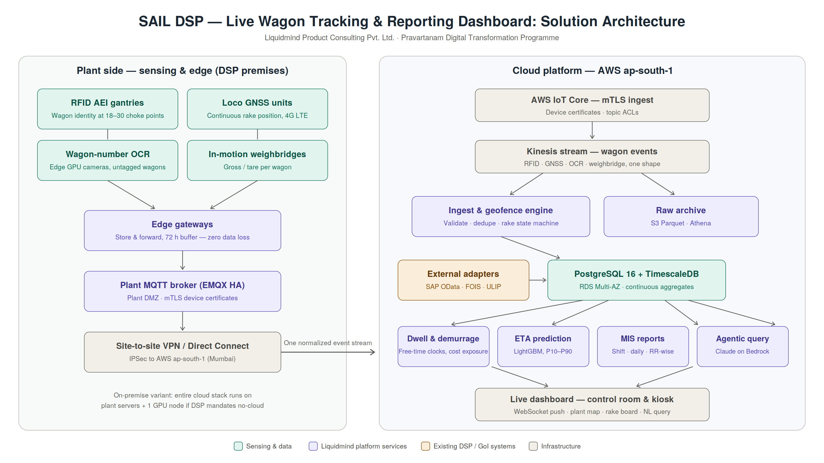
Solution architecture
Notes:
Walk left to right: plant sensing survives WAN outages on its own; cloud side is one normalized stream. On-premise variant available.

Slide 6
Integration without disruption
API-first and read-mostly — nothing invasive touches DSP's running systems
SAP
FOIS / ULIP
OData V4 services for POs and material masters; unloading confirmations posted back with full audit trail. We hold SAP PartnerEdge authorization.
Working Government of India ULIP API access today. Inbound rakes appear on the dashboard days before they reach the interchange.
Weighbridges & SCADA
Plant IT & security
Software adapters for serial, OPC-UA or file-drop interfaces — whatever the installed vendor exposes.
mTLS everywhere, plant AD single sign-on, all data resident in India. Full on-premise deployment available if mandated.

Slide 7
From site survey to full rollout in about six months
Pilot-first: prove it on one commodity stream before scaling plant-wide
Weeks 1–3
Weeks 4–12
Weeks 13–22
Weeks 20–26
Discovery & survey
Pilot corridor
Full network
Intelligence & handover
Rail layout digitised, reader placement plan, integration inventory with C&IT
→
One stream end-to-end (e.g. iron ore, interchange to tippler): live map, lifecycle, dwell console
→
All commodities and empties, complete gantry set, ETA models, automated MIS, SAP flows
→
Plain-language queries, congestion prediction, hyper-care, training
The pilot is designed to pay for itself: demurrage avoided on one commodity stream typically exceeds the pilot cost.

Slide 8
Why Liquidmind
Already inside the SAIL ecosystem, already building for Indian rail logistics
SAIL, already
Engaged with SAIL Rourkela Steel Plant under our MoA with MSTC Limited (GoI Mini Ratna) — our RSP solution suite includes a rake movement dashboard for this exact problem class
GoI data rails, live
Working ULIP API access and FOIS-linked visibility in production use — not a proposal, a capability
Credentialed
DPIIT-recognized · Karnataka Elevate 2025 grantee · Aegis Graham Bell Award 2026 · SAP PartnerEdge · NVIDIA Inception · AWS Activate
Procurement-ready
MSTC empanelment offers a familiar, PSU-compliant contracting route for DSP

Slide 9
Proposed next steps
1
Scoping discussion with GM (Traffic)
Rail network layout, rake volumes, existing systems — so our proposal is specific to DSP
2
Two-day site survey at Durgapur
Walk the interchange, yards and tipplers; validate reader placement and connectivity
3
Detailed technical & commercial proposal
Fixed-scope pilot with clear success criteria and PSU-compliant commercial structure
Naveen Athresh, Founder & CEO · naveen@liquidmind.ai · Srivani Dharwar Vijaya, Co-founder & CTO

