Slide 1
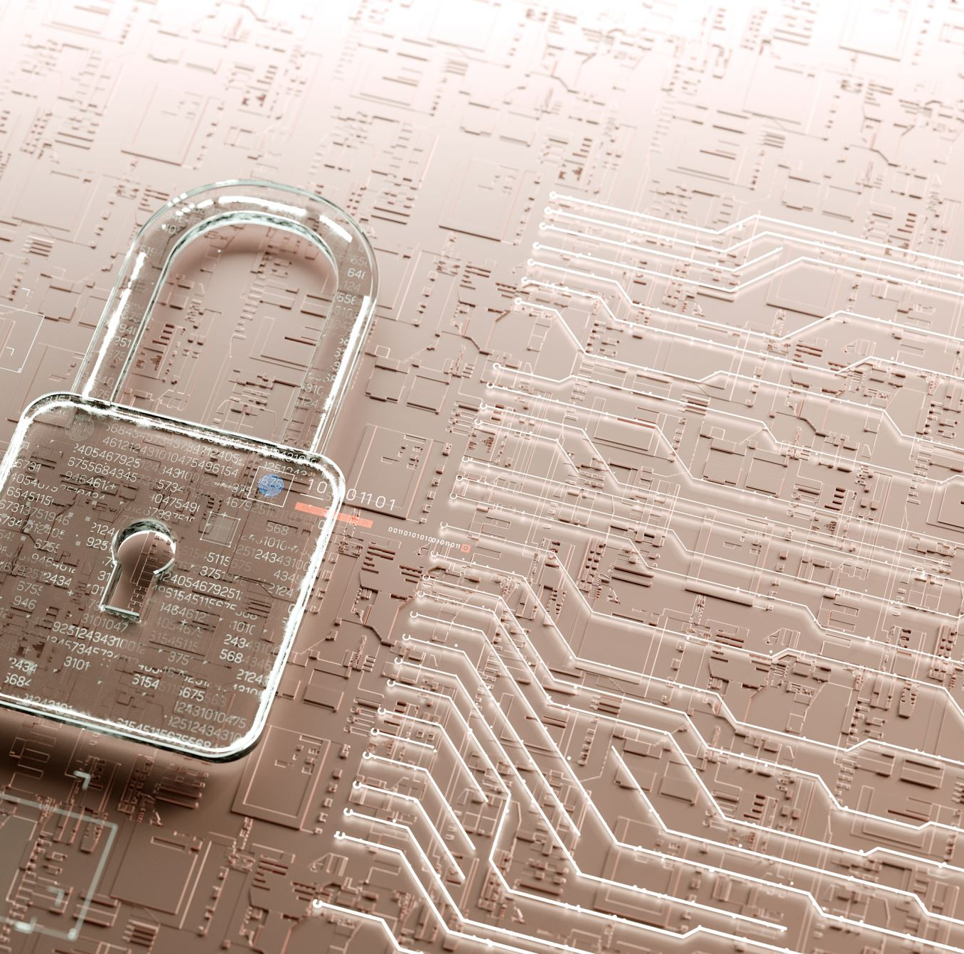
Endpoint Security
By Kailey Owens and Logan Riley

Slide 2
What is Endpoint Security?
An Endpoint is a hardware device that is connected to a network
Ex. Phone, Laptop, Printer
Endpoint security is the defense of Endpoints
This includes protection against malicious entities, keeping systems up to date, and shielding against possible threats
It is important to keep networks safe from their corruptible users: Endpoints

Slide 3
We need Endpoint Security
Electrical devices are primary targets. Endpoint security prevents the loss of essential data, access, and control
Protects individual systems
Saves space and efficiency
System upkeep, updates
It forces malicious activity to target a single device rather than a full system, forcing them to spend resources on a smaller catch

Slide 4
Prevent Malicious Actors
One of the most important reasons for security; stop malware
Firewalls, user permissions, and encryption
Firewalls prevent suspicious activity from entering the system over a network
Malicious or hacked users can only do so much with limited access to the system
Important data, such as what could be found in files or disks, are heavily defended through encryption

Slide 5
Dealing with Vulnerabilities
Devices are primarily attacked through active vulnerabilities. Endpoint security reduces vulnerabilities as much as possible
Disable unused services or programs
This is why updating obsolete software reduces risk
Replacing default passwords adds another layer of defense
Open or unused ports are protected through closing them or installing firewalls

Slide 6
Activity Importance
Our activity goes over a few ways to create Endpoint Security
These examples show theoretical, real-world cases where Endpoint Security may be useful. Protecting our systems can be a remarkably simple process. Setting up these fundamental levels of security could be the difference between a healthy or broken machine

Slide 7
Sources
learn.zybooks.com Chapter 9

