Slide 1
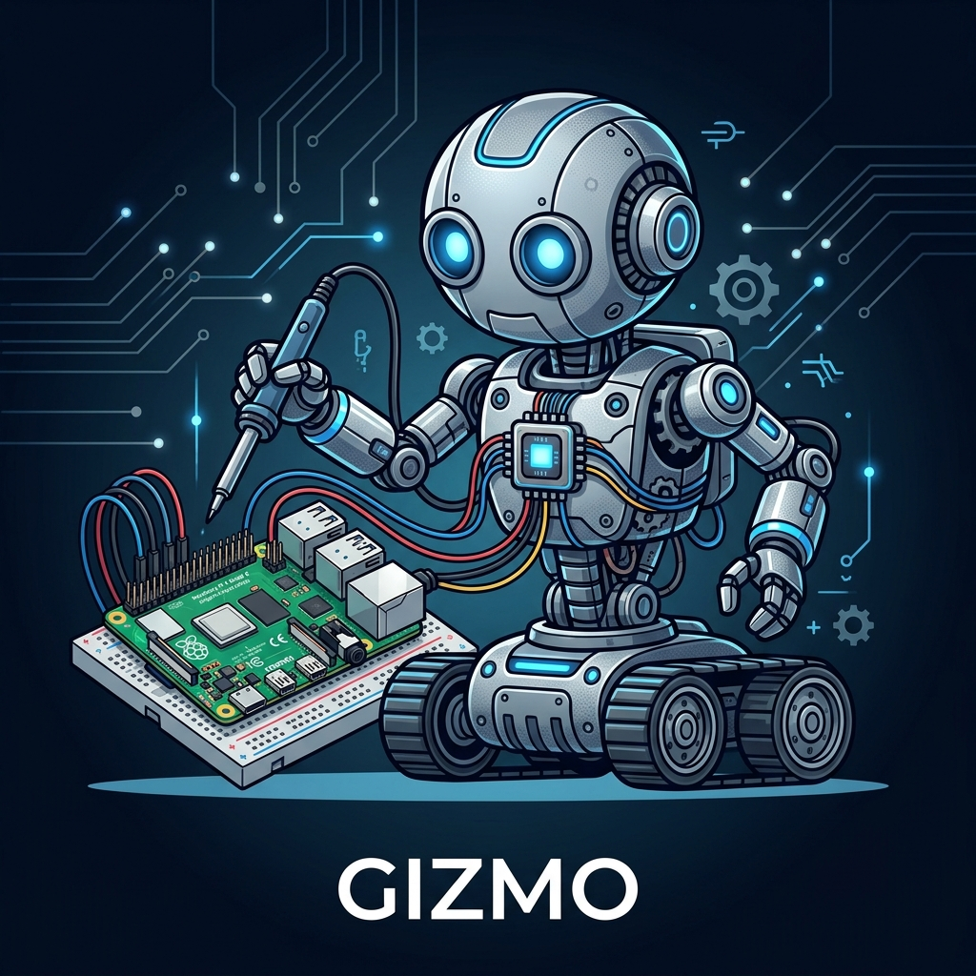
Gizmo
AI-Powered Meccanoid Robot Assistant
CSCI 498/499 — Senior Project Defense
Logan Riley
Charleston Southern University | Spring 2026
1

Slide 2
Introduction
The Problem
- Toy robots have pre-programmed behaviors only
- Cannot hold real conversations or learn
- Building custom robots from scratch is expensive
- No accessible path to an intelligent robot
Purpose
- Transform a Meccanoid G15KS into an AI assistant
- Voice-controlled movement and conversation
- Real-time web search for current information
- Persistent memory across sessions
Goal: Commodity hardware + modern AI = a genuinely interactive robotic system
2

Slide 3
Background & Research
AI & Speech
- GPT-4o-mini for conversational AI and function calling
- Vosk offline speech recognition (Kaldi-based)
- Three-tier TTS: OpenAI, Piper, espeak
Hardware & Embedded
- Meccanoid proprietary 2400-baud servo protocol
- GPIO bit-banging on Raspberry Pi 5
- ctypes clock_nanosleep to bypass Python GIL
NLP & Interaction
- Mid-sentence self-correction detection ("turn left — oh wait, right")
- Serper API web search for real-time data (weather, news, scores)
3

Slide 4
Project Overview
Hardware
- Raspberry Pi 5 controller
- 8 Meccanoid smart servos
- L298N motor driver
- USB microphone + speaker
Software
- Python 3 (~2,300 lines)
- OpenAI API (GPT-4o-mini)
- Vosk speech recognition
- Runs as systemd service
Key Features
- 18 physical gestures
- Real-time web search
- Persistent memory
- Idle animations
- Voice wake/sleep
- Mid-speech interruption
4

Slide 5
LIVE DEMO
"Hey Gizmo!"
5

Slide 6
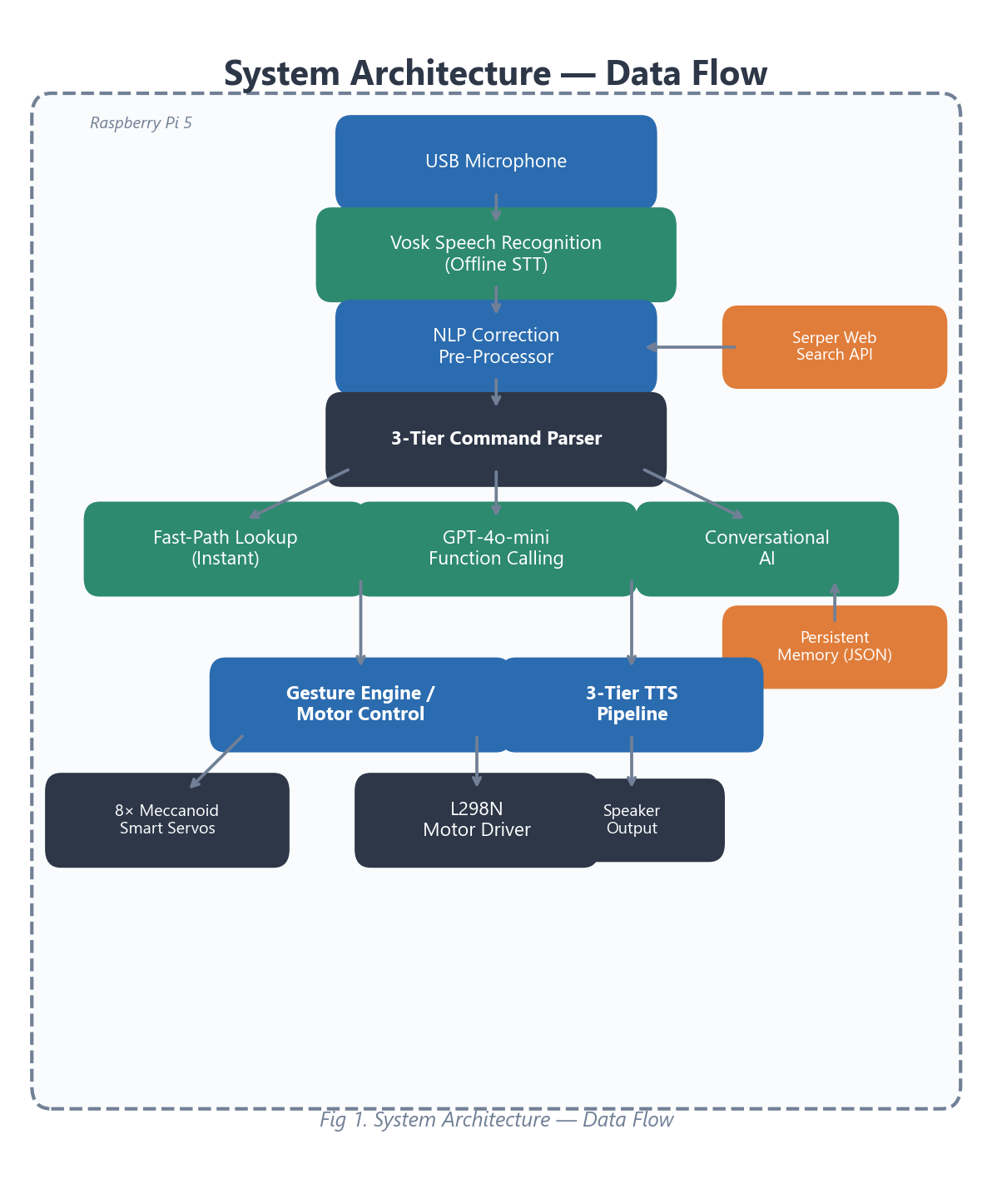
System Architecture
- Microphone to Vosk STT to NLP to Parser
- 3-tier command parsing: Fast-path, GPT function calls, Chat fallback
- Gesture engine + motor control
- 3-tier TTS pipeline to speaker
- All running concurrently on Raspberry Pi 5
6

Slide 7
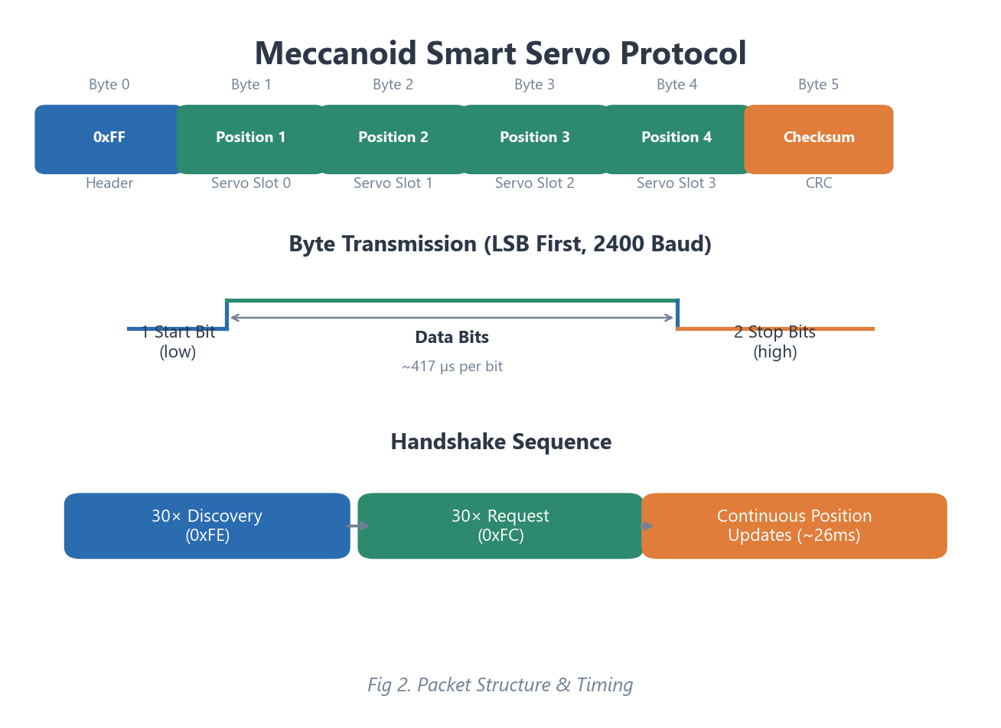
Technical Design
Custom Servo Protocol
- Proprietary 2400-baud serial (not standard PWM)
- 6-byte packets sent every ~26ms
- Bit-banged via individual GPIO pins
- 8 independent servo chains on dedicated threads
AI Conversation & Memory
- GPT-4o-mini with custom personality prompt
- Chat history maintained (last 8 messages)
- Persistent JSON memory (name, facts, events)
- Automatic web search via Serper API
7

Slide 8
Requirements
Functional
- Voice wake/sleep activation
- Multi-turn conversational AI
- Voice command execution (move + gesture)
- 15+ physical gesture library
- Real-time web search
- Persistent memory across power cycles
Non-Functional
- Response: <2s commands, <5s AI queries
- Continuous systemd service with auto-restart
- Graceful degradation on subsystem failure
- Boot-time hardware safety check
- Mid-speech interruption (<50ms)
8

Slide 9
Testing & Results
Automated Tests
- 33 test cases (test_gizmo.py)
- Mocks all hardware and API
- 33/33 passed
Hardware Diagnostics
- 4 diagnostic scripts
- 8/8 servo chains verified
- Motor wiring confirmed
Integration Tests
- Voice accuracy at 1-3 ft
- Multi-turn conversation
- Web search validation
- 4+ hour endurance run
Summary
33/33 automated tests passed | Accurate at 1-3 ft | No memory leaks after 4+ hrs | Speech interrupt <50ms
9

Slide 10
Challenges Overcome
Servo Protocol
Meccanoid uses proprietary serial, not PWM — built custom driver from scratch
GIL Timing
Python GIL corrupted servo signals — solved with ctypes clock_nanosleep
Startup Jerk
Servos snapped violently on boot — pre-loaded park angles before handshake
TTS Latency
Pre-cached thinking phrases + parallel API calls reduced delay from 6s to instant
Self-Hearing
Audio queue flush + cooldown period prevents Gizmo hearing its own voice
Thread Safety
8+ concurrent threads coordinated with Events, Locks, and Queues
10

Slide 11
Future Enhancements & Conclusion
Future Work
- Computer vision (face/object detection)
- Emotion detection (tone-based gestures)
- LED eye expressions
- Autonomous navigation with sensors
- Multi-user voice fingerprinting
- Companion mobile app
Conclusion
- Toy robot transformed into functional AI assistant
- Voice-controlled with natural conversation
- Custom servo driver built from reverse engineering
- 33/33 tests passing, 4+ hour endurance
- Commodity hardware + modern AI works
11

Slide 12
Questions?
Thank you for your time.
Logan Riley | Liriley@csustudent.net
github.com/LIRiley-prog/ai_robot
12

