Slide 1
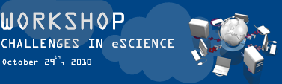


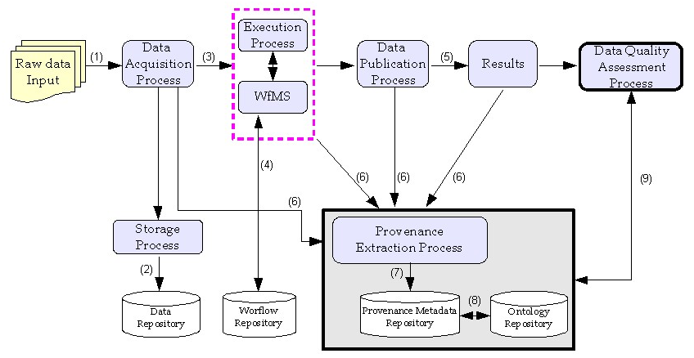
Handling Provenance in Biodiversity
Joana G. Malaverri , Claudia B. Medeiros
{jmalav09, cmbm}@ic.unicamp.br
Institute of Computing (UNICAMP)
Sociedade
Brasileira para o Progresso da Ciência
Sociedade
Brasileira para o
Progresso da
Ciência
Sociedade
Brasileira para o
Progresso da
Ciência
Architecture
Motivation
eScience research: work cooperatively among scientists
Life cycle: data acquisition, analysis and publication of results
Understand, reproduce and sharing results on a global scale
To acquire the metadata that we use to describe provenance
To define the methodologies to estimate the trustworthiness of data
Future Work
Objective
To provide means to collect and store provenance information related to the scientific_xffff_ processes performed by researchers in biodiversity studies.
To complement other studies, whose main focus is to enable the reproducibility of the data derivation processes.
CNPq (BioCORE project)
INCT in Web Science (CNPq 557.128/2009-9)
CAPES
Acknowledgments
Contributions
Handling provenance issues such as manual activities, Web information sources and processes
Assessment of the results based on data inputs and in the processes executed

