Slide 1
Existential quantification and closed vs. open worlds
Dave Dubin

Slide 2
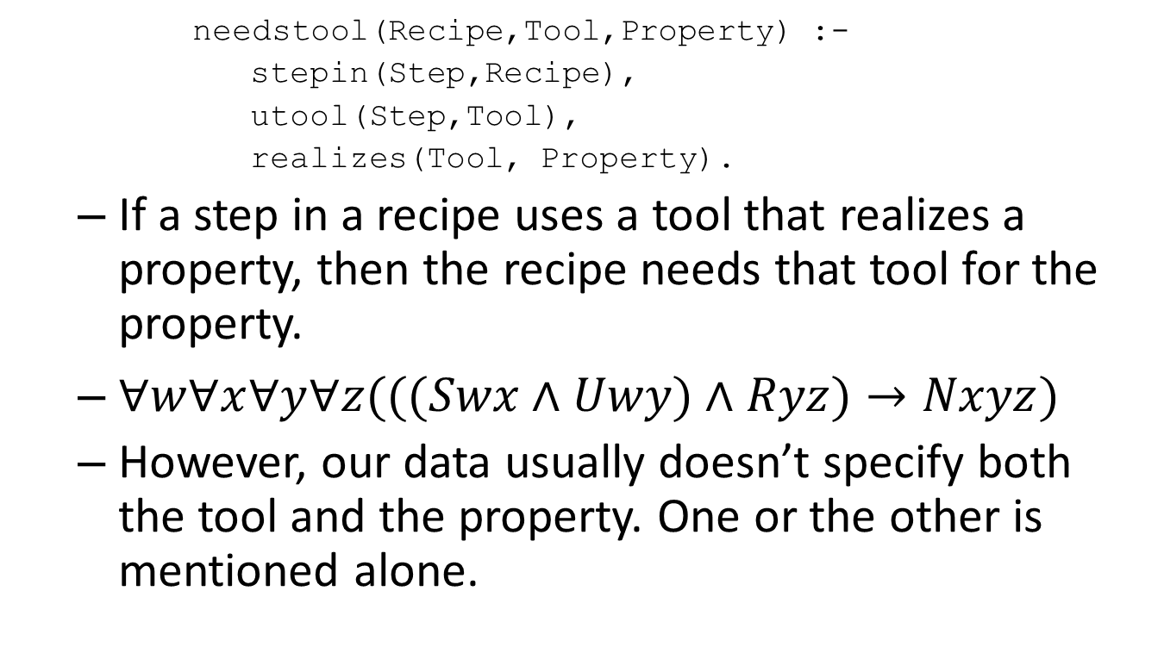
Inference rule from last week
needstool(Recipe,Tool,Property) :- stepin(Step,Recipe), utool(Step,Tool), realizes(Tool, Property).
If a step in a recipe uses a tool that realizes a property, then the recipe needs that tool for the property.
$∀w∀x∀y∀z(((Swx∧Uwy)∧Ryz)→Nxyz)$
However, our data usually doesn’t specify both the tool and the property. One or the other is mentioned alone.

Slide 3
Using existential quantification
With predicate logic we could deduce the existence of a needed tool from a property that it should realize.
$∀x∀y∀z((Rxy∧Syz)→∃wNxwz)$
This is a powerful inference, since it lets us reason about one or more individuals that aren’t specified.
But Datalog doesn’t give us full existential quantification for reasoning.

Slide 4
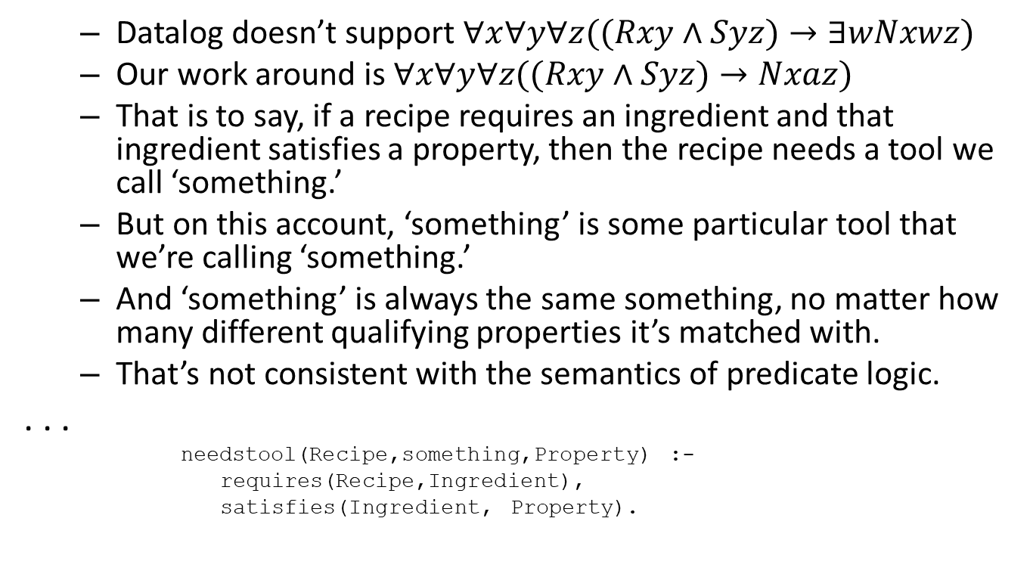
Our approximation using constants
Datalog doesn’t support $∀x∀y∀z((Rxy∧Syz)→∃wNxwz)$
Our work around is $∀x∀y∀z((Rxy∧Syz)→Nxaz)$
That is to say, if a recipe requires an ingredient and that ingredient satisfies a property, then the recipe needs a tool we call ‘something.’
But on this account, ‘something’ is some particular tool that we’re calling ‘something.’
And ‘something’ is always the same something, no matter how many different qualifying properties it’s matched with.
That’s not consistent with the semantics of predicate logic.
. . .
needstool(Recipe,something,Property) :- requires(Recipe,Ingredient), satisfies(Ingredient, Property).

Slide 5
The closed world assumption
Many deductive applications are based on a ‘closed world assumption.’
This means that if a statement is not deduced to be true, then that statement should be treated as false.
For example, our assertions do not directly state that the chicken soup recipe needs a slow cooker.
But a substep of a step included in the recipe uses a slow cooker, so the need for the tool can be deduced.
We deduce that some tool is needed for dicing, skinning, and trimming.
But we can’t deduce that we need a knife for those actions.
Under a closed world assumption we would take it as false that a knife is needed for this recipe.

Slide 6
The closed world assumption
The closed world assumption is reasonable in applications where all relevant facts and rules of inference are available.
Systems under the stewardship of one organization with limited use cases and all information stored together are good candidates for the closed world assumption.
But these days many information systems rely on loosely coupled, widely distributed data.
Systems are designed for uses across institutional boundaries.
Stakeholders cooperate on maintaining and integrating machine readable data.

Slide 7
The open world assumption
With an open world assumption, we can’t conclude that failure to deduce a proposition means that the proposition is false.
Reasoning must be based on what might be true, consistent with what we know.
Understanding how this works requires the concept of an interpretation.

Slide 8
Bach on Semantics
The structure of language can each be described using formal systems.
Language has meaning.
Meanings are things that aren’t language.

Slide 9
Language and the world
page 10 figure from Bach (1989)

Slide 10
Language and the world
page 12 figure from Bach (1989)

Slide 11
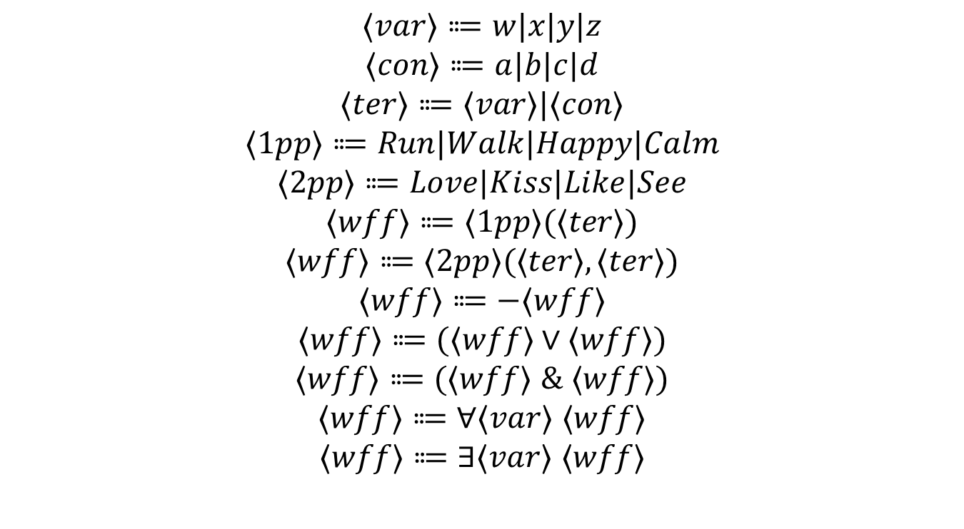
Syntax of Bach’s logic subset
$$⟨var⟩⩴w|x|y|z$$
$$⟨con⟩⩴a|b|c|d$$
$$⟨ter⟩⩴⟨var⟩|⟨con⟩$$
$$⟨1pp⟩⩴Run|Walk|Happy|Calm$$
$$⟨2pp⟩⩴Love|Kiss|Like|See$$
$$⟨wff⟩⩴⟨1pp⟩(⟨ter⟩)$$
$$⟨wff⟩⩴⟨2pp⟩(⟨ter⟩,⟨ter⟩)$$
$$⟨wff⟩⩴−⟨wff⟩$$
$$⟨wff⟩⩴(⟨wff⟩∨⟨wff⟩)$$
$$⟨wff⟩⩴(⟨wff⟩ \& ⟨wff⟩)$$
$$⟨wff⟩⩴∀⟨var⟩ ⟨wff⟩$$
$$⟨wff⟩⩴∃⟨var⟩ ⟨wff⟩$$

Slide 12
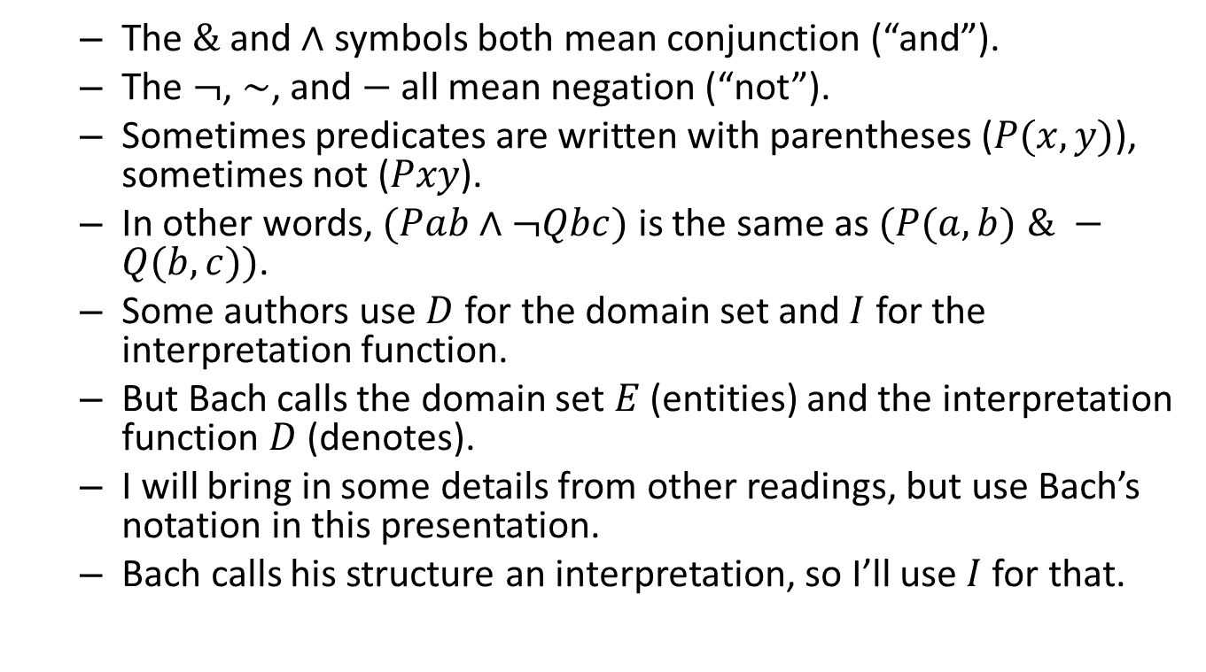
Notational differences between readings
The $\&$ and $∧$ symbols both mean conjunction (“and”).
The $¬$, $∼$, and $−$ all mean negation (“not”).
Sometimes predicates are written with parentheses ($P(x,y)$), sometimes not ($Pxy$).
In other words, $(Pab∧¬Qbc)$ is the same as $(P(a,b) \& −Q(b,c))$.
Some authors use $D$ for the domain set and $I$ for the interpretation function.
But Bach calls the domain set $E$ (entities) and the interpretation function $D$ (denotes).
I will bring in some details from other readings, but use Bach’s notation in this presentation.
Bach calls his structure an interpretation, so I’ll use $I$ for that.

Slide 13
Language and the world
Animal example

Slide 15
Language and the world
Animal example

Slide 17
Language and the world
Animal example

Slide 19
Language and the world
Animal example

Slide 21
Language and the world
Animal example

Slide 23
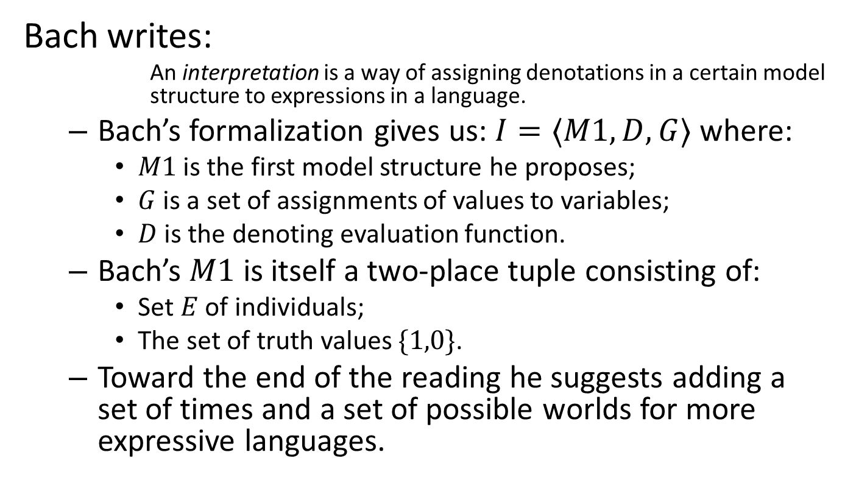
Models and interpretations
Bach writes:
An interpretation is a way of assigning denotations in a certain model structure to expressions in a language.
Bach’s formalization gives us: $I=⟨M1,D,G⟩$ where:
$M1$ is the first model structure he proposes;
$G$ is a set of assignments of values to variables;
$D$ is the denoting evaluation function.
Bach’s $M1$ is itself a two-place tuple consisting of:
Set $E$ of individuals;
The set of truth values $\{1,0\}$.
Toward the end of the reading he suggests adding a set of times and a set of possible worlds for more expressive languages.

Slide 24
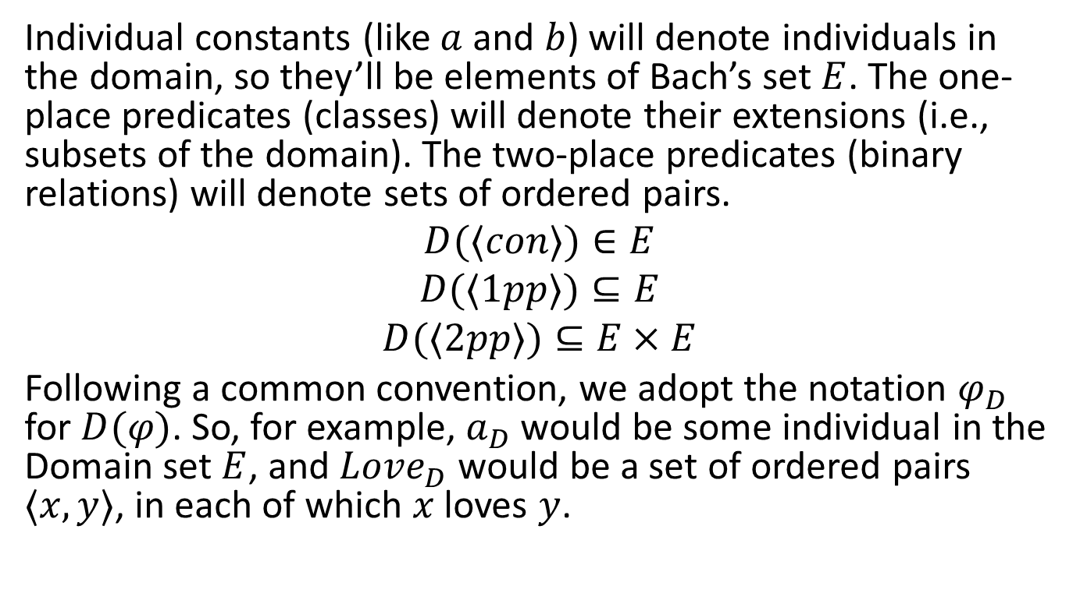
Simple denotations
Individual constants (like $a$ and $b$) will denote individuals in the domain, so they’ll be elements of Bach’s set $E$. The one-place predicates (classes) will denote their extensions (i.e., subsets of the domain). The two-place predicates (binary relations) will denote sets of ordered pairs.
$$D(⟨con⟩)∈E$$
$$D(⟨1pp⟩)⊆E$$
$$D(⟨2pp⟩)⊆E×E$$
Following a common convention, we adopt the notation $φ_{D}$ for $D(φ)$. So, for example, $a_{D}$ would be some individual in the Domain set $E$, and $Love_{D}$ would be a set of ordered pairs $⟨x,y⟩$, in each of which $x$ loves $y$.

Slide 25
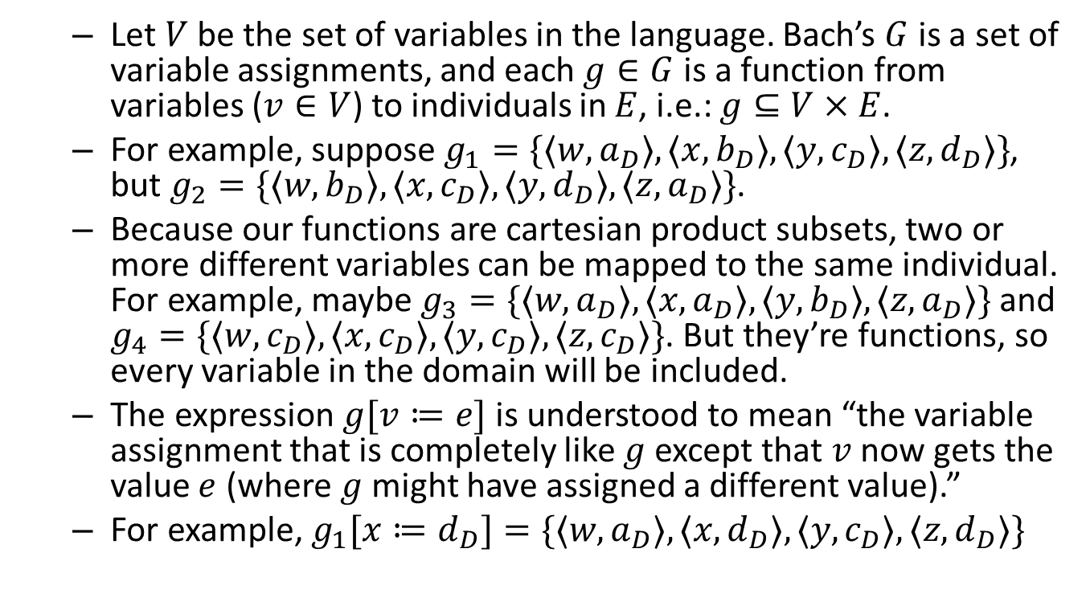
Variable assignments
Let $V$ be the set of variables in the language. Bach’s $G$ is a set of variable assignments, and each $g∈G$ is a function from variables ($v∈V$) to individuals in $E$, i.e.: $g⊆V×E$.
For example, suppose $g_{1}=\{⟨w,a_{D}⟩,⟨x,b_{D}⟩,⟨y,c_{D}⟩,⟨z,d_{D}⟩\}$, but $g_{2}=\{⟨w,b_{D}⟩,⟨x,c_{D}⟩,⟨y,d_{D}⟩,⟨z,a_{D}⟩\}$.
Because our functions are cartesian product subsets, two or more different variables can be mapped to the same individual. For example, maybe $g_{3}=\{⟨w,a_{D}⟩,⟨x,a_{D}⟩,⟨y,b_{D}⟩,⟨z,a_{D}⟩\}$ and $g_{4}=\{⟨w,c_{D}⟩,⟨x,c_{D}⟩,⟨y,c_{D}⟩,⟨z,c_{D}⟩\}$. But they’re functions, so every variable in the domain will be included.
The expression $g[v≔e]$ is understood to mean “the variable assignment that is completely like $g$ except that $v$ now gets the value $e$ (where $g$ might have assigned a different value).”
For example, $g_{1}[x≔d_{D}]=\{⟨w,a_{D}⟩,⟨x,d_{D}⟩,⟨y,c_{D}⟩,⟨z,d_{D}⟩\}$

Slide 26
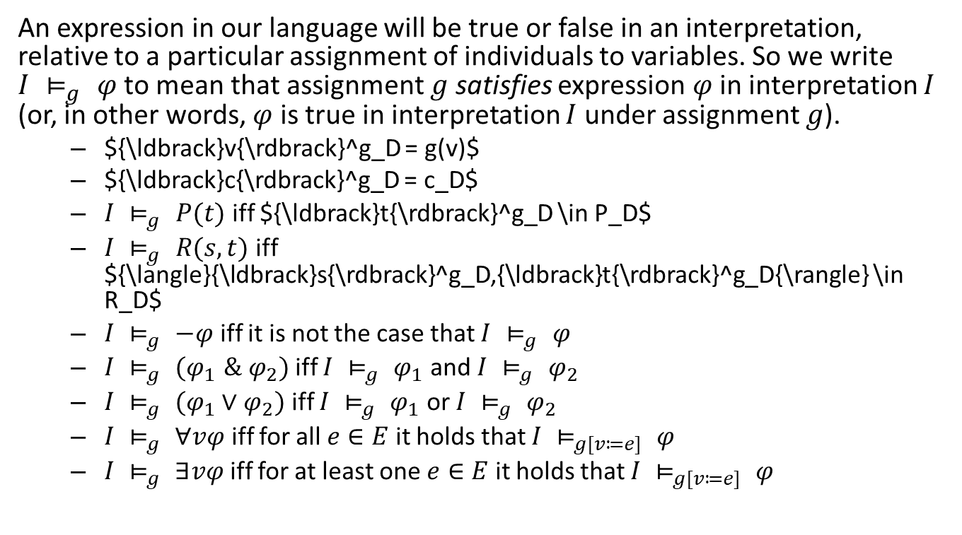
Denotation, support, and truth
An expression in our language will be true or false in an interpretation, relative to a particular assignment of individuals to variables. So we write $I ⊨_{g} φ$ to mean that assignment $g$ satisfies expression $φ$ in interpretation $I$ (or, in other words, $φ$ is true in interpretation $I$ under assignment $g$).
${\ldbrack}v{\rdbrack}^g_D = g(v)$
${\ldbrack}c{\rdbrack}^g_D = c_D$
$I ⊨_{g} P(t)$ iff ${\ldbrack}t{\rdbrack}^g_D \in P_D$
$I ⊨_{g} R(s,t)$ iff ${\langle}{\ldbrack}s{\rdbrack}^g_D,{\ldbrack}t{\rdbrack}^g_D{\rangle} \in R_D$
$I ⊨_{g} −φ$ iff it is not the case that $I ⊨_{g} φ$
$I ⊨_{g} (φ_{1} \& φ_{2})$ iff $I ⊨_{g} φ_{1}$ and $I ⊨_{g} φ_{2}$
$I ⊨_{g} (φ_{1}∨φ_{2})$ iff $I ⊨_{g} φ_{1}$ or $I ⊨_{g} φ_{2}$
$I ⊨_{g} ∀vφ$ iff for all $e∈E$ it holds that $I ⊨_{g[v≔e]} φ$
$I ⊨_{g} ∃vφ$ iff for at least one $e∈E$ it holds that $I ⊨_{g[v≔e]} φ$

