Slide 1
Arjun Ray
Facility for Rare Isotope Beams, Michigan State University, East Lansing, MI 48824 USA
2025

Slide 2
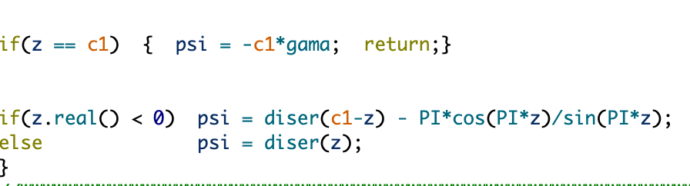
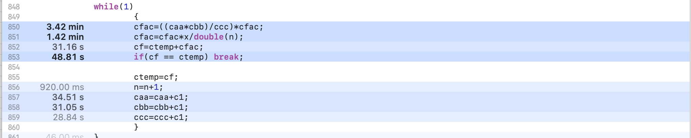
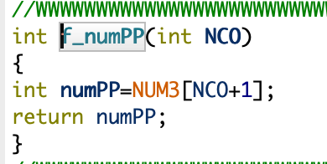
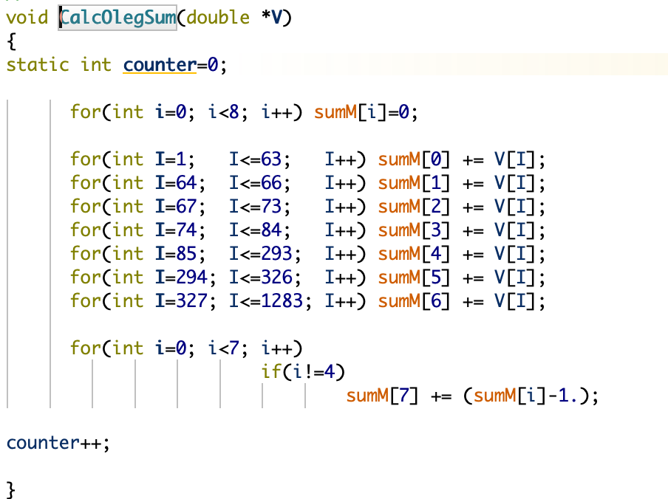
BOTTLENECK POINTS AND POSSIBLE OPTIMIZATIONS METHODS
SOME BOTTLENECK POINTS:
Function chypser in e_Tceis
Function digam in e_Tceis
BOTTLENECK POINTS AFTER PRESSING THE “CONTINUE” BUTTON
POSSIBLE SOLUTIONS:
-First step will be to optimize numerical calculations by reducing redundant calculations(reducing iterations and more efficient methods of calculation, using temporary variables)
-Parallelize the computation of loops in heavy functions.
-Approximations for Large Iterations
In e_F4
In e_ETACHA

Slide 3
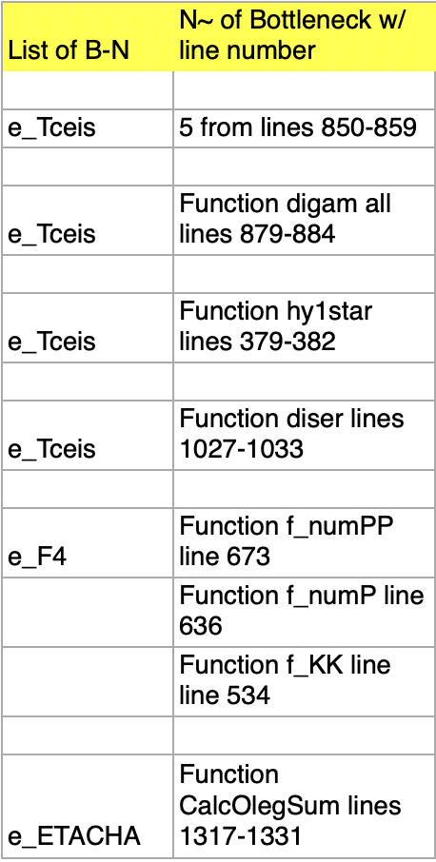
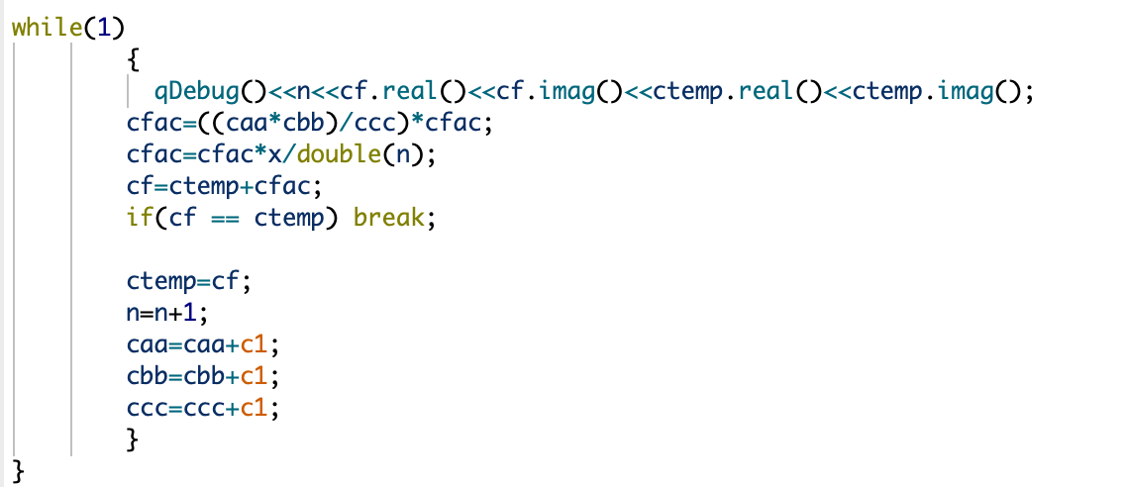
Bottleneck Solutions
METHODS THAT WE WILL USE TO OPTIMIZE-
-Precompute (caa * cbb / ccc) to avoid redundant calculations.
-Use abs(cf - ctemp) < EPSILON instead of direct equality for convergence.
-Parallelize with #pragma omp parallel for faster execution.

Slide 4

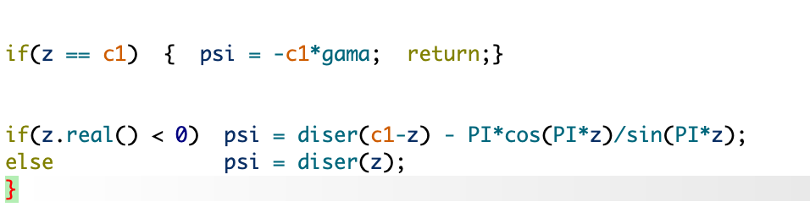
#2
METHODS THAT WE WILL USE TO OPTIMIZE-
-Using asymptotic approximations for larger values of z
-Use constexpr for Constants

