Slide 1
Arjun Ray
Gear’s Backward Differentiation
Facility for Rare Isotope Beams, Michigan State University, East Lansing, MI 48824 USA
2025

Slide 2
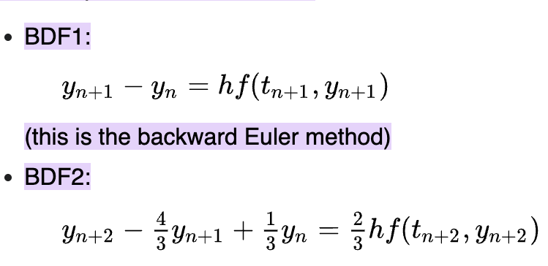
Gear’s BDF
Backwards Differentiation is an implicit numerical method for solving stiff ODE’s, where the derivative at the next time step is used, instead of the current one(future value to calculate current step).
It provides improved stability over explicit methods, especially for rapidly changing or stiff systems
-The two on the left(orders 1 and 2) are best for solving the stiffness problem in our integrator in ETACHA4.

Slide 3
Code Implementation
Ideally, the implementation in code would look something like this-
Blend the most recent solutions to make an initial guess for the next step.
Iteratively refine that guess by checking it against your ODE model until the change is tiny.
Save the new result, confirm it meets your accuracy needs, tweak the step size, and repeat.
SUNDIALS(https://computing.llnl.gov/projects/sundials/cvode) already has a pre-existing library with an industry grade BDF solver.
Furthermore, python also has an inbuilt BDF solver in the scipy library.

