Slide 1
Arjun Ray
Facility for Rare Isotope Beams, Michigan State University, East Lansing, MI 48824 USA
2025

Slide 2
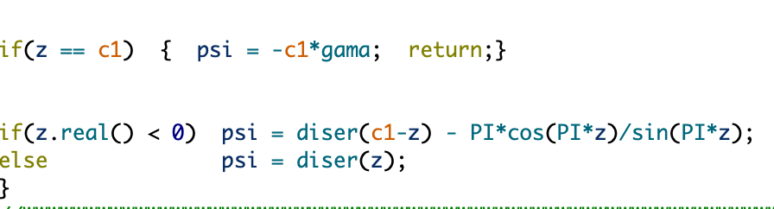
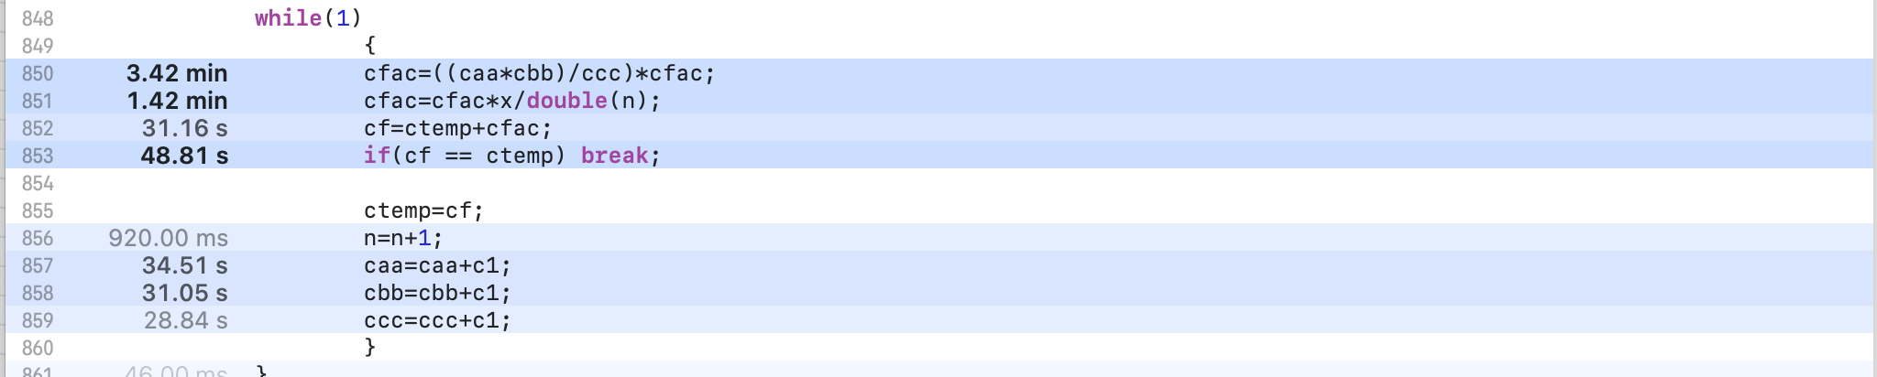
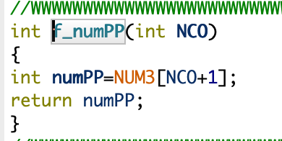
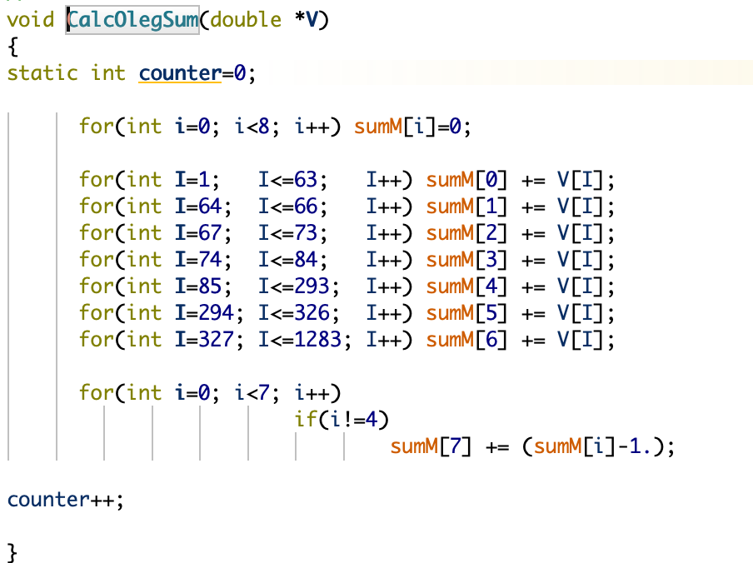
BOTTLENECK POINTS AND POSSIBLE OPTIMIZATIONS METHODS
SOME BOTTLENECK POINTS:
Function chypser in e_Tceis
Function digam in e_Tceis
BOTTLENECK POINTS AFTER PRESSING THE “CONTINUE” BUTTON
POSSIBLE SOLUTIONS:
-First step will be to optimize numerical calculations by reducing redundant calculations(reducing iterations and more efficient methods of calculation, using temporary variables)
-Parallelize the computation of loops in heavy functions.
-Approximations for Large Iterations
In e_F4
In e_ETACHA

Slide 3
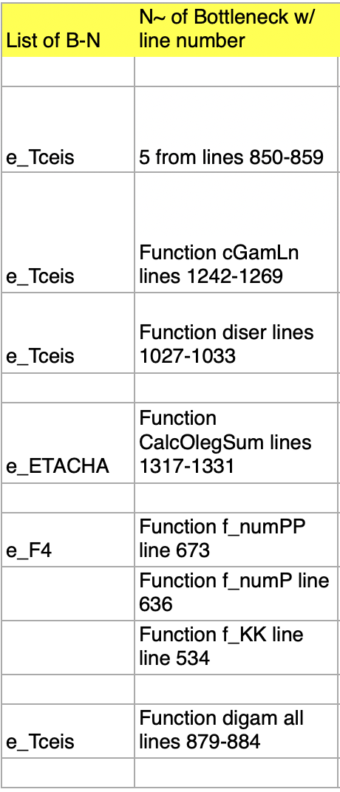
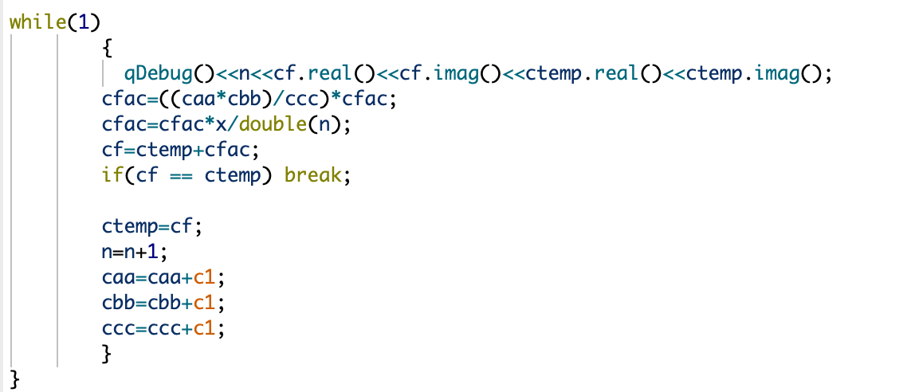
Bottleneck Solutions #1
METHODS THAT WE WILL USE TO OPTIMIZE-
-Precompute (caa * cbb / ccc) to avoid redundant calculations.
-Use abs(cf - ctemp) < EPSILON instead of direct equality for convergence.
-Parallelize with #pragma omp parallel for faster execution.

Slide 4
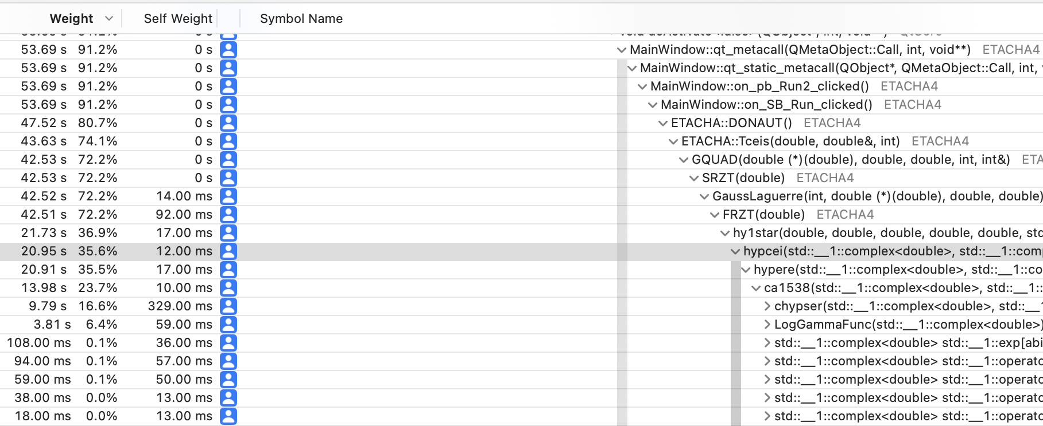
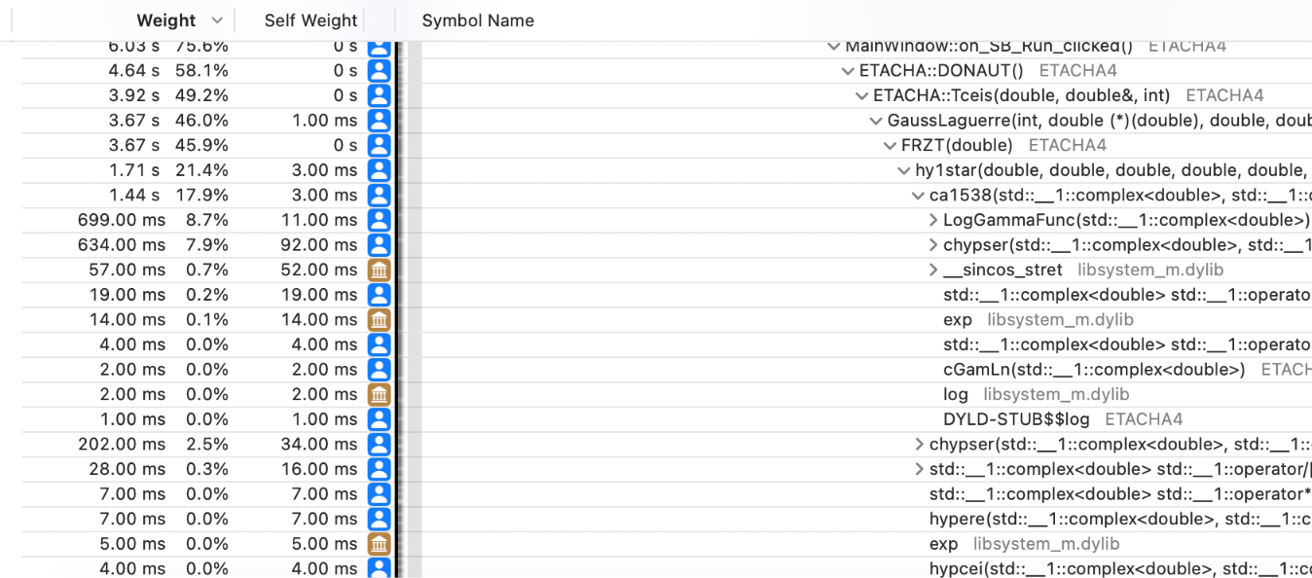
Result #1
-Made three key improvements to make the function run faster and more reliably:
Instead of doing the same calculation over and over, it now computes it once and reuses it.
Instead of looking for an exact match, it checks if the difference is small enough to safely stop.
Organized the loop better so the function doesn’t waste effort.
-Results of optimisation
Overall function runtime cut by almost 60%
No longer the heaviest function in e_Tceis

Slide 5
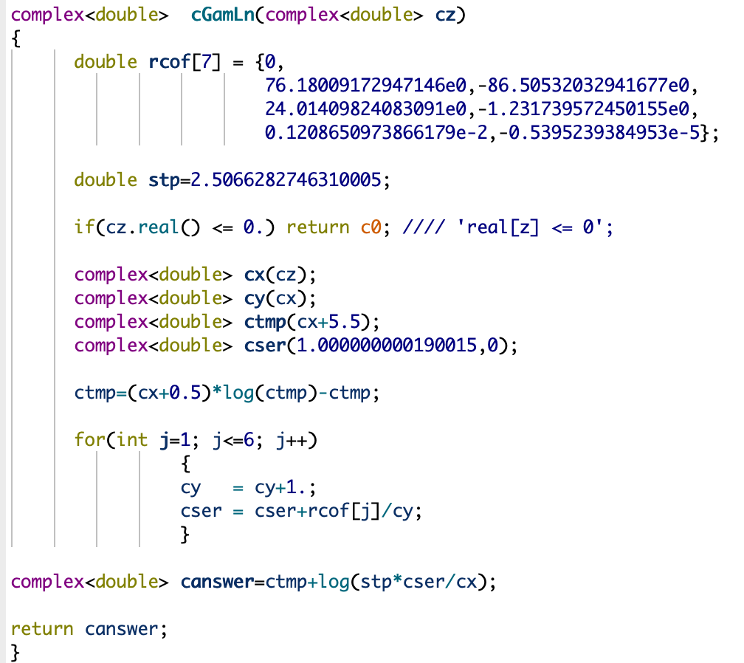
#2
METHODS THAT WE WILL USE TO OPTIMIZE-
-Use of constexpr for Constants
-Avoided unnecessary pre computations in loop
-Use fewer temporary variables in return statement

Slide 6
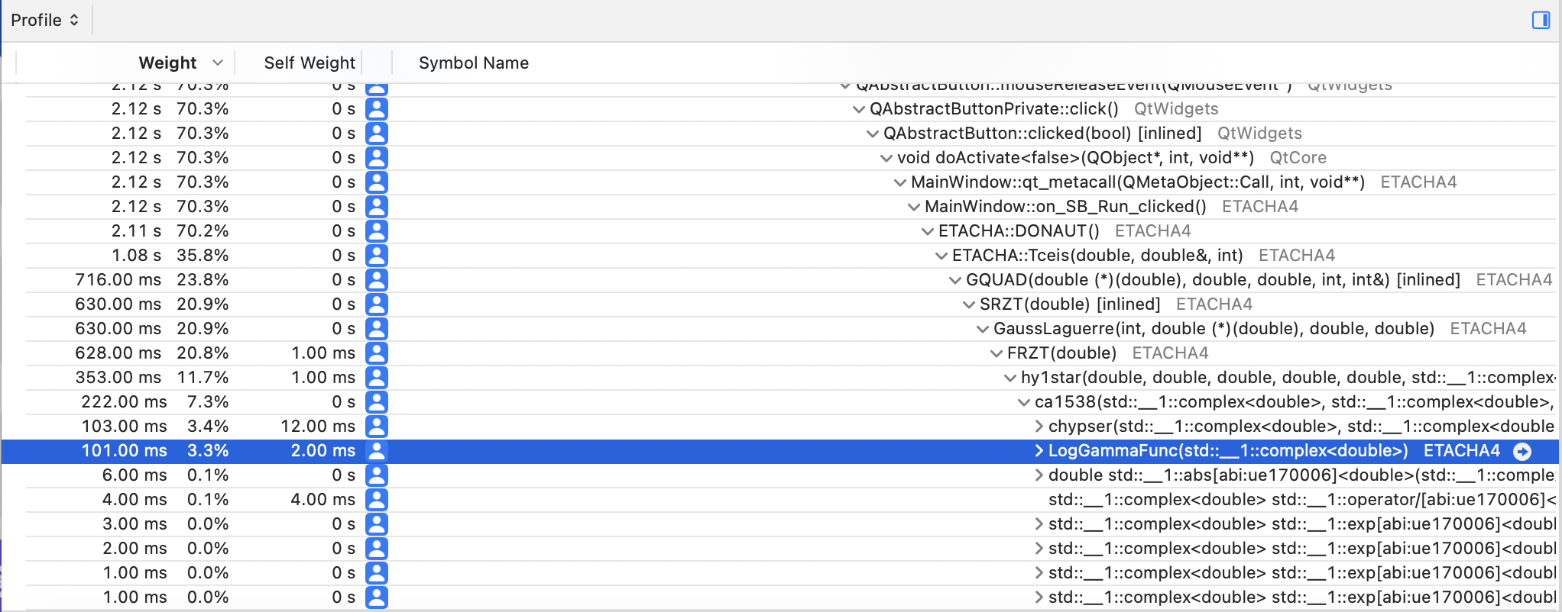
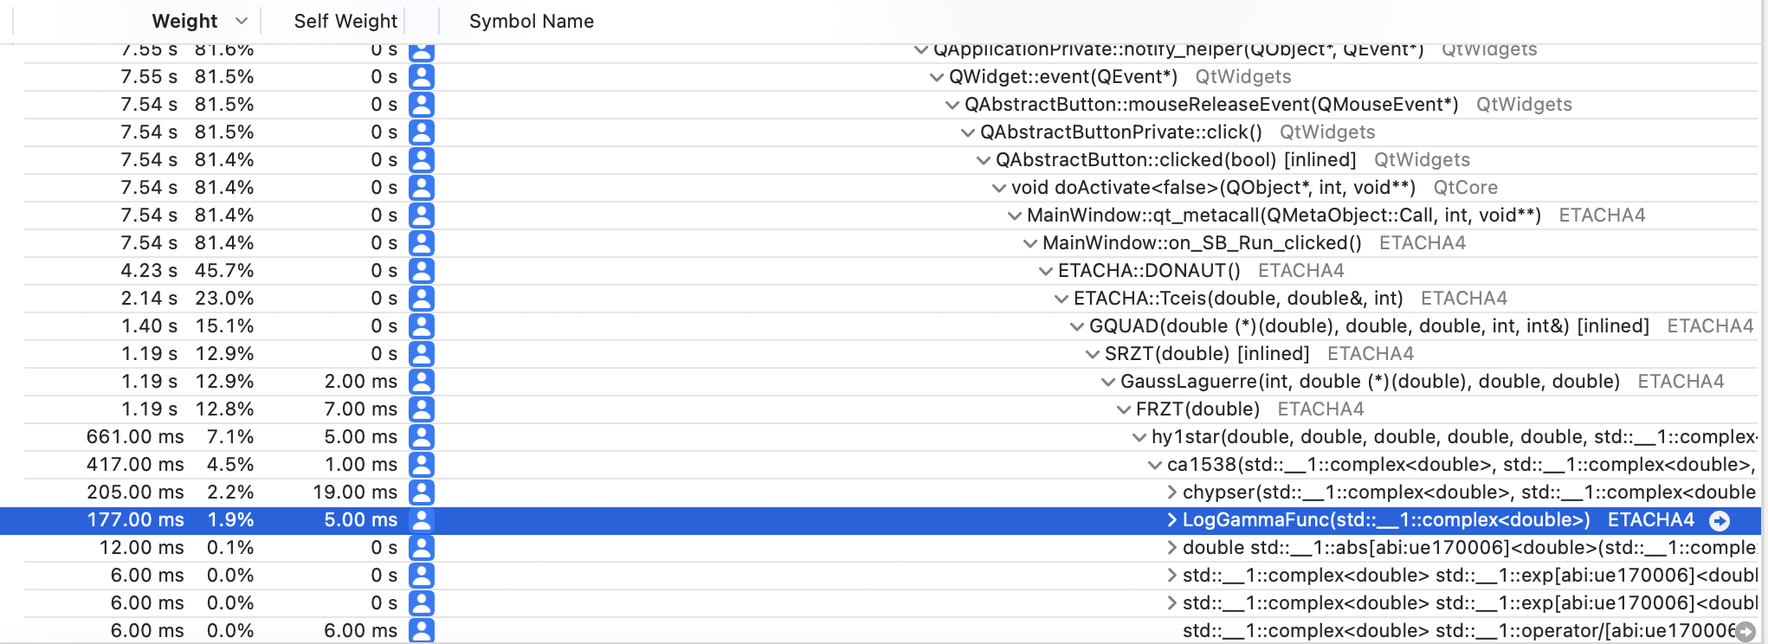
Result #2
-Made three key improvements to make the function run faster and more reliably:
Use of constexpr for Constants
Avoided unnecessary pre computations in loop
Use fewer temporary variables in return statement
-Results of optimisation
Overall function runtime cut by more than 50%

Slide 7
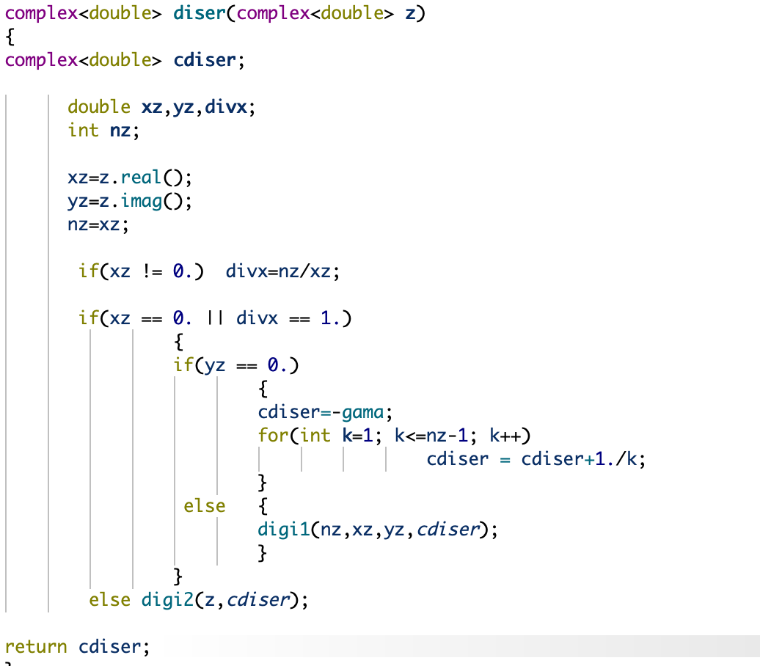
#3
METHODS THAT WE WILL USE TO OPTIMIZE-
-Asymptotic Expansion for Large nz
-Declare xz, yz, and nz as const
-Simplified Conditional Structure

Slide 8
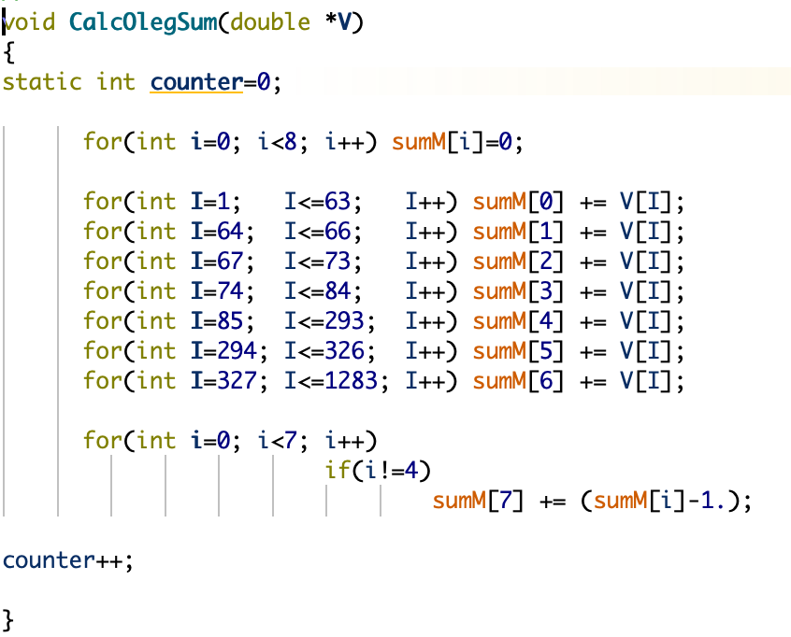
#4
METHODS THAT WE WILL USE TO OPTIMIZE-
-Reduced Loop Overhead: Instead of looping separately for each sum range, a single loop iterates through V, categorizing values in one pass.
-The categorization is handled via if-else blocks
-Using constexpr for range values

Slide 9
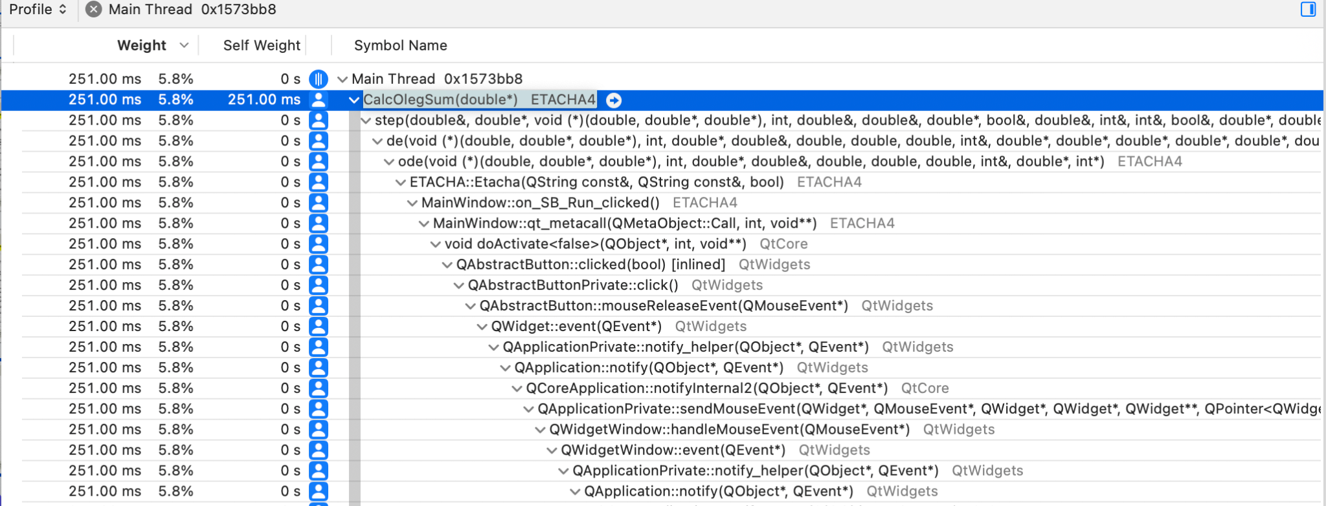
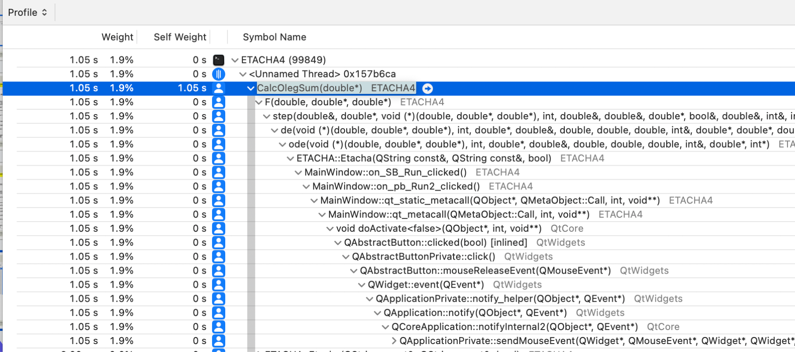
Results #4
Made three key improvements to make the function run faster and more reliably:
Instead of looping separately for each sum range, a single loop iterates through V, categorizing values in one pass.
The categorization is handled via if-else blocks
-Results of optimisation
Overall function runtime cut by more than 65%

Slide 10
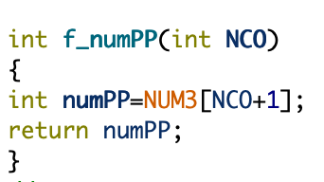
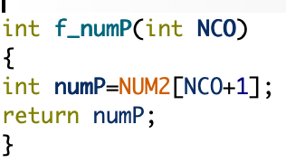
#5 and #6 and Results
-Results of optimisation
Removed the unnecessary numPP and numP variable, returned directly
(f_numPP)-The function runtime has decreased by approximately 29%
(f_numP)-Function runtime has negligible runtime compared to program runtime(Almost 95% decrease).

