Slide 1

Codex
A practical intro for IsomerAPI
Offline reading deck: Windows app, CLI, Git workflow, and safe first tasks for a Qt/C++ project
For plane reading - no internet required once downloaded

Slide 2
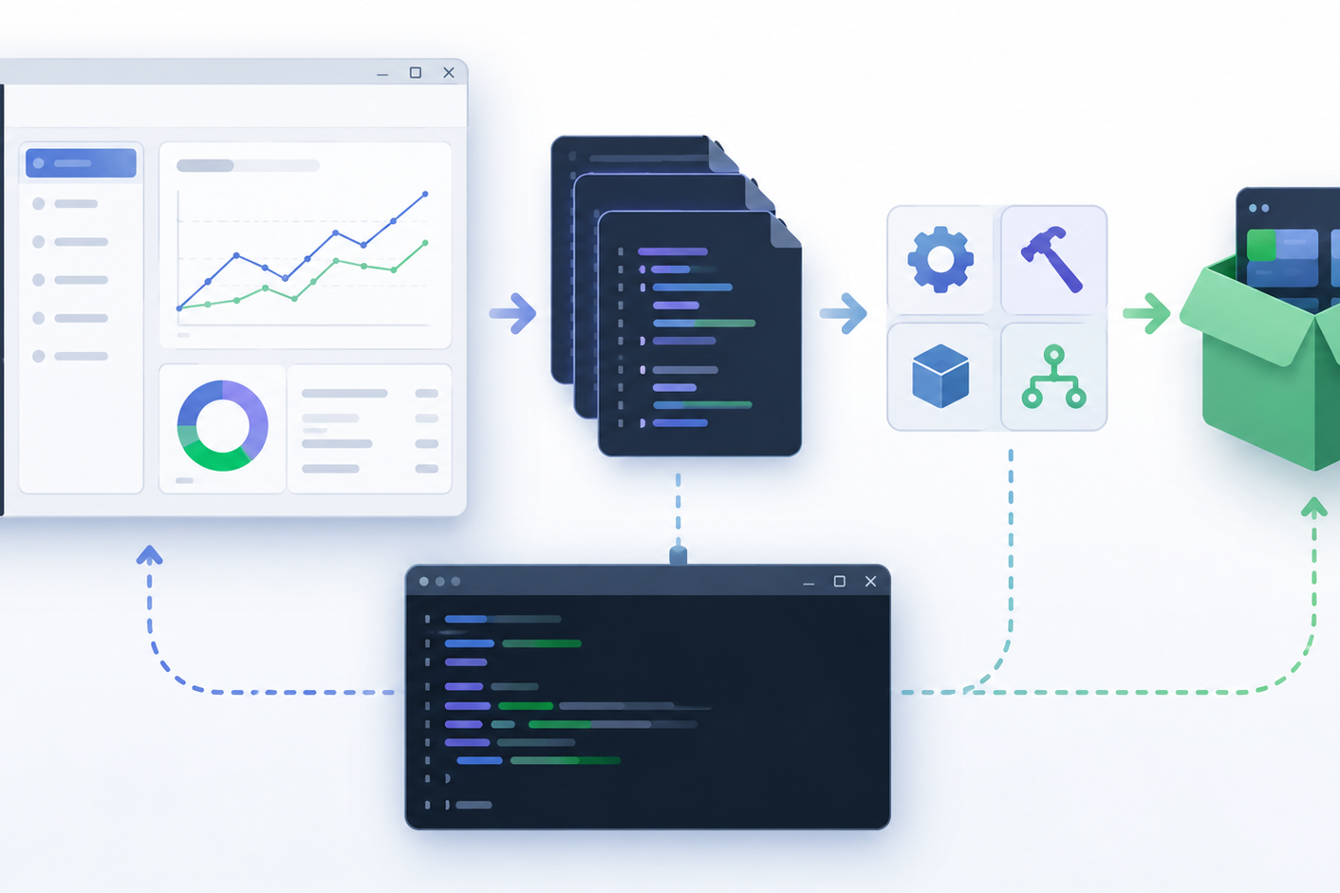
What Codex is
A coding agent that can inspect a repository, edit files, run commands, and prepare changes for review.
Think of Codex as a careful junior developer working inside your repo
It is strongest when the task is narrow: cleanup, build notes, small bug fixes, tests, or refactoring
It should not silently redesign physics logic, database schema, or LISE++ integration without your review
Best mental model
You set constraints. Codex proposes a diff. You compile and approve.
Codex intro for IsomerAPI | 1

Slide 3
Which Codex interface to use
For IsomerAPI on Windows 10, start with the desktop app; keep Qt Creator as the build authority.
Codex app
Codex CLI
IDE extension
Best first choice on Windows: open the repo, run parallel threads, review diffs, use Git/worktrees.
Terminal workflow from Git Bash or PowerShell. Good for repo inspection and command-line checks.
Useful later in VS Code/Cursor/Windsurf. Less central if Qt Creator stays your main IDE.
Use Codex to edit and prepare branches
Use Qt Creator/MSVC/MinGW to compile the real application
Use GitHub PRs for review before merging
Codex intro for IsomerAPI | 2

Slide 4
First setup on Windows
A small checklist before letting Codex touch the repository.
Install/open the Codex Windows app and sign in
Open C:\IsomerAPI or a fresh clone of LISEcute/IsomerAPI
Make sure Git works: git status, git branch, git remote -v
Build once manually in Qt Creator to establish the baseline
Ask Codex to inspect only - no edits - for the first run
First prompt:
Inspect this Qt/C++ repository. Do not change files. Tell me the repo structure, build assumptions, accidental committed files, and safest first cleanup tasks.
Rule zero
Before accepting changes: review diff, compile in Qt Creator, then commit/push.
Codex intro for IsomerAPI | 3

Slide 5
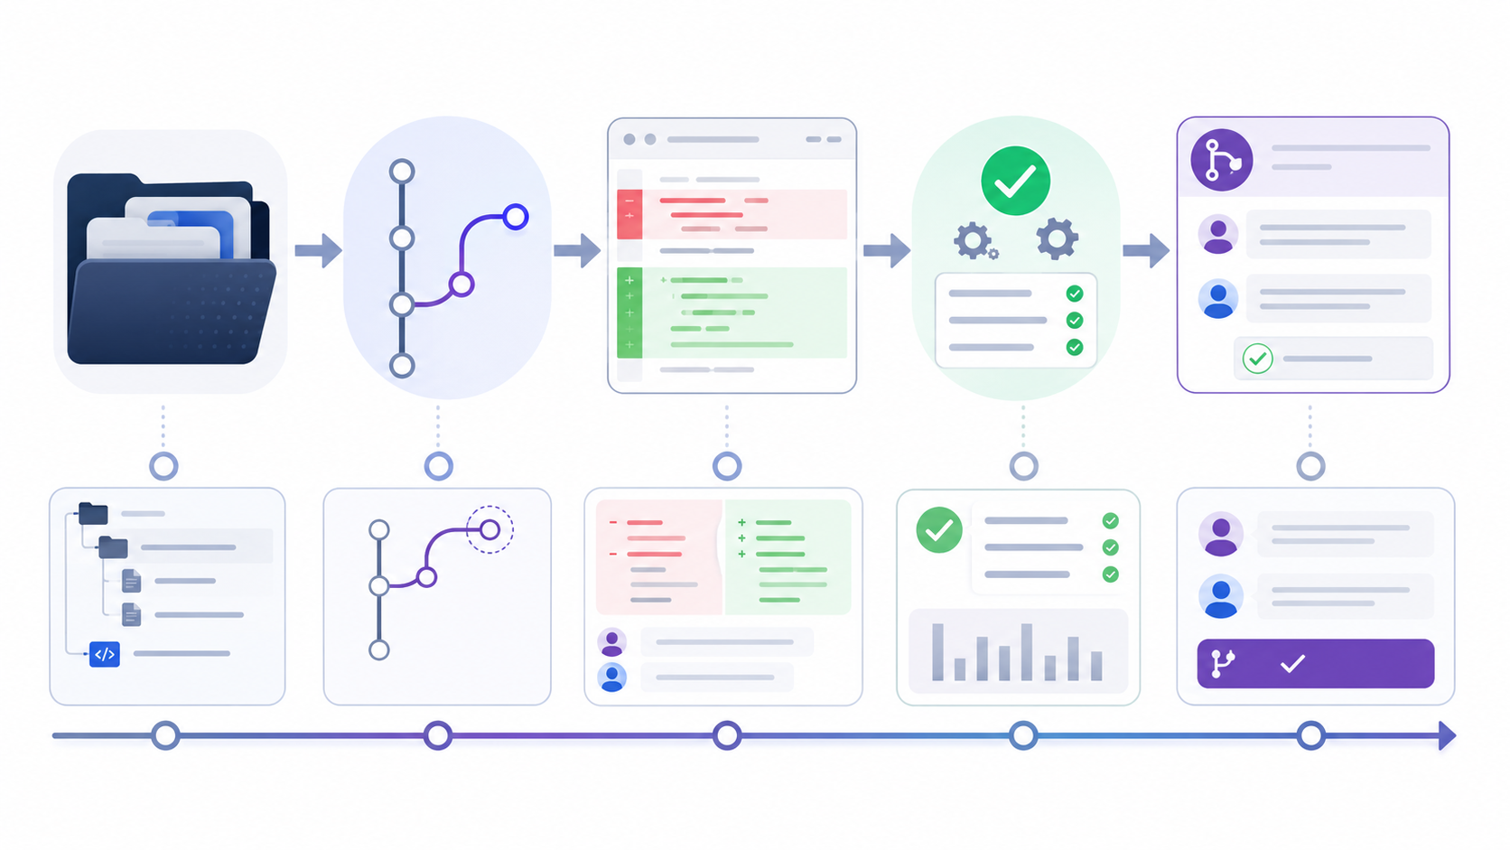
Safe Git workflow
Small branch, small diff, easy rollback. This is how to avoid a “helpful disaster.”
Start from a clean working tree: git status should be boring
Create a branch: git switch -c cleanup/codex-first-pass
Let Codex make a narrow diff only
Review every file, especially .pro, .cpp, database files, and paths
Compile manually; only then merge or create a PR
Never skip
The diff is the contract. If the diff is too big, stop and split the task.
Codex intro for IsomerAPI | 4

Slide 6
Good first Codex task for IsomerAPI
Start with repository hygiene, not physics or GUI logic.
Prompt to Codex:
This is a Qt/C++ project named IsomerAPI intended to be integrated with LISE++.
Prepare a small cleanup branch that only:
1. removes README.md merge-conflict markers,
2. removes IsomerAPI.pro.user from version control,
3. checks .gitignore for Qt Creator / MinGW / MSVC files,
4. adds a short BUILD.md for Qt Creator 16+, Qt 6.7.3, MinGW/MSVC.
Do not modify source-code logic. Show me the diff before committing.
Why this is ideal
It tests Codex on Git, text edits, project structure, and build documentation without risking application behavior.
Expected files
README.md, .gitignore, BUILD.md, and Git tracking change for IsomerAPI.pro.user.
Your verification
Open Qt Creator and build both MinGW and MSVC versions if possible.
Codex intro for IsomerAPI | 5

Slide 7
AGENTS.md: give Codex project rules
Codex reads project instructions before working. Use this to preserve your workflow.
Describe the project: Qt/C++ GUI for isomer levels and gamma lines
List build systems: Qt Creator 16+, Qt 6.7.3, MinGW and MSVC kits
State “do not modify physics/database logic unless explicitly requested”
Document verification: build in Qt Creator, inspect diffs, avoid user files
Minimal AGENTS.md:
# IsomerAPI instructions
- Qt/C++ GUI project for LISE++ integration.
- Do not change physics logic, database schema, or file formats unless explicitly requested.
- Prefer small, reviewable commits.
- Never commit *.pro.user, build folders, .pdb, .bak, or local cert files.
- Verify by building in Qt Creator with Qt 6.7.3 MinGW/MSVC.
Value
This turns repeated warnings into persistent repo-level instructions.
Codex intro for IsomerAPI | 6

Slide 8
Qt/C++ build information Codex needs
Codex is not Qt Creator. Give it the map so it does not guess.
Project file
Build outputs
Deployment
IsomerAPI.pro - qmake project configuration, sources, headers, resources, install paths.
_install for MinGW, _install_MSVC for MSVC, plus any local build-* directories.
windeployqt.bat scripts copy Qt runtime DLLs into the install folder.
Tell Codex which kit is active before asking for compile fixes
Paste build errors from Qt Creator exactly; do not paraphrase them too much
Ask for minimal changes and require explanation of each changed file
Codex intro for IsomerAPI | 7

Slide 9
Tasks where Codex should help immediately
These are low-risk and high-payoff for the repository.
Clean README, BUILD.md, release notes, and comments
Improve .gitignore for Qt Creator and Windows artifacts
Find accidental binaries or user settings in Git
Create deployment scripts for MinGW/MSVC
Summarize code structure and dependencies
Write small helper functions or refactor duplicate UI code after review
Good prompt phrase
“Make the smallest safe change that solves this, and show the diff.”
Codex intro for IsomerAPI | 8

Slide 10
Tasks to avoid at the beginning
Codex is powerful, but “large smart rewrite” is where trouble starts.
Do not ask it to redesign the isomer/gamma database model yet
Do not ask it to integrate deeply into LISE++ without a written design first
Do not accept large automatic rewrites of working Qt widgets
Do not let it change file formats, paths, or physics assumptions silently
Do not merge changes that were not compiled and tested locally
My recommended boundary
ChatGPT for design discussion; Codex for implementation of a narrow approved change.
If Codex proposes too much
Say: “Stop. Split this into three smaller PRs and start with documentation only.”
Codex intro for IsomerAPI | 9

Slide 11
Review checklist before accepting a Codex diff
Fast is good. Fast plus review is better.
Does git diff show only the files you asked to change?
Did Codex remove local/user files rather than add more?
Did it preserve comments, paths, encodings, and Qt project settings?
Does the application build in the intended Qt kit?
Did windeployqt still package the executable correctly?
Can you explain every change in one sentence?
Useful command set:
git status
git diff --stat
git diff
git check-ignore -v IsomerAPI.pro.user
Then build in Qt Creator.
Merge criterion
The code builds, the diff is small, and the purpose is clear.
Codex intro for IsomerAPI | 10

Slide 12
Prompt cards for the plane
Copy these later when you are back online.
Inspect only:
Tell me how this Qt/C++ project is organized. Do not modify files. Identify likely build scripts, generated files, and risky tracked artifacts.
Build error:
Here is the exact Qt Creator build error. Explain the likely cause and propose the smallest change. Do not edit until I approve.
Small cleanup:
Create a branch and update documentation only. Do not touch source-code logic. Show the diff before committing.
Code review:
Review this diff for accidental behavior changes, Windows path problems, Qt resource issues, and files that should not be committed.
Style that works
Clear scope + “do not modify X” + “show diff” + “smallest safe change.”
Codex intro for IsomerAPI | 11

Slide 13
Recommended first week workflow
Use Codex repeatedly, but keep each pass boring and reversible.
Day 1: inspect repo, clean README, remove .pro.user, add BUILD.md
Day 2: add AGENTS.md and verify MinGW/MSVC deployment scripts
Day 3: ask Codex to summarize major classes and dependencies
Day 4: pick one small UI or build warning cleanup
Day 5: review whether Codex is reliable enough for larger tasks
For IsomerAPI
Start with housekeeping. Then use Codex for targeted implementation after we define the design here.
For LISE++ integration
Write the interface contract first. Then ask Codex to implement only that contract.
Codex intro for IsomerAPI | 12

Slide 14
Sources and offline note
This deck is a compact plane-reading version of the official OpenAI Codex docs.
Codex overview: openai.com/codex
Codex app docs: developers.openai.com/codex/app
Windows app docs: developers.openai.com/codex/app/windows
Quickstart: developers.openai.com/codex/quickstart
CLI docs: developers.openai.com/codex/cli
AGENTS.md: developers.openai.com/codex/guides/agents-md
Best practices: developers.openai.com/codex/learn/best-practices
Plane reading tip
Use the PDF for reading. Use the PPTX later if you want to edit the deck for students or collaborators.
Codex intro for IsomerAPI | 13

