Slide 1
Egotropic, sociotropic and communitarian appeals on support for housing developments
Simon Kiss
Anthony Piscitelli
October 6, 2022

Slide 2
Motivation
Lack of housing is being partly driven by NIMBY groups’ fears, which are often driven by racism and beliefs about declines in property values associated with development (Wassmer & Wahid, 2019; Tighe & Goetz, 2019; McNee & Pojani; 2021).
Fears associating well designed new builds with drops in property values are largely unfounded (Nguyen, 2005)

Slide 3
Impact
One dollar invested in residential building adds $1.52 to GDP and every million invested generates 8.49 full time equivalent jobs (Zon, Molson, & Oschinski, 2014).
When low-income families are integrating into mixed-income neighbourhoods their quality of life improves and their children have better long-term outcomes (Joseph, Chaskin, & Webber, 2007).

Slide 4
Experiment Goal
Identify messaging that works to address the underlying attitudes that contribute to NIMBYism
Provide language for hopeful future testing in campaigns designed to address NIMBYism
Explore the possibility of a social norms approach to prevent NIMBYism (see Fabiano et al. 20003)
Notes:
Fabiano social norms involved engaging male allies in preventing sexual violence

Slide 5
Experiment Goal
Identify the potential for messaging to persuade those opposed to social housing
Explore the possibility of a social norms approach to prevent NIMBYism (see Fabiano et al. 20003)
Notes:
Fabiano social norms involved engaging male allies in preventing sexual violence

Slide 6
Experiment Design
Tested three different messages to appeal to three different types of rationality
Egotropic self-interest (“This is good for you…”
Socio-tropic self-interest (”This is good for your community…”
Value Rationality (”This is the right thing to do”)
Notes:
Fabiano social norms involved engaging male allies in preventing sexual violence

Slide 7
Experiment Design
Respondents were randomly assigned to one of four groups (three messages plus a control)
The population of Ontario is expected to increase by at least 2.1% over the coming year. Continued population growth over the next decade is expected to put pressure on infrastructure, housing and amenities. As a result, Ontario will be faced with choices on how to accommodate this continued population growth.
CONTROL
Increasing residential housing density offers a number of benefits to citizens. Ongoing research is working towards identifying how to best achieve these benefits to accommodate the increased population growth in Ontario.
Notes:
Fabiano social norms involved engaging male allies in preventing sexual violence

Slide 8
Experiment Design
Respondents were randomly assigned to one of four groups (three messages plus a control)
The population of Ontario is expected to increase by at least 2.1% over the coming year. Continued population growth over the next decade is expected to put pressure on infrastructure, housing and amenities. As a result, Ontario will be faced with choices on how to accommodate this continued population growth.
SOCIOTROPIC RATIONALITY
Increasing residential housing density offers a number of public benefits to citizens, including an increase in amenities for your neighbourhood. There may be additional choices and flexibility for transportation options, including the growth of comprehensive and reliable public transportation.
Notes:
Fabiano social norms involved engaging male allies in preventing sexual violence

Slide 9
Experiment Design
Respondents were randomly assigned to one of four groups (three messages plus a control)
The population of Ontario is expected to increase by at least 2.1% over the coming year. Continued population growth over the next decade is expected to put pressure on infrastructure, housing and amenities. As a result, Ontario will be faced with choices on how to accommodate this continued population growth.
EGOTROPIC RATIONALITY
Increasing residential housing density offers a number of personal benefits to citizens, including stabilizing property tax rates. Real estate development may also increase the value of your home, allowing you to access additional equity.
Notes:
Fabiano social norms involved engaging male allies in preventing sexual violence

Slide 10
Experiment Design
Respondents were randomly assigned to one of four groups (three messages plus a control)
The population of Ontario is expected to increase by at least 2.1% over the coming year. Continued population growth over the next decade is expected to put pressure on infrastructure, housing and amenities. As a result, Ontario will be faced with choices on how to accommodate this continued population growth.
VALUE RATIONALITY
Increasing residential housing density offers a number of societal benefits, including increasing availability of housing for low-income families. Affordable housing is an investment in current and future generations of Canadians.
Notes:
Fabiano social norms involved engaging male allies in preventing sexual violence

Slide 11
Experiment Design
Respondents were asked to rate six types of development
6 Storey Condominium Tower
6 Storey Rental Tower
15 Storey Condominium Tower
15 Storey Rental Building
Semi-Detached House
Single-Detached House
Notes:
This allows us to test the impact of structural features of a development (e.g. its presumed class target and its physical appearance) in addition to any effects of persuasive appeals)

Slide 12
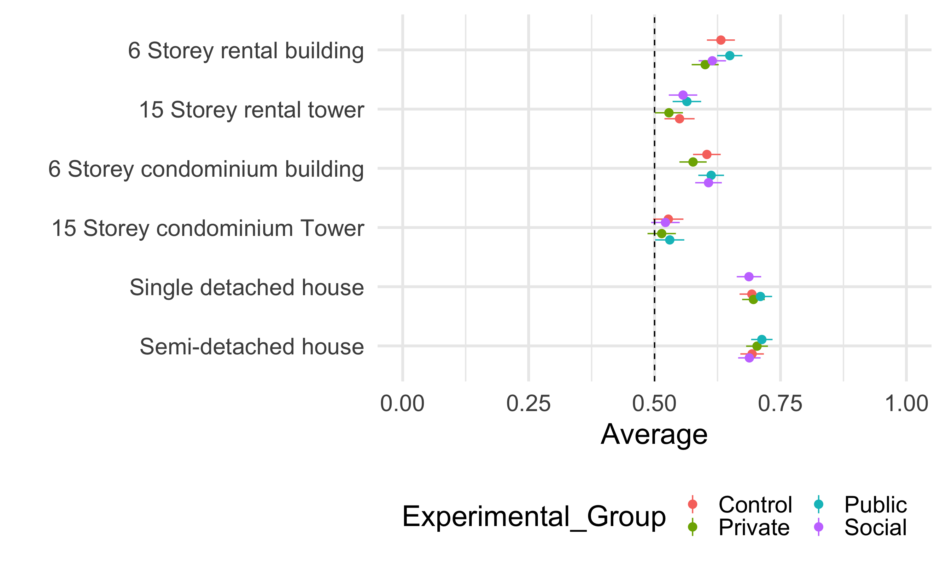
Results
Notes:
Almost no effects of messaging at all; significant effects of structural features. Respodnents much more likely to support single-family and semi-detached homes, then moderate sized buildings followed by towers. Class basis didn’t really have a significant impact.

Slide 13
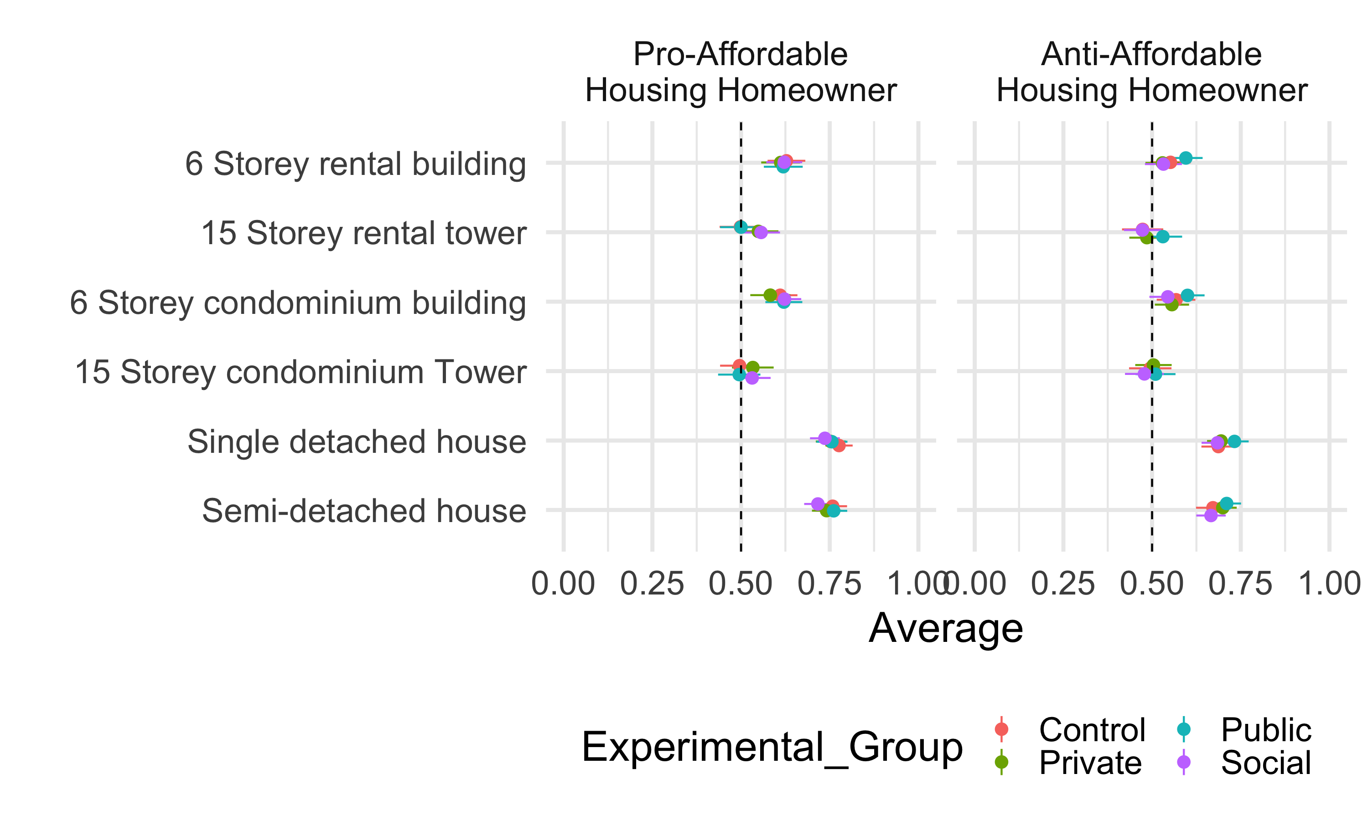
Results
Notes:
Almost no effects of messaging at all; significant effects of structural features. Respodnents much more likely to support single-family and semi-detached homes, then moderate sized buildings followed by towers. Class basis didn’t really have a significant impact.

Slide 14
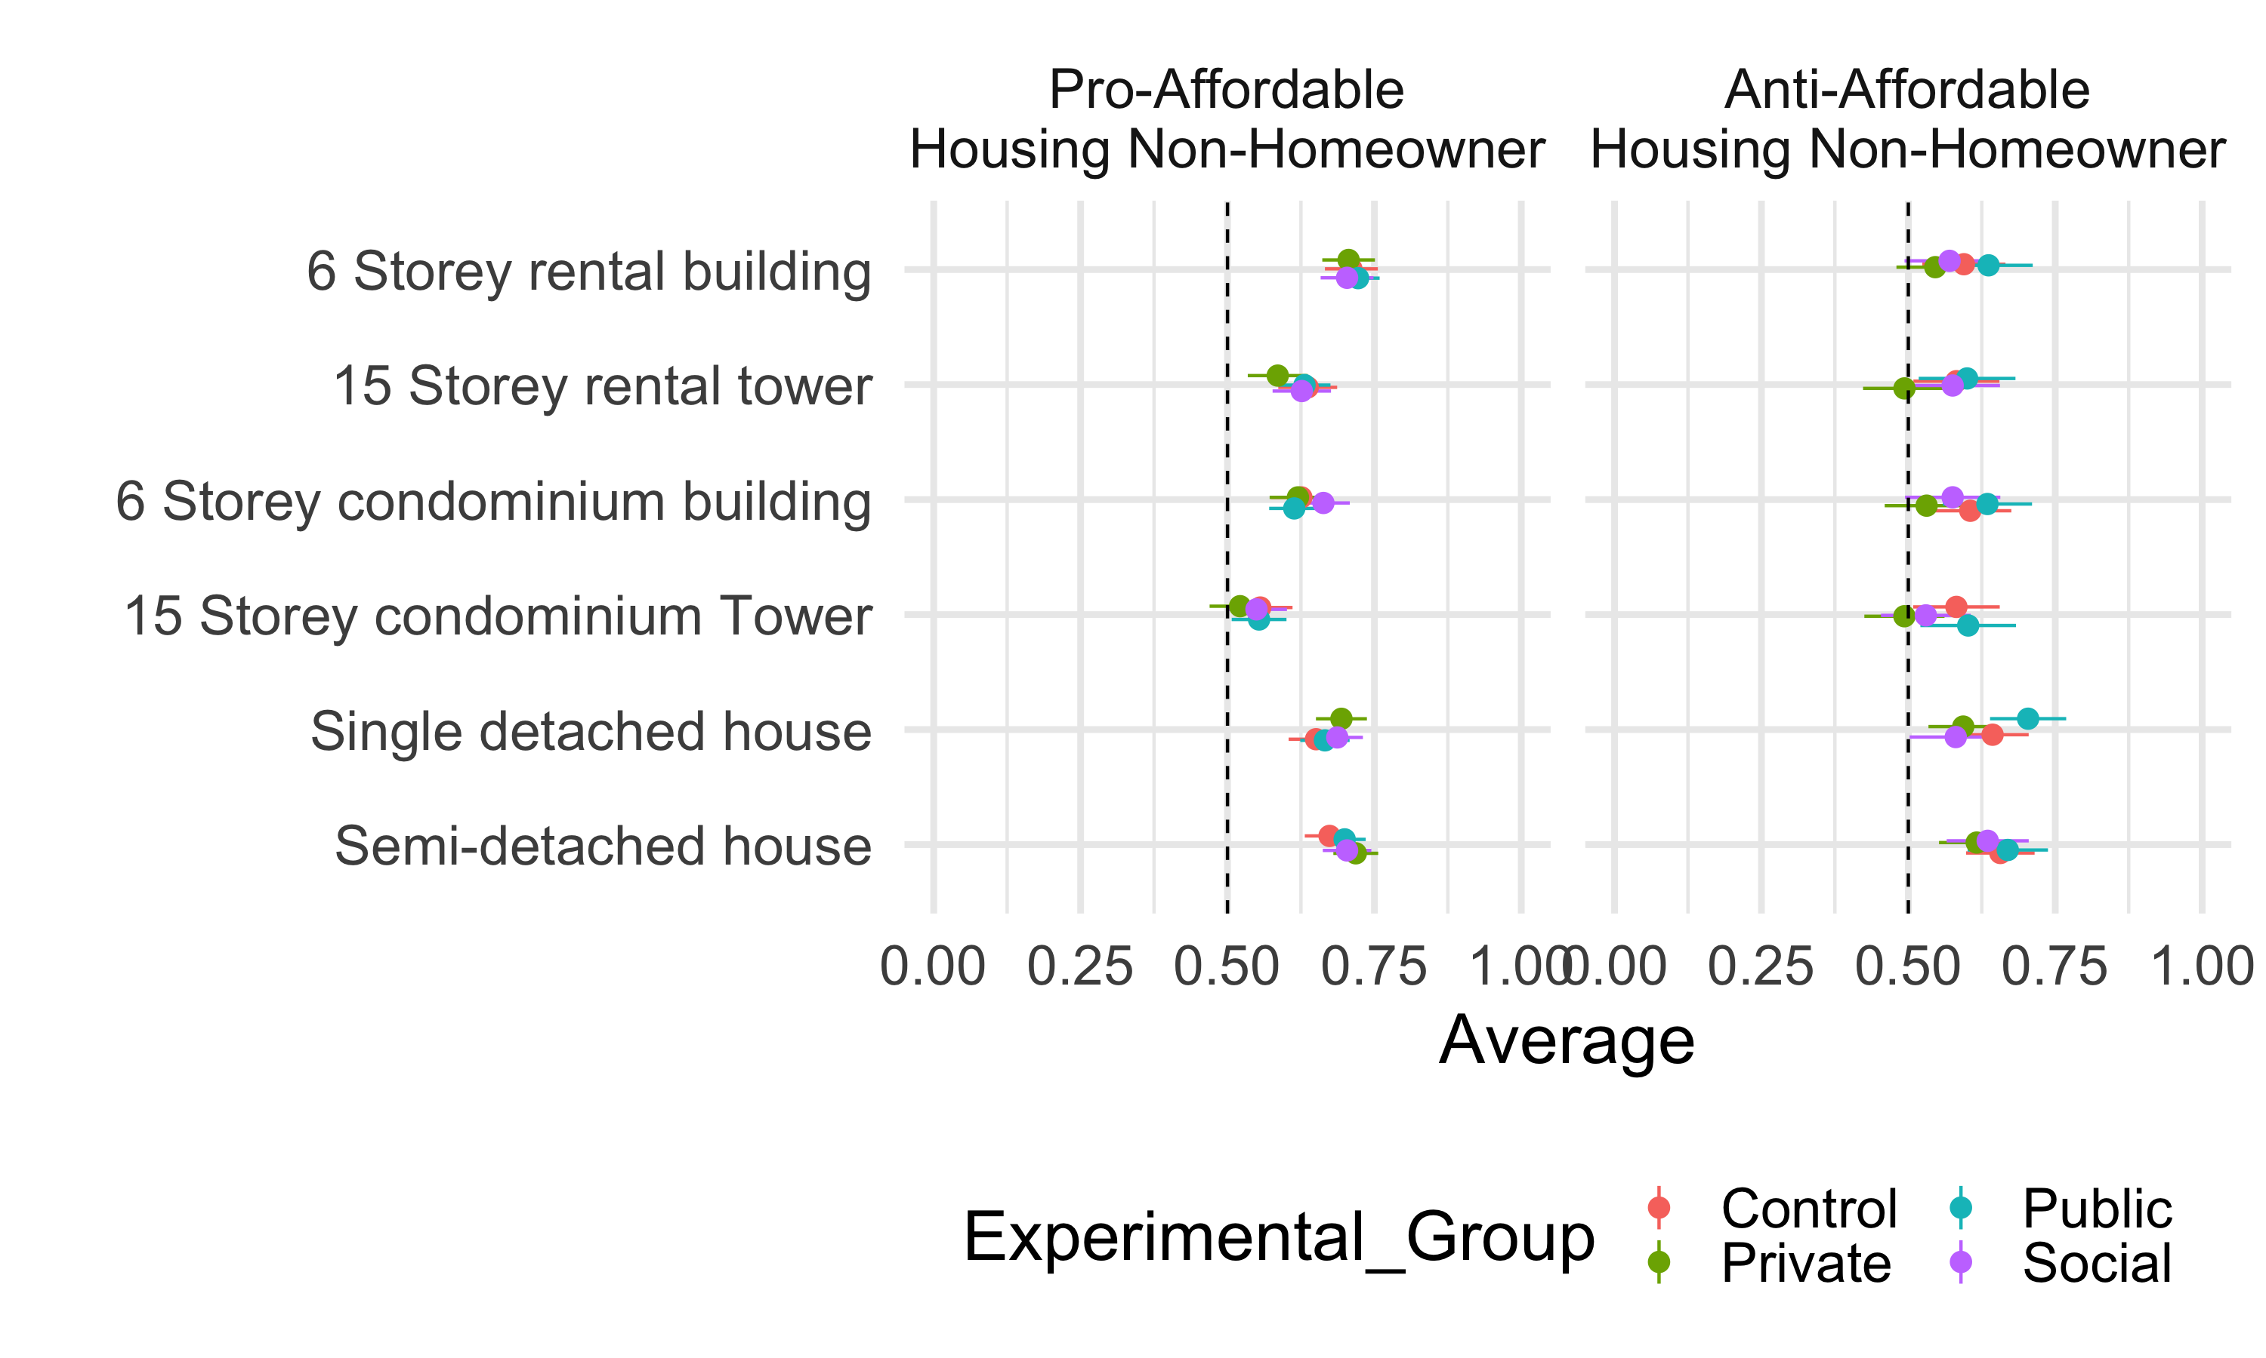
Results
Notes:
Almost no effects of messaging at all; significant effects of structural features. Respodnents much more likely to support single-family and semi-detached homes, then moderate sized buildings followed by towers. Class basis didn’t really have a significant impact.

Slide 15
References
(2021). Vital signs: 2021 report affordable housing. Kitchener Waterloo Community Foundation.
Fabiano, P. M., Perkins, H. W., Berkowitz, A., Linkenbach, J., & Stark, C. (2003). Engaging men as social justice allies in ending violence against women: Evidence for a social norms approach. Journal of American College Health, 52(3), 105-112.
Joseph, M. L., Chaskin, R. J., & Webber, H. S. (2007). The theoretical basis for addressing poverty through mixed-income development. Urban Affairs Review, 42(3), 369–409.
McNee, G., & Pojani, D. (2021). NIMBYism as a barrier to housing and social mix in San Francisco. Journal of Housing and the Built Environment, 1–21.
Moffat, M. (2021, July 19). Ontarians on the Move, 2021 Edition #18 — Ontario’s pre-pandemic housing shortage was a uniquely Ontario problem. Medium. Accessed from: https://mikepmoffatt.medium.com/ontarians-on-the-move-2021-edition-18-ontarios-pre-pandemic-housing-shortage-was-a-uniquely-d64751c4f1e6
Nguyen, M. T. (2005). Does affordable housing detrimentally affect property values? A review of the literature. Journal of Planning Literature, 20(1), 15–26.
Tighe, J. R., & Goetz, E. G. (2019). Comment on “Does the Likely Demographics of Affordable Housing Justify NIMBYism?” Housing Policy Debate, 29(2), 369–373.
Wassmer, R. W., & Wahid, I. (2019). Does the likely demographics of affordable housing justify NIMBYism? Housing Policy Debate, 29(2), 343–358.
Zon, N., Molson, M., & Oschinski, M. (2014). Building blocks: The case for federal investment in social and affordable housing in Ontario. Mowat Centre for Policy Innovation.

