Slide 1
Partisan Consensus and its Limits in Ontario Housing Policy
Simon Kiss Anthony Piscitelli Matthew Arp

Slide 2
Ontario Provincial Election Survey
LISPOP’s mandate to support research, training and knowledge mobilization of public opinion and policy
Survey of 2000 voters during 2022 Ontario Provincial Election
Field dates between May 18th and May 30th, 2022
Standard political variables (e.g. federal and provincial vote, federal and provincial partisanship) as well as heavy focus on housing-specific variables
Data publicly available here for sharing
Notes:
Support for LISPOP comes from Office of Research Services
Strength of Laurier in all aspects of public opinion training and research, e.g. survey design, analysis
regularly commission surveys on important issues, we conducted an OPES 2018 and wanted to repeat that in 2022
clear Housing was going to be an issue, focus of this survey
emphasize dataset publicly available

Slide 3
Context of the 2022 Election Campaign
Provincial government commissioned an expert panel to make recommendations on housing affordability
Signature recommendation to build 1.5 million homes
subsequently included in the NDP and Liberal platforms
Topic | n | Percent
Cost of living, living expenses / wages / Inflation | 380 | 23
Health care issues (non-COVID) | 188 | 11
Housing | 176 | 11
Environmental / ecological issues / climate change | 74 | 4
Economy | 70 | 4
Notes:
Prior to the campaign, expert panel announced to make recommendations
Signature policy was to create 1.5 million homes over 10 years
Cross-partisan consensus on the need to increase supply
Implementation is harder than you might think
The data here will show how this support seeming consensus is fragile
Governments can’t just wave a wand and “increase supply”. Requires financing, cooperation from developers, municipalities, rule changes, each of which can present place obstacles to emerge

Slide 4
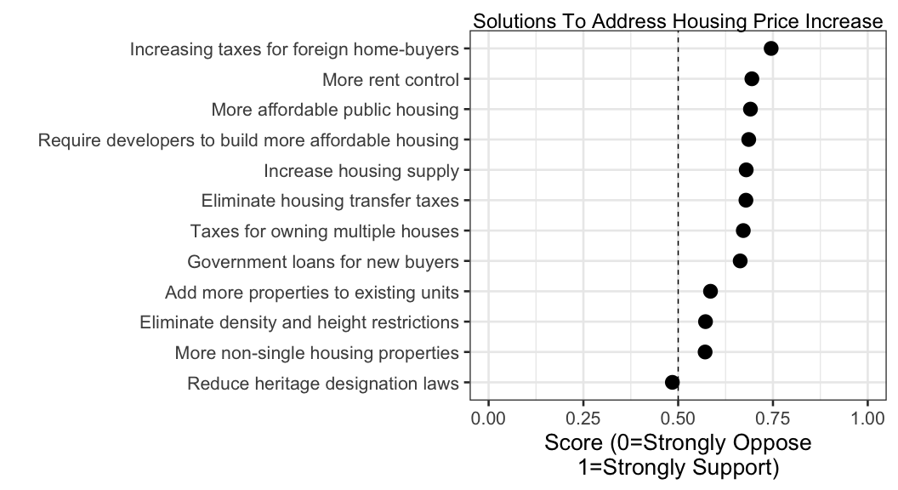
Solutions

Slide 5
Ideology in housing policy
Two clusters of policies:
Government regulation
Reducing barriers to increasing supply (Market forces)
These cluster mirror two fundamental ways of accomplishing collective goals: markets and states (or bureaucracy) (Samuelson 1954)
In this case, government regulation is noticeably more popular
The general goal of increasing supply is actually correlated with both clusters
Question | Government | Market
Require developers to build more affordable housing | 0.75 | 0.22
More affordable public housing | 0.72 | 0.27
More rent control | 0.72 | 0.12
Taxes for owning multiple houses | 0.71 | 0.05
Increasing taxes for foreign home-buyers | 0.66 | 0.02
Government loans for new buyers | 0.53 | 0.36
Reduce heritage designation laws | -0.07 | 0.73
Eliminate density and height restrictions | 0.12 | 0.68
Add more properties to existing units | 0.11 | 0.64
More non-single housing properties | 0.22 | 0.61
Increase housing supply | 0.44 | 0.52
Eliminate housing transfer taxes | 0.20 | 0.43

Slide 6
Ideology in housing policy
Two clusters of policies:
Government regulation
Reducing barriers to increasing supply (Market forces)
These cluster mirror two fundamental ways of accomplishing collective goals: markets and states (or bureaucracy) (Samuelson 1954)
In this case, government regulation is noticeably more popular
The general goal of increasing supply is actually correlated with both cluster
Question | Regulation | Market
Require developers to build more affordable housing | 0.75 | 0.22
More affordable public housing | 0.72 | 0.27
More rent control | 0.72 | 0.12
Taxes for owning multiple houses | 0.71 | 0.05
Increasing taxes for foreign home-buyers | 0.66 | 0.02
Government loans for new buyers | 0.53 | 0.36
Reduce heritage designation laws | -0.07 | 0.73
Eliminate density and height restrictions | 0.12 | 0.68
Add more properties to existing units | 0.11 | 0.64
More non-single housing properties | 0.22 | 0.61
Increase housing supply | 0.44 | 0.52
Eliminate housing transfer taxes | 0.20 | 0.43

Slide 7
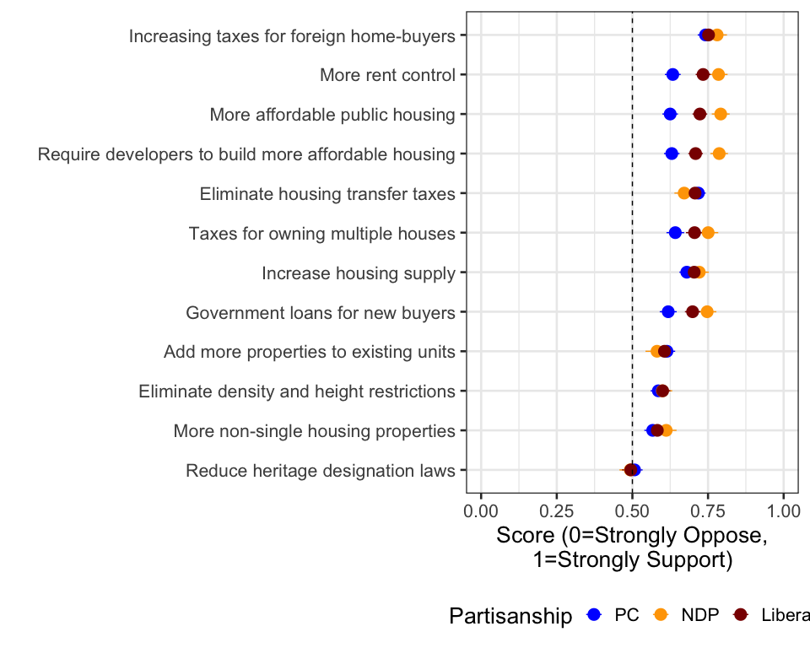
Importance of partisan cues
Voters often take cues from parties they identify with as to what positions they should hold (Zaller 1992)
Cross-partisan consensus in the platforms is evident in

Slide 8
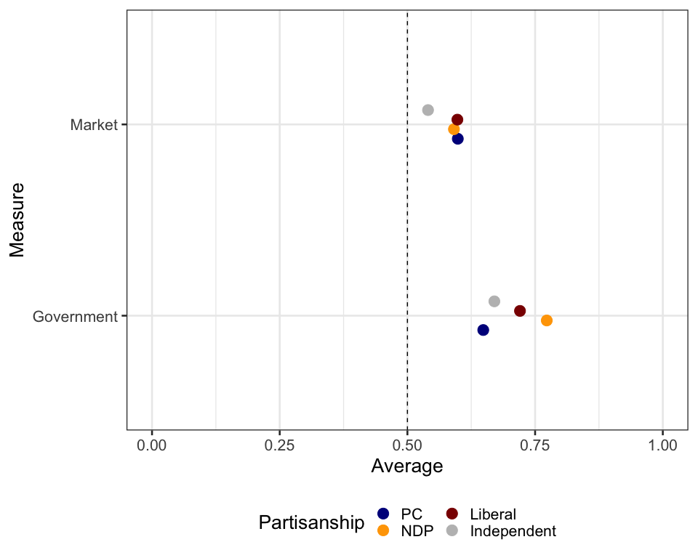
Popularity of the clusters
Notes:
Overall, if we compare the clusters by partisanship, it’s clear that a lot of the difference is driven by left-wing support for government regulation. PC voters are less enthusiastic than the other parties to do support either cluster.

Slide 9
Conclusion
Cross-partisan consensus on the need to increase housing supply
Public opinion remains protective of single-family homes
Combined with public opposition to sprawl leaves the impression of remarkable challenges to adding to supply, despite #1
Notes:
Cross-partisan consensus on the need to increase housing supply
This only goes so far
Public opinion remains protective of single-family homes
Government action on prices remains more popular than government action which might increase housing supply without contributing to urban sprawl
Combined with public opposition to sprawl (see blowback on Greenbelt) leaves the impression of remarkable challenges to adding to supply, despite #1

Slide 10
References
Samuelson, Paul A. 1954. “The Pure Theory of Public Expenditure.” The Review of Economics and Statistics 36 (4): 387–89. https://www.jstor.org/stable/1925895?casa_token=8Rj-SesB2OkAAAAA:vZwSh7LJCdk0FW23d31--87_SumZ96Me8Z8w_-H3aTx1sLdPICvJTCMj9jczC6VPkC4sz_gjVTxWFW4yookH5L4N-x7lVD4O9M_ttdcnZjZ_xfB_9k4.
Zaller, J. 1992. The Nature and Origins of Mass Opinion. Cambridge: Cambridge University Press. http://books.google.ca/books?id=83yNzu6toisC.

