Slide 1
Introduction to R
Simon J. Kiss

Slide 2
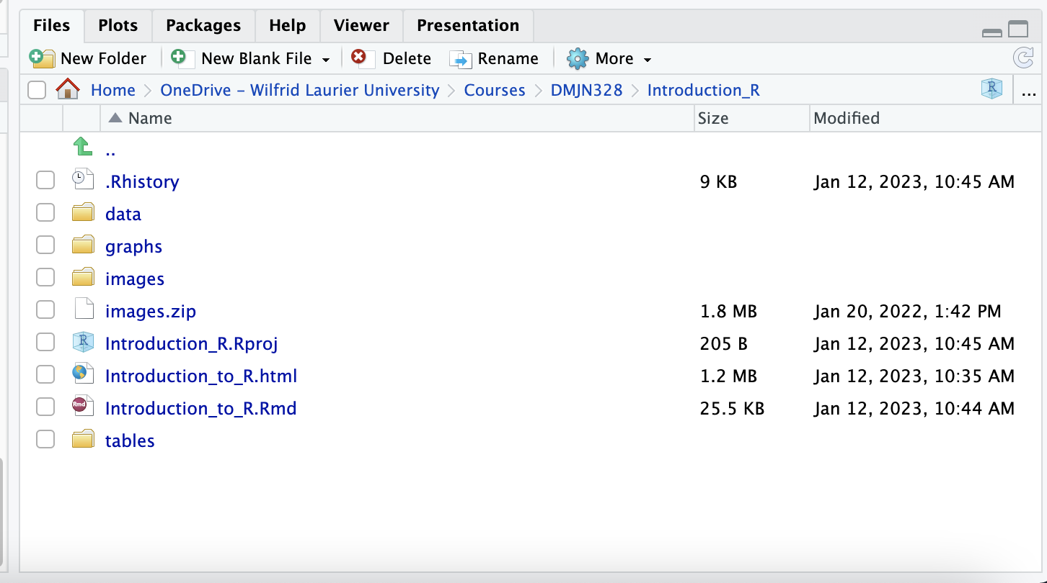
Introduction
In the previous section, we coded an R script step-by-step to learn about how to program in R. This was saved as an .R file. But look at the directory you are in, in the bottom right pane of the RStudio cloud window.
You will see your .R script that you saved yesterday, but also the HTML file that is the guide for the script and an .rmD file that has the same prefix introduction_to_R.Rmd as the HTML file.
include_graphics(path="images/files.png")

Slide 3
You can open that file up by selecting File > Open and take a peek.

Slide 4
R Markdown
Markdown is really useful. It’s a very lightweight scripting language that lets you focus on writing rather than on writing and formatting (e.g. selecting text, formatting it, bolding it, etc. etc. ).
With just a few very basic commands in a markdown document, you can produce all kinds of documents with proper formatting: e.g. HTML, PDFs, Word, etc.
RMarkdown is a flavor of Markdown that lets you integrate R code, and its results, into a Markdown document and then quickly convert that into all kinds of useful documents.
I will be using RMarkdown to produce the HTML documents as guides for the class. I probably will ask you to submit assignments in the form of RMarkdown documents, so it will be useful to learn how to use it.
Making it work
An Rmarkdown document starts with a header section, like the one in this file that has specified fields for author, title, date, etc. Those are the main ones. You can also specify what
For now, open up a new RMarkdown document in the YAML header and set the following fields:
author to be your name
title, pick a title,
pick output to be an HTML document.
date
Copy the formatting form this document into your own.
Then, below that, just start writing some text.
To compile the R Markdown document. cliock on the knit button.
You can italicize text like this. Hi there! NIce to meet you!
You can boldface text like this, Nice to meet you too!
You an set a blockquote like this:
These are some very fancy words.
You can also embed a clickable URL like this, to the Globe and Mail
Embedding R Code
Most importantly you can embed R code write into the RMarkdown document with code chunks.
The keyboard shortcut is OPT-CMD-I on a Mac and CTL-ALT-I on a PC.
For each code cunk you should give it a label, after the r. And then you just write the R code you want.
print("hello world")
## [1] "hello world"
In the same way as in regular R, you can store the results with the < operator.
output<-print("hello world")
## [1] "hello world"
And then you can call it later.
output
## [1] "hello world"

Slide 5
RMarkdown templates
When you select File > New File > RMarkdown you will get a template that will rock and roll pretty much right away.

Slide 6
Changing output
To really show you the power of this, watch what happens when you set different outputs. You can even specify different types of files to produce.

