Slide 1
Hyosung GDMS
B&R Korea

Slide 2
Introduction
Contents
Communication Configuration
1
B & R Hardware Configuration
2
B & R Software Structure
3

Slide 3
HyoSung GDMS
Network Configuration
Modbus RTU, TCP
Gas Detector <-> PLC (Master)
PLC (Slave) <-> Gateway
GDMS
Gas Detector
Upper HMI
DCS
Modbus RTU 485
Master
Modbus
to
61850
B&R PLC
Schneider
Gateway
Modbus TCP
Slave

Slide 4
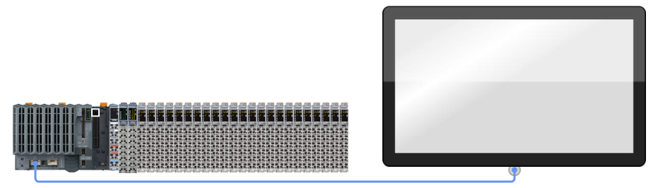
HyoSung GDMS
B&R PLC
X20CP1586
POE
FT50
21’’
ETH
ETH
POE (Power Over Ethernet)
Power is supplied to the Ethernet cable (RJ45, UTP)

Slide 5
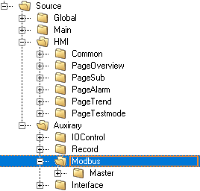

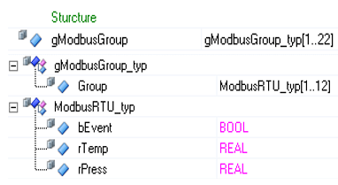
HyoSung GDMS
Software Structure
Modbus RTU
#1 Volume
Number of Module : 22EA
Number of Channel : 12EA
#2 How can get data?
When Modbus bEvent is TRUE,
They can receive data(Temp, Press).

Slide 6
HyoSung GDMS
B&R PLC

Slide 7
Perfection in Automation

