Slide 1
Convolutional Variational Autoencoder
指導恩師：龍大大
報告學生：劉翰穎

Slide 2
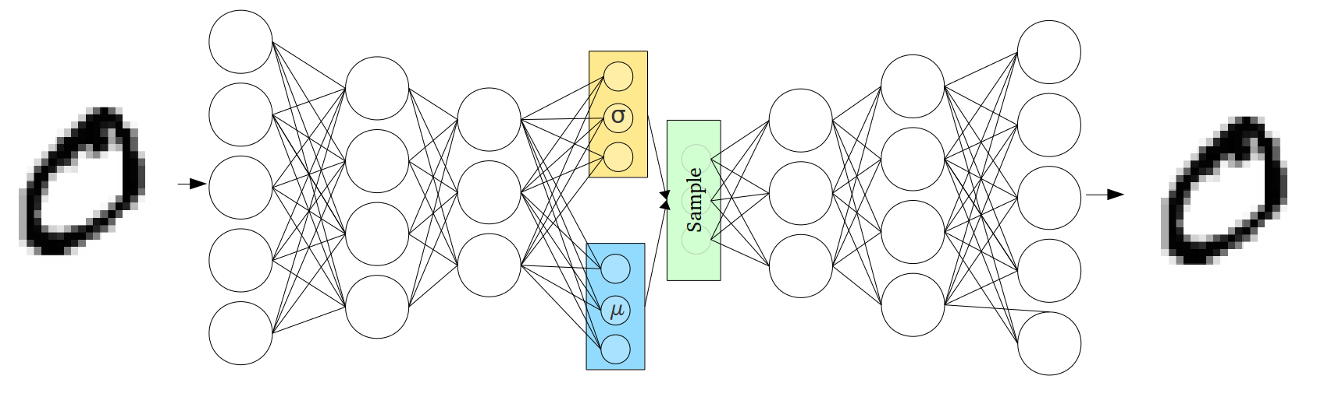

Slide 3
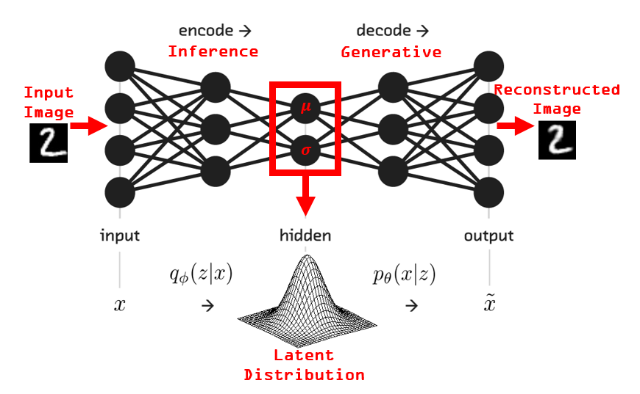

Slide 4
# to generate gifs
!pip install imageio
!pip install tfp-nightly

Slide 5
Import TensorFlow and other libraries
from IPython import display
import glob
import imageio
import matplotlib.pyplot as plt
import numpy as np
import PIL
import tensorflow as tf
import tensorflow_probability as tfp
import time

Slide 6
glob | 查找文件路徑
imageio | 讀取網絡圖片、讀取視頻、生成gif圖
matplotlib.pyplot | matplotlib的pyplot子庫提供了和matlab類似的繪圖API
numpy | 用於資料處理
PIL | 影像處理套件
tensorflow | 支援各式不同的深度學習演算法
tensorflow_probability | 用於進行機率推理和統計分析
time | 時間模組

Slide 7
Load the MNIST dataset
(train_images, _), (test_images, _) =
tf.keras.datasets.mnist.load_data()#加載MNIST數據集
(train_images, _), (test_images, _) #表示只取得輸入圖像

Slide 8
def preprocess_images(images):
images = images.reshape((images.shape[0], 28, 28, 1)) / 255. #改變張量(tensor)的形狀。
return np.where(images > .5, 1.0, 0.0).astype('float32’)
#返回元素中為True的元素所對應的位置索引
train_images = preprocess_images(train_images)
test_images = preprocess_images(test_images)
train_size = 60000
batch_size = 32
test_size = 10000

Slide 9
Use tf.data to batch and shuffle the data
train_dataset = (tf.data.Dataset.from_tensor_slices(train_images)
#根據輸入數據創建源數據集
.shuffle(train_size).batch(batch_size))
test_dataset = (tf.data.Dataset.from_tensor_slices(test_images)
.shuffle(test_size).batch(batch_size))

Slide 10
Define the encoder and decoder networks with tf.keras.Sequential
class CVAE(tf.keras.Model):
"""Convolutional variational autoencoder."""
self.encoder = tf.keras.Sequential(
[........................................................]
)
self.decoder = tf.keras.Sequential(
[…………………………….........................]
)
@tf.function
def sample(self, eps=None):
if eps is None:
eps = tf.random.normal(shape=(100, self.latent_dim))
return self.decode(eps, apply_sigmoid=True)

Slide 11
Define the encoder and decoder networks with tf.keras.Sequential
def encode(self, x):
mean, logvar = tf.split(self.encoder(x), num_or_size_splits=2, axis=1)
return mean, logvar
def reparameterize(self, mean, logvar):
eps = tf.random.normal(shape=mean.shape)
return eps * tf.exp(logvar * .5) + mean
def decode(self, z, apply_sigmoid=False):
logits = self.decoder(z)
if apply_sigmoid:
probs = tf.sigmoid(logits)
return probs
return logits

Slide 12
self.encoder
Dense
Flatten
self.encoder = tf.keras.Sequential(
[
tf.keras.layers.InputLayer(input_shape=(28, 28, 1)),
tf.keras.layers.Conv2D(filters=32, kernel_size=3,
strides=(2, 2), activation='relu’),
tf.keras.layers.Conv2D(filters=64, kernel_size=3,
strides=(2, 2), activation='relu’),
tf.keras.layers.Flatten(),
# No activation
tf.keras.layers.Dense(latent_dim + latent_dim),
]
)
Conv2
Conv1

Slide 13
self.decoder
Dense
Reshape
self.decoder = tf.keras.Sequential(
[
tf.keras.layers.InputLayer(input_shape=(latent_dim,)),
tf.keras.layers.Dense(units=7*7*32, activation=tf.nn.relu),
tf.keras.layers.Reshape(target_shape=(7, 7, 32)),
tf.keras.layers.Conv2DTranspose(filters=64, kernel_size=3,
strides=2, padding='same',activation='relu’),
tf.keras.layers.Conv2DTranspose(filters=32, kernel_size=3,
strides=2, padding='same',activation='relu'),
# No activation
tf.keras.layers.Conv2DTranspose(filters=1, kernel_size=3,
strides=1, padding='same'),
]
Conv3
Conv2
Conv1

Slide 14
Define the loss function and the optimizer
optimizer = tf.keras.optimizers.Adam(1e-4)
def log_normal_pdf(sample, mean, logvar, raxis=1):
log2pi = tf.math.log(2. * np.pi)
return tf.reduce_sum(
-.5 * ((sample - mean) ** 2. * tf.exp(-logvar) + logvar + log2pi),
axis=raxis)

Slide 15
Define the loss function and the optimizer
def compute_loss(model, x):
mean, logvar = model.encode(x)
z = model.reparameterize(mean, logvar)
x_logit = model.decode(z)
cross_ent = tf.nn.sigmoid_cross_entropy_with_logits(logits=x_logit, labels=x)
logpx_z = -tf.reduce_sum(cross_ent, axis=[1, 2, 3])
logpz = log_normal_pdf(z, 0., 0.)
logqz_x = log_normal_pdf(z, mean, logvar)
return -tf.reduce_mean(logpx_z + logpz - logqz_x)

Slide 16
Define the loss function and the optimizer
@tf.function
def train_step(model, x, optimizer):
"""Executes one training step and returns the loss.
This function computes the loss and gradients, and uses the latter to
update the model's parameters.
"""
with tf.GradientTape() as tape:
loss = compute_loss(model, x)
gradients = tape.gradient(loss, model.trainable_variables)
optimizer.apply_gradients(zip(gradients, model.trainable_variables))

Slide 17
Training
epochs = 10
# set the dimensionality of the latent space to a plane for visualization later
latent_dim = 2
num_examples_to_generate = 16
# keeping the random vector constant for generation (prediction) so
# it will be easier to see the improvement.
random_vector_for_generation = tf.random.normal(
shape=[num_examples_to_generate, latent_dim])
model = CVAE(latent_dim)

Slide 18
Training
def generate_and_save_images(model, epoch, test_sample):
mean, logvar = model.encode(test_sample)
z = model.reparameterize(mean, logvar)
predictions = model.sample(z)
fig = plt.figure(figsize=(4, 4))
for i in range(predictions.shape[0]):
plt.subplot(4, 4, i + 1)
plt.imshow(predictions[i, :, :, 0], cmap='gray')
plt.axis('off')
# tight_layout minimizes the overlap between 2 sub-plots
plt.savefig('image_at_epoch_{:04d}.png'.format(epoch))
plt.show()
# Pick a sample of the test set for generating output images
assert batch_size >= num_examples_to_generate
for test_batch in test_dataset.take(1):
test_sample = test_batch[0:num_examples_to_generate, :, :, :]

Slide 19
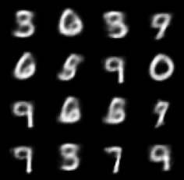
Training
generate_and_save_images(model, 0, test_sample)
for epoch in range(1, epochs + 1):
start_time = time.time()
for train_x in train_dataset:
train_step(model, train_x, optimizer)
end_time = time.time()
loss = tf.keras.metrics.Mean()
for test_x in test_dataset:
loss(compute_loss(model, test_x))
elbo = -loss.result()
display.clear_output(wait=False)
print('Epoch: {}, Test set ELBO: {}, time elapse for current epoch: {}'
.format(epoch, elbo, end_time - start_time))
generate_and_save_images(model, epoch, test_sample)

Slide 20
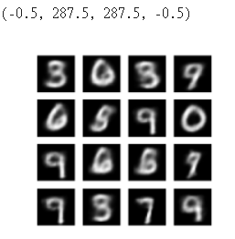
Display a generated image from the last training epoch
def display_image(epoch_no):
return PIL.Image.open('image_at_epoch_{:04d}.png'.format(epoch_no))
plt.imshow(display_image(epoch))
plt.axis('off') # Display images

Slide 21
Display an animated GIF of all the saved images
anim_file = 'cvae.gif'
with imageio.get_writer(anim_file, mode='I') as writer:
filenames = glob.glob('image*.png')
filenames = sorted(filenames)
last = -1
for i, filename in enumerate(filenames):
frame = 2*(i**0.5)
if round(frame) > round(last):
last = frame
else:
continue
image = imageio.imread(filename)
writer.append_data(image)
image = imageio.imread(filename)
writer.append_data(image)
import IPython
if IPython.version_info >= (6, 2, 0, ''):
display.Image(filename=anim_file)

Slide 22
Display an animated GIF of all the saved images
try:
from google.colab import files
except ImportError:
pass
else:
files.download(anim_file)

Slide 23
Display a 2D manifold of digits from the latent space
def plot_latent_images(model, n, digit_size=28):
"""Plots n x n digit images decoded from the latent space."""
norm = tfp.distributions.Normal(0, 1)
grid_x = norm.quantile(np.linspace(0.05, 0.95, n))
grid_y = norm.quantile(np.linspace(0.05, 0.95, n))
image_width = digit_size*n
image_height = image_width
image = np.zeros((image_height, image_width))
for i, yi in enumerate(grid_x):
for j, xi in enumerate(grid_y):
z = np.array([[xi, yi]])
x_decoded = model.sample(z)
digit = tf.reshape(x_decoded[0], (digit_size, digit_size))
image[i * digit_size: (i + 1) * digit_size,
j * digit_size: (j + 1) * digit_size] = digit.numpy()
plt.figure(figsize=(10, 10))
plt.imshow(image, cmap='Greys_r')
plt.axis('Off')
plt.show()
plot_latent_images(model, 20)

Slide 24
