Slide 1
SOC_HW_3
C108112135_劉益志

Slide 2
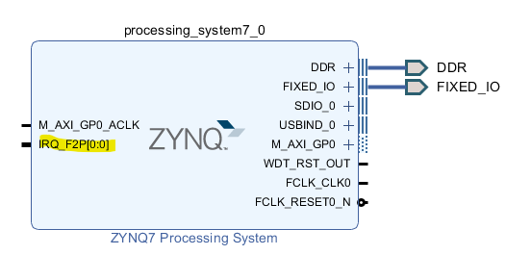
Block_Design
中斷啟用

Slide 3
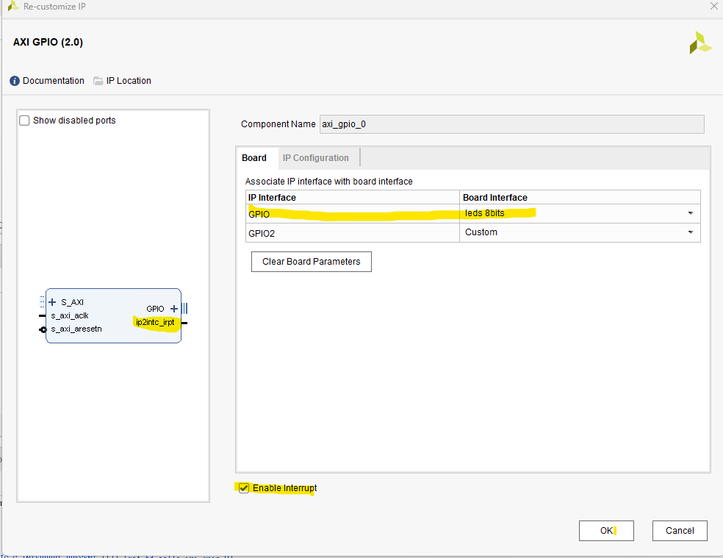
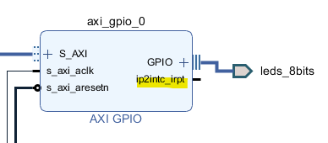
Block_Design
AXI_GPIO設定

Slide 4
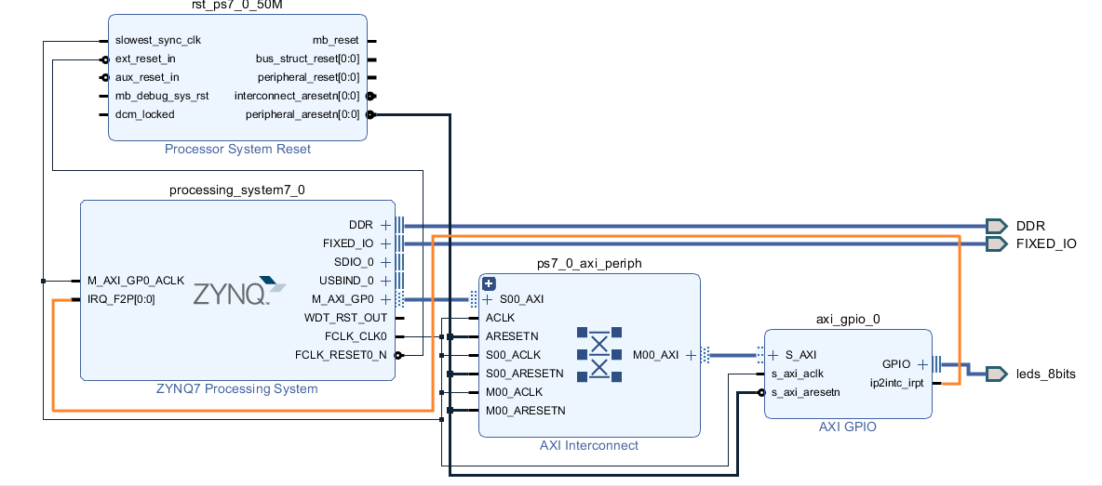
Block_Design
AXI_GPIO設定

Slide 5
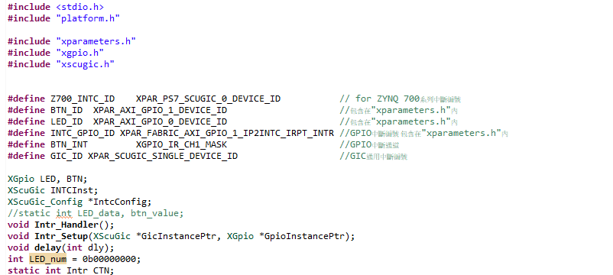
SDK-函式庫設定

Slide 6
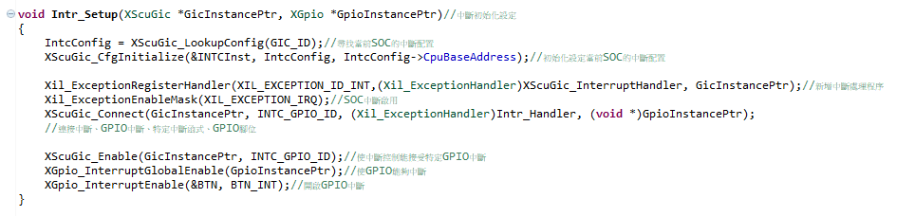
SDK-中斷初始化設定

Slide 7
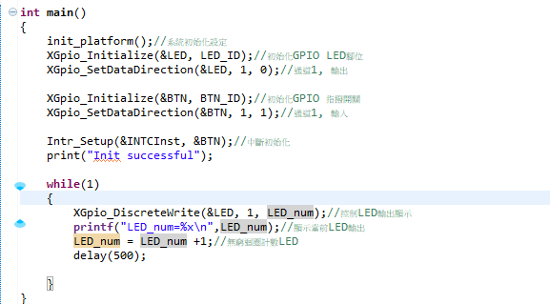
SDK-計數LED

Slide 8
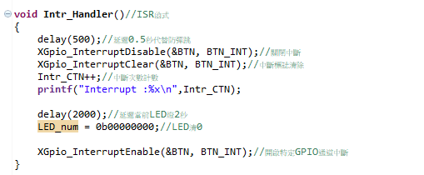
SDK-ISR內容

Slide 9
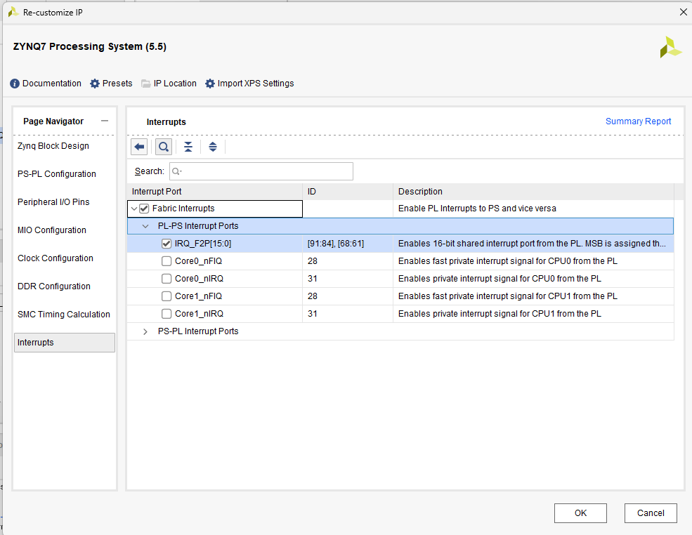
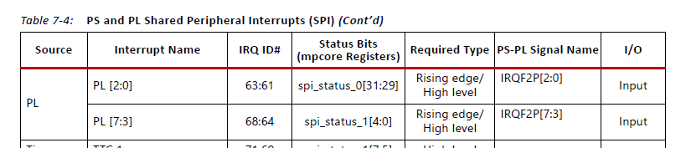
SDK-ISR編號
Zynq-7000 SoC Technical Reference Manual (UG585) (uhcl.edu),P231

Slide 10
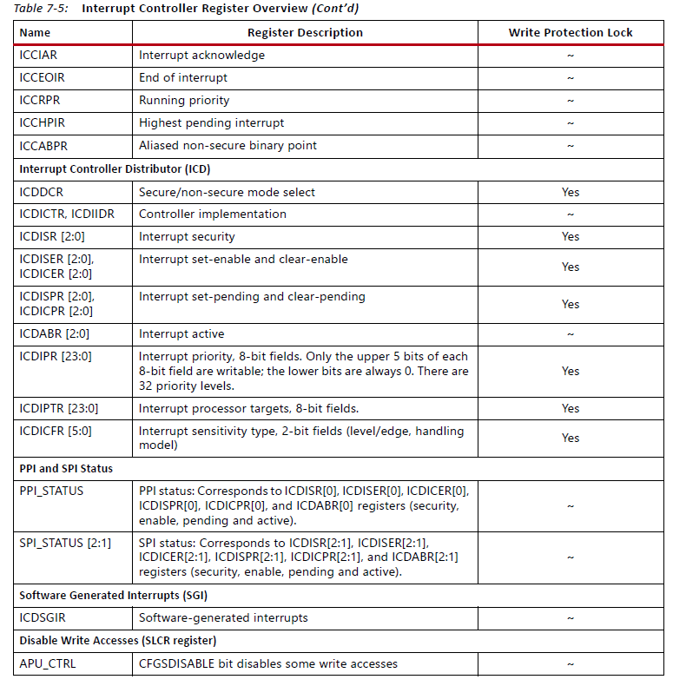
手冊-中斷有關暫存器
Zynq-7000 SoC Technical Reference Manual (UG585) (uhcl.edu),P233-234

