Slide 1
SOC_HW_2
C108112135_劉益志

Slide 2
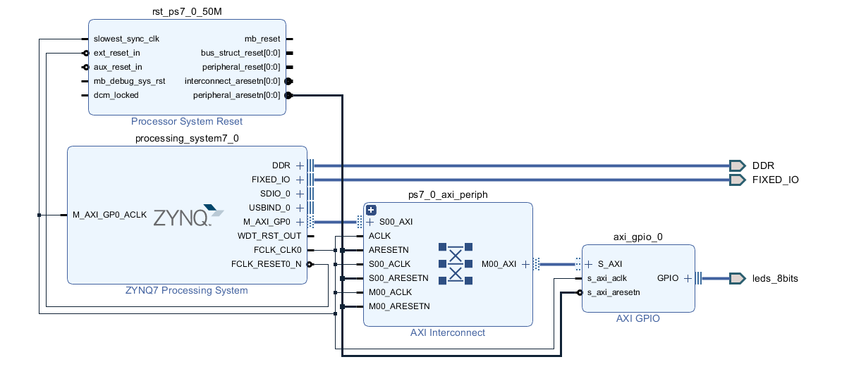
Block_Design

Slide 3

SDK
Function library

Slide 4
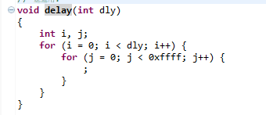
SDK
delay Function

Slide 5
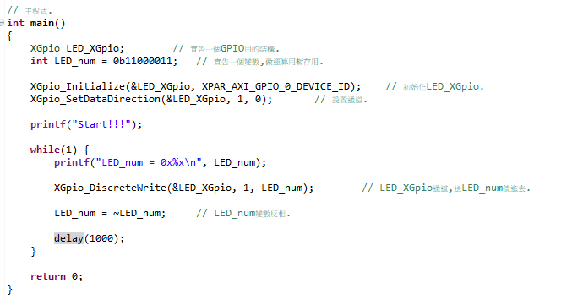
SDK
main

