Slide 1
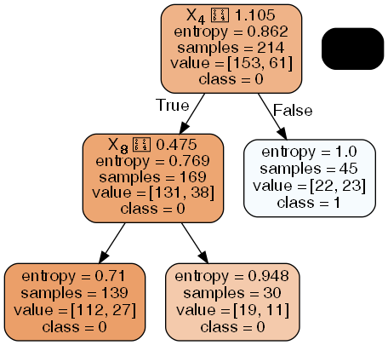
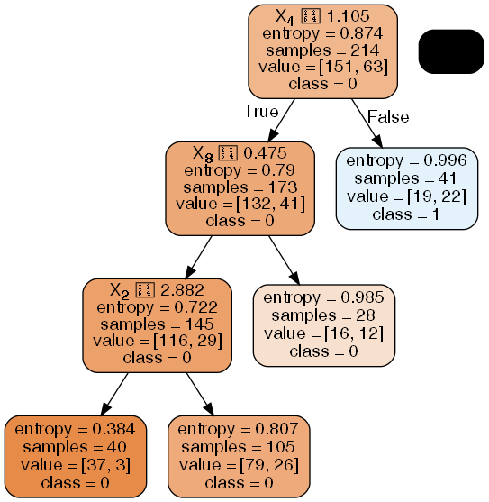
The decision tree trained on Breast Cancer Data
The depth-3 tree
The depth-4 tree

Slide 2
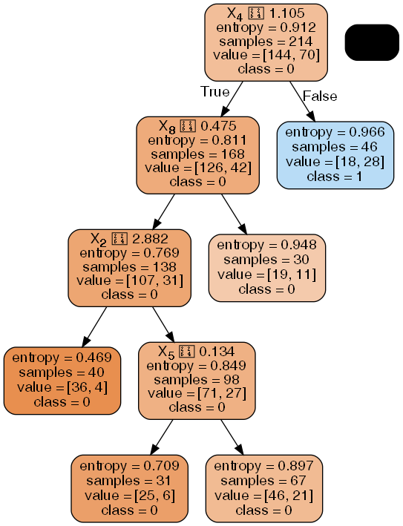
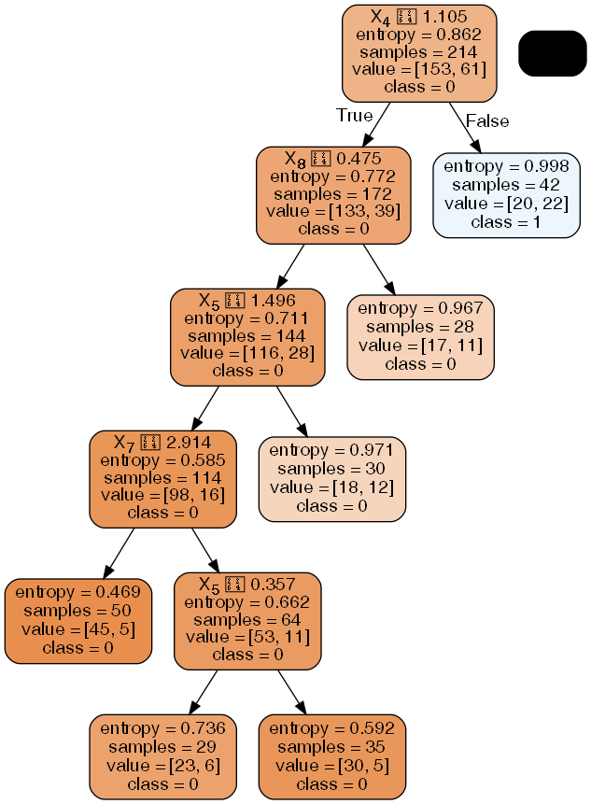
The decision tree trained on Breast Cancer Data
The depth-5 tree
The depth-6 tree

Slide 3
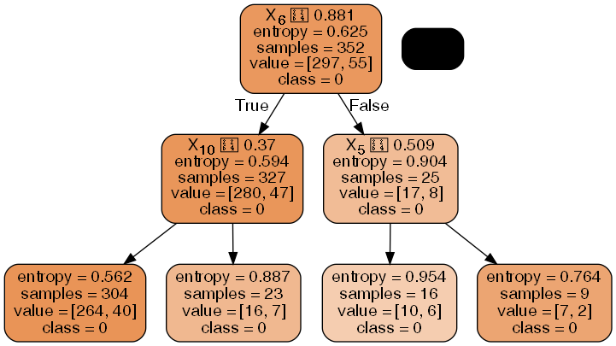
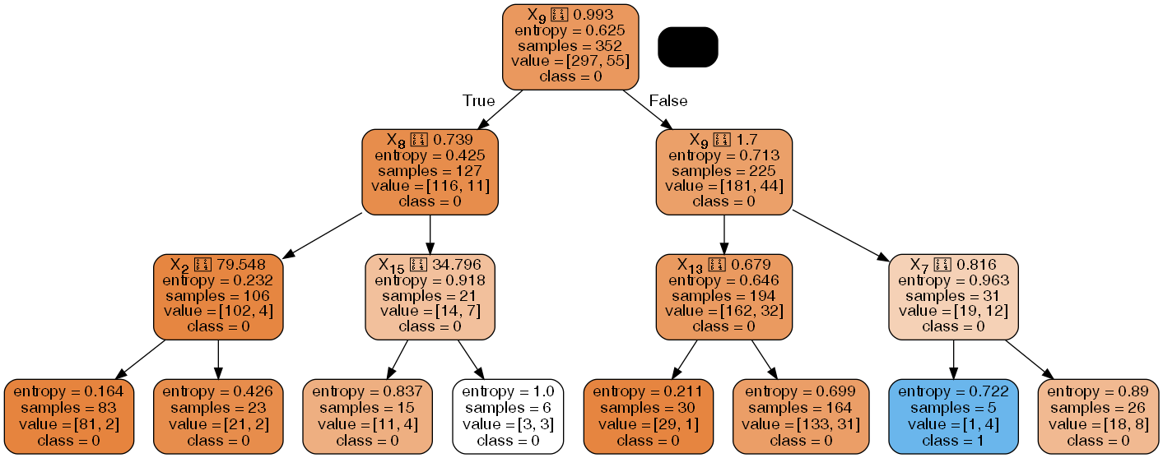
The decision tree trained on Thoracic Surgery Data
The depth-3 tree
The depth-4 tree

Slide 4
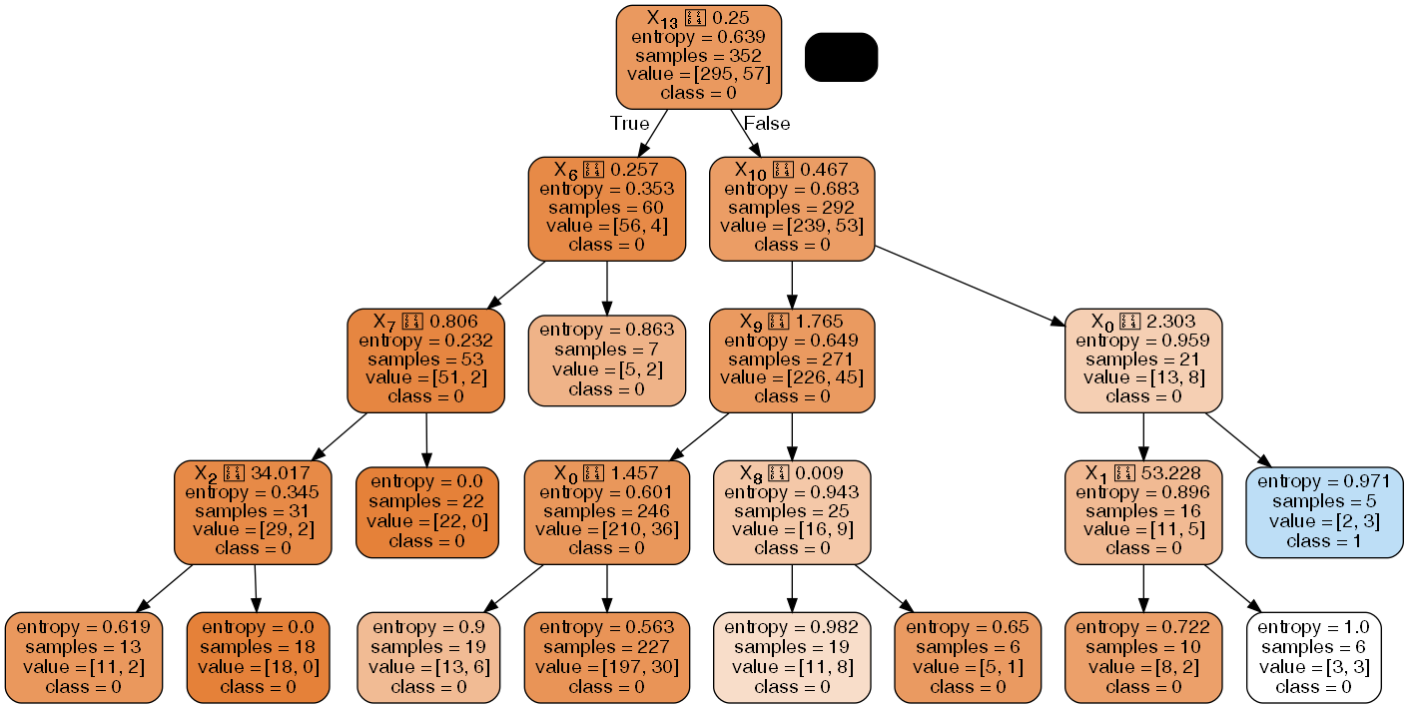
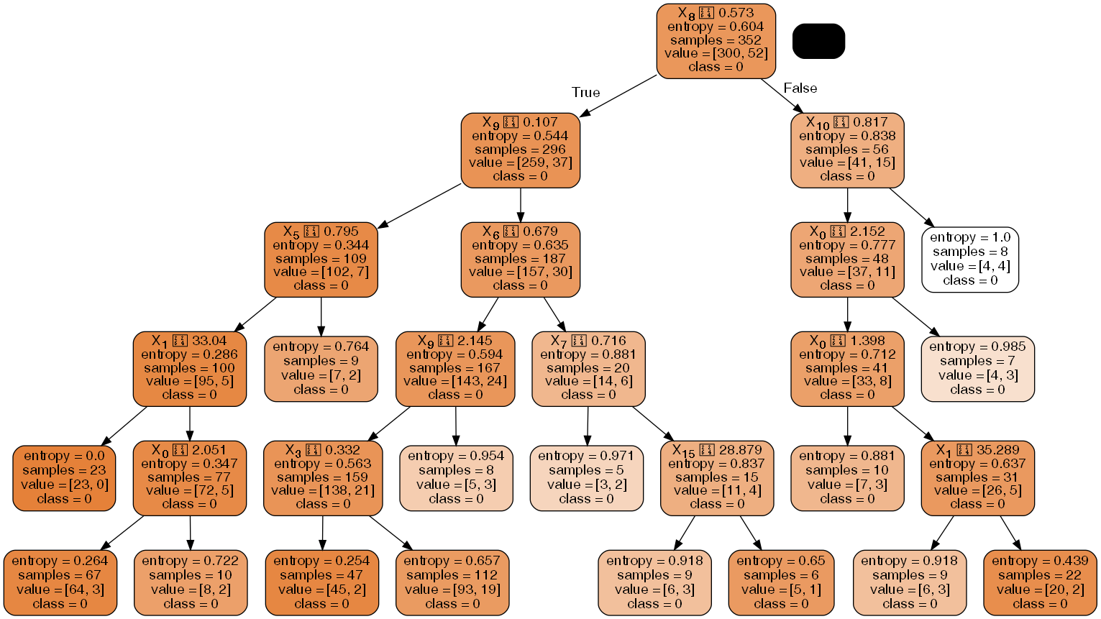
The decision tree trained on Thoracic Surgery Data
The depth-5 tree
The depth-6 tree

