Slide 1
Background
Sample-based models to account for biased probability judgements
General assumption: Probability judgements based on instances sampled from underlying probability distributions in mind
One existing model: Probability Theory Plus Noise (PT+N) model (Costello & Watts, 2014)
Limitation: PT+N model only investigated using probability estimation task
Mono-operation bias
Sampling parameters not identifiable on individual level without additional assumptions
Remedy: A novel ranking task is proposed
Notes:
Hello, my name is...

Slide 2
Ranking task
Participants are asked to rank four events, A, not-A, B, not-B
- tied rankings not allowed
A way to categorise rankings:
8 logically possible rankings
where the complement rule holds
In total
24
linear
rankings
8 Type 1 logically impossible rankings
i.e., A & not-A simultaneously ranked above B & not-B
8 Type 2 logically impossible rankings
i.e., A > B & not-A > not-B simultaneously hold

Slide 3
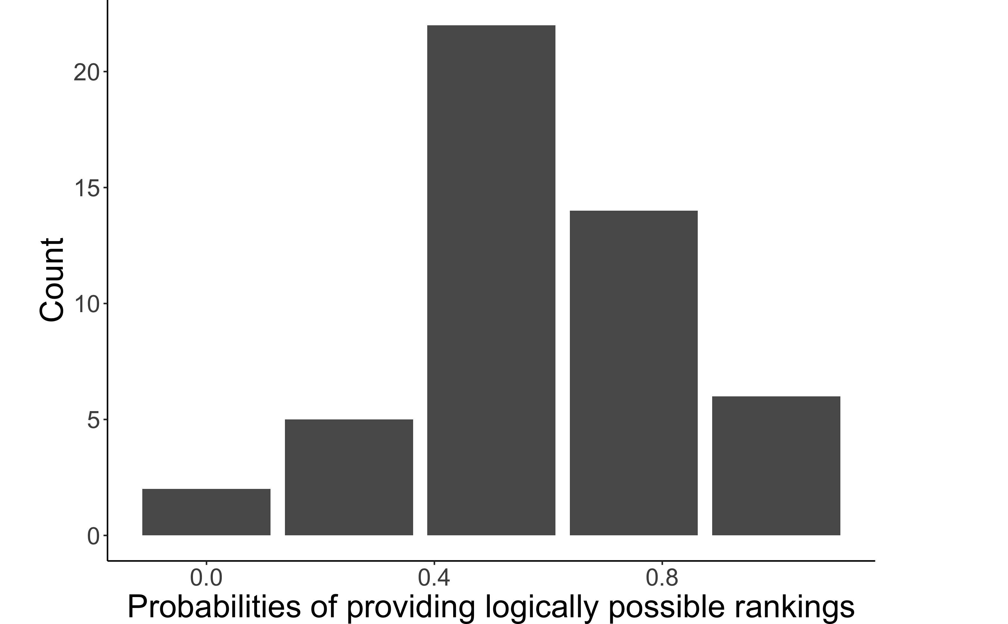
A new bias?
49 participants were asked to repeatedly rank {A, not-A, B, not-B} with different content
On average, around two out of the four rankings that participants provided were logically possible (mean = 0.59, SD = 0.24).

Slide 4
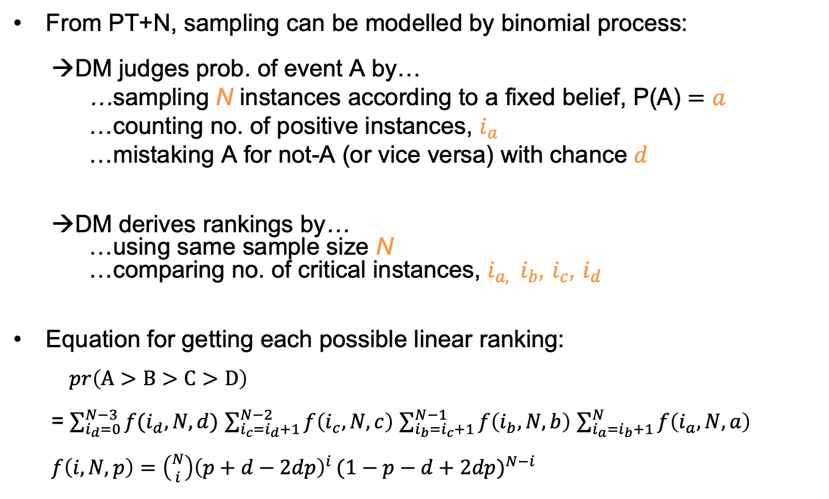
Predictions for rankings from PT+N
From PT+N, sampling can be modelled by binomial process:
→DM judges prob. of event A by…
…sampling N instances according to a fixed belief, P(A) $=a$
…counting no. of positive instances, $i_{a}$
…mistaking A for not-A (or vice versa) with chance $d$
→DM derives rankings by…
…using same sample size N
…comparing no. of critical instances, $i_{a, }$ $i_{b}$, $i_{c}$, $i_{d}$
Equation for getting each possible linear ranking:
$pr\left(A>B>C>D\right)$
= $\sum_{i_{d}=0}^{N−3}{f(i_{d}, N, d)}$ $\sum_{i_{c}=i_{d}+1}^{N−2}{f\left(i_{c}, N, c\right)}$ $\sum_{i_{b}=i_{c}+1}^{N−1}{f\left(i_{b}, N, b\right)}$ $\sum_{i_{a}=i_{b}+1}^{N}{f\left(i_{a}, N, a\right)}$
$f\left(i, N, p\right)=\left({N \atop i}\right){\left(p+d−2dp\right)}^{i }{(1−p−d+2dp)}^{N−i}$

Slide 5
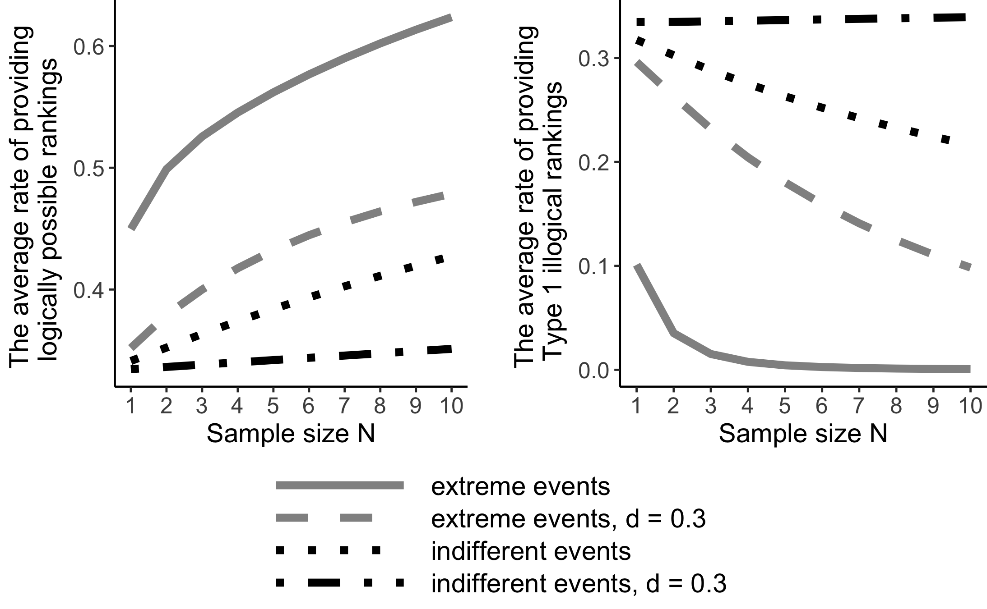
Predictions for rankings from PT+N
Simulation with different parameter values
Results show qualitative differences under two conditions
- Condition 1: rank extreme events (i.e., P(A) = 0.1, P(B) = 0.2) from Beta(1, 10)
- Condition 2: rank indifferent events (i.e., P(A) = 0.5, P(B) = 0.6) from Beta(10, 10)

Slide 6
Summary and future steps
A novel way to investigate probability judgements
- Identify a new probabilistic reasoning bias
A method to test PT+N model
- Test qualitative predictions from PT+N model for rankings
- Estimate sampling parameters on individual level

Slide 7
Thank you!
Collaborators
Funding group
This research is a joint work by
Xiaotong Liu
(University of Mannheim),
Henrik Singmann
(University College London),
and Arndt Bröder
(University of Mannheim).
This research was funded by the Deutsche Forschungsgemeinschaft (DFG), grant 2277, Research Training Group “Statistical Modeling in Psychology" (SMiP).

