Slide 1

ENBIOS
15.02.24
Version 2.2.7
LivenLab installation party/workshop

Slide 2
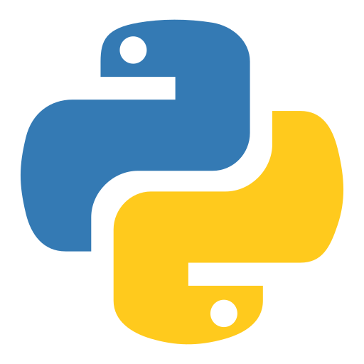
Outline
Basics of ENBIOS (current state)
Setup – 10:00 🙏 … ?
Running the first demo
Freestyle fun (TBD)

Slide 3
Enbios Experiment structure
Hierarchy
the “dendrogram” consisting of nodes
Adapters, Aggregators
builtin or external python files, which run code for nodes
Scenarios
Outputs for bottom nodes in the hierarchy

Slide 4
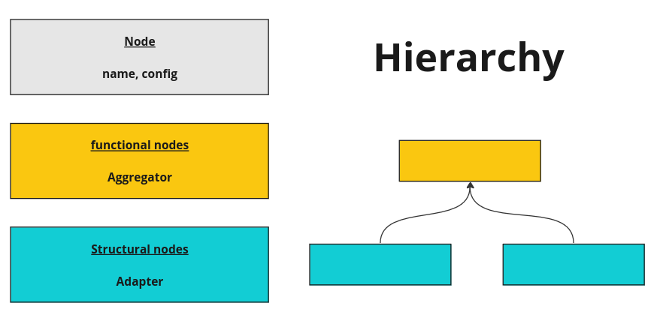

Slide 5
Adapters/Aggregators
Name (of the builtin A/A)
Path to the module that contains the A/A (alt.)
Config
Methods (for Adapters)Adapters/Aggregators

Slide 6
Scenario
Assigning outputs to bottom nodes
e.g.
"scenarios": [
{
"nodes": {
"solar": {
"unit": "MWh",
"magnitude": 30
},
"wind": {
"unit": "MWh",
"magnitude": 20
}
}
}]

Slide 7
When you initiate an experiment
Validate basic experiment structure
Load ada/agg modules.
Validate ada/agg config against loaded ada/agg
validate hierarchy
  validate basic structure
  validate each nodes config against its specified ada./agg.
validate scenarios
  Validate node output against adapter configs of corresponding node

Slide 8
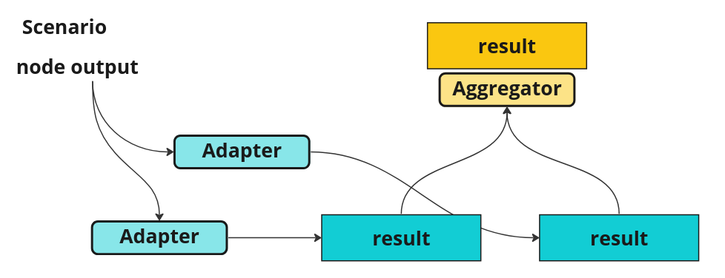
Running a scenario – what happens
Scenario outputs for each bottom node is sent to their corresponding Adapter
Adapter calculate the results (for the given methods). The adapters process all node outputs at once.
Results are
passed upwards
Aggregators calculate
the result values

Slide 9

LET’S GET INTO IT

Slide 10
Setup
get a computer
install python
install an integrated development environment (IDE) (Pycharm, MS Code)
Create a project (for this workshop) (A folder)
create a python virtual environment (a folder inside your project folder)
install enbios in that environment (how to use pip,enbios on pypi)
Download ecoinvent
create a python script to create a brightway project with the ecoinvent database
create a python script (in the IDE) to run enbios experiment
create experiment configuration file (basically just some brightway adapter stuff)
run experiment in script with configuration file

Slide 11
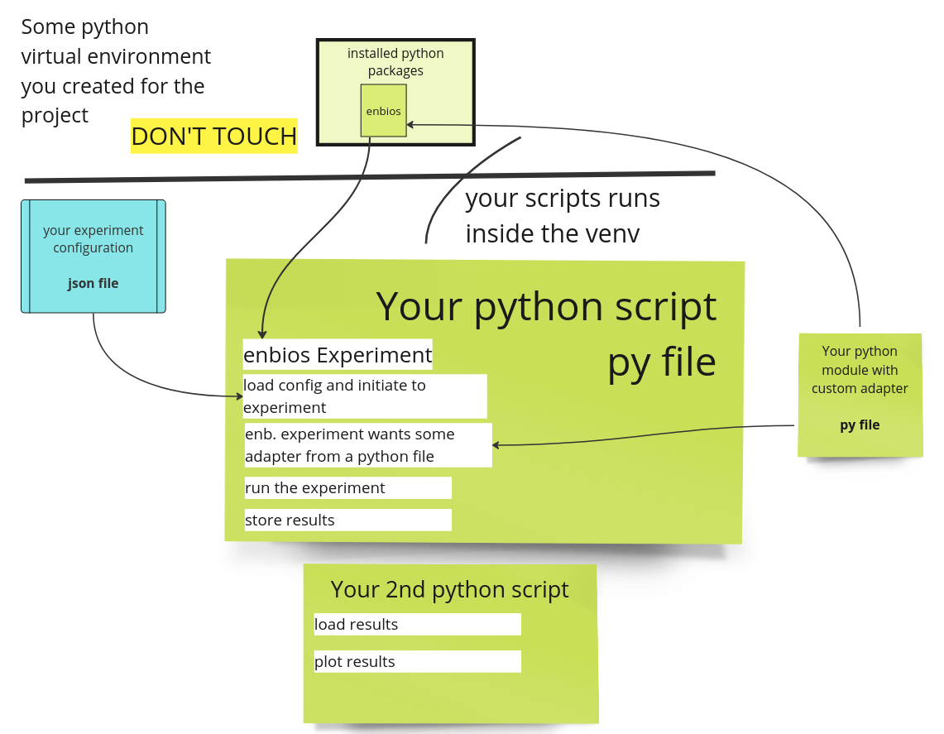

Slide 12
Python fundamentals
Object oriented script language
Dynamically typed (but type hints were recently introduced and make your program much much better)
Code Structure through format: indention (4 spaces, 2 tabs, ...)

Slide 13
Object-oriented programming (OOP)
OOP is a programming style that uses "objects" -- data structures consisting of data fields and methods together -- to design and organize software programs. Classes, in this context, are blueprints for creating objects, offering a way to group related tasks and data together.

Slide 14
Object-oriented programming (OOP)
OOP is a programming style that uses "objects" -- data structures consisting of data fields and methods together -- to design and organize software programs. Classes, in this context, are blueprints for creating objects, offering a way to group related tasks and data together.

Slide 15

Objects
Have the fields (variables) as defined in the class and provide the functions that can do operation on the object state...

Slide 16
Classes in Enbios
Experiment
Scenario
TreeNode
Adapter, Aggregator (Abstract classes and some concrete implementations)

Slide 17
Fundamental types in python
Basic types: int, float, string, bool
Classes:
List: lists of something (anything). Items can anytime added, removed and accessed by index
Dictionary: key, values pairs (keys: generally strings; values can be of any type. Items can be added, removed and accessed by the keys)
Any arbitrary nesting of those 2 is possible (as it is in json)

Slide 18
Modules (py files)
Contain: code (variable declarations, expressions), classes, functions
Individual parts can be imported in other modules
Import runs the whole imported module (that’s why we have the __name__ == “__main__” condition

Slide 19
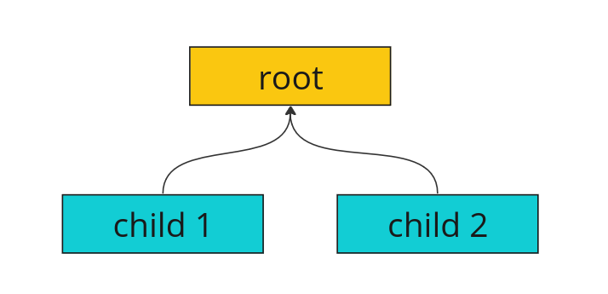
TreeNode class in Enbios
Fields:
name (unique in the tree)
children
parent
data (e.g. output, result)
Functions: to add/remove children and navigate through the tree

Slide 20
Package
A self contained set of python modules (.py files) that have a specific purpose
Can be published on Pypi
Packages on Pypi can be installed with python pip
E.g. numpy, scipy, matplotlib, brightway, enbios and thousand others

Slide 21
Python virtual environments
Little contained installations of python on your computer. Why?
  Different projects sometimes need different versions of python or packages
  Makes it much easier to reproduce project requirements
  Easy to dispose

Slide 22
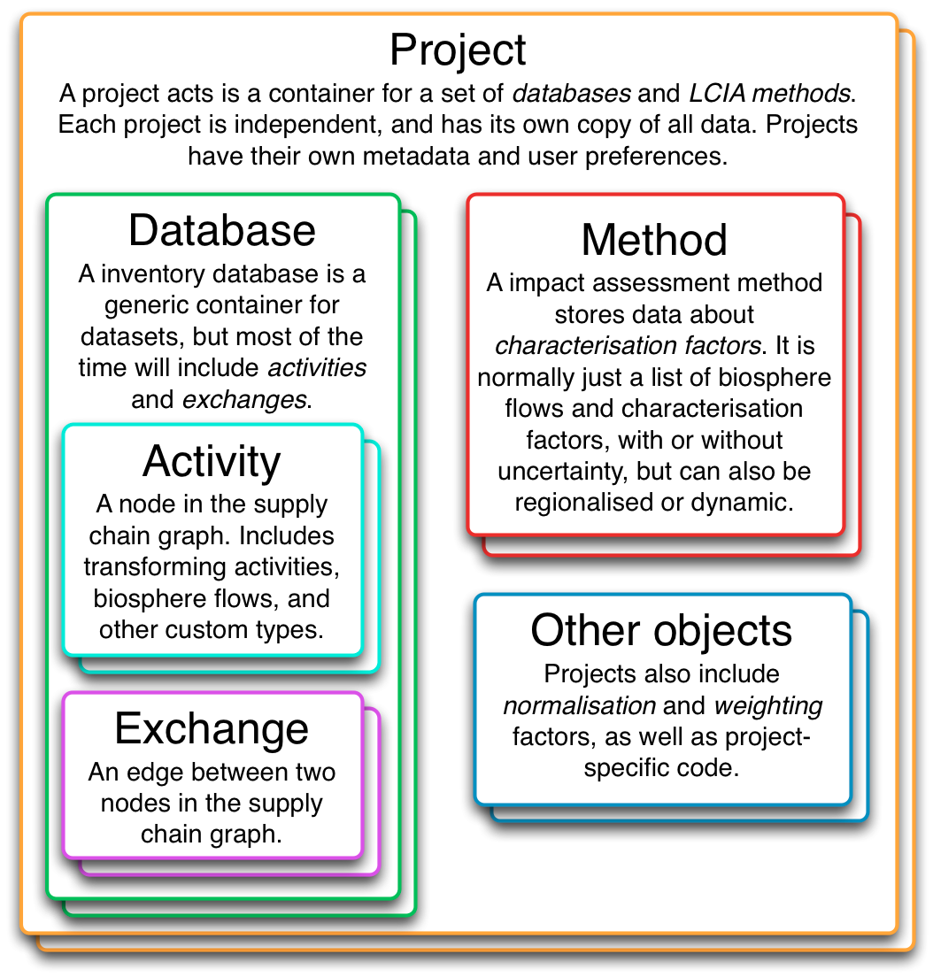
Brightway
LCA splitup in 3 (or more) packages
Brightway projects are system wide
Now: Create a BW project and import ecoinvent into it’s database [LINK]

Slide 23
Some Documentation
https://github.com/LIVENlab/enbios/tree/main/docs

Slide 24
Enbios Demo notebooks
Intro ++
Plotting?
Regionalization?
… You decide

Slide 25
Questions for your scenario?
Whats your scenario? 1 sentence
What would be the structural nodes? What are their possible outputs, what would be the methods of the Adapter(s) in your scenario.
What would the Aggregators calculate/decide?

