Slide 1
SMART WATCH ATTENDANCE SYSTEM BY LIVINKUMAR.D MONISHA.R SURUTHIKA.S SUSHMA.H

Slide 2
PROBLEM FACED:
Delhi government announced the suspension of biometric attendance in its offices via a written letter due to spread of covid.
Maharishi Valmiki Hospital in the Capital City of India suspended biometric attendance announcing it as a “precautionary measure on account of coronavirus scare.
So the need of smart attendance system is required.

Slide 3
SOLUTION:
COMPONENTS USED:
Fingerprint sensor
IR transmitter
IR receiver
Arduino based program
RTC module
Database programming
Common fingerprint system is avoided. Instead of common fingerprint system, we can use individual fingerprint system.
We provide the smart wrist watch for each workers which contains an IR transmitter and fingerprint scanner.
IR receiver is fitted inside a entrance of the campus.
IR transmitter and IR receiver is to make sure that the person is in the campus.
Fingerprint scanner is to find whether right individual is giving the attendance.

Slide 4
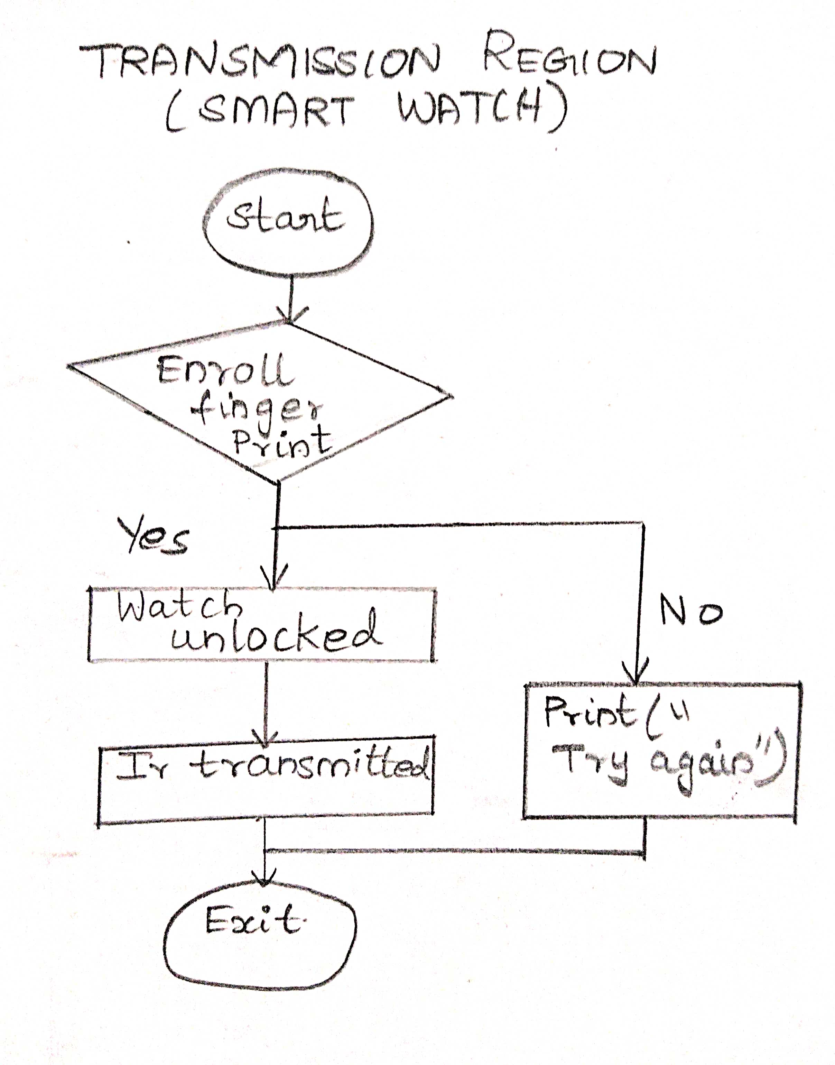
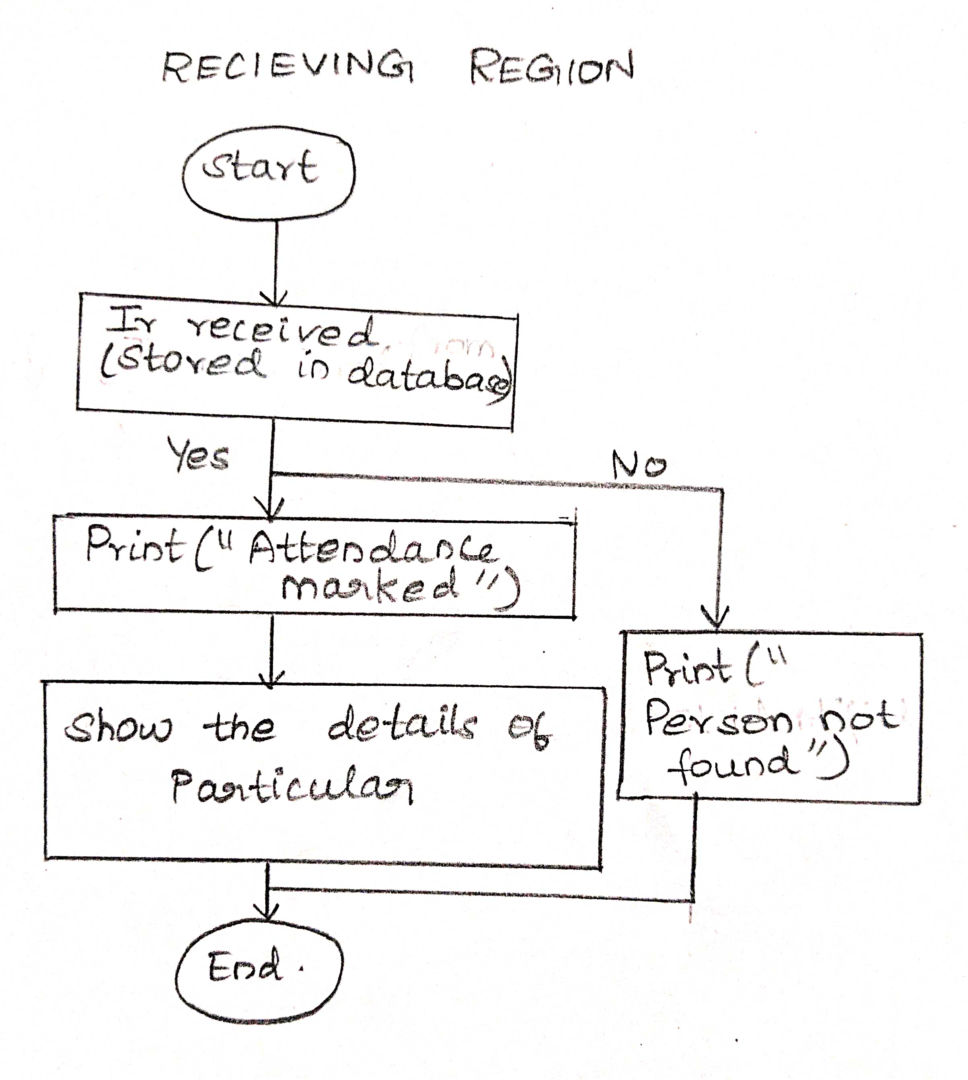
FLOW OF WORKING

Slide 5
IR TRANSMITTER AND IR RECEIVER
IR transmitter is fitted in the watch and IR receiver is fitted in the device which is present inside the entrance of the campus.
RF transmitter is fitted with a button. When the button is pressed, binary code associated with the button gets generated.
Binary code is modulated in order to prevent the change of IR to sunlight .
We can make the IR transmitter and IR receiver to work in a range of 5 meters

Slide 6
CAPACITIVE FINGERPRINT SENSOR
Capacitive scanners make use of pixel array of capacitors instead of visible light, to produce the image of fingerprints .
An array of tiny capacitors is placed just below the scanning surface to collect fingerprint details.
When fingertip touches the scanning surface, charge of capacitors changes which are located just below the friction ridges.
This difference of charge beneath the friction ridges and valleys is tracked by an op-amp integrator circuit, which can then be recorded by an analogue-to-digital converter.

Slide 7
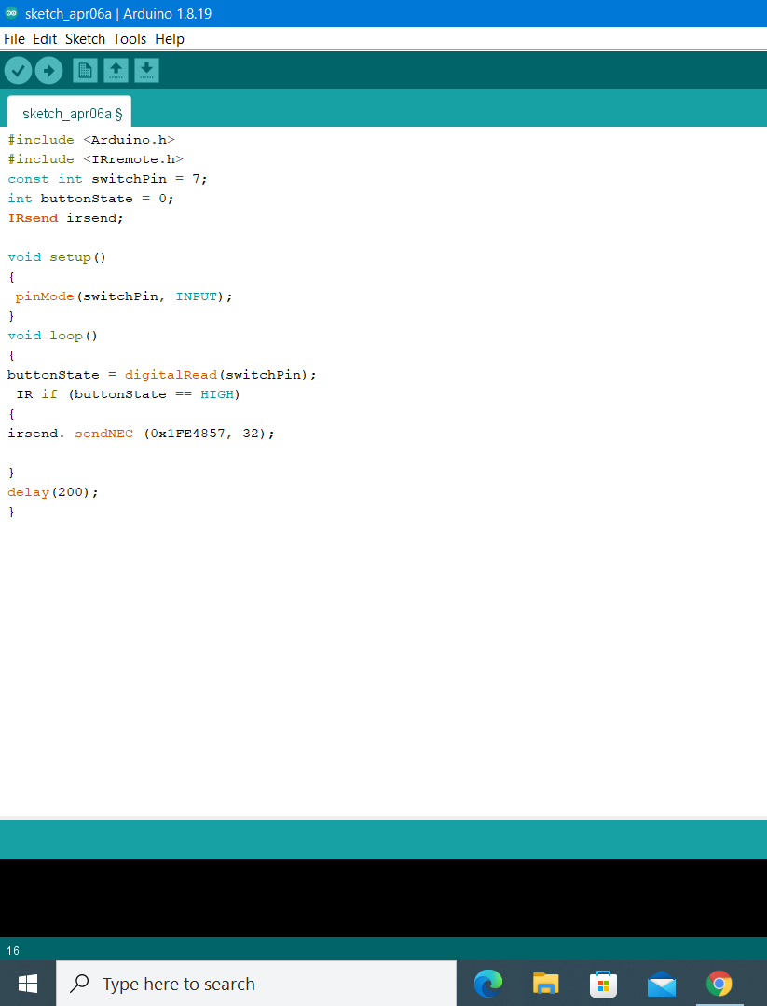
IR TRANSMITTER

Slide 8
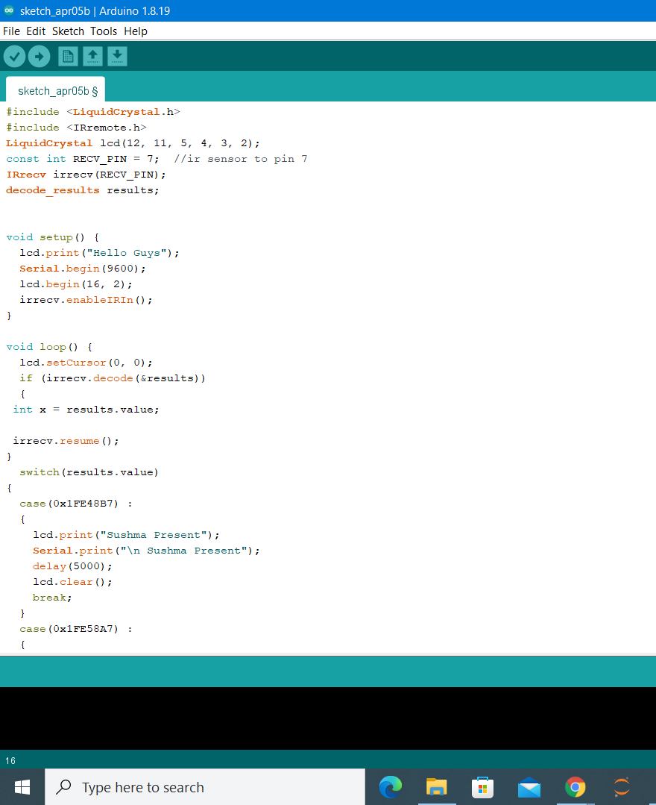
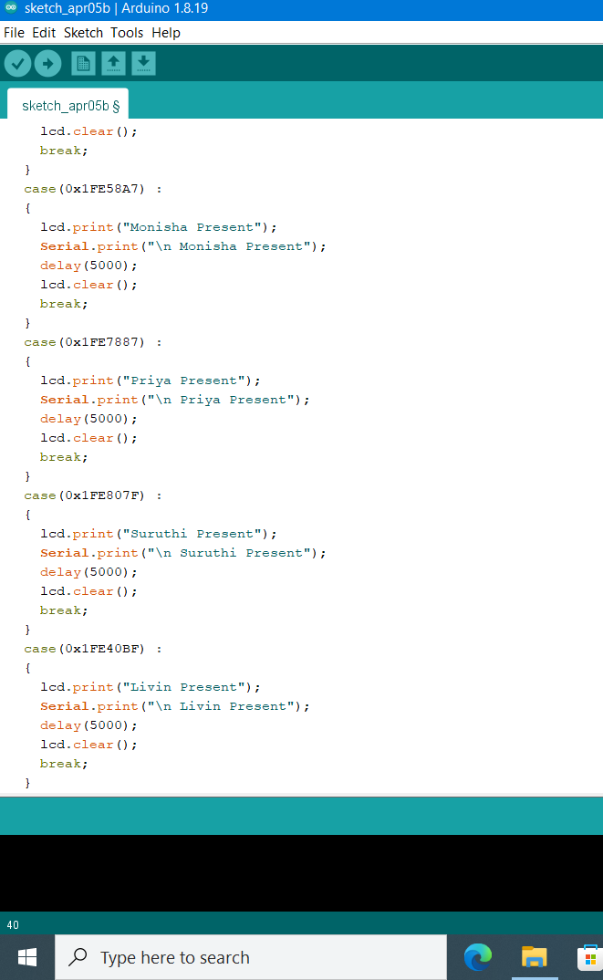
IR RECEIVER

Slide 9
DETAILS IN DATABASE: create table students(name char,rollno int,dept char,Ircode varchar(10)); insert into students values(‘SUSHMA’,123,’eee’,’0x1FE48B7’);- insert into students values(‘MONISHA’,456,’eee’,’0x1FE58A7’); insert into students values(‘LIVIN’,789,’eee’,’0x1FE40BF’); select * from students;

Slide 10
THANK YOU

