Slide 1
MATH 1014 – Calculus II (Tutorial 1)
Department of Mathematics, HKUST

Slide 2
Arrangements of MATH1014-T8A
Teaching Assistant: LI Yixin (yliqh@connect.ust.hk)
Time and Venue: Th 06:00PM - 06:50PM, Rm 1034, LSK Bldg
Tutorial Notes (Prepared by Professor WU’s TA Team):
Before Tutorials: Homepage on Canvas (Available on Mondays)
After Tutorials: My homepage (Available on Fridays)
Handwritten notes and Photos during the tutorials
NO need to download before or during the tutorials
Procedure: Review -> Do exercise by yourself (3 min) -> Share my methods -> …
Any questions or suggestions, feel free to contact!

Slide 3
Know what you understand and what you do not.
Then, Practice!

Slide 4
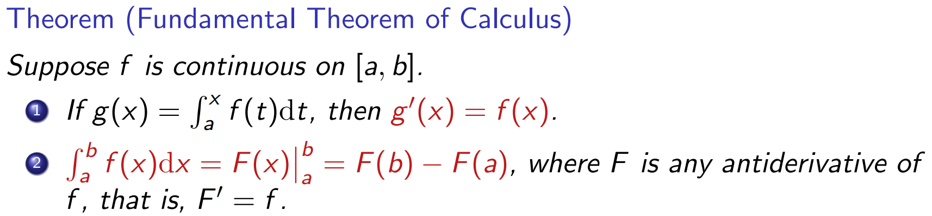

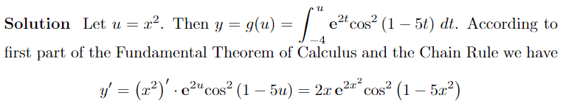

Slide 5
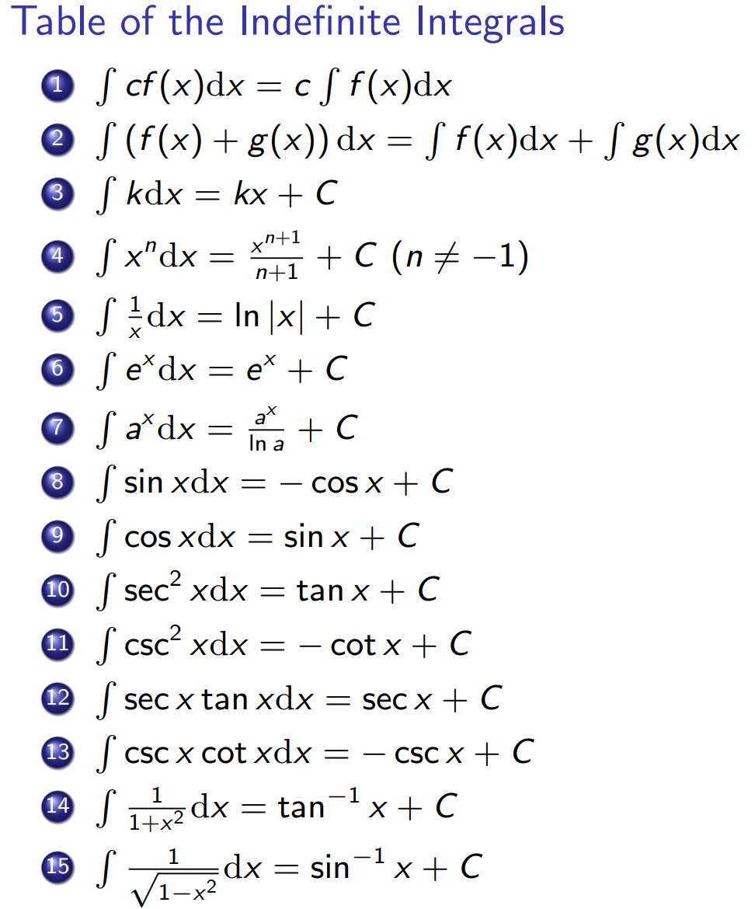
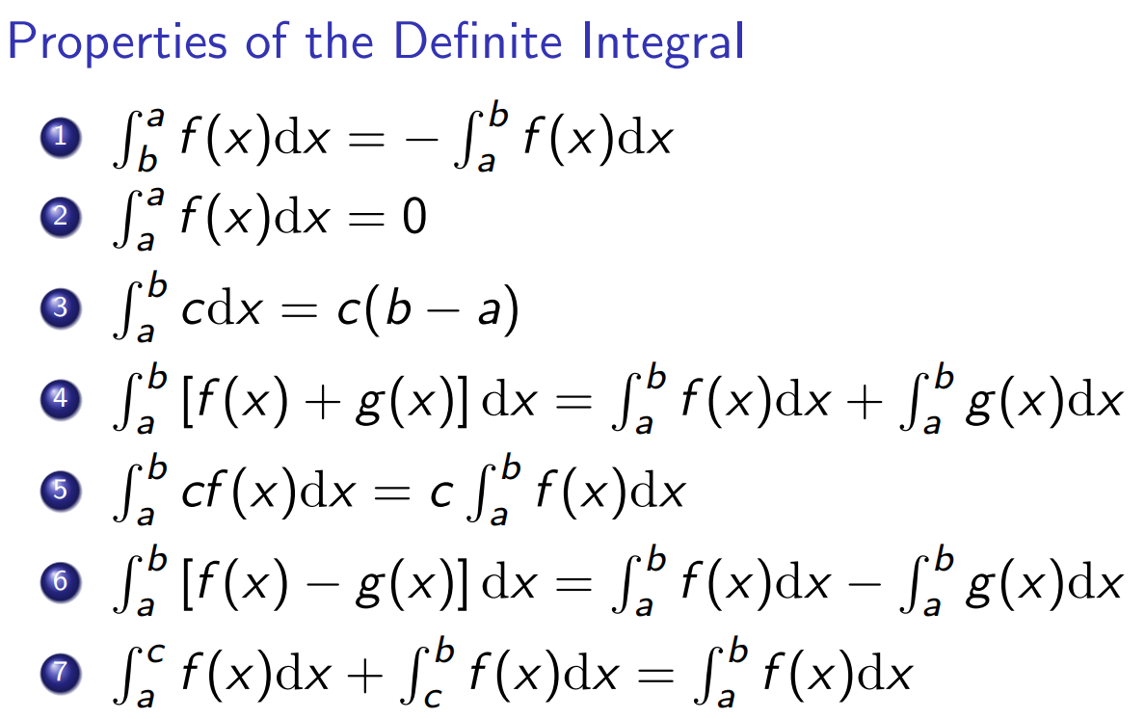
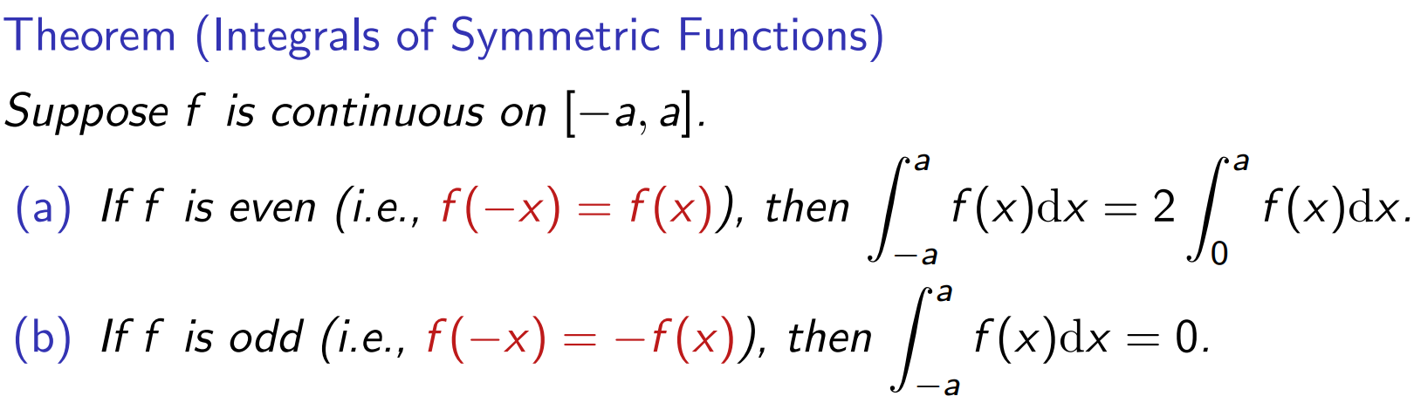

Slide 6
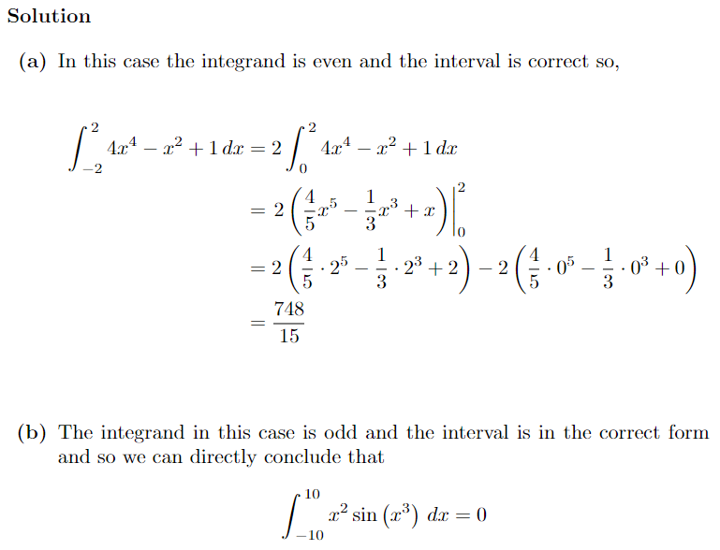
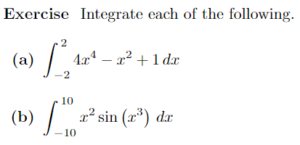

Slide 7
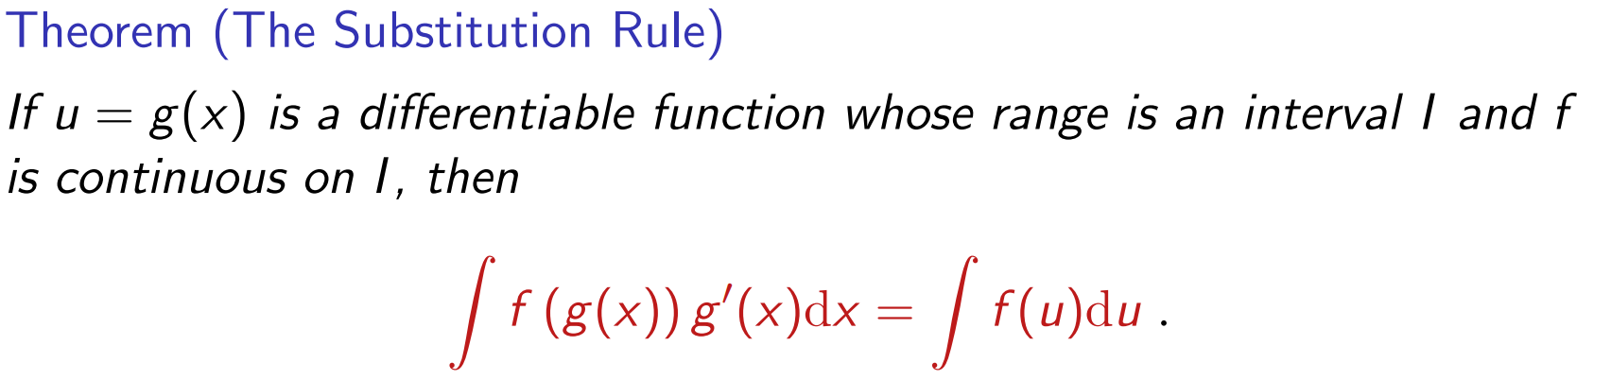
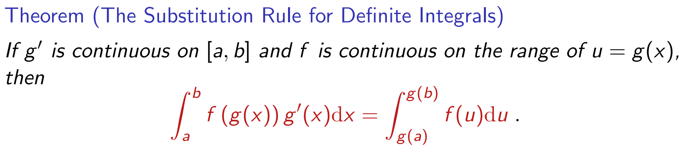

Slide 8
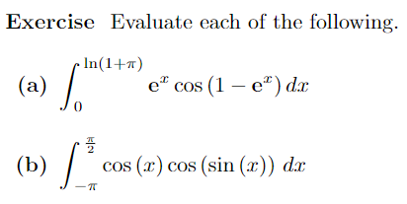
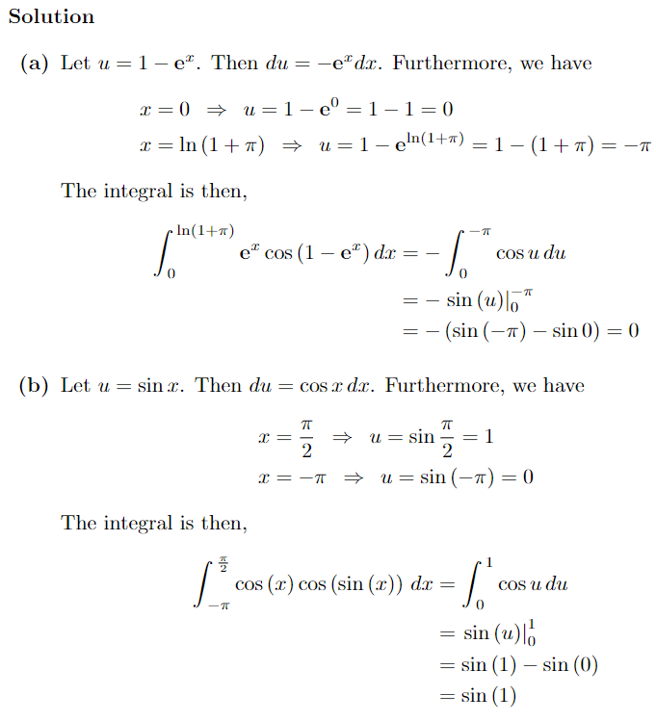

Slide 9
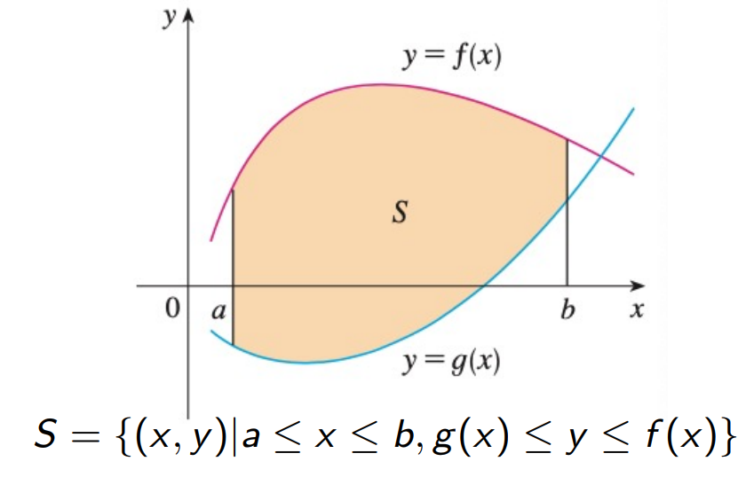
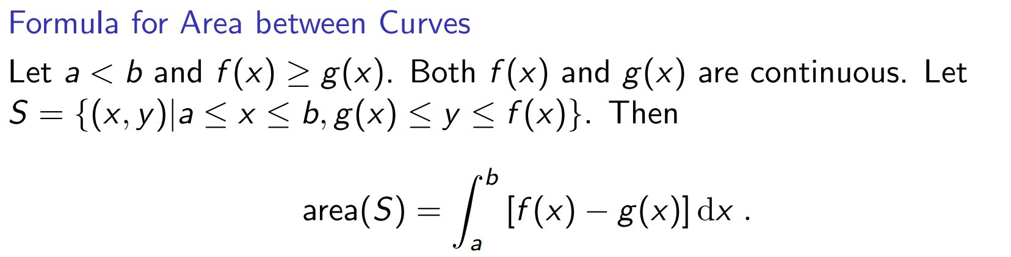

Slide 10
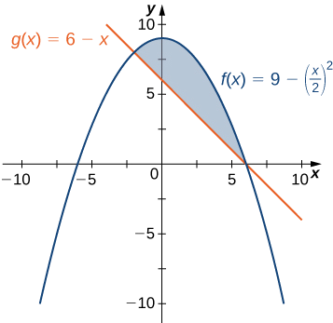
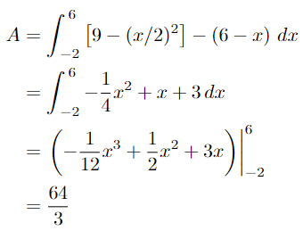

Slide 11
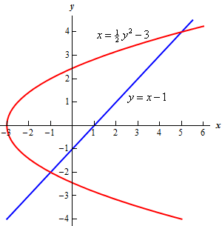
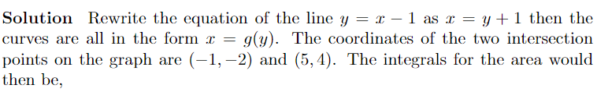
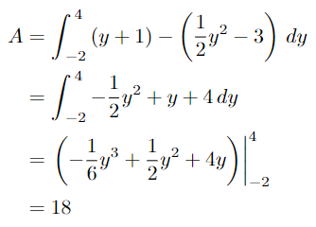
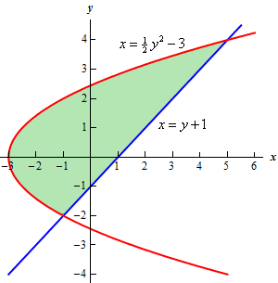

Slide 12
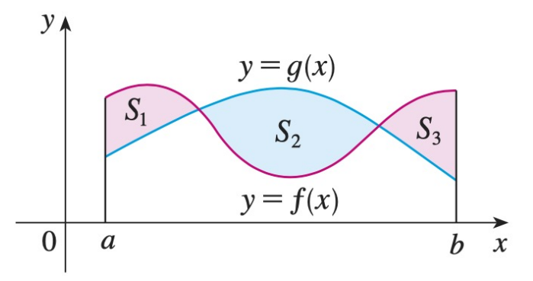
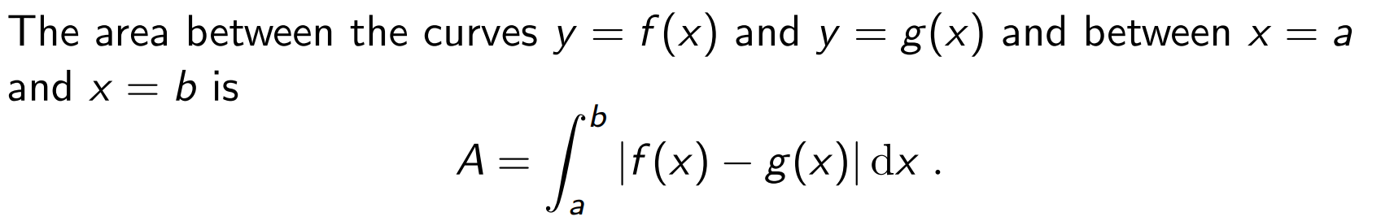

Slide 13
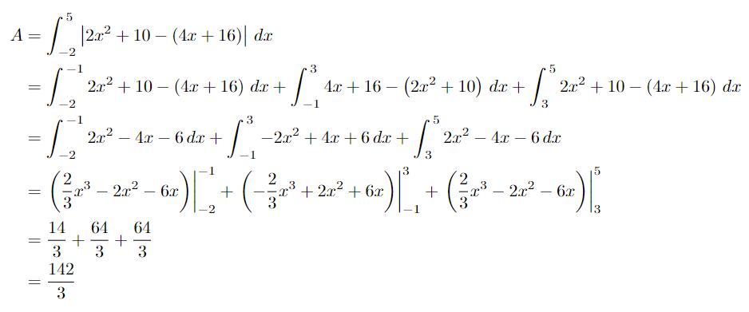
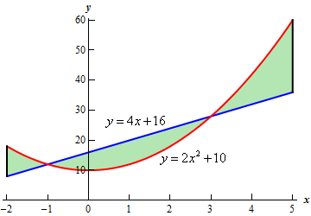

Slide 14
Thanks!

