Slide 1
MATH 1014 – Calculus II (Tutorial 3)
Department of Mathematics, HKUST

Slide 2


Things Before the Tutorial
Calculator in the Midterm
No Calculator is allowed in the examination.
No question requires the use of a calculator.
Suggestion from POON Wing Yin: More Visualization
[Link] [T02-Exercise1]
[Link] [T02-Exercise1] [T02-Exercise2]

Slide 3

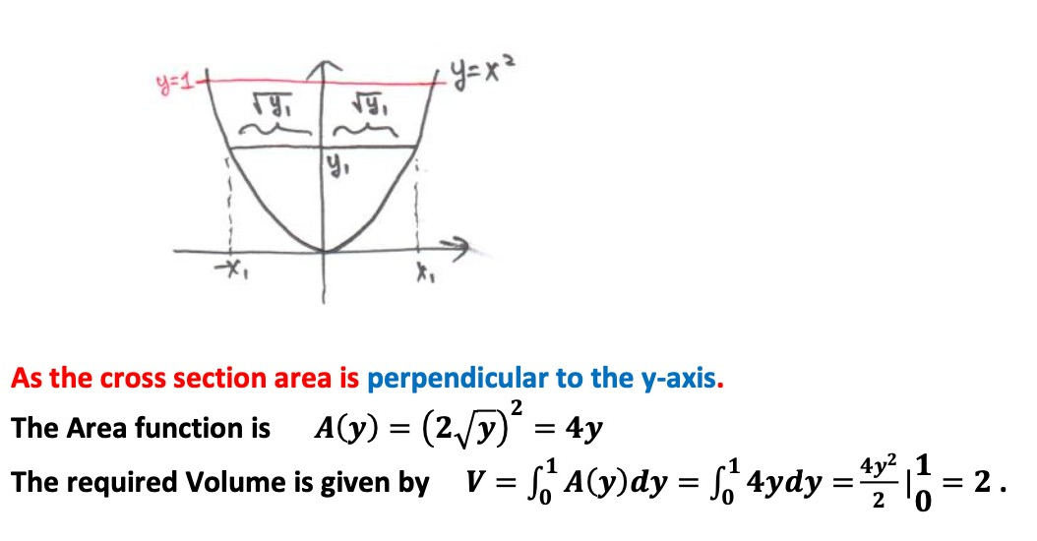
T02-Exercise 1

Slide 4

T02-Exercise 2

Slide 5
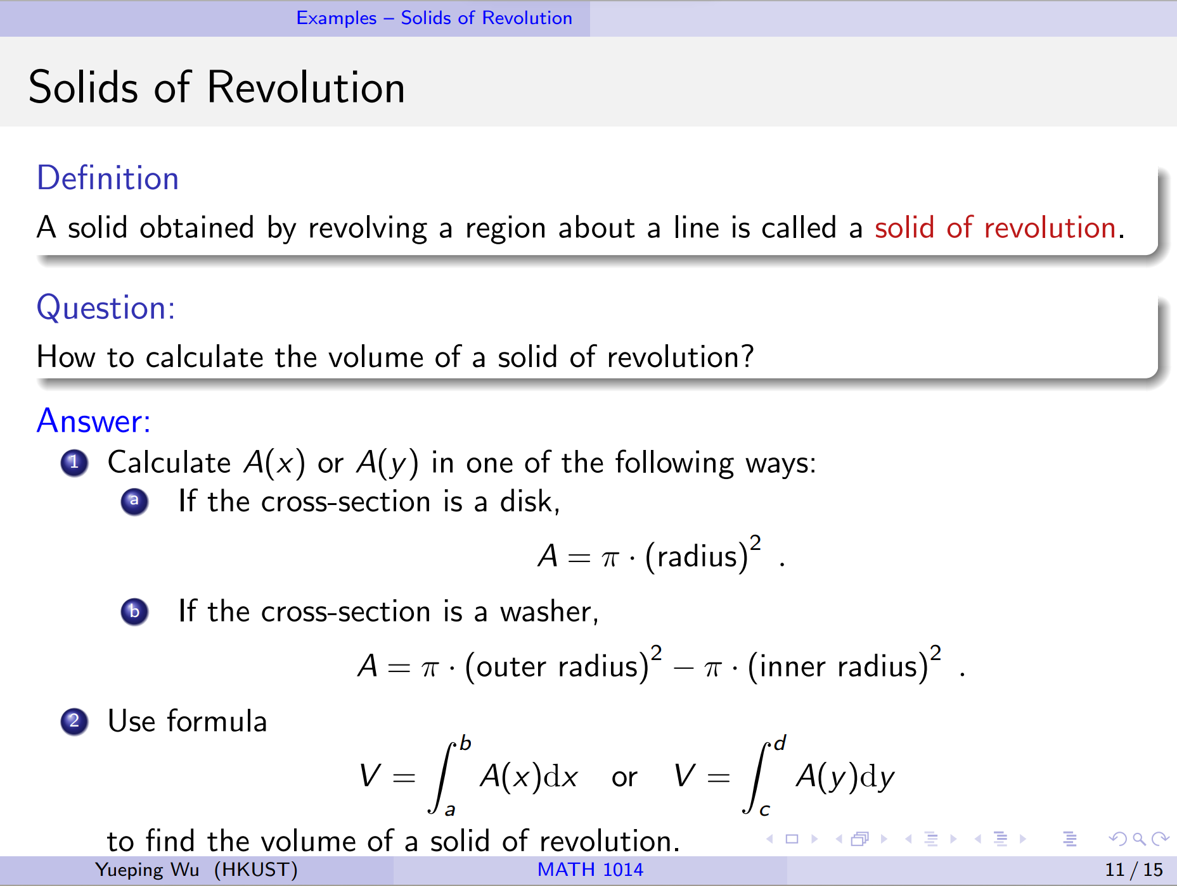

Slide 6
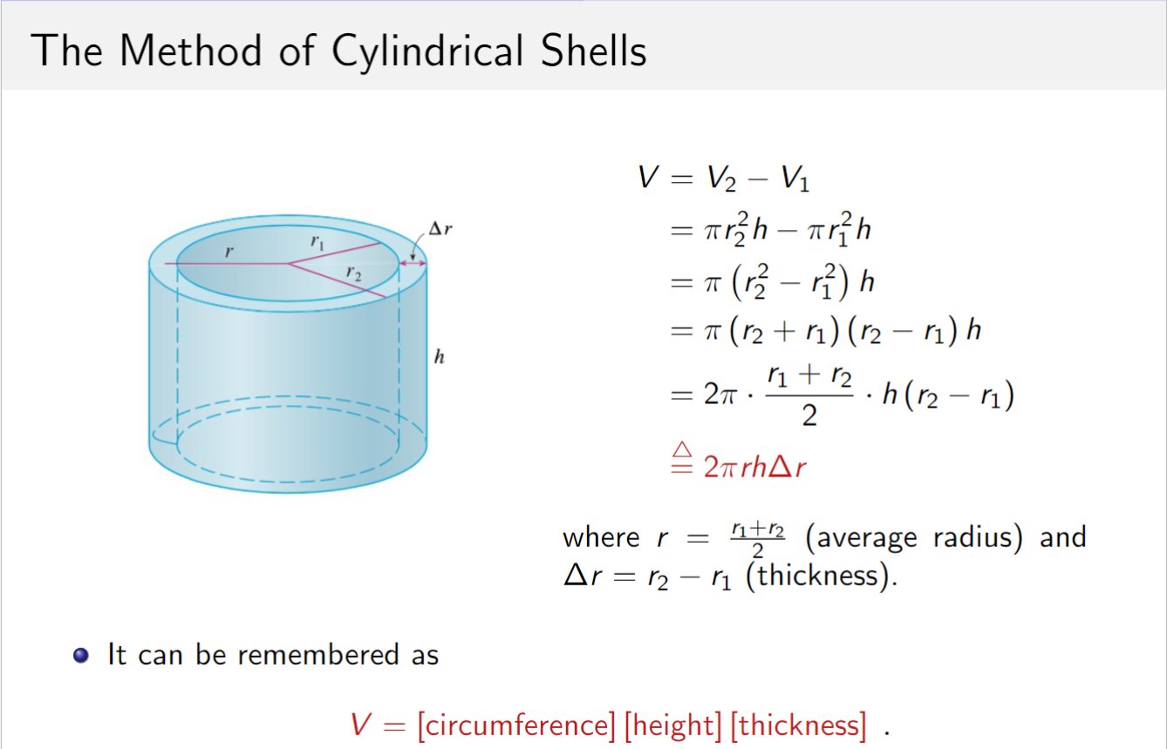
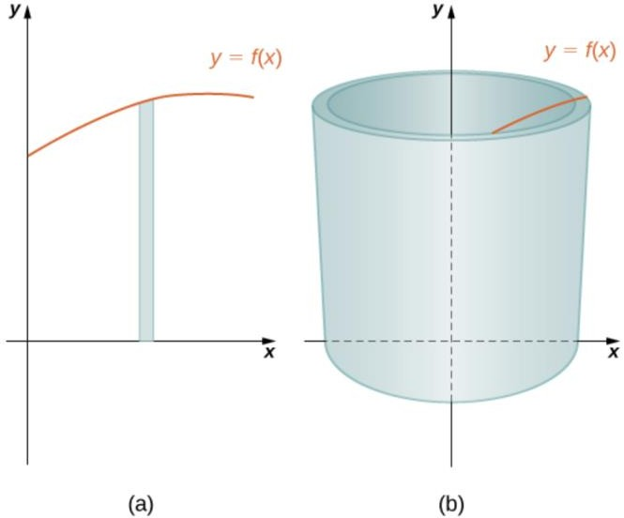
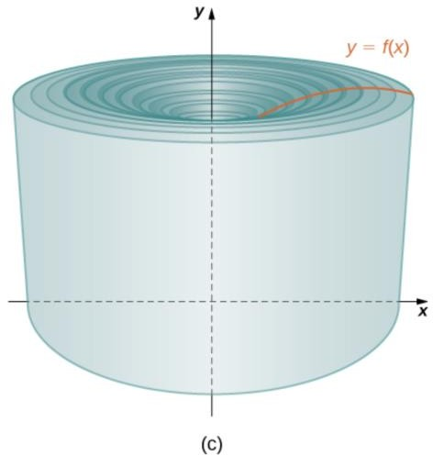



Slide 7

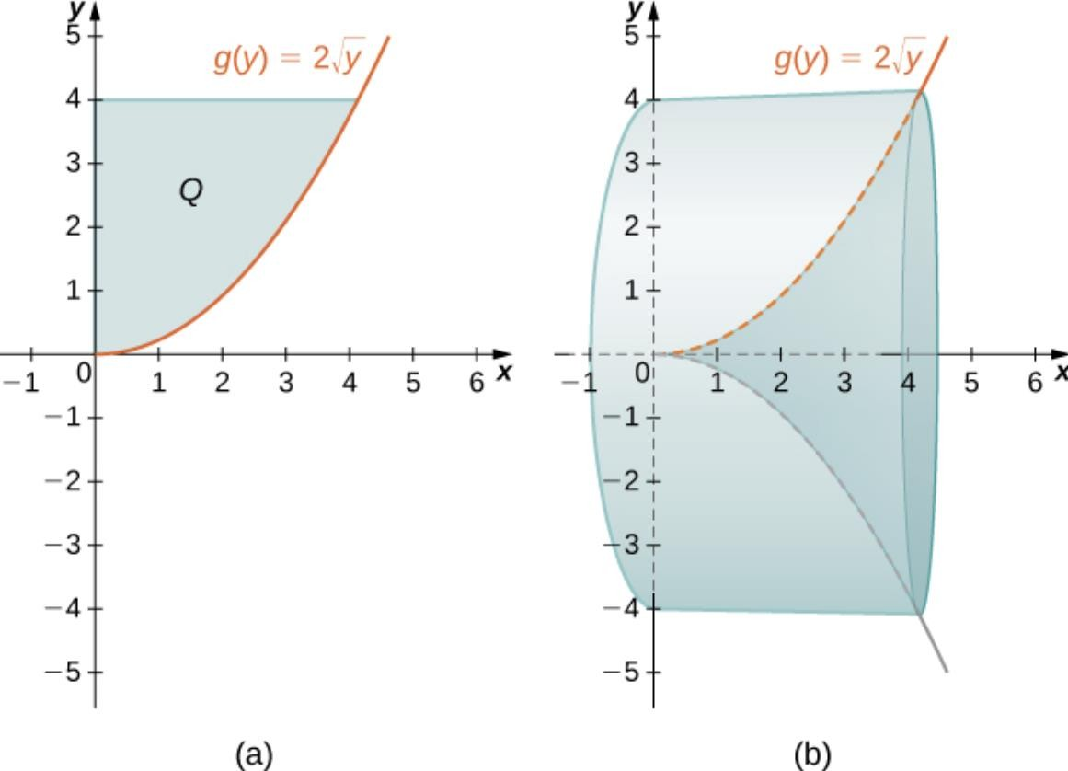
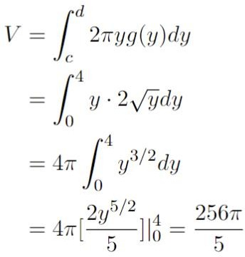
T03-Exercise 3

Slide 8


T02-Exercise 3

Slide 9

T02-Exercise 4

Slide 10

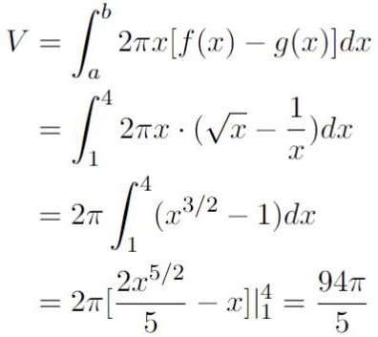

T03-Exercise 2

Slide 11
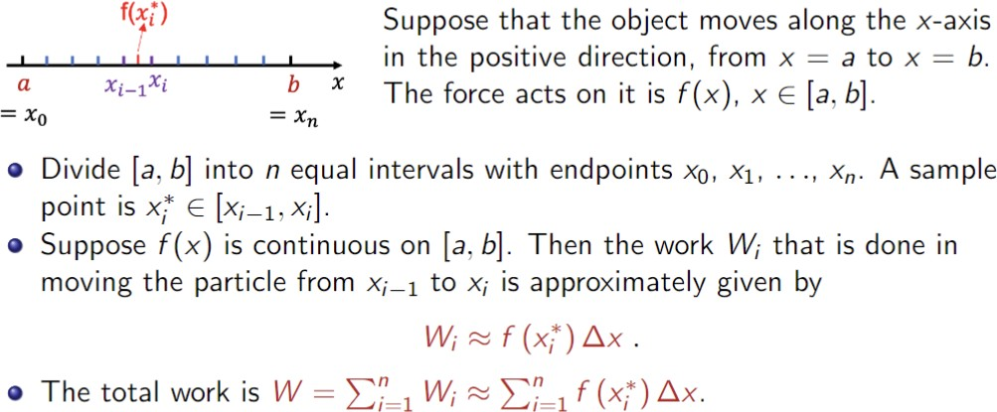

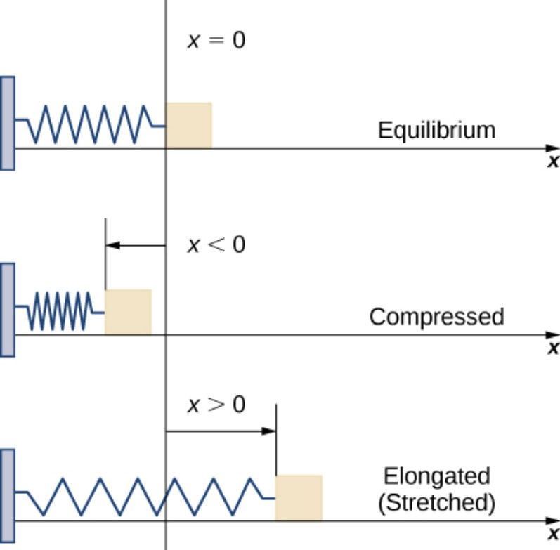


Slide 12

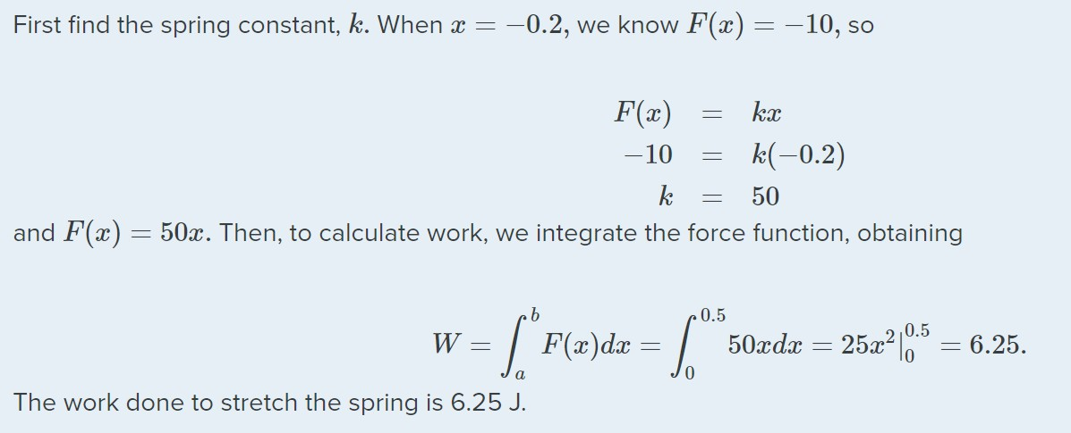
T03-Exercise 4

Slide 13

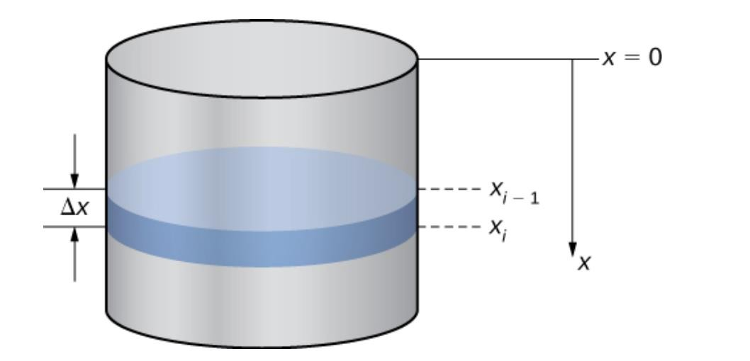
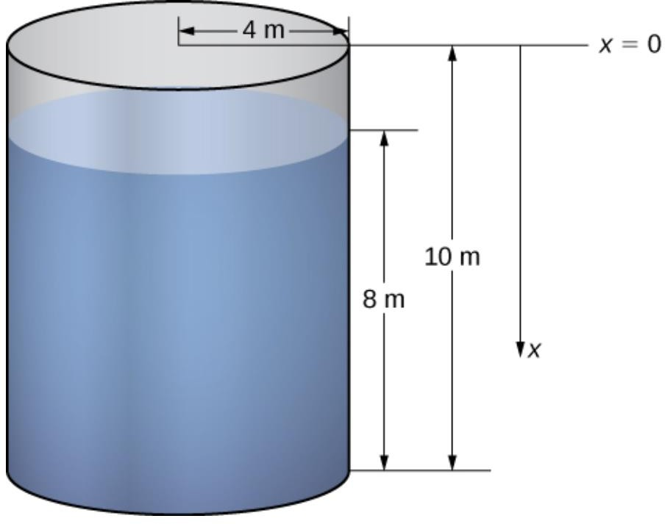
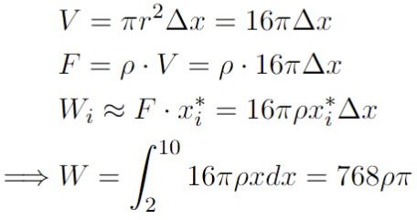
T03-Exercise 5
g
g
g

Slide 14
Skipped Questions

Slide 15


T02-Exercise 5

Slide 16

T02-Exercise 6

Slide 17


T02-Exercise 7

Slide 18

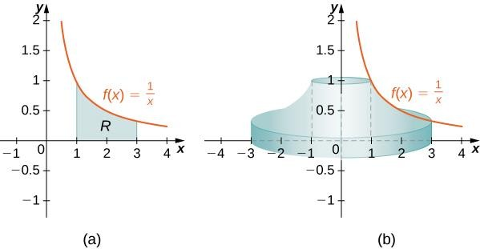
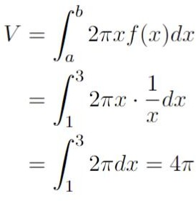
T03-Exercise 1

Slide 19
Thanks!

