Slide 1
MATH 1014 – Calculus II (Tutorial 5)
Department of Mathematics, HKUST

Slide 2
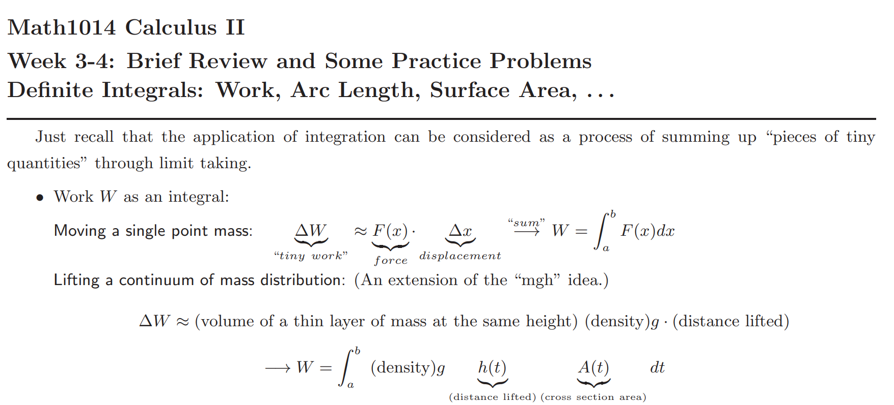

Slide 3
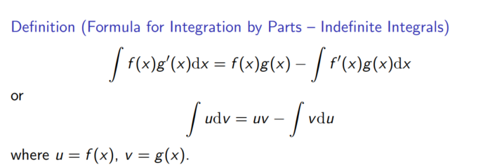
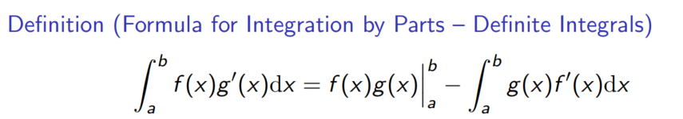

Slide 4
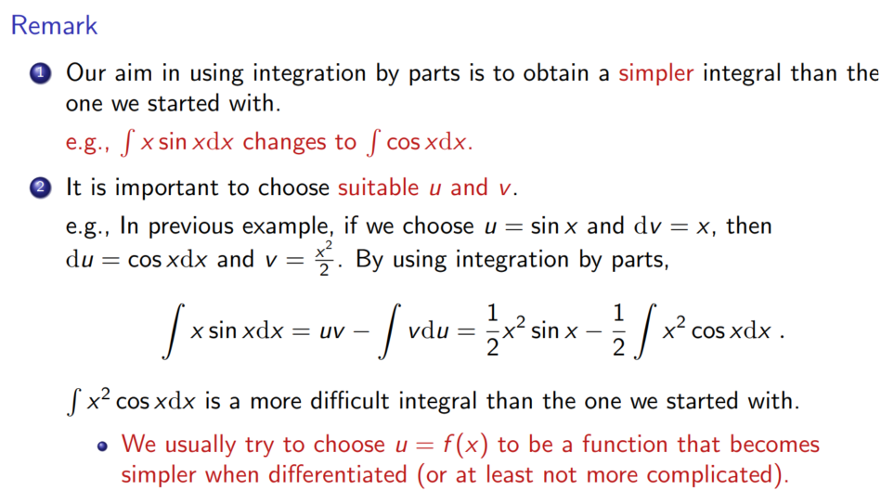

Slide 5






How to choose u and v
Inverse Trigonometric Functions
Logarithmic Functions
Power Functions
Exponential Functions
Trigonometric Functions
Choose the type on the top as u.
Repeated integration by parts [Link] (NOT suggested in exams)

Slide 6







Exercise 1
Solution

Slide 7


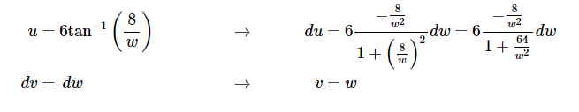



Exercise 2
Solution

Slide 8


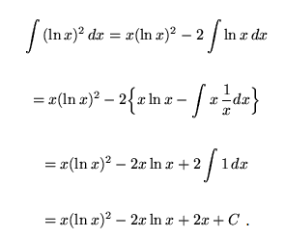


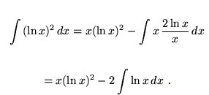


Exercise 3
Solution

Slide 9
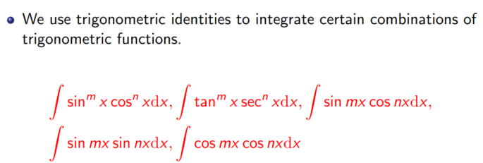

Slide 10
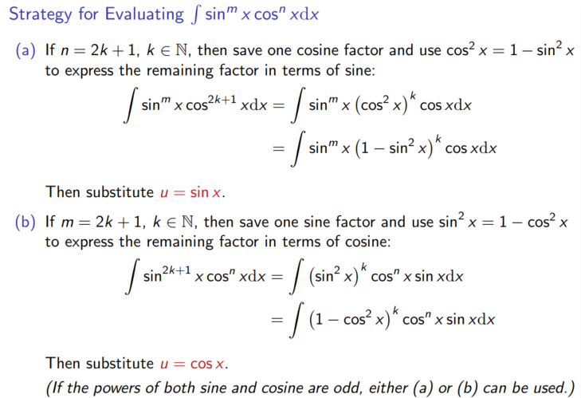

Slide 11
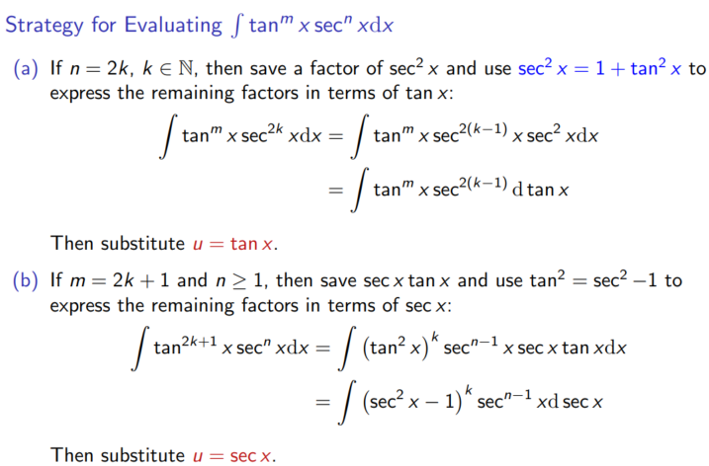

Slide 12





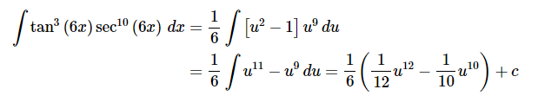

Exercise 4
Solution

Slide 13

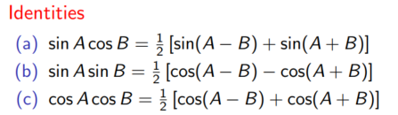
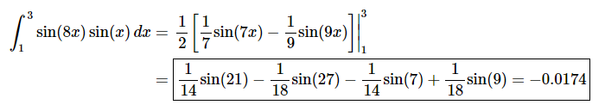
Exercise 5
Solution

Slide 14




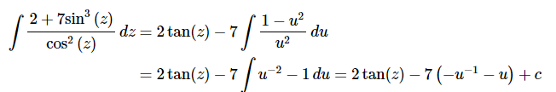

Exercise 6
Solution

Slide 15
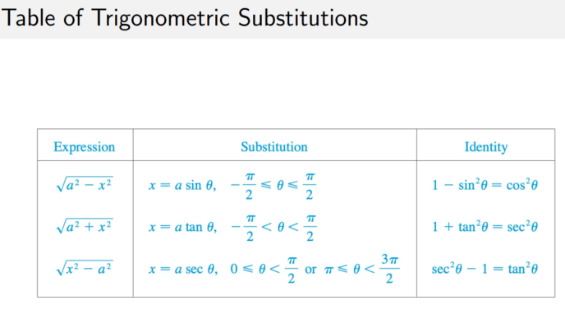

Slide 16

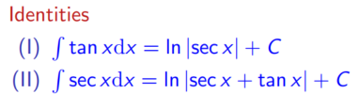
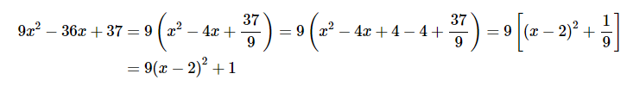

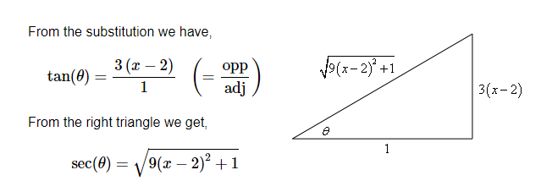






Exercise 7
Solution

Slide 17



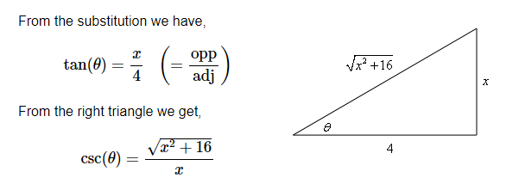





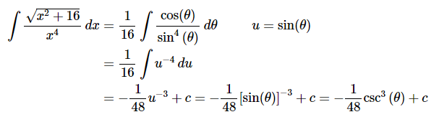
Exercise 8
Solution

Slide 18
Thanks!

