Slide 1
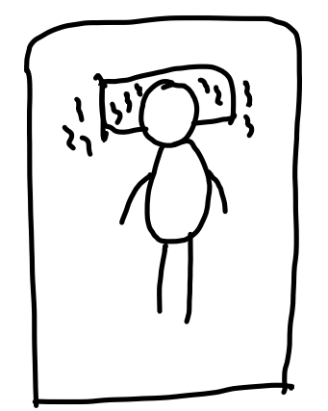

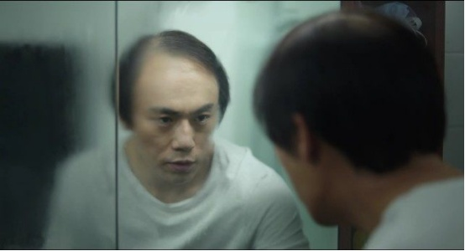

- Shower
- Wake up
- Thinking

Slide 2

Presented by Yunzhe Li

Slide 3
Outline
- Current situation of Alopecia in College
- The reason
- How to prevent

Slide 4
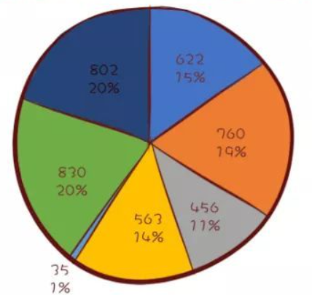


Current situation of Alopecia in College
Undergraduate: 2436 Master: 830 Doctor: 802
Freshman
Sophomore
Junior
Senior
Master
Doctor

Slide 5

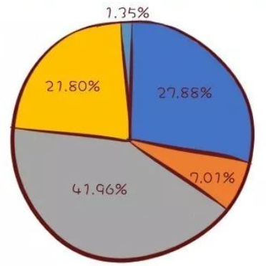

Do you feel that you have excessively hair loss?
Yes, a lot of
Almost bold
Same as before
A little bit
Not at all
Nearly 60% of the sutdents felt that they had some degree of hair loss

Slide 6
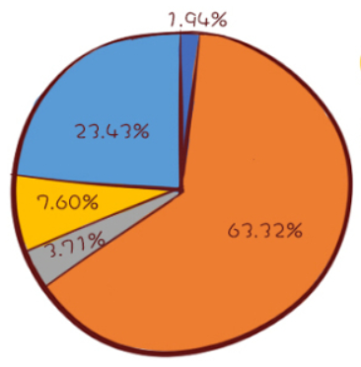
Do you feel that your hairline is rising?
Not at all
Same as before
Start growing
Yes, a lot of
A little bit
Nearly 40% of the sutdents felt that their hairline raised in various degrees.

Slide 7
The reason of Alopecia
- Gene
- Changes in diet structure
- Over-Exopsure to screen
- Overwhelming peer pressure

Slide 8
How to ease peer pressure to prevent Alopecia
To be Buddha-like
Do what we can do
Compare with ourselves before
Cultivate strong ability
Not GPA but ability that matters

