Slide 1
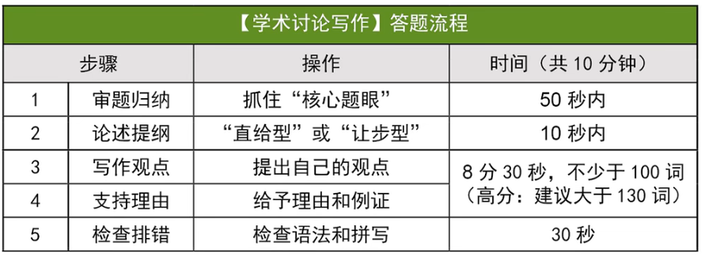
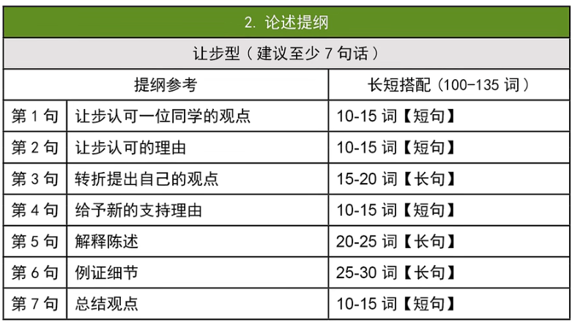
让步型：
Xx’s argument about xxxxx holds value/merit/weight.
Indeed, xxxxxxx 让步理由
However, 转折观点 xxx can be more beneficial.
When xxxxx 给出理由
Especially for xxxxxxxx 解释理由陈述
For example, xxxxxxx【描述问题】But fortunately, xxxxxxx, allowing xxxxxx【解决问题】
Therefore, although xxxx has advantages in xxxx, having xxxxx provides more xxxxx
成就 乐趣
方便 效率
经济 耐用
健康 情感
经验 交流
安全 环保
提升：improve, enhance, elevate, promote, prompt, boost, increase, facilitate
培养：foster, nurture, integrate, prioritize
减小：diminish, reduce, alleviate
大量：paramount, huge, tremendous
激发/吸引：spark, encourage, spur, attract, drive, motivate
困难/缺点：flaw, challenges, shortcomings, problems, issue
保持/支持：sustain, ensure, secure, support, commitment, dedication, devotion
有助于：contribute to, be conductive to, serve the purpose, in favor of
胜过：...incentives far outweigh the benefit of,

Slide 2
not saying nice = promoting goodwill
In other words : 用于引出一个陈述
However, to xxxx, xxx necessiate more than xxxx but also require xxx
prevent minor issues from escalating
foster long-term progress for the team
openness
in intricate multi-field collaborations
are essential for

Slide 3
participating in sports competitions
However, for ....., ... necessitate .... but .... to start a distinguished career,
optimal = best
elite athletes
gain recognition and receive professional training
renowned = famous
top-tier talents
nuture future champions
promote personal growth

Slide 4
对立观点时，要用despite the flaws of .....，through...., it
而平行观点时，可以用while ... is vital, ......is also pivotal.
... is sound = .. is valid.
encountered health challenges
overuse
electronic devices digital products
alleviate(diminish) negative impacts
spurs = encourages
flaws of
progressive improvement
very year sees / witnesses / experiences the release of improved solutions.

Slide 5
paramount advantage
the most siginificant value lies in ...ing
fostering interactions interaction > communication （促进交流）
assemble = gather
drawing = attracting
the role / function / duty of noun.
tremendously
foster = nurture = promote
enjoyment / insights
beyond .... contributions
auto shows featuring on-site test drives
sparking intellectual exchanges and tremendously boosting the residents' happiness
nurture worldwide communication
exchange insights

Slide 6
deliver the benefit
has the advantage of
fulfill the residents’ desires for a richer spiritual life
taking into account the correlation between infrastructures and urban development
secure sustained support
the community around the art gallery will witness the increase in consumption and tax revenue
ensure a sustainable development
Personally, Andrew’s argument that an art gallery delivers the society holds value. Admittedly, the recreational social environment can inspire citizens, fulfilling their desires for richer spiritual life.However, concerning the long-term development, the most significant benefit of an art gallery is the contribution to the economy.In other words, taking into account the correlation between infrastructures and urban development, an art gallery that suprs economic growth is more likely to strengthen sustained support.Specifically, the community around the art gallery will witness the increase in consumption and tax revenue.For example, the Shanghai Art Gallery organized several exhibitions of world-known artists which attracted millions of visitors to come to Shanghai. Not only they attended the exhibition but they also visited places nearby, nurturing immense financial potential. Therefore, beyond inspiration and joy brought by the art gallery, economic improvement is more pivotal.

Slide 7
promote research efficiency
provide specialized guidance to
the budget allocation
elevate education quality
integrate theory with frrontline practice
benefit lifelong career
Paul makes a valid point that schools cannot overlook investing in teaching resources. Admittedly, investing in educational equipment highlights a university's commitment for promoting research efficiency. However, considering that teaching and research work should be people-oriented, the budget allocation should prioritize improving educators' salaries. By raising salaries, universities can attract more experienced professionals for teaching, thereby elevating education quality and fostering students' achievements in the long term.Specifically, many schools are increasingly hiring top-tier professionals from the industry to provide specialized guidance to undergraduate students. For example, one of our architecture programs, guided by industry experts who earn high salaries, has integrated theory with frontline practice, helping students build networks to benefit their lifelong careers after graduation. Therefore, despite the importance of educational tools, promoting teachers' well-being should be the priority of universities' financial planning.

Slide 8
Personally, Andrew’s perspective that artworks created by artists brings enjoyment to citizens holds value. Admittedly, by appreciating their paintings or music, we tend to be inspired and feel relaxed. However, to foster an efficient development of one city, urban funds should prioritize essential be utilized on city’s amenities. In other words, as the financial budget is limited, they are required to local authorities should allocate them properly and contribute them to the majority in the city instead of the minority of artists. Specifically, investing in public transportation can be conductive to enhance commuting in daily life. For example, developing a swift underground can diminish the negative impact resulted from serious traffic congestion in our city, serving as a more efficient way to commute and saving our time. Therefore, beyond happiness brought by artworks, supporting more necessary services is more beneficial for the long-term improvement.

Slide 9
①
...’s perspective that ... holds value / is valid .
... brings about ... is a issue
maintain (verbal caution) is beneficial for individuals
the advantages of (being an only child)
the development of (social skills) through (part-time jobs)
an exhibition hall can spur economic development
②
Admittedly, when it comes to 讨论主题, ... often / can ... minimize / obtain more / encounter
promoting goodwill can minimize conflicts to a great extent.
obtain more financial support from their families.
encountered health challenges due the over use of digital products.
③
However, to ... / for ..., can diminish negative impacts / can be more beneficial for / necessitate more than but also require .
to achieve the team’s overall development
for talented young athletes
mutual support among siblings can be more beneficial for personal progress.
for locals and people worldwide, the most significant value of an exhibition center lies in fostering interactions and bringing tremendous joy

Slide 10
④
In other words, if ... , ... can ..., ...ing ....
if a family encounters long-term challenges, all family members can share the responsibility, reducing stress for each individual
if team members openly express their thoughts, it prevents minor issues from escalating. fostering the long-term progress of the whole team.
if you want to reach your friends, profesors or family immediately, the Internet eliminates geographic barriers, getting responses quickly.
if they engage in competitions, it’s an optimal pathway to start their future careers
taking the urban development into account, an art gallery that brings economic benefits is more likely to secure sustained support
⑤
Especially for ... / in a ... society, 概述例子
Especially in an aging society, taking care of elderly parents has become a paramount concern for every family.
in intricate multi-field collaborations, immediate reminders and sincere responses are essential for controlling project risks.
for many elite athletes, they began competing in an early age to gain recognition and receive professional training.
for students who got sick and cannot go to school, the Internet enables them not to miss a class.
⑥
For example, one of ... who was..., had to ... But fortunately, ... helped to ...., allowing him to ...
According to statistics, half of ..., causing many to ... during...

Slide 11
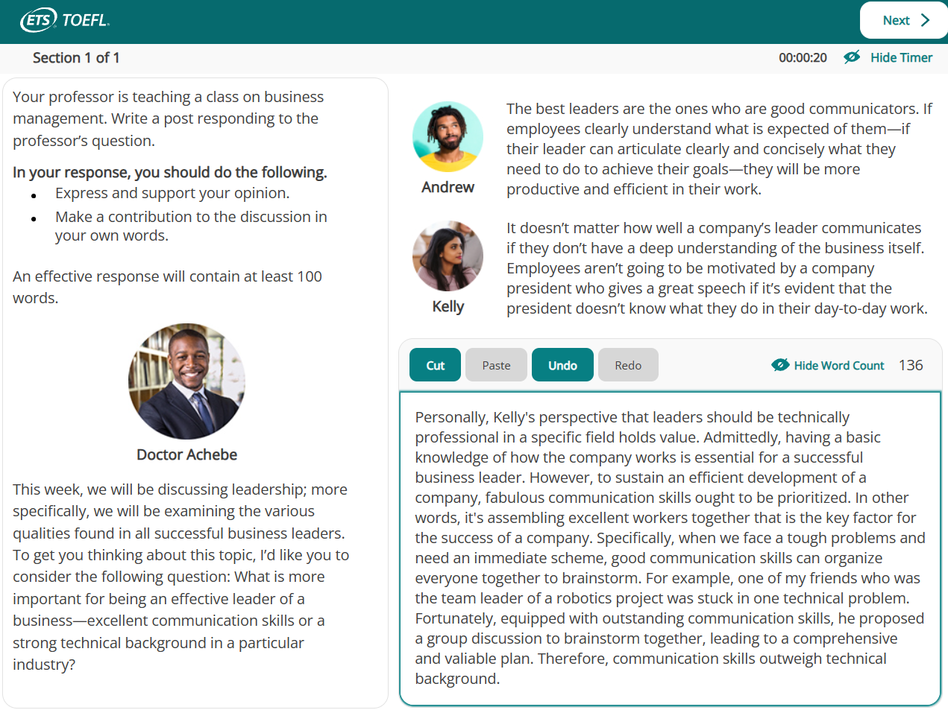

Slide 12
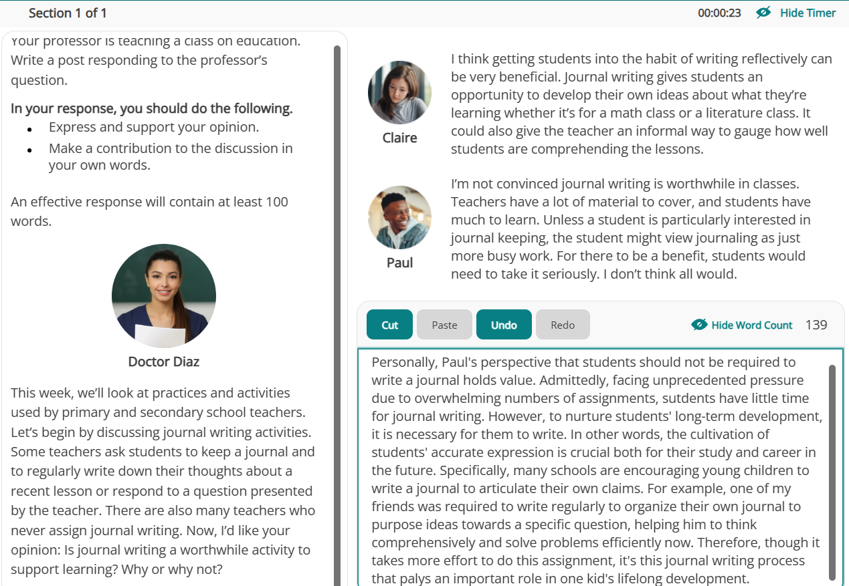
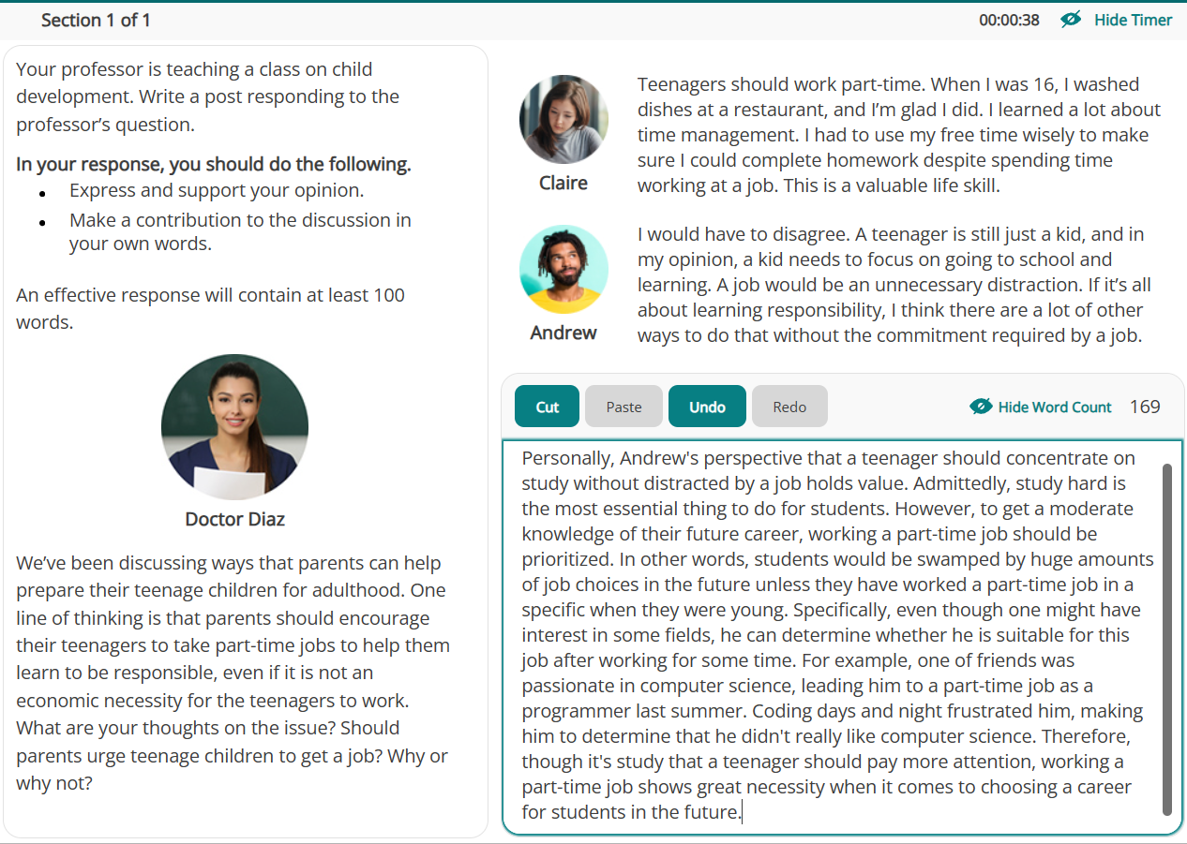

Slide 13
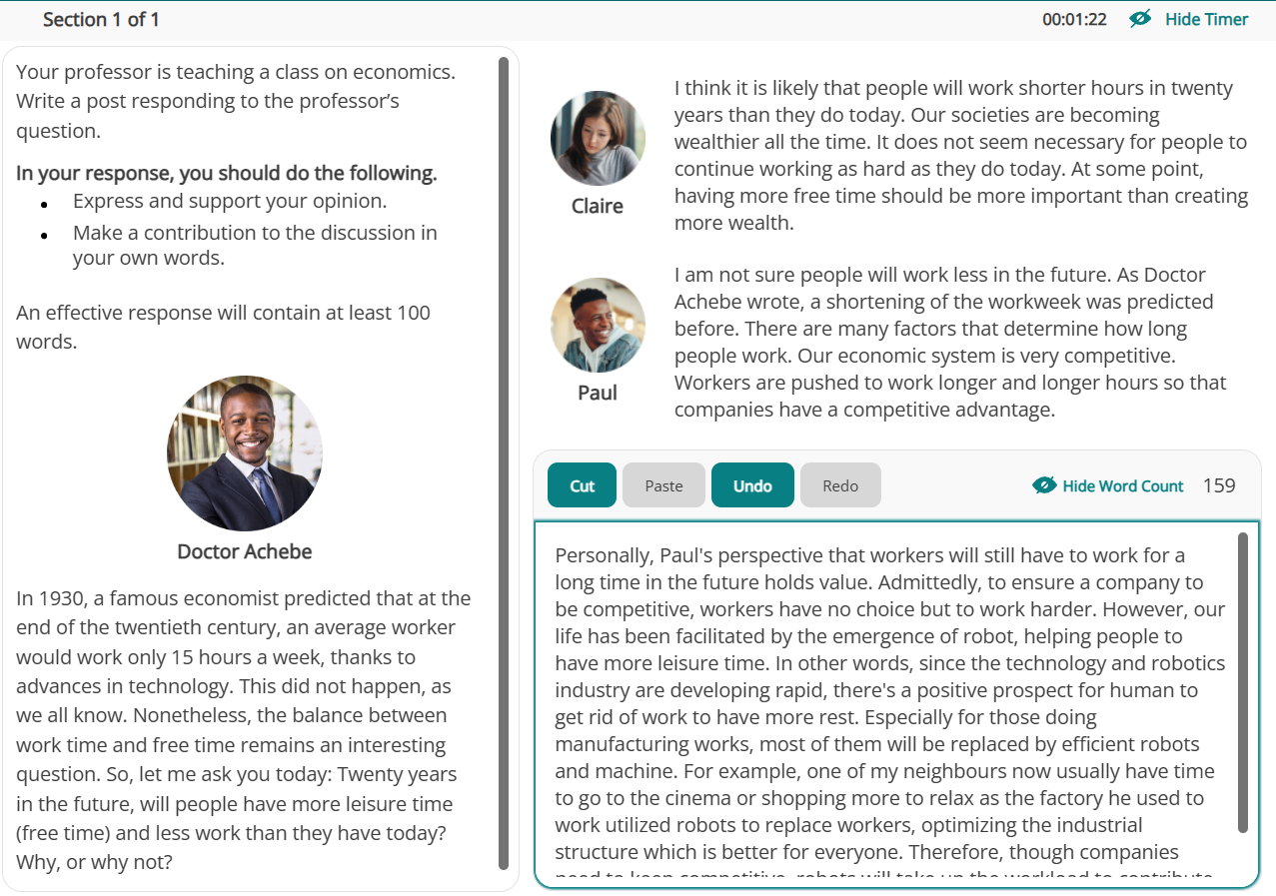
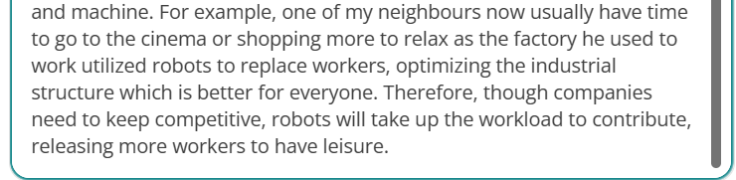

Slide 14
