Slide 1
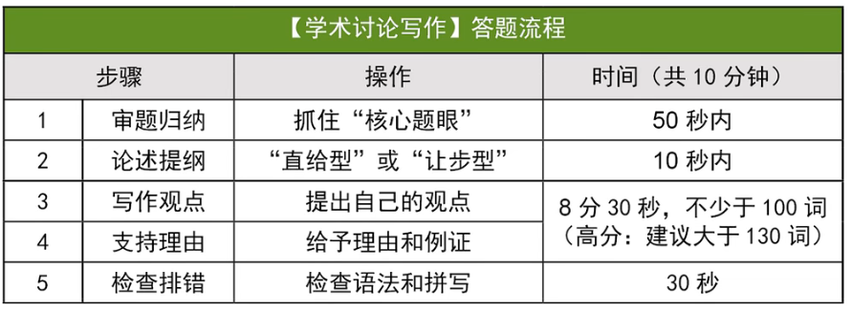
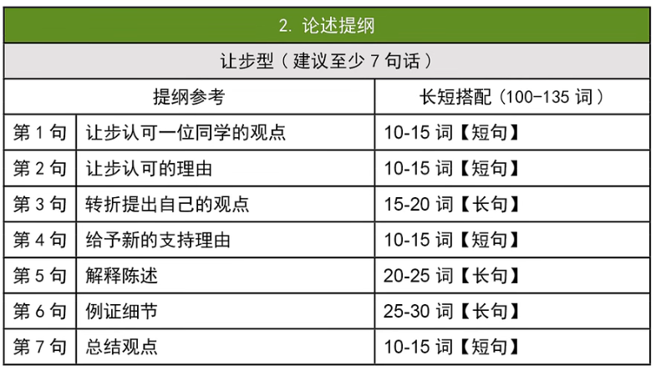
让步型：
Xx’s argument about xxxxx holds value/merit/weight.
Indeed, xxxxxxx 让步理由
However, 转折观点 xxx can be more beneficial.
When xxxxx 给出理由
Especially for xxxxxxxx 解释理由陈述
For example, xxxxxxx【描述问题】But fortunately, xxxxxxx, allowing xxxxxx【解决问题】
Therefore, although xxxx has advantages in xxxx, having xxxxx provides more xxxxx
成就 乐趣
方便 效率
经济 耐用
健康 情感
经验 交流
安全 环保
提升：improve, enhance, elevate, promote, prompt, boost, increase, facilitate
培养：foster, nurture, integrate, prioritize
减小：diminish, reduce, alleviate
大量：paramount, huge, tremendous
激发/吸引：spark, encourage, spur, attract, drive, motivate
困难/缺点：flaw, challenges, shortcomings, problems, issue
保持/支持：sustain, ensure, secure, support, commitment, dedication, devotion
有助于：contribute to, be conductive to, serve the purpose, in favor of
胜过：...incentives far outweigh the benefit of,

Slide 2
not saying nice = promoting goodwill
In other words : 用于引出一个陈述
However, to xxxx, xxx necessiate more than xxxx but also require xxx
prevent minor issues from escalating
foster long-term progress for the team
openness
in intricate multi-field collaborations
are essential for

Slide 3
participating in sports competitions
However, for ....., ... necessitate .... but .... to start a distinguished career,
optimal = best
elite athletes
gain recognition and receive professional training
renowned = famous
top-tier talents
nuture future champions
promote personal growth

Slide 4
对立观点时，要用despite the flaws of .....，through...., it
而平行观点时，可以用while ... is vital, ......is also pivotal.
... is sound = .. is valid.
encountered health challenges
overuse
electronic devices digital products
alleviate(diminish) negative impacts
spurs = encourages
flaws of
progressive improvement
very year sees / witnesses / experiences the release of improved solutions.

Slide 5
paramount advantage
the most siginificant value lies in ...ing
fostering interactions interaction > communication （促进交流）
assemble = gather
drawing = attracting
the role / function / duty of noun.
tremendously
foster = nurture = promote
enjoyment / insights
beyond .... contributions
auto shows featuring on-site test drives
sparking intellectual exchanges and tremendously boosting the residents' happiness
nurture worldwide communication
exchange insights

Slide 6
deliver the benefit
has the advantage of
fulfill the residents’ desires for a richer spiritual life
taking into account the correlation between infrastructures and urban development
secure sustained support
the community around the art gallery will witness the increase in consumption and tax revenue
ensure a sustainable development
Personally, Andrew’s argument that an art gallery delivers the society holds value. Admittedly, the recreational social environment can inspire citizens, fulfilling their desires for richer spiritual life.However, concerning the long-term development, the most significant benefit of an art gallery is the contribution to the economy.In other words, taking into account the correlation between infrastructures and urban development, an art gallery that suprs economic growth is more likely to strengthen sustained support.Specifically, the community around the art gallery will witness the increase in consumption and tax revenue.For example, the Shanghai Art Gallery organized several exhibitions of world-known artists which attracted millions of visitors to come to Shanghai. Not only they attended the exhibition but they also visited places nearby, nurturing immense financial potential. Therefore, beyond inspiration and joy brought by the art gallery, economic improvement is more pivotal.

Slide 7
promote research efficiency
provide specialized guidance to
the budget allocation
elevate education quality
integrate theory with frrontline practice
benefit lifelong career
Paul makes a valid point that schools cannot overlook investing in teaching resources. Admittedly, investing in educational equipment highlights a university's commitment for promoting research efficiency. However, considering that teaching and research work should be people-oriented, the budget allocation should prioritize improving educators' salaries. By raising salaries, universities can attract more experienced professionals for teaching, thereby elevating education quality and fostering students' achievements in the long term.Specifically, many schools are increasingly hiring top-tier professionals from the industry to provide specialized guidance to undergraduate students. For example, one of our architecture programs, guided by industry experts who earn high salaries, has integrated theory with frontline practice, helping students build networks to benefit their lifelong careers after graduation. Therefore, despite the importance of educational tools, promoting teachers' well-being should be the priority of universities' financial planning.

Slide 8
Personally, Andrew’s perspective that artworks created by artists brings enjoyment to citizens holds value. Admittedly, by appreciating their paintings or music, we tend to be inspired and feel relaxed. However, to foster an efficient development of one city, urban funds should prioritize essential be utilized on city’s amenities. In other words, as the financial budget is limited, they are required to local authorities should allocate them properly and contribute them to the majority in the city instead of the minority of artists. Specifically, investing in public transportation can be conductive to enhance commuting in daily life. For example, developing a swift underground can diminish the negative impact resulted from serious traffic congestion in our city, serving as a more efficient way to commute and saving our time. Therefore, beyond happiness brought by artworks, supporting more necessary services is more beneficial for the long-term improvement.

Slide 9
①
...’s perspective that ... holds value / is valid .
... brings about ... is a issue
maintain (verbal caution) is beneficial for individuals
the advantages of (being an only child)
the development of (social skills) through (part-time jobs)
an exhibition hall can spur economic development
②
Admittedly, when it comes to 讨论主题, ... often / can ... minimize / obtain more / encounter
promoting goodwill can minimize conflicts to a great extent.
obtain more financial support from their families.
encountered health challenges due the over use of digital products.
③
However, to ... / for ..., can diminish negative impacts / can be more beneficial for / necessitate more than but also require .
to achieve the team’s overall development
for talented young athletes
mutual support among siblings can be more beneficial for personal progress.
for locals and people worldwide, the most significant value of an exhibition center lies in fostering interactions and bringing tremendous joy

Slide 10
④
In other words, if ... , ... can ..., ...ing ....
if a family encounters long-term challenges, all family members can share the responsibility, reducing stress for each individual
if team members openly express their thoughts, it prevents minor issues from escalating. fostering the long-term progress of the whole team.
if you want to reach your friends, profesors or family immediately, the Internet eliminates geographic barriers, getting responses quickly.
if they engage in competitions, it’s an optimal pathway to start their future careers
taking the urban development into account, an art gallery that brings economic benefits is more likely to secure sustained support
⑤
Especially for ... / in a ... society, 概述例子
Especially in an aging society, taking care of elderly parents has become a paramount concern for every family.
in intricate multi-field collaborations, immediate reminders and sincere responses are essential for controlling project risks.
for many elite athletes, they began competing in an early age to gain recognition and receive professional training.
for students who got sick and cannot go to school, the Internet enables them not to miss a class.
⑥
For example, one of ... who was..., had to ... But fortunately, ... helped to ...., allowing him to ...
According to statistics, half of ..., causing many to ... during...

Slide 11
2023.9.12
成就，团队进步和发展
Kelly: I believe that if you can't say something nice about someone, you should just keep it to yourself. Words can really change how we see others and can mess with relationships. It's kinder and more respectful to keep some thoughts to ourselves. Avoiding trash-talking makes everything more positive and helps everyone focus on the good in each other, which can cut down on fights or misunderstandings.
Paul: Yes, it's great to keep things positive, but it's also important to be real and find a good middle ground between being honest and keeping the peace. Sometimes, a little bit of feedback can really help someone get better at something. Like, if you talk about what they can work on but do it nicely, it can help them see where they can grow.
Kelly’s argument about not saying anything holds value.Indeed, avoid trash-talking can reduce conflicts and misunderstanding to maintain long-lasting friendship.However, speaking out everything directly even though it would be harsh can be more beneficial for each other.When both of us figure out the truth, we can work together more efficiently toward the same goal.Especially for members of researching team in our college, even one mistake could turn down a whole project even the progress of human science.For example, I used to develop a robot with one of my teammates who didn’t work hard. I urged him to cheer up and get rid of negative moods, allowing him to do some adjustments. We then finished an exceptional robot 2 weeks before the deadline.Therefore, although saying nice has advantages in keeping so-called friendship, saying everything is the keystone for permanent relationship and critical to work efficiently.
Doctor Diaz: In interpersonal communication, the subtle nuances of language and attitude can significantly influence the quality of the interaction. Especially in today's era, where many forms of communication involve instant messaging applications, people need to be mindful of the context. Considering the dynamics of communication, do you agree with the following statement: If you cannot say anything nice about someone, it's better not to say anything? Share your perspective on this matter and provide supporting reasons for your stance.

Slide 12
让步型大纲
【让步认可】Kelly的观点有道理，言语谨慎对个人有好处。
【让步理由】的确，在交流上表达善意可以避免人际冲突
【转折观点】但在团队发展中，队员之间更需要彼此坦诚。
【给出理由】坦诚可以避免积少成多的冲突，有利于团队关系长期稳定。
【解释陈述】尤其在跨学科合作中，及时提醒伙伴，可以控制项目风险。
【例证细节】
人物：一位刚加入实验室的同学；
起因：因不熟悉而错误连接设备；
发展：师兄及时制止并帮助改正；
结果：避免损失，团队进展顺利。
【总结观点】虽然维持和睦很重要，但在团队协作中，交流纠错的氛围，有助于团队的可持续发展。

Slide 13
Kelly’s argument about not saying anything holds value.
Indeed, [xxxxx], avoid trash-talking(=promopting goodwill) can reduce(=minimize) conflicts and misunderstanding to maintain long-lasting friendship.
However, [to xxxx], speaking out everything directly even though it would be harsh can be more beneficial for each other.
When both of us figure out the truth(=openly express their thoughts), we can work together more efficiently toward the same goal.
Especially for members of researching team in our college, even one mistake could turn down a whole project even the
progress of human science.
For example, I used to develop a robot with one of my teammates who didn’t work hard. but I pointed out his mistake and urged him to cheer up and get rid of negative moods, allowing him to do some adjustments correct the error promplty. We then finished an exceptional robot 2 weeks before the deadline.
Therefore, although saying nice has advantages in keeping so-called friendship, saying everything that encourages is also the keystone for permanent relationship and critical to work efficiently.
Kelly's perspective that maintaining / exercising / upholding verbal caution is benefitial for individuals is sound.
Admittedly, when it comes to personal interactions, promoting goodwill can minimize disagreements / conflicts / disputes to a great extent.
However, to achieve the team's overall development, team members necessitate more than just pleasant communication but also require openness / honesty / truthfulness with each other.
In other words, if team members openly express their thoughts, it stops / prevents / hinders minor issues from escalating and fosters the long-term progress of the whole team.
Especially in intricate multi-field collaborations, timely / immediate / prompt reminders and sincere responses are essential for controlling project risks.
For example, in our interdisciplinary lab, one of my classmates misconnected the equipment, but a senior pointed out his mistake on-site verbally and helped him correct the error promptly, preventing / avoiding / averting potential losses.
Therefore, while preserving harmony is vital, cultivating an environment / setting / atmosphere that encourages honest communication is also pivotal.

Slide 14
not saying nice = promoting goodwill
In other words : 用于引出一个陈述
However, to xxxx, xxx necessiate more than xxxx but also require xxx
prevent minor issues from escalating
foster long-term progress for the team
openness
Indeed, when it comes to Doctor中的背景, 不支持的同学的观点改写 can ........
However, 为了理由的目的，we necessiate more than不支持的同学的观点改写还需要支持的同学的观点改写
In other words, if 我们可以支持的同学的观点改写，就可以避免理由延申并且foster理由延申
Especially in .....环境中，支持的同学的观点 is essential to 避免理由的失败. 【对example进行概述】
For example,
Therefore, while is vital, xxxx that encourages is also pivotal.

Slide 15
2023.9.13
Reading: 50s
write：12’
Total: 14‘41’‘
Claire: I strongly believe that children should primarily play sports for enjoyment. Sports should be a space for exploring their extracurricular interests, making friends, and developing a love for physical activity. When sports are enjoyable and relaxed, children can avoid the psychological burden of competition and are more likely to stay active throughout their lives.
交流 经验
安全 环保
经济 耐用
乐趣 成就 - career
方便 效率
健康 情感
Andrew: While I get the emphasis on fun in sports, I can't overlook the value of competition. Competing teaches children real-world stuff: discipline, determination, and teamwork. And let's be honest, dealing with wins and losses? You see, learning how to adjust to stress and deal with the disappointment of failure can benefit us throughout our lives.
Personally, Claire’s perspective that children should uphold a relaxed attitude towards sports without competitions holds value. Admittedly, when it comes to children’s mental health, avoiding competitions help them minimize pressure. However, to achieve efficient communication with others, children necesscitate more than fun in sports but also require brainstorming with teammates to fight against opponents. In other word, if children can listen to others’ opinions, they will integrate own thoughts with others and articulate a comprehensive strategy. For example, one of my soccer teammates expressed his ideas to attack. After listening to him, I came up with an idea of attacking when we successfully defended opponents, allowing us to win the game. Therefore, while alleviating children’s psychological burden is vital, competitions that encourages children to brainstorming are also pivotal.
Doctor Diaz: The topic of children's involvement in sports is a subject of debate. While sports activities are crucial for the development of young people, parents are also deeply concerned about the psychological pressure that academic requirements and participation in sports events might impose on their children. Do you believe parents should encourage their children to play sports just for fun, without the need to attend sports competitions? Share your perspective on this matter and provide supporting reasons for your stance.

Slide 16
【直接认可】Andrew有道理，体育竞技对年轻人的成长很重要。
【补充理由】尤其有体育天赋的年轻人，参赛是事业起步的途径。
【解释陈述】很多顶尖运动员，从小参赛，得到关注被重点培养。
【例证细节】
人物：世界知名球星梅西；
起因：从小就参加各种足球竞赛；
发展：13岁进入足球青训学院；
结果：为传奇足球生涯奠定基础。
【对比论证】但是如果家长不支持子女参赛，可能导致体育界损失。
【例证细节】
人物：著名篮球运动员姚明；
起因：从小因为身高受到球队关注；
发展：如果家长不支持他参赛训练；
结果：损失一名NBA球员和国家队教练。
【总结观点】参加竞技有助成长，更是培养优秀人才的渠道。

Slide 17
Personally, Claire’s perspective that children should uphold a relaxed attitude towards sports without competitions holds value.
Admittedly, when it comes to children’s mental health, avoiding competitions help them minimize pressure.
However, for talented young athletes, to achieve efficient communication with others, children necesscitate more than fun in sports but also require brainstorming with teammates to fight against opponents engaging in contests has been the optimal pathway to start careers.
In other word, if children can listen to others’ opinions, they will integrate own thoughts with others and articulate a comprehensive strategy.
For example, one of my soccer teammates expressed his ideas to attack. After listening to him, I came up with an idea of attacking when we successfully defended opponents, allowing us to win the game.
Therefore, while alleviating children’s psychological burden is vital, competitions that encourages children to brainstorming are also pivotal.
Andrew compellingly / persuasively / convincingly argues that participating in sports competitions is vital for enhancing young individuals' social skills.
Moreover, in my opinion, for talented young athletes, engaging in contests has been the best / optimal / premier pathway to start their careers.
Specifically, many elite athletes began competing in sports at a young / an early / a tender age to gain recognition and receive professional training.
For example, globally renowned soccer player Lionel Messi played in matches from a young age and entered a soccer academy at thirteen, laying the base / groundwork / foundation for his distinguished career.
However, if parents do not support / back / endorse their children's engagement in sports competitions, the world might miss top-tier talents.
For instance, Yao Ming, the world-famous basketball player, might not have climbed / ascended / risen to NBA stardom without his parents' support for his involvement in contests from a young age.
Therefore, participating in sports competitions promotes personal growth in youth and raises / cultivates / nurtures future champions..

Slide 18
participating in sports competitions
However, for ....., ... necessitate .... but .... to start a distinguished career,
optimal = best
elite athletes
gain recognition and receive professional training
renowned = famous
top-tier talents
nuture future champions
Personally, Clarie’s perspective that children should uphold a relaxed attitude towards sports and just for fun holds value. Admittedly, when it comes to mental health, avoiding competitions can minimize their psychological stress. However, for talented young athletes, they necessitate more than fun from sports but also require high-level competitions. In other words, if they can engage in competitions, it’s an optimal pathway to start their future careers. Especially for many elite athletes, they began competing in an early age to gain recognition and receive professional training. For example, world renowned soccer player Lionel Messi played in matches from young ages and entered a soccer academy at 13, laying solid foundation for his future career. Therefore, while reducing psychological burden is vital, participating in competitions that nutures future champions and promotes children’s growth is also pivotal.

Slide 19
2023.9.14
Reading: 1‘36s- 2’20‘’
write：14’51
Total: ‘’‘
Kelly: I think technology often complicates our lives. Take smartphones, for example. While they aim to streamline communication, they've created a constant state of distraction. People find themselves glued to screens, responding to social media notifications. Research has shown that excessive reliance on mobile phones can impair the vision of teenagers.
安全 环保
成就 乐趣
方便 效率
耐用 经济
交流 经验
健康 情感
Paul: I disagree with Claire. Technology, when used mindfully, can genuinely simplify our lives. Consider the advancements in automation, which have eliminated the need for manual and repetitive tasks in various industries. This allows individuals to focus on more meaningful and creative aspects of their work. Responsible use of technology can enhance our quality of life.
Personally, Kelly’s perspective that overtime dependent on electronic device is harmful to individuals is sound. Admittedly, most teenagers spend much of their time on cell phones instead of studies. However, when it comes to the development of technology, the Internet eliminates geological barriers. In other word, to reach to other people immediately, the Internet offers great convenience. Especially for students who’s sick and cannot go to school shcool, he can join the class online as usual. For example, one of my classmates got a fever last week and was absent from a lecture. But fortunately, he watched this class recording online when he recovered, allowing him to keep up with the progress. Therefore, while the distraction brought by technology is vital, the convenience that promote a simplified life is also pivotal.
Doctor Achebe: Technology has transformed the way we live, offering solutions to challenges. However, sociologists have focused on the negative effects brought about by technology. For the advancement of technology, it is necessary to reflect on existing issues. Do you agree that technology, originally designed to simplify our lives, might actually make our lives more complicated? Explain your perspective and provide supporting reasons for your stance.

Slide 20
让步型大纲
【让步认可】Kelly有道理，科技可能带来社会问题。
【让步理由】的确，很多人过度使用科技产品影响健康。
【转折观点】但是，科技一直在进步修正问题。
【给出理由】市场促使企业优化技术，取得更好的市场表现。
【解释陈述】尤其是消费类电子产品，每年都有技术改良。
【例证细节】
时间：几年前手机问题确实多；
起因：屏幕小，只能低头看屏幕；
发展：近几年技术进步摆脱限制；
结果：配合app保护用眼健康。
【总结观点】尽管技术初期不完善，但技术迭代提供更多便利。

Slide 21
Personally, Kelly’s perspective that overtime dependent on electronic device is harmful to individuals is sound.
Admittedly, most teenagers spend much of their time on cell phones instead of studies.
However, when it comes to the development of technology, the Internet eliminates geographic geological barriers. 【此句应该是观点，就是应该说...is more beneficial / ... alleviate ....(problem)】
In other words, to reach to other people immediately, the Internet offers great convenience.
Especially for students who’s sick and cannot go to school shcool, he can join the class online as usual.
For example, one of my classmates got a fever last week and was absent from a lecture. But fortunately, he watched this class recording online when he recovered, allowing him to keep up with the progress.
Therefore, while the distraction brought by technology is vital, the convenience that promote a simplified life is also pivotal.
Kelly's argument that technology may bring about potential issues is valid / sound / credible.
Admittedly, many individuals have faced / experienced / encountered health challenges due to the overuse of digital products.
However, technology has been evolving, reducing / mitigating / alleviating the associated complications and negative impacts..
One driving factor behind this is the market economy, which encourages / fosters / spurs creative companies to constantly refine technology to attract customers and achieve better market performance.
Especially in the case of consumer electronics, almost every year sees / witnesses / experiences the release of improved solutions.
For instance, in recent years, advancements, such as virtual reality and vocal instructions, have addressed problems / issues / dilemmas like small screens and poor interactions associated with earlier smartphones, even aiding eye health when paired with management apps.
Therefore, despite the flaws / imperfections / shortcomings of new technology, through progressive improvements, it can offer increased convenience while diminishing negative impacts.

Slide 22
对立观点时，要用despite the flaws of .....，through...., it
而平行观点时，可以用while ... is vital, ......is also pivotal.
... is sound = .. is valid.
encountered health challenges
overuse
electronic devices digital products
alleviate(diminish) negative impacts
spurs = encourages
flaws of
progressive improvement
6’36’’
Personally, Kelly’s argument that technology may bring about potential issue is valid.
Admittedly, when it comes to health, most individuals have encountered health challenges due to the overuse of digital products.
However, to communicate with others more efficiently, the progressive improvements of the Internet exactly diminish negative impacts.
In other words, if you want to reach your friends, profesors or family immediately, the Internet eliminates geographic barriers.
Especially for students who got sick and cannot go to school, the Internet enables them not to miss a class.
For example, one of my classmates got a fever last week and was absent from a lecture. But fortunately, he watched this lecture recording on the Internet when he was recovered, allowing him to keep up with the progress.
Therefore, despite flaws of technology, it absolutely offers convenience and simplifies our life.

Slide 23
2023.9.15
Reading: 1’
write：15’40’’
Total:
Claire: I think the most significant advantage of having an exhibition hall is the enrichment of cultural life. Cultural experiences are essential for individual growth and a sense of identity. Exhibition halls provide a venue for both local and international organizations to display their works, fostering a vibrant community and enhancing the city's brand image.
Andrew: I believe that the most significant advantage of having an exhibition hall is its potential for economic growth. These facilities can draw tourists and visitors, stimulating the local economy. Exhibition halls can also attract conferences and events. Visitors often spend money on accommodations, dining, and shopping, providing a boost to businesses.
Personally, Claire’s argument that an exhibition hall brings about progressive improvements for one city holds value. Admittedly, when it comes to the existence of cultural atmosphere, exhibitions halls nurture cities’ cultural potentials. However, to become one of the top-tier city in the world, an exhibition hall encourages international cultural communication. In other words, if elicte scholars, artifacts can be gathered in this hall, it will attract a lot of visitors and tourists as proposed by Andrew. Especially in this rapidly developing society, technology concentration and exchange can boost the scientific progress. For example, world AI conference was established in Shanghai exhibition hall, which attracted many scholars. Many overseas tech company such as Tesla, then set their factories in Shanghai, pushing the technical development in Shanghai. Therefore, while it enhances city’s brand is vital, technical progress is also pivotal.
Doctor Achebe: The presence of cultural amenities, such as an exhibition hall, can significantly impact a city's identity and its residents' quality of life. The advantages of having such a facility in a city can vary widely. Before we start the case study presentation, I'd like you to think about the benefits of exhibition halls. For a city and its residents, what do you think is the most significant advantage of having an exhibition hall located in that city? Explain why you think so.

Slide 24
直给型大纲
【给出观点】展览推动经济，但这并不是对居民最大的好处 。
【补充理由】展览最大的价值，是通过展示交流为本地人带来乐趣。
【解释1】主题展为来自各地的访客提供交流机会。
【例证细节】
地点：北京国际展览中心；
起因：每季度都有新的主题展；
发展：吸引世界各地访客来交流；
结果：经济之外碰撞出精神火花。
【解释2】展览的交流体验，让本地人感受到乐趣。
【例证细节】
地点：洛杉矶会展中心 ；
起因：本地汽车发烧友非常多；
发展：每年车展观众现场试驾；
结果：为居民带来了极大乐趣。
【总结观点】展览除了物质价值，也贡献了交流和快乐等精神价值。

Slide 25
Personally, Claire’s argument that an exhibition hall brings about progressive improvements for one city holds value.
Admittedly, when it comes to the existence of cultural atmosphere, exhibitions halls nurture cities’ cultural potentials.
However, to become one of the top-tier city in the world, an exhibition hall encourages international cultural communication.
In other words, if elicte scholars, artifacts can be gathered in this hall, it will attract a lot of visitors and tourists as proposed by Andrew.
Especially in this rapidly developing society, technology concentration and exchange can boost the scientific progress.
For example, world AI conference was established in Shanghai exhibition hall, which attracted many scholars. Many overseas tech company such as Tesla, then set their factories in Shanghai, pushing the technical development in Shanghai.
Therefore, while it enhances city’s brand is vital, technical progress is also pivotal.
An exhibition hall can drive / stimulate / spur economic development, but this is not its paramount advantage.
In my opinion, the most significant value of an exhibition center lies in / resides in / stems from fostering interactions and bringing tremendous joy to locals.
First, theme exhibitions enable visitors from diverse backgrounds to gather / converge / assemble and exchange insights.
For example, the Beijing International Exhibition Center regularly hosts thematic exhibitions every quarter, attracting / drawing / luring visitors worldwide and sparking intellectual exchanges in the long term beyond solely financial gains in a short period.
Moreover, the role / function / duty of an exhibition center allows residents to experience delight.
For instance, the Los Angeles Convention Center, a hub for automobile fans, has organized several auto shows featuring on-site test drives, greatly / immensely / tremendously boosting the residents' happiness.
Therefore, beyond material economic contributions, an exhibition center can foster / nurture / promote worldwide communication and spread enjoyment.

Slide 26
paramount advantage
the most siginificant value lies in ...ing
interaction > communication （促进交流）
assemble = gather
drawing = attracting
the role / function / duty of noun.
tremendously
foster = nurture = promote
enjoyment / insights
beyond .... contributions
Personally, Claire’s argument that an exhibition hall can spur economic development holds value. Admittedly, when it comes to the existence of cultural atmosphere, exhibitions halls nurture cities’ cultural potentials. However, for locals and people worldwide, the most significant value of an exhibition center lies in fostering interactions and bringing tremendous joy. In other words, if elicte scholars, artifacts can be assembled in this hall, it will attract a lot of visitors and tourists. Especially in theme exhibitions, visitors from diverse backgrounds can exchange insights and experience delight together. For example, the Shanghai International Exhibition Center regularly hosts several auto shows featuring on-site test drives, sparking intellectual exchanges and tremendously boosting the residents' happiness. Therefore, beyond material economic contributions, an exhibition center can nurture worldwide communication and spread enjoyment.

Slide 27
2023.9.19
Reading: 1’
write：12’42’’
Total:
Claire: The most crucial advantage of hosting an art gallery is its role in fostering education. A local art gallery can offer a space for the community to engage with artistic expressions, from classical paintings to contemporary installations. And it often hosts educational programs, making art accessible to people of all ages and backgrounds.
Andrew: Claire makes a good point, but I see greater benefit in the social aspect of a local gallery. Art venues often create a peaceful social atmosphere, enhancing the quality of residents' lives and bringing joy to the community. It offers a leisure space where individuals can find inspiration, adding a joyful dimension to everyday life.
Personally, Andrew’s perspective that an art gallery offers a recreational place for local residents holds value. Admittedly, when it comes to relax in spare time, it serves a good place for people to appreciate artifacts. However, the most significant benefit resulted from an art gallery is boosting the economic growth of one city an art gallery lays a solidified foundation. In other words , if hundreds of art works can be assembled here, tourists worldwide will come to our city and enhance consumption. Especially for some theme art exhibitions held periodically, our city has been consistently pushed forward. For example, Shanghai Art Gallery organized exhibitions of world-known artists which attracted millions of visitors came to Shanghai. Not only they attended the exhibition but they also visited places nearby, nurturing immense financial potential. Therefore, beyond inspiration and joy brought by the art gallery, economic improvement is more pivotal.
Doctor Diaz: Art galleries play a significant role in many cities, showcasing various forms of artistic expression. These institutions often receive support from both the public and private sectors. Today, I'd like you to consider art galleries' benefits. What do you think is the most important benefit of hosting an art gallery for a city and its residents? Explain why you think so.

Slide 28
让步型大纲【自制模板举例】7句话
【让步认可】Andrew's viewpoint that [填入Andrew 的观点] holds merit.
【让步理由】Admittedly, [填入Andrew 的理由], fulfilling the local residents' desire for a richer spiritual life.
【转折观点】However, taking into account the correlation between public facilities and urban development, [填入自己的观点].
【给出理由】In other words, concerning [填入讨论的背景或主题], an art gallery that brings economic benefits is more likely to secure sustained support.
【解释陈述】示范：Specifically, the communities around an art gallery can witness an increase in consumption and tax revenue, ensuring its sustainable development.
【例证细节】自己准备1-2个可以替换的例证，无论是“记叙文法”还是“引用调查法”，只要能保证考试现场快速输出就可以。
【总结观点】Therefore, although [填入andrew 的观点] might resonate with a portion of the population, [填入自己的观点] would be more beneficial to the long-term development.

Slide 29
Personally, Andrew’s perspective that an art gallery offers a recreational place for local residents holds value.
Admittedly, when it comes to relax in spare time, it serves a good place for people to appreciate artifacts.
However, the most significant benefit resulted from an art gallery is boosting the economic growth of one city an art gallery lays a solidified foundation.
In other words , if hundreds of art works can be assembled here, tourists worldwide will come to our city and enhance consumption.
Especially for some theme art exhibitions held periodically, our city has been consistently pushed forward.
For example, the Shanghai Art Gallery organized several exhibitions of world-known artists which attracted millions of visitors to come to Shanghai. Not only they attended the exhibition but they also visited places nearby, nurturing immense financial potential.
Therefore, beyond inspiration and joy brought by the art gallery, economic improvement is more pivotal.
Personally, Andrew’s argument that an art gallery delivers the society holds value.
Admittedly, the recreational social environment can inspire citizens, fulfilling their desires for richer spiritual life.
However, concerning the long-term development, the most significant benefit of an art gallery is the contribution to the economy.
In other words, taking into account the correlation between infrastructures and urban development, an art gallery that suprs economic growth is more likely to strengthen sustained support.
Specifically, the community around the art gallery will witness the increase in consumption and tax revenue.
For example, the Shanghai Art Gallery organized several exhibitions of world-known artists which attracted millions of visitors to come to Shanghai. Not only they attended the exhibition but they also visited places nearby, nurturing immense financial potential.
Therefore, beyond inspiration and joy brought by the art gallery, economic improvement is more pivotal.

Slide 30
deliver the benefit
has the advantage of
fulfill the residents’ desires for a richer spiritual life
taking into account the correlation between infrastructures and urban development
secure sustained support
the community around the art gallery will witness the increase in consumption and tax revenue
ensure a sustainable development
Personally, Andrew’s argument that an art gallery delivers the society holds value. Admittedly, the recreational social environment can inspire citizens, fulfilling their desires for richer spiritual life.However, concerning the long-term development, the most significant benefit of an art gallery is the contribution to the economy.In other words, taking into account the correlation between infrastructures and urban development, an art gallery that suprs economic growth is more likely to strengthen sustained support.Specifically, the community around the art gallery will witness the increase in consumption and tax revenue.For example, the Shanghai Art Gallery organized several exhibitions of world-known artists which attracted millions of visitors to come to Shanghai. Not only they attended the exhibition but they also visited places nearby, nurturing immense financial potential. Therefore, beyond inspiration and joy brought by the art gallery, economic improvement is more pivotal.

Slide 31
2023.9.20
Reading: 1’
write：17’05’’
Total:
Kelly: I think raising teachers' salaries is crucial because it can encourage people to view teaching as a viable profession rather than pursuing careers in other industries. Additionally, offering competitive wages can attract some of the brightest and most talented individuals to become teachers. When teachers are fairly compensated, it not only motivates them to excel in their roles but also enhances the overall quality of education.
Paul: Teacher salaries are already quite competitive, and it may be more prudent to allocate resources toward improving student equipment and providing up-to-date materials. Enhancing the learning environment with better technology and modern educational resources can greatly benefit students' education.
school spending
attract more
edu, resources
Personally, Kelly’s argument that enhancing teachers’ salaries promotes their passion toward professions holds value. Admittedly, more capable teachers tend to be attracted by increased wages, securing a high standard teaching foundation. However, to achieve long-term development for students, abundant learning resources and facilities are more important. In other words, if students get access to up-to-date books, technology, they are more like to cultivate a life-long interest toward a career. Specifically, what students experienced in their schools will have an influence on choosing their major in college. For example, one of my high school classmates spent lots of time building a robot in high school. Fortunately, he was obsessed in vision recognition, inspiring him to learn computer science in the college. He now makes great achievements. Therefore, beyond the benefits of more competitive teachers, the improvement of learning resources can be more pivotal.
Doctor Diaz: Let's consider how schools allocate their funds for various resources, with a focus on the allocation between teacher salaries and other resources such as computers and books. What do you think is the best way for schools to prioritize their spending? Should more funds go towards increasing teacher salaries to attract and retain quality educators, or should they invest more in technology and learning materials like computers and books? Share your perspective on this matter and provide supporting reasons for your stance.

Slide 32
让步型大纲
【让步认可】Paul的观点有道理，不能忽视教学工具。
【让步理由】的确，购买设备能体现对科研的支持。
【转折观点】但是，教研以人为本，经费要优先照顾教师。
【给出理由】提高工资吸引优秀人才任教，有助学生一生事业受益。
【解释陈述】邀请产业专家教学，学生可以获得在产业一线的资源。
【例证细节】
人物：很多顶尖的行业专家；
起因：大学高薪聘请主持教学；
发展：理论联系实践教学成果显著；
结果：学生获得一线人脉终生受益。
【总结观点】虽然设备很重要，但教师人才更宝贵，预算优先照顾。

Slide 33
Personally, Kelly’s argument that enhancing teachers’ salaries promotes their passion toward professions holds value.
Admittedly, more capable teachers tend to be attracted by increased wages, securing a high standard teaching foundation.
However, to achieve long-term development for students, abundant learning resources and facilities are more important.
In other words, if students get access to up-to-date books, technology, they are more like to cultivate a life-long interest toward a career.
Specifically, what students experienced in their schools will have an influence on choosing their major in college.
For example, one of my high school classmates spent lots of time building a robot in high school. Fortunately, he was obsessed in vision recognition, inspiring him to learn computer science in the college. He now makes great achievements.
Therefore, beyond the benefits of more competitive teachers, the improvement of learning resources can be more pivotal.
Paul makes a valid point that schools cannot overlook / ignore / bypass investing in teaching resources.
Admittedly, investing in educational equipment highlights a university's support / commitment / dedication for promoting research efficiency.
However, considering that teaching and research work should be people-oriented / -centered, the budget allocation should prioritize improving educators' salaries / well-being / welfare.
By raising salaries, universities can attract more experienced / seasoned / veteran professionals for teaching, thereby elevating education quality and fostering students' achievements in the long term.
Specifically, many schools are increasingly hiring top-tier professionals from the industry to provide specialized direction / guidance / mentorship to undergraduate students.
For example, one of our architecture programs, guided by industry experts who earn high salaries, has combined / merged / integrated theory with frontline practice, helping students build networks to benefit their lifelong careers after graduation.
Therefore, despite the importance of educational tools, promoting teachers' well-being should be the priority of universities' financial / funding / expenditure planning.

Slide 34
promote research efficiency
provide specialized guidance to
the budget allocation
elevate education quality
integrate theory with frrontline practice
benefit lifelong career
Paul makes a valid point that schools cannot overlook investing in teaching resources. Admittedly, investing in educational equipment highlights a university's commitment for promoting research efficiency. However, considering that teaching and research work should be people-oriented, the budget allocation should prioritize improving educators' salaries. By raising salaries, universities can attract more experienced professionals for teaching, thereby elevating education quality and fostering students' achievements in the long term.Specifically, many schools are increasingly hiring top-tier professionals from the industry to provide specialized guidance to undergraduate students. For example, one of our architecture programs, guided by industry experts who earn high salaries, has integrated theory with frontline practice, helping students build networks to benefit their lifelong careers after graduation. Therefore, despite the importance of educational tools, promoting teachers' well-being should be the priority of universities' financial planning.

Slide 35
2023.9.20
Reading: 4’
write：16’05’’
Total:
Claire: I think municipal revenue should be spent on something other than unnecessary goods and services. Artists should support themselves by selling their works to individuals and companies. If they cannot find enough buyers in the market or other sponsors in their circle, they may consider changing their profession to earn a living.
Andrew: I must say art is actually necessary. Without artwork, many public spaces in my hometown would be dull. From statues in parks to paintings on commercial buildings, my hometown really benefits from supporting the artists who create these works. Due to the presence of artworks, local residents find enjoyment and outdoor spaces are more interesting for visitors.
Personally, Claire’s perspective that fundings should be used on more important services instead on artists holds value. Admittedly, it’s artists’ own duty to sell their works to make a living. However, to secure the sustainable development of one city, artists is reasonable to be supported to create inspiring artworks. In other wordsworld, artists who draw a painting or compose a music are more likely to foster a cultural atmosphere. Specifically, some communities have witnessed the positive influence brought by artworks exhibited in an art gallery. For example, several painters in Shanghai monthly received allowance from the city government. Supported by this, they managed to survive and then created many paintings to be exhibited in Shanghai Art Gallery, attracting visitors worldwide to visit. Therefore, though there’re a lot of necessary city affairs should be funded, supporting artists is more beneficial as it contributes to city’s long-term development.
Doctor Diaz: One of the roles of municipal councils is to promote local cultural development. In recent years, supporting the arts has been a topic of debate. Given that each city has a limited development fund, investments in various fields need to be carefully balanced. Do you think the local city council should provide financial support to artists, such as painters or musicians? Share your perspective on this matter and provide supporting reasons for your stance.

Slide 36
直给型大纲
【直接认可】Claire的观点有道理，资金优先投给必须的服务。
【补充理由】提升城市效率，要重点投入大多数人需要的项目。
【解释陈述】资助艺术家只能让少部分人受益，收效有限。
【例证细节】
机构：人才市场调查；
调研：艺术从业者少而且很分散；
结果：资助对促进城市发展有限。
【对比论证】相反，投入改善交通，能提升整体生活品质。
【例证细节】
地点：市区私家车拥堵严重；
起因：缺少高效的公共交通；
发展：投资城市轨道交通；
结果：让大部分市民都能受益。
【总结观点】尽管艺术有文化价值，但最好优先投资服务大多数市民。

Slide 37
Personally, Claire’s perspective that fundings should be used on more important services instead on artists holds value.
Admittedly, it’s artists’ own duty to sell their works to make a living.
However, to secure the sustainable development of one city, artists is reasonable to be supported to create inspiring artworks.
In other wordsworld, artists who draw a painting or compose a music are more likely to foster a cultural atmosphere.
Specifically, some communities have witnessed the positive influence brought by artworks exhibited in an art gallery.
For example, several painters in Shanghai monthly received allowance from the city government. Supported by this, they managed to survive and then created many paintings to be exhibited in Shanghai Art Gallery, attracting visitors worldwide to visit.
Therefore, though there’re a lot of necessary city affairs should be funded, supporting artists is more beneficial as it contributes to city’s long-term development.
Claire's assertion is sound that city finance should prioritize essential urban services / amenities / utilities.
Moreover, to enhance urban operational efficiency, local authorities should channel limited budgets into projects / programs / initiatives that serve the larger population.
Financing artists would only benefit a tiny portion / fraction / segment of the population, failing to foster efficient development across the city.
According to data / survey / statistics, the number of artists has been relatively limited, and many work across different cities, implying that financial aid may not effectively promote urban development.
Conversely, allocating / directing / diverting funds to improve public transportation would likely benefit more locals.
For instance, developing a swift urban rail transport system has addressed / mitigated / tackled traffic jams, promising a convenient commute experience for the majority and enhancing overall urban efficiency.
Therefore, although art can offer cultural value, it is wise / sensible / prudent for urban budgets to concentrate on investments serving most residents.

Slide 38
Personally, Andrew’s perspective that artworks created by artists brings enjoyment to citizens holds value. Admittedly, by appreciating their paintings or music, we tend to be inspired and feel relaxed. However, to foster an efficient development of one city, urban funds should prioritize essential be utilized on city’s amenities. In other words, as the financial budget is limited, they are required to local authorities should allocate them properly and contribute them to the majority in the city instead of the minority of artists. Specifically, investing in public transportation can be conductive to enhance commuting in daily life. For example, developing a swift underground can diminish the negative impact resulted from serious traffic congestion in our city, serving as a more efficient way to commute and saving our time. Therefore, beyond happiness brought by artworks, supporting more necessary services is more beneficial for the long-term improvement.

Slide 39
2023.9.23
Total: 9’42
Kelly: I think having a mix of different tasks can make work more enjoyable. Doing the same thing every day can wear you down without giving you a real sense of accomplishment. But having a variety of tasks can keep things fresh and exciting. It helps to avoid burnout and sparks creativity since you're constantly switching things up and facing new scenarios.
Paul: Constantly jumping between different things can mean you end up not giving any one task your full attention. Someone might encounter tough challenges trying to keep track of a couple of things simultaneously. If one thing isn't done well or completed on time, it can undoubtedly lead to delays in other tasks, greatly further affecting overall work efficiency.
Personally, Kelly’s perspective that workers will be refreshed by doing various types of work in the same time holds value. Admittedly, doing the same task consistently is tedious, frustrating workers to continue working. However, to achieve long-term success in a specific task, doing a same task outweigh doing different types of tasks. In other words, since every working position require competitive professional abilities, strengthening one task foster one’s particular professional ability to be the best. Specifically, for engineers in robotics field, mastering one specific and insist on it secure one’s position. For example, one of my friends working in a robotics company just kept encoding to control a robot without doing anything else. He was the top engineer in his company and got the most paid. Therefore, though creativity can be triggered, doing one task is more beneficial.
Doctor Achebe: Workplace satisfaction is a complex subject that involves many factors, especially now with many changes in office environments and more flexible job selections. It raises questions about the impact of task variety on employee well-being and productivity. Do you think workers would be much happier if they were doing different types of tasks at the same time than doing the same task? Explain your perspective and provide supporting reasons for your stance.

Slide 40
【让步认可】Kelly的论述有道理，不同的工作任务能带来新鲜感。
【让步理由】的确，单一乏味容易疲惫，让人失去工作兴趣。
【转折观点】但是，从事多项任务又要保证质量，工作压力更大。
【给出理由】工作强度增加带来的心里压力，会影响员工的健康。
【解释陈述】尤其在技术领域，多线程工作对心理影响极大。
【例证细节】
人物：手机售后技术人员；
起因：业务都是时间紧要求严格；
发展：切换不同的紧急维修任务；
结果：经常出现焦虑失眠的困扰。
【总结观点】尽管多任务很有趣，但想把所有任务同时做好压力太大。

Slide 41
Personally, Kelly’s perspective that workers will be refreshed by doing various types of work in the same time holds value.
Admittedly, doing the same task consistently is tedious, frustrating workers to continue working.
However, to achieve long-term success in a specific task, doing a same task outweigh doing different types of tasks.
In other words, since every working position require competitive professional abilities, strengthening one task foster one’s particular professional ability to be the best.
Specifically, for engineers in robotics field, mastering one specific and insist on it secure one’s position.
For example, one of my friends working in a robotics company just kept encoding to control a robot without doing anything else. He was the top engineer in his company and got the most paid.
Therefore, though creativity can be triggered, doing one task is more beneficial.
Kelly's argument is compelling that having different / diverse / varied tasks at work can bring a sense of freshness.
Admittedly, repetitive / unvarying / monotonous work can easily lead to fatigue and loss of passion for the job.
However, attempting to handle multiple tasks while maintaining a top level of quality can increase / heighten / escalate employees' stress levels significantly.
Even more seriously, the increased work intensity and subsequent mental pressure can negatively / adversely / detrimentally affect the staff's health.
Especially in the technical service sector, too much / abundant / excessive multitasking has rendered engineers overwhelmed.
For instance, due to time-sensitive requirements, smartphone after-sales technicians often face a demanding work environment where they frequently / continually / constantly switch between different urgent repair tasks, resulting in anxiety and sleep disorders / insomnia.
Therefore, although multitasking might seem engaging, tackling all tasks / duties / responsibilities effectively and simultaneously poses a significant challenge.

Slide 42
2023.9.23
Total: 9’42
Claire: While I see the cool stuff space exploration has given us, I think the money could be spent in better ways right here on Earth, with so many urgent issues right at our doorstep, like climate change, which requires us to find a balance between reaching for the stars and keeping our feet on the ground. Maybe it’s time to take a look at our priorities.
Andrew: I disagree that investing in space exploration is just a waste of money. Seriously, space research has brought about a lot of tech advancements that we use every day. Think about the developments of GPS systems, which have greatly impacted our daily lives. Who can do without these navigation technologies in our daily travels?
Personally, Andrew’s perspective that technology advancement will be improved by investing money into space exploration. Admittedly, achievements like GPS systems facilitate our practical life. However, taking into account the correlation between public infrastructures in daily life and urban development, funds should be allocated to invest in more necessary facilities. In other words, since the budget is limited, it should be used properly to contribute to the majority instead of the minority. Specifically, public transport systems will tremendously reduce commuting time, fostering more convenient city life. For example, our city has worked on an urban rail transport system, diminishing negative impact caused by traffic congestion. People can utilize this time on the rail to study and work instead of taking the risk of being late for school or work. Therefore, investing in urban things is more beneficial.
Doctor Achebe: The boundaries of human civilization's exploration have already exceeded Earth. Although space technology has been advancing, the allocation of funds for space exploration has long been a subject of debate. Given the significant costs involved, do you think investing in exploring the universe and developing space travel is a waste of money? Why or why not?

Slide 43
【给出观点】Andrew的观点有道理，太空探索不是浪费钱。
【补充理由】太空技术民用化提升人类健康，保护人类生存安全。
【解释1】宇航员的保健技术已经开始民用化。
【例证细节】
人物：身在太空的宇航员；
起因：长期停留在太空远离地面；
发展：开发了远程医疗诊断技术；
结果：民用已用于远程医治看护。
【解释2】卫星长期监控全球环境保护人类安全。
【例证细节】
地点：全球；
起因：温室气体排放量大；
发展：卫星监控大气指标；
结果：理解气候问题制定长期方案。
【总结观点】虽然太空探索投资大 ，但技术开发可以造福全人类。

Slide 44
Personally, Andrew’s perspective that technology advancement will be improved by investing money into space exploration. Admittedly, achievements like GPS systems facilitate our practical life. However, taking into account the correlation between public infrastructures in daily life and urban development, funds should be allocated to invest in more necessary facilities. In other words, since the budget is limited, it should be used properly to contribute to the majority instead of the minority. Specifically, public transport systems will tremendously reduce commuting time, fostering more convenient city life. For example, our city has worked on an urban rail transport system, diminishing negative impact caused by traffic congestion. People can utilize this time on the rail to study and work instead of taking the risk of being late for school or work. Therefore, investing in urban things is more beneficial.
Andrew's perspective is compelling that space exploration is not a misuse of our financial / economic / monetary resources.
In fact, numerous innovations derived / stemming / originating from space exploration have significantly improved human health and protected our survival in the long run.
First, hospitals have applied / utilized / incorporated space technologies in medical care.
For example, to address / handle / tackle health challenges during prolonged space journeys, scientists invented remote diagnostic technology, which is now employed in the civilian sector to enhance healthcare accessibility.
Furthermore, space technology has been critical / instrumental / pivotal in improving the human living environment.
For instance, based on monitoring greenhouse gases, satellite systems have aided in analyzing potential threats and planning against climate issues, protecting / securing / safeguarding lives on Earth in the long term.
Therefore, although space exploration requires substantial investment, space technologies have been beneficial to humans / mankind / humanity instead of a waste of money.

Slide 45
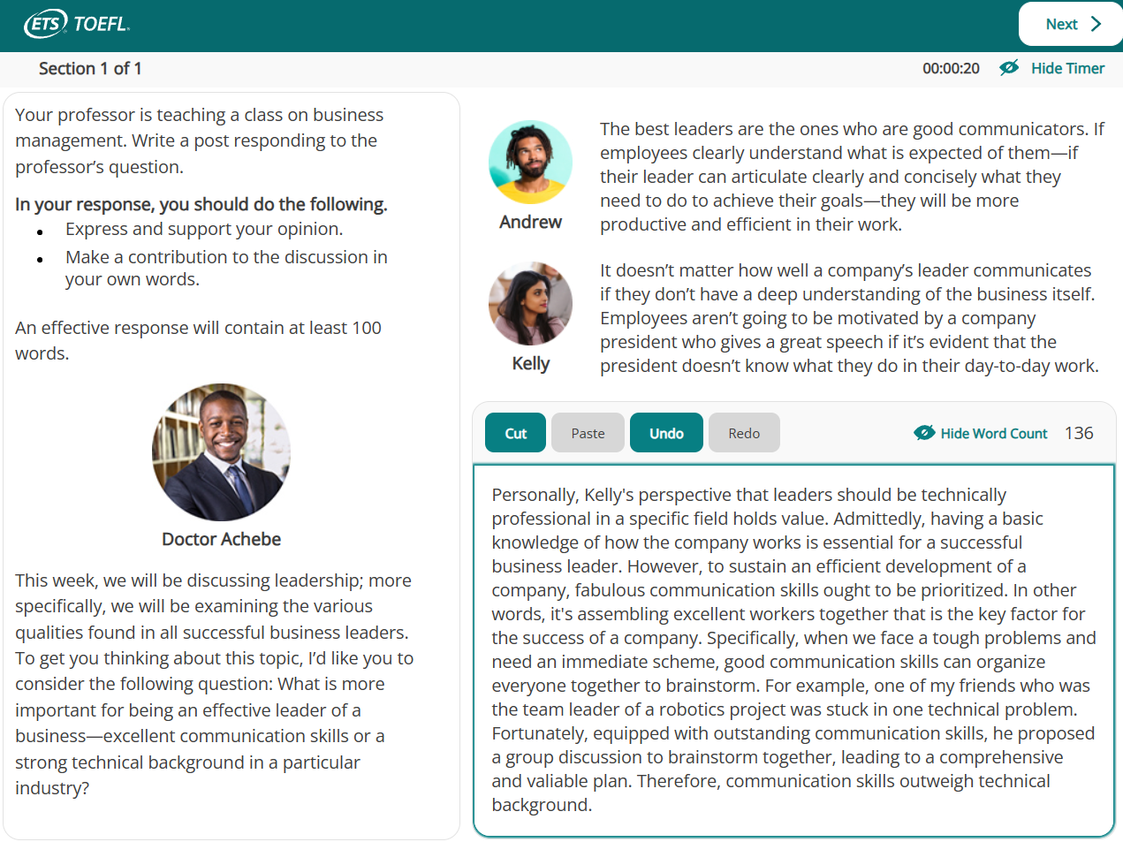

Slide 46
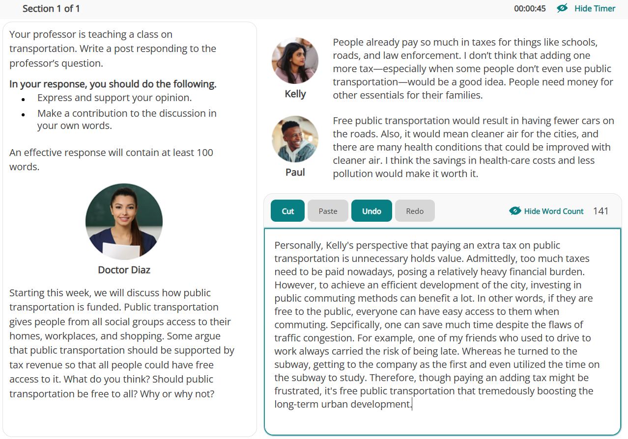
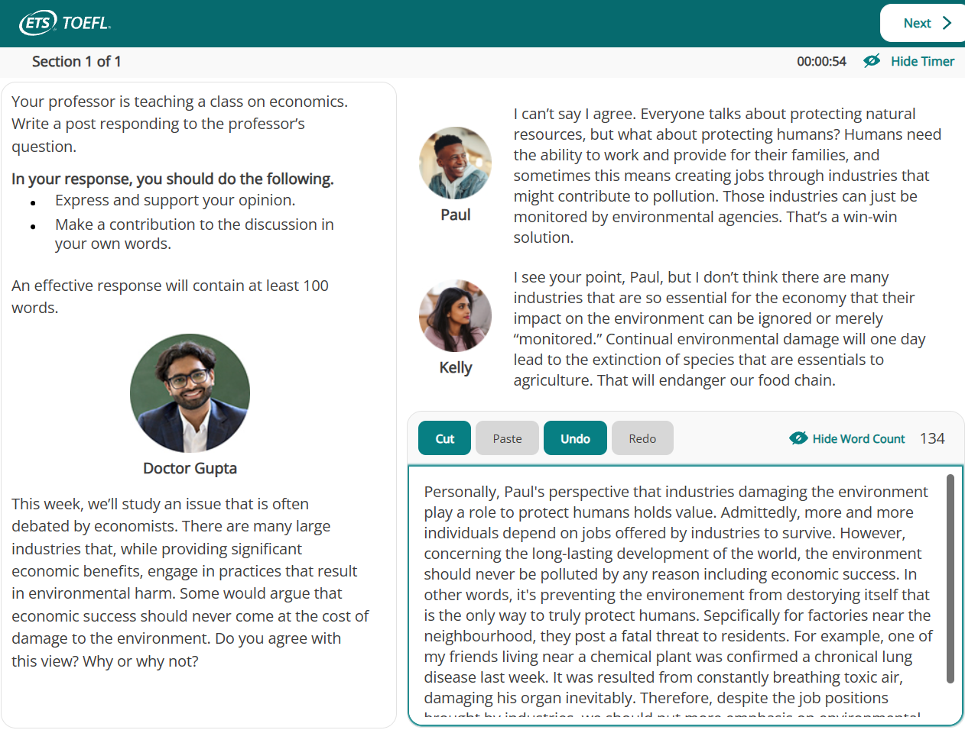


Slide 47
家庭类话题
1.In discussions about parent-child relationships, do you agree with the following statement: parents should take full responsibility for planning the types of extracurricular activities for their children?
【成就/耐久】培养自立让孩子选择，父母不强迫，家庭长期和睦。
【乐趣】孩子选择自己感兴趣的课外活动，喜欢的项目更开心。
2.With the Internet being widely accessible, students often resort to online sources for assignment answers. Parents should monitor their children while they do homework to prevent plagiarism.
【成就/耐久】培养自立给孩子信任，父母不强迫，家庭长期和睦。
【健康】子女总被监控，心理压力大，对心理健康不利。
3.Do parents today spend too much time trying to help determine the futures of their children, and should children be allowed to make their own choices?
【成就/耐久】培养自立让孩子试错，父母做后盾，家庭长期和睦。
【经验】父母不了解的专业很多，老师有专业经验，更有帮助。
4.Many school students are doing a lot of school work already. Some people believe that students should help their parents with household chores, since it's the best way to give them a sense of responsibility.
【成就/耐久】培养家庭的责任心，理解父母不易，家庭长期和睦。
【健康】做作业一直久坐影响健康，家务培养责任感还活动身体。
5.Do you believe that growing up in a large family with several siblings offers more advantages, or being an only child is more advantageous?
【成就/耐久】共同承担挑战，每个人家庭压力小，更多精力做事业。
【经验】兄弟姐妹的学业工作经验，可以最直接分享传授给彼此。

Slide 48
家庭类话题
【让步认可】Claire's perspective is sound that [填入Claire 的观点].
【让步理由】Admittedly, [填入Claire 的理由], which demonstrates parents' concern for their children' progress.
【转折观点】However, given the necessity for students to develop individuality, [填入自己的观点].
【给出理由】In other words, with regard to [填入讨论的背景或主题], families respecting children's choices and providing support can benefit their achievements and sustain long-term family harmony.
【解释陈述】示范：Especially for adult children, even if parents offer suggestions based on their understanding of the specialty, the children should retain the final decision-making authority.
【例证细节】自己准备1-2个可以替换的例证，无论是“记叙文法”还是“引用调查法”，只要能保证考试现场快速输出就可以。
【总结观点】Therefore, although [填入Claire 的观点] is accepted by numerous parents, [填入自己的观点], which can promote children's independence and family harmony in the long run.
1. 子女自主
Children's autonomy
2. 家庭团结
Family cohesion
3. 家庭关怀
Family care giving
6. 亲戚纽带关系
Relative bonding ties
7. 家庭和谐氛围
Family harmonious atmosphere
8. 家庭冲突解决
Family conflict resolution
9. 子女独立发展
Children's independent growth
10. 父母子女共同成长
Parent-child mutual growth
4. 代际沟通
Intergenerational communication
5. 兄弟姐妹争吵
Sibling squabbles

Slide 49
公共建筑类话题
Considering the well-being of a community and its residents, how might establishing a theater within the community bring profound benefit?
【交流】剧场提供交流场所，活跃社区互动，讨论新剧目。
【乐趣】剧场演出，居民观看放松解压，增加生活乐趣
【经济】剧场演出增加收入，吸引人群带动周边消费。
2.Regarding urban development, what could be the most significant benefit of building a cinema in a newly developed district?
【交流】电影院提供交流场所，活跃社区互动，讨论新影视。
【乐趣】电影放映，居民观看放松解压，增加生活乐趣。
【经济】电影上映增加收入，吸引人群带动周边消费。
3.For urban inhabitants, what is the most remarkable benefit that an exhibition center can offer to a city and its people?
【交流】展览中心提供交流场所，活跃社区互动，讨论新的展览出题。
【乐趣】展览推出新主题，居民观展放松解压，增加生活乐趣。
【经济】展览开馆增加收入，吸引人群带动周边消费。
4.Reflecting on the potential development, what would you identify as the most substantial benefit of having a sports arena in the region?
【交流】体育馆提供交流场所，活跃社区互动，讨论新的健身话题。
【乐趣】体育馆提供健身场地，居民运动解压，增加生活乐趣。
【经济】举办赛事增加收入，吸引人群带动周边消费。
5.For a city and its residents, what do you think is the most significant advantage of having a museum located in that city?
【交流】博物馆提供交流场所，活跃社区互动，讨论新的展品。
【乐趣】博物馆引进新展品，居民参观放松解压，增加生活乐趣。
【经济】新品展出增加收入，吸引人群带动周边消费。

Slide 50
5. 公共空间改善
Public space enhancements
6. 公共场所互动活动
Public space interactive events
7. 社区发展计划
Community development initiatives
8. 居民健康改善
Resident health promotion
9. 提高居民生活质量
Improve residents' quality of life
10. 提供休闲娱乐
Offer leisure and recreation
1. 居民城市参与度
Resident urban engagement
2. 居民城市认同感
Resident urban identity
3. 城市文化交流
Urban cultural exchange
4. 城市文化融合
Urban cultural integration

