Slide 1
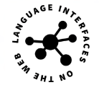
LIonWeb
Language Interfaces on the Web
How do we envision cloud-based
modeling infrastructures; guides
the rest of the layers
Reference
Architecture
Model access APIs and over- the-wire serialisation formats
Transport
Model maninpulation APIs for
Various programming languages
Programming
Service Integration
Type systems, interpreters and
other value-added services
S P E C I F I C A T I O N S – R E F E R E N CE I M P L E M E N T A T I O N S – E X A M P L E S - T U T O R I A L S

