Slide 1
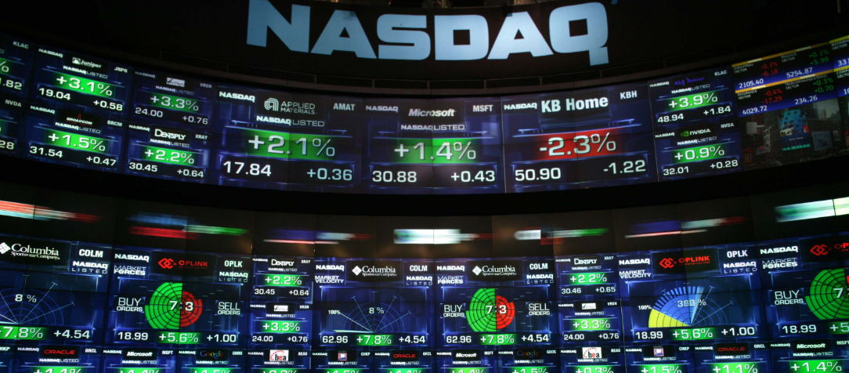

Analysts increasingly excited about Western Digital $WDC
New Insider Filing on $TMUS !!
Don’t believe the hype!! Future for $FISV looking gloomier. The FSA
$TMUS growth has been slowing, they have consolidated, with dominant share in their geographic verticals
Analysts increasingly excited about Western Digital $WDC. Upgrades around the corner?
Best tech stock to own long term? $ADP

Slide 2
Dowload historical price data for the stocks from Yahoo Finance
Download tweets for each cashtag
Notebook Part 1
Add a new daily change –column to the data
Run text in each tweet through the Vader sentiment analyzer algorithm
Combine the sentiment data with the tweets
Clean data, remove unnecessary features
Create a new feature; tweet sentiment multiplied by the nr of followers of the account
Scale the new feature to prepare it for the machine learning algorithms
Create a new dataframe of daily averages for each feature
Combine the daily averages tweet data with the stock’s daily data incl. percentage changes
Interpolate stock data for weekends to make it compatible with the tweet data
Create a label –column for ”Buy” or ”Sell”; this is what the model aims to predict!

Slide 3
Apply the following process for each of the 80+ cashtags (data prepared in the first step)
Notebook Part 2
Start training the model with various ML algorithms
cc
Make a Train/Test –split (80/20) of the data covering 74 days
cc
Data from 59 days (80%) will be used for training and 15 days (20%) will be used for testing
Applying
K-nearest Neighbors (KNN)
Logistic Regression(LogReg)
Support Vector Machines (SVM)
Naive Bayes
Decision Tree
Random Forest
and checking accuracy with 10-fold cross validation
cc
Collecting the results and making a summarized overview; which models and cashtags performed best
cc

Slide 4
Apply the following process for each of the 80+ cashtags (data prepared in the first step)
Notebook Part 2
Start training the model with various ML algorithms
Scrape more recent tweets with cashtags through the Twitter Development API
cc
cc
cc
cc
cc

