Slide 1
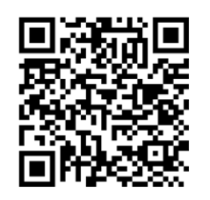
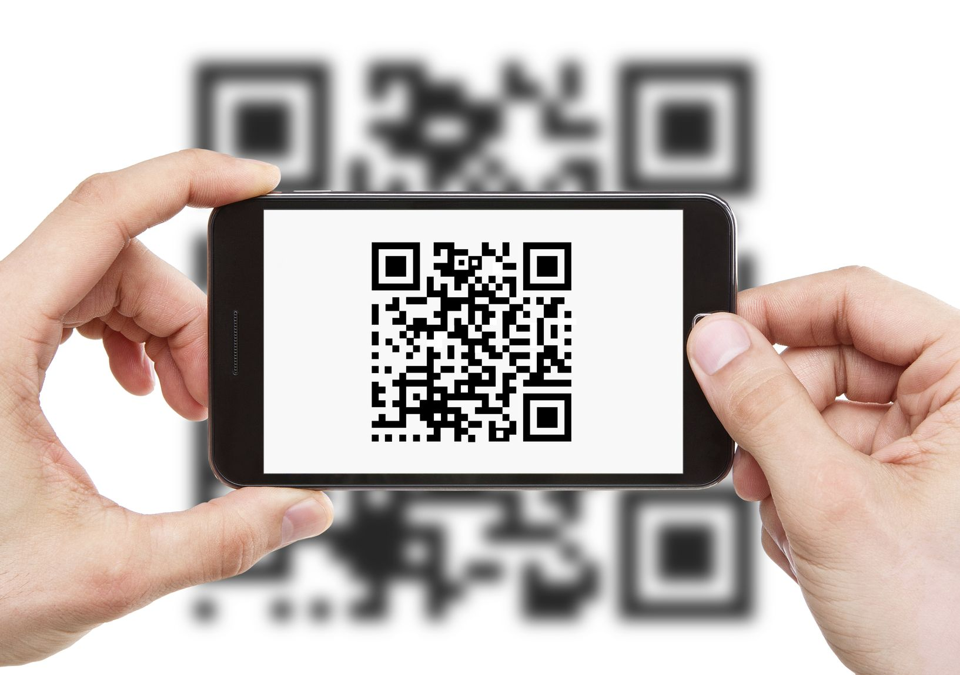


Course Evaluation
We Value Your Feedback!
Pls scan the QR Code and submit the course feedback before you exit the session. Looking forward to seeing you again. Thanks! ☺
https://form.gov.sg/62d4c2264f946e00139dfade
Notes:
« Royaty Free Music: https://www.bensound.com »

