Slide 1
GRCR-Net: A Complex Residual Network with GPR Denoising and Rotational Augmentation for Automatic Modulation Classification
A Breakthrough Approach for AMC
Junkai Li
College of Information Engineering Zhejiang University of Technology
July 5, 2025
GRCR-Net

Slide 2






Outline
1
Background and Challenges
2
GRCR-Net Innovation Overview
Core Technical Innovations
Experimental Results and Analysis
5
Technical Contributions and Impact
6
Conclusion and Future Work
GRCR-Net

Slide 3

The Importance of Automatic Modulation Classification
Critical Applications:
Cognitive Radio: Dynamic spectrum sensing and management
Spectrum Monitoring: Radio environment situational awareness
Military Communications: Electronic warfare and signal intelligence
5G/6G Networks: Intelligent signal processing
Cognitive Radio
Spectrum
Monitor
AMC
Key Challenge:
Accurate classification under low Signal-to-Noise Ratio (SNR)
Preserving I/Q signal phase information
Robust performance in complex electromagnetic
Military Comm
5G/6G
environments
GRCR-Net

Slide 4
Core Challenge: Performance Degradation in Low SNR
Limitations of Existing Methods:
Likelihood-based methods: High computational complexity
Feature-based methods: Rely on expert knowledge
Deep learning methods: Severe performance drop in low SNR
100
80
60
Accuracy (%)
40
20
Baseline GRCR-Net
10 20
Critical Issues:
Noise severely affects signal quality Loss of I/Q signal phase information Data imbalance and poor generalization
−20 −10
0
SNR (dB)
GRCR-Net

Slide 5
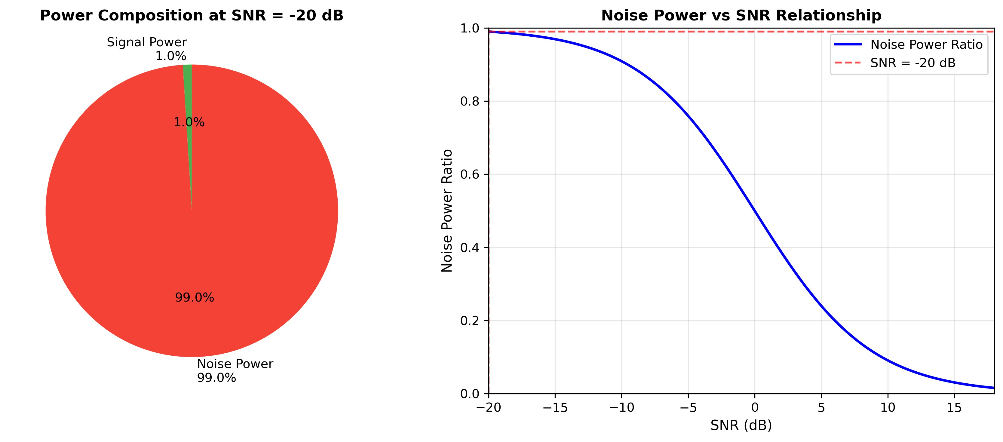
Power Analysis: Visual Understanding
Understanding Power Relationships
GRCR-Net

Slide 6
The Challenge: Extreme Noise Conditions
SNR = -20dB: Signal Power Only 1%, Noise 99%
Extreme Low SNR Challenge:
At SNR = -20dB: P_{signal} = 1%, P_{noise} = 99% Previous SOTA methods: only ∼60% accuracy Massive noise severely degrades classification Traditional denoising methods fail
Signal 1%
Noise 99%
Denoised
GPR
Our Solution: Adaptive GPR Denoising
Model signal as Gaussian Process
Assume Additive White Gaussian Noise (AWGN) Derive noise power from signal statistics Adaptive scale parameters for different SNRs
SNR = -20dB
GRCR-Net

Slide 7
Why Tackle the Impossible? The Value in the Noise
From 99% Noise to Actionable Intelligence
The Core Question:
Why tackle a problem where signals are 99% noise?
Critical Real-World Scenarios:
Military Reconnaissance: Enemy communications are intentionally weak to evade detection. Just knowing "something is there" provides critical intelligence for strategic decisions.
Deep Space Communication: Probe signals, after traveling billions of kilometers through cosmic noise, arrive incredibly faint on Earth. We must recover them from the void to maintain contact.
Harsh Environment Degradation: Normal signals passing through dense buildings or strong interference become temporarily buried in noise. The connection must be maintained.
GRCR-Net
10 / 29

Slide 8
Our Unified Strategy: From Noise to Intelligence
Two-Step Approach to Tackle the Impossible
Our Unified Strategy:
Step 1: Build a noise-robust model that can extract weak signals → OUR WORK
Step 2: Long-term integration of thousands of weak results → HIGH CONFIDENCE
Our Contribution: GRCR-Net - A breakthrough noise-robust model Achievement: Extract signals from noise with 65.38% accuracy Impact: Enabling detection where others see only noise
Step 1 is the focus of this work - Building the noise-robust model!
GRCR-Net
10 / 29

Slide 9
GRCR-Net: Three Core Innovations
GRCR-Net Hybrid Architecture
GPR
Denoising
Adaptive Noise Suppression
Rotational Augmentation
Geometric Symmetry
Hybrid Architecture
ComplexCNN
+ResNet
+5.86%
+3.78%
56.94%
Final Performance: 65.38% Accuracy, Surpassing State-of-the-Art
GRCR-Net
10 / 29

Slide 10
GPR Denoising: Theoretical Foundation
Part I: Signal Model and Assumptions
Core Assumptions:
Additive White Gaussian Noise (AWGN):
r [n] = s[n] + w [n]
Independent Gaussian Distribution: Each noise sample is independent and follows Gaussian distribution
1
(1)
2
w_{I} [n], w_{Q} [n] ∼ N (0, σ²) (I/Q components) (2)
n
3
Gaussian Process Modeling: The entire signal can be modeled as a Gaussian Process
w [n] ∼ CN (0, σ²) (Complex AWGN) (3)
n
With these assumptions, we can derive the optimal noise estimationỊ
GRCR-Net
10 / 29

Slide 11
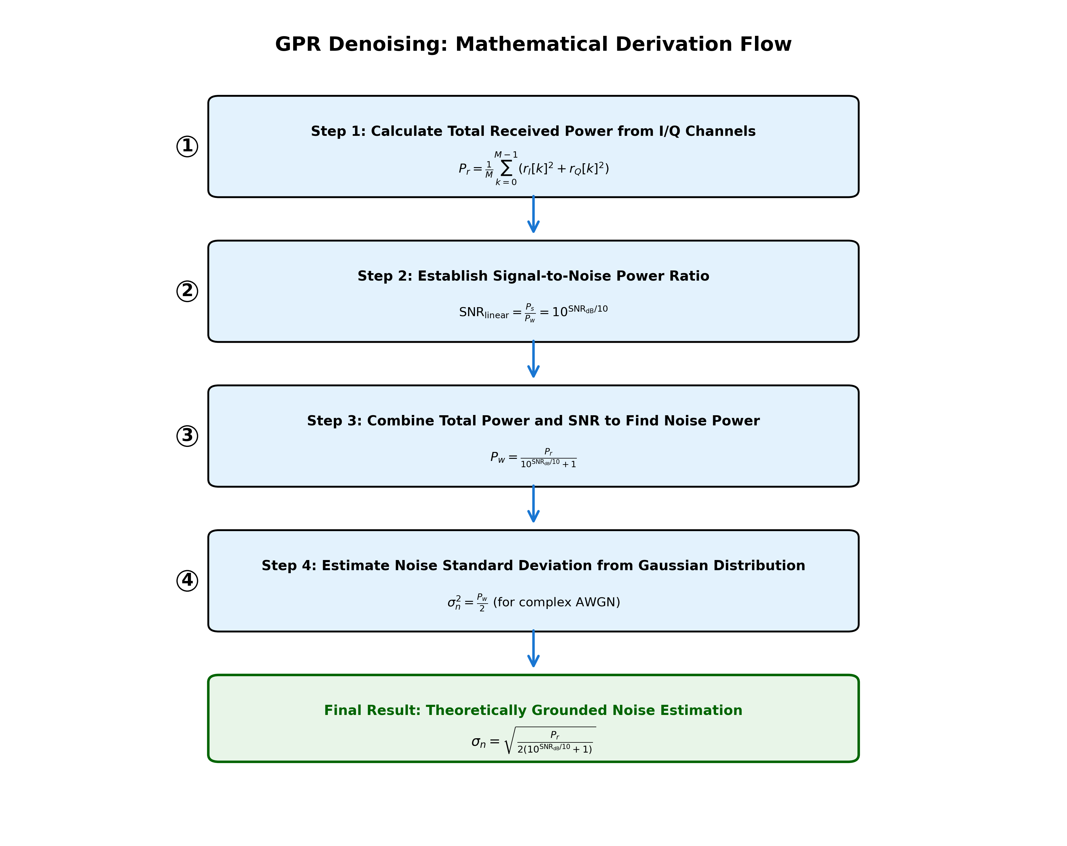
GPR Denoising: Mathematical Derivation Process
Part II: Complete Derivation Process
Step-by-Step Derivation:
1. I/Q Power Calculation:
M−1
1
M
Σ
P =
2
2
r
(r [k] + r
[k] ) (4)
I Q
k=0
SNR Power Ratio:
_{SNRlinear = 10}SNR_{dB}/10
Noise Power Calculation:
(5)
P_{r}
P =
(6)
w
₁₀SNR_{dB}/10 ₊ ₁
4. Gaussian Noise Estimation
:
GRCR-Net

Slide 12
GPR Denoising: Final Noise Estimation
Step 4: Estimate Noise Standard Deviation from Gaussian Distribution
Since noise follows Gaussian distribution, for complex AWGN:
P_{w} = E[|w [n]|²] = E[w ²[n]] + E[w ² [n]] = 2σ²
I Q n
Therefore, the noise variance for each component:
(8)
P P
2
w r
σ = =
(9)
n
2 2(10^{SNRdB/10} + 1)
Final Noise Standard Deviation:
s
=
P_{r}
σ
n
(10)
2(10^{SNRdB/10} + 1)
Key Insight: This σ² becomes the noise
n
variance parameter α in our GPR model,
enabling theoretically grounded denoising!
GRCR-Net

Slide 13
GPR Denoising: Adaptive Length Scale Strategy
RBF Kernel Function:
(x − x )
2
2
i j
2L²
k(x_{i}, x_{j} ) = σ_{f} exp −
Length Scale L Controls Smoothing Strength:
(11)
Large L → Strong smoothing, risk of oversmoothing Small L → Weak smoothing, preserves signal details
Problems with Fixed Large L at Low SNR:
1
2
3
Oversmoothing of signal features Loss of time-domain details
Loss of critical phase information
Our Adaptive Strategy:
(
L
if SNR ≥ 0 dB if SNR < 0 dB
L =
0
(12)
max(L_{min}, L₀(1 + SNR/20))
Key Insight: Lower SNR → Smaller L → Preserve more signal details!
GRCR-Net

Slide 14
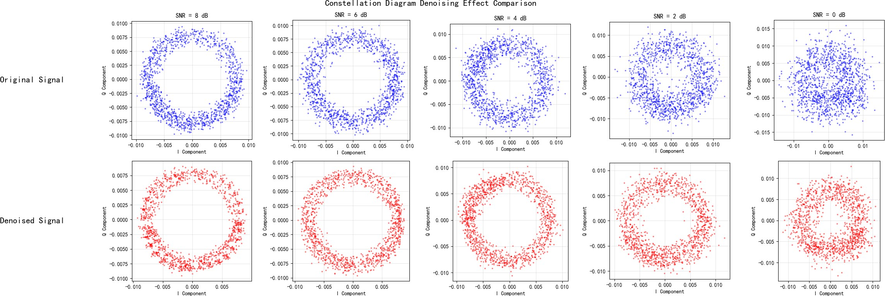
Innovation 1: Complete GPR Denoising Pipeline
Complete Algorithm:
1
Power Estimation:
Σ
P =
1
M
M−1
k=0
2
2
r
(r [k] + r
[k] )
I
Q
2
P
2
Noise Variance: σ =
r
n
2(10^{SNR/10}+1)
3
Adaptive Length Scale:
L = max(L_{min}, L₀(1 + SNR/20))
GPR Denoising: Apply to I and Q components separately
Signal Reconstruction: sˆ[n] = sˆ_{I} [n] + jsˆ_{Q} [n]
4
5
Result: +5.86% Accuracy Improvement
Key Advantages:
Theoretically grounded noise estimation SNR-adaptive smoothing control Preserves signal feature integrity
Optimal for different noise conditions
Junkai Li (ZJUT)
GRCR-Net

Slide 15
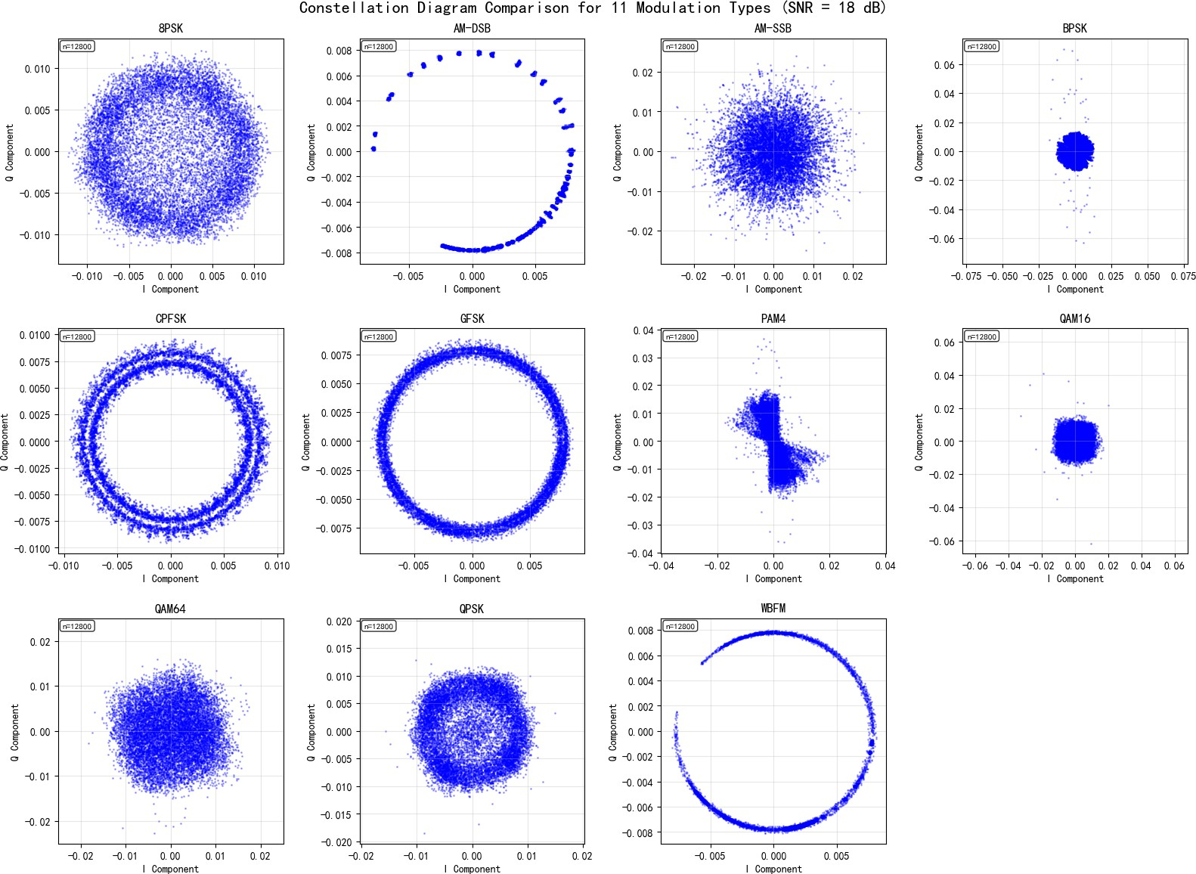
Innovation 2: Geometric Symmetry-Based Rotational Augmentation
Theoretical Foundation:
Rotational symmetry of digital modulation constellations
Mathematical rigor of complex plane rotation
Exploitation of phase invariance
Implementation:
′
s [n]
cos θ − sin θ s [n] sin θ cos θ s_{Q} [n]
I
=
I
(13)
s′ [n]
Q
Augmentation Strategy:
90°, 180°, 270° rotations 4× training data expansion
Applied to symmetric modulation types
GRCR-Net
15 / 29

Slide 16
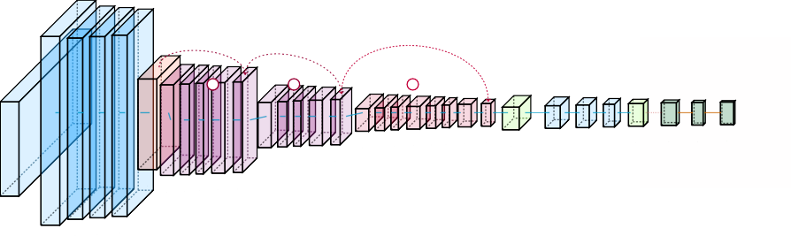
Innovation 3: Hybrid ComplexCNN-ResNet Architecture
Lightweight Hybrid Complex-ResNet Architecture
Multi-Layer Residual Blocks with Direct Skip Connections Complex Domain Processing
Real Domain Classification
skip
skip
skip
+
+
+
ComplexConv1D Complex^{C}Cºo^{m}n^{p}v^{l}1^{eC}D^{xomplex ComplexComplex}DropoutComplex Dense 256Dropout Dense
_{Complex}Comple^{C}xºC^{m}o^{p}n_{A}^{l}v^{e}_{c}1^{x}_{t}D_{ivation BN Global}
Dense ^{Leaky}
0.5
Softmax
Magnitude ReLU 0.3
^{256 filters Acti}2^{v}5ª6^{ti}fiºl^{n}ter^{B}s ^{N 256 filters}
11 classes
ComplexConv1D
BN
Complex^{(s=2)}
Avg Pool ^{512 units ReLU}
Complex^{ComplexConv1D}
128 filters ^{Acti}₁^{v}₂ª₈^{ti}_{fi}º_{l}^{n}_{tersBN}
Complex Pool
Complex^{CompleCxComonpvle1xD}
(s=2) ^{BN}
^{(64,6C4o)mplexCon}A^{v}c¹t^{D}ivation _{BN}
I/Q Radio Signals
Input (2,128)
64 filters^{BN 64 filters}
Model: 400K parameters — 4 processing stages — Simple residual skip connections
— Complex Flow — Real Flow
11 Modulation Classes
ComplexConv1^{C}D^{omplex}
→ Direct Skip Connection
+ Residual Addition
Complex_{Leaky}
_{Permut}3_{e}2 filters, _{BN ReLU}
(128,2) ^{k=5}
Design Principles:
Complex Domain Processing: Direct I/Q signal handling, preserving phase information
Residual Learning: Solving gradient vanishing in deep networks ModReLU Activation: Maintaining complex geometric structure Lightweight Design: Balancing performance and computational efficiency
GRCR-Net

Slide 17
Dataset and Experimental Setup
RML2016.10a Dataset:
11 modulation types
SNR range: -20dB to +18dB 128 complex samples per signal Data split: 72%/8%/20%
Experimental Environment:
Intel Core i9-13900K
NVIDIA GeForce RTX 4090 (24GB)
TensorFlow 2.17.0 + Keras 3.6.0
Ubuntu 24.04.2 LTS
Modulation | Samples
8PSK | 22,000
AM-DSB | 22,000
AM-SSB | 22,000
BPSK | 22,000
CPFSK | 22,000
flFSK | 22,000
PAM4 | 22,000
QAM16 | 22,000
QAM64 | 22,000
QPSK | 22,000
WBFM | 22,000
GRCR-Net

Slide 18
Baseline Model Performance Comparison
Key Findings:
ComplexCNN shows natural advantage for I/Q signals
ResNet’s residual connections improve training stability
GRCR-Net achieves 8.27% improvement over best baseline
Model Architecture
Accuracy (%)
FCNN CNN2D
Transformer CNN1D
ResNet ComplexCNN
42.65
47.31
47.86
54.94
55.37
57.11
Performance Breakthrough:
Surpasses existing SOTA methods
Consistent improvement across all SNR conditions
Exceptional performance in low SNR environments
GRCR-Net
65.38
GRCR-Net

Slide 19
Ablation Study: Component Contribution Analysis
Ablation Study: Cumulative Contribution Analysis of Technical Components
70.0
Baseline Performance Data Augmentation Contribution GPR Denoising Contribution
 |  |  |  |  | 65.38%
62.80%
60.72%
56.94%
67.5
65.0
Classification Accuracy (%)
62.5
60.0
57.5
55.0
52.5
50.0
Hybrid Model
+ Data Augmentation
+ GPR Denoising
+ Complete Solution
Technical Configuration
Key Insights:
GPR denoising contributes most: +5.86 percentage points
Rotational augmentation provides stable improvement: +3.78 percentage points Synergistic effect of both techniques: total improvement of 8.44 percentage points
GRCR-Net

Slide 20
Performance Across Different SNR Conditions
GPR Denoising Performance Analysis
Model Performance vs SNR
Low SNR Performance Detailed Comparison
100
40
ResNet CNN1D
-10dB
0dB
10dB
35
ComplexCNN
Hybrid
80
Hybrid+GPR+Aug
30
Classification Accuracy (%)
Classification Accuracy (%)
60
25
20
40
15
10
20
ResNet CNN1D
ComplexCNN
5
Hybrid Hybrid+GPR+Aug
0
-20
-15
-10
-5 0 5
Signal-to-Noise Ratio (dB)
10
15
0
-20.0
-17.5
-15.0
-12.5 -10.0 -7.5
Signal-to-Noise Ratio (dB)
-5.0
-2.5
GRCR-Net

Slide 21
Detailed SNR Performance Analysis
Key Findings:
Low SNR (-20 to -8dB):
Peak: +14.90% at -10dB Average: 7.25%
Medium SNR (-6 to 4dB):
Range: 3.74% to 6.82%
Average: 5.12%
High SNR (6 to 18dB):
Range: 3.50% to 5.93%
Average: 5.07%
SNR | Base | +GPR | Gain
-20 | 8.93 | 9.96 | +1.03
-18 | 8.68 | 10.22 | +1.54
-16 | 9.85 | 12.69 | +2.84
-14 | 11.08 | 17.32 | +6.24
-12 | 12.65 | 24.18 | +11.53
-10 | 20.15 | 35.05 | +14.90
-8 | 34.66 | 47.36 | +12.70
-6 | 54.86 | 61.21 | +6.35
-4 | 64.02 | 70.84 | +6.82
-2 | 75.66 | 80.89 | +5.23
0 | 79.43 | 83.17 | +3.74
2 | 82.96 | 87.07 | +4.11
4 | 84.56 | 89.00 | +4.44
6 | 83.93 | 89.38 | +5.45
8 | 83.17 | 89.10 | +5.93
10 | 84.73 | 89.85 | +5.12
12 | 85.81 | 90.31 | +4.50
14 | 85.31 | 88.81 | +3.50
16 | 82.25 | 88.15 | +5.90
18 | 83.87 | 88.98 | +5.11
Best Performance:
+14.90% improvement
GRCR-Net

Slide 22
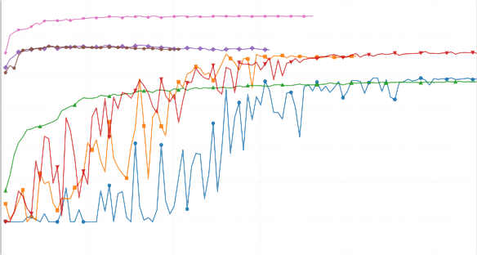
Training Convergence Analysis
Key Insights:
Fast Convergence: Optimal in 5-10 epochs
Stable Training: Smooth without oscillations
Best Performance: Outperforms all baselines
Robust Results: Consistent across runs
Validation Accuracy Convergence Curves
0.70
0.60
Validation Accuracy
0.50
0.40
0.30
0.20
CNN2D CNN1D
Transformer ResNet
Complex NN Hybrid
GRCR-Net (Proposed)
0.10
0.00
0
20
40
60
Training Epochs
80
100
Training Advantage: Fast & Stable Convergence
GRCR-Net

Slide 23
Major Technical Contributions
Adaptive Noise Suppression Technology
First SNR-adaptive GPR denoising algorithm Optimal denoising under different noise conditions
Novel approach for complex electromagnetic environments
Geometric Property Data Augmentation Strategy Exploits inherent symmetry of modulation signals Significantly improves robustness to phase offset Effective solution for data-scarce scenarios
Hybrid Neural Network Architecture Innovation First fusion of ComplexCNN and ResNet advantages Deep residual learning in complex domain
New architectural paradigm for I/Q signal processing
1
2
3
GRCR-Net

Slide 24
Comparison with State-of-the-Art Methods
Method | Accuracy(%) | Year | Publication | Model Size | Key Technology
LDCVNN | 62.41 | 2025 | JCR Q2 | Lightweight | Dual-branch complex network
ULCNN | 62.47 | 2022 | JCR Q2 | Lightweight | Ultra-lightweight CNN
AMC-NET | 62.51 | 2023 | ICASSP (CCF B) | Normal | Frequency-domain denoising
HFECNET-CA | 63.92 | 2023 | JCR Q2 | Lightweight | Attention mechanism
AbFTNet (Previous SOTA) | 64.59 | 2024 | JCR Q2 | Normal | Multimodal fusion
GRCR-Net (Ours) | 65.38 | 2025 | This Work | Lightweight | GPR+Rotation+Hybrid
Core Advantages:
Performance Leadership: Surpasses best existing method by 0.79% Technical Innovation: Organic fusion of three core technologies Practical Robustness: Stable performance in complex environments Scalability: Components can be applied independently
GRCR-Net

Slide 25
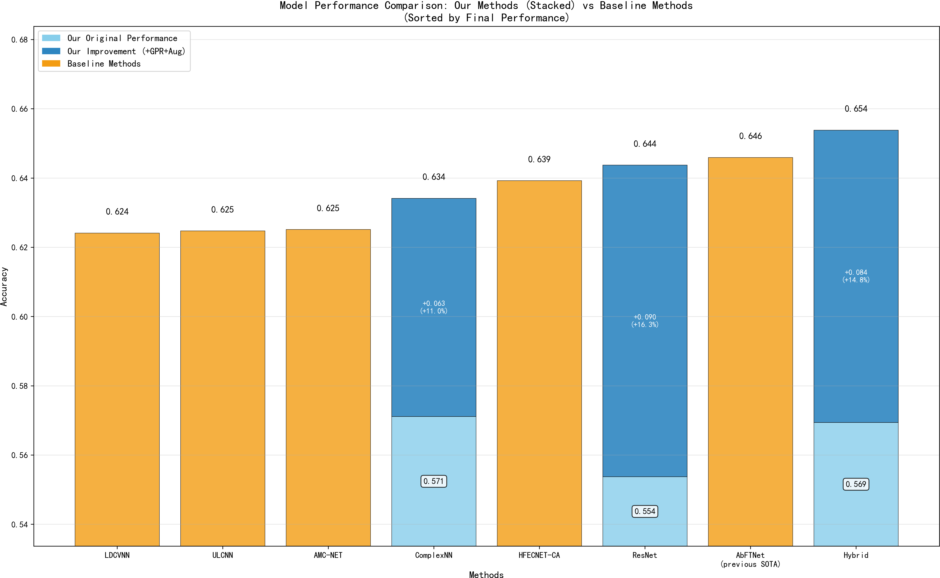
Comprehensive Performance Comparison
SOTA Achievement: 65.38% accuracy
+0.79% vs. AbFTNet (2024)
+2.87% vs. AMC-NET (2023)
+2.91% vs. ULCNN (2022)
Key Advantages:
Clear performance leadership Consistent improvements Robust across conditions New benchmark established
New SOTA 65.38%
GRCR-Net

Slide 26
Research Summary
GRCR-Net: A Breakthrough AMC Method
Core Achievements:
Achieved 65.38% classification accuracy
Surpassed existing SOTA methods
Exceptional performance in low SNR environments
Proposed three core technical innovations
Technical Breakthroughs:
Adaptive GPR denoising algorithm
Geometric symmetry data augmentation
Hybrid ComplexCNN-ResNet architecture
Impact Significance:
Solution for complex electromagnetic environments
Advancement of cognitive radio technology
New insights for signal processing field
Important theoretical and practical value
Open Source Contribution:
Complete code open-sourced
Detailed experimental data
Comprehensive technical documentation
GRCR-Net

Slide 27
Future Research Directions
Algorithm Optimization and Extension
Explore performance in more complex channel environments Research real-time processing optimization strategies Extend to more modulation types
Technology Fusion and Innovation
Combine with emerging architectures like Transformers Explore multimodal signal fusion
Research self-supervised learning methods
Practical Deployment and Applications
Hardware acceleration and edge computing optimization Large-scale real-environment validation
Industrial application promotion
1
2
3
GRCR-Net

Slide 28
Thank You!
Questions and Discussion Welcome
Open Source Repository:
https://github.com/LJK666666666/radioML-v3
GRCR-Net

