Slide 1
Junkai Li
College of Information Engineering Zhejiang University of Technology
June 30, 2025
GRCR-Net

Slide 2






Outline
1
Background and Challenges
2
GRCR-Net Innovation Overview
Core Technical Innovations
Experimental Results and Analysis
5
Technical Contributions and Impact
6
Conclusion and Future Work
GRCR-Net

Slide 3

The Importance of Automatic Modulation Classification
Critical Applications:
Cognitive Radio: Dynamic spectrum sensing and management
Spectrum Monitoring: Radio environment situational awareness
Military Communications: Electronic warfare and signal intelligence
5G/6G Networks: Intelligent signal processing
Cognitive Radio
Spectrum
Monitor
AMC
Key Challenge:
Accurate classification under low Signal-to-Noise Ratio (SNR)
Preserving I/Q signal phase information
Robust performance in complex electromagnetic
Military Comm
5G/6G
environments
GRCR-Net

Slide 4
Core Challenge: Performance Degradation in Low SNR
Limitations of Existing Methods:
Likelihood-based methods: High computational complexity
Feature-based methods: Rely on expert knowledge
Deep learning methods: Severe performance drop in low SNR
100
80
60
40
20
Accuracy (%)
Traditional GRCR-Net
−20 −10 0 10
SNR (dB)
Critical Issues:
Noise severely affects signal quality Loss of I/Q signal phase information Data imbalance and poor generalization
GRCR-Net

Slide 5
GRCR-Net: Three Core Innovations
GRCR-Net Hybrid Architecture
GPR
Rotational
Denoising Adaptive Noise Suppression
Hybrid Architecture
Augmentation
Geometric
ComplexCNN+ResNet
Symmetry
+5.86%
+3.78%
+8.27%
Final Performance: 65.38% Accuracy, Surpassing State-of-the-Art
GRCR-Net

Slide 6
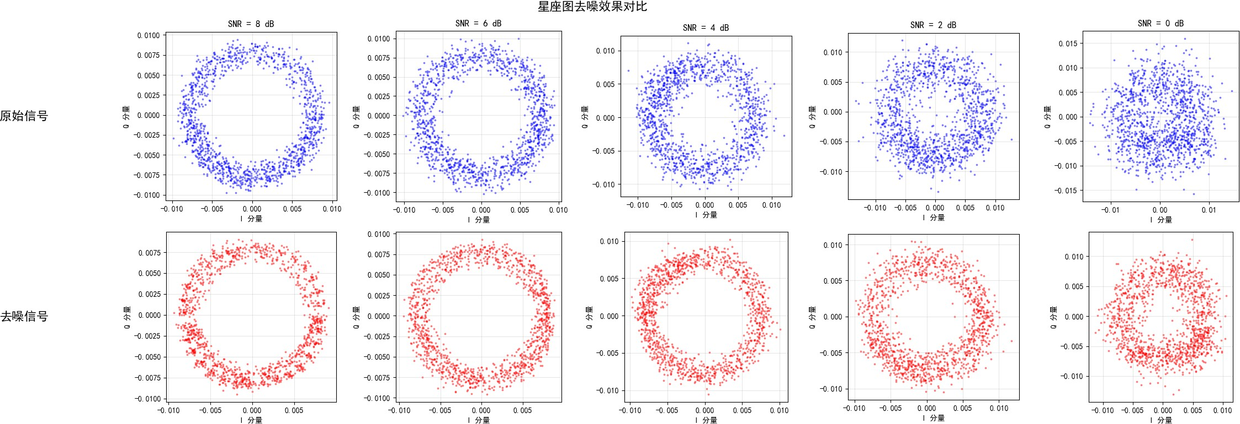
Innovation 1: Adaptive GPR Denoising Algorithm
Core Concept:
SNR-adaptive noise estimation Dynamic kernel length-scale adjustment Separate processing of I/Q channels
Mathematical Foundation:
s
=
P_{r}
σ
n
(1)
2(10^{SNRdB /10} + 1)
L = max(L_{min}, L₀(1 + SNR/20))
Key Advantages:
7.25% improvement in low SNR conditions Preserves signal feature integrity
High computational efficiency
(2)
GRCR-Net

Slide 7
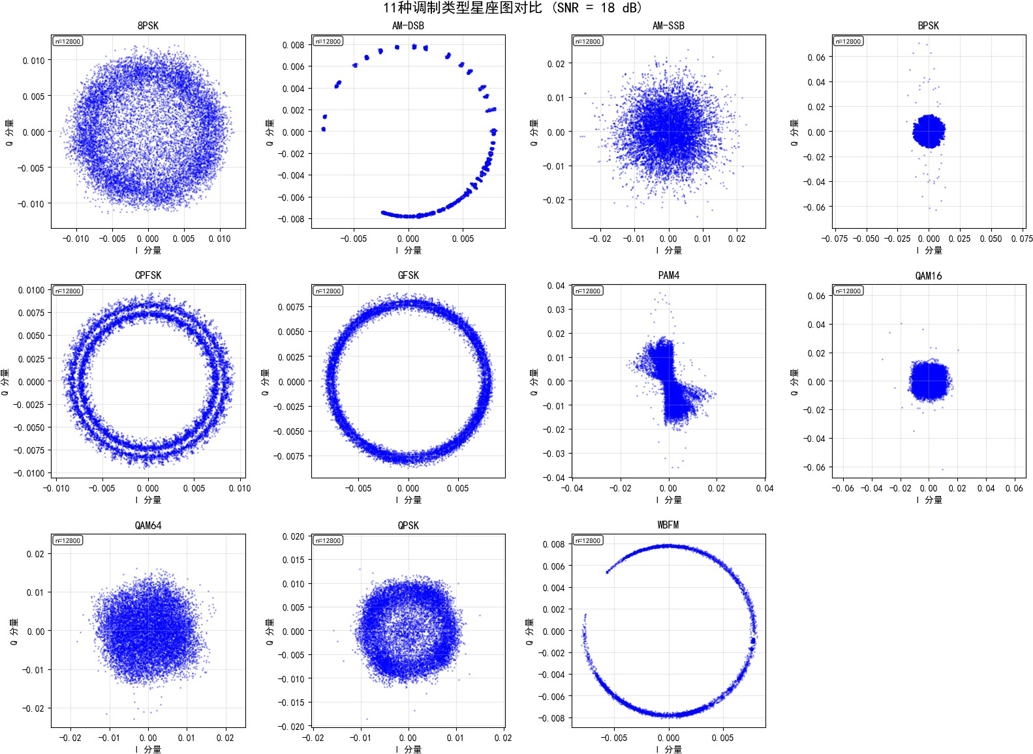
Innovation 2: Geometric Symmetry-Based Rotational Augmentation
Theoretical Foundation:
Rotational symmetry of digital modulation constellations
Mathematical rigor of complex plane rotation
Exploitation of phase invariance
Implementation:
′
s [n]
cos θ − sin θ s [n] sin θ cos θ s_{Q} [n]
I
=
I
(3)
s′ [n]
Q
Augmentation Strategy:
90°, 180°, 270° rotations 4× training data expansion
Applied to symmetric modulation types
GRCR-Net
7 / 18

Slide 8
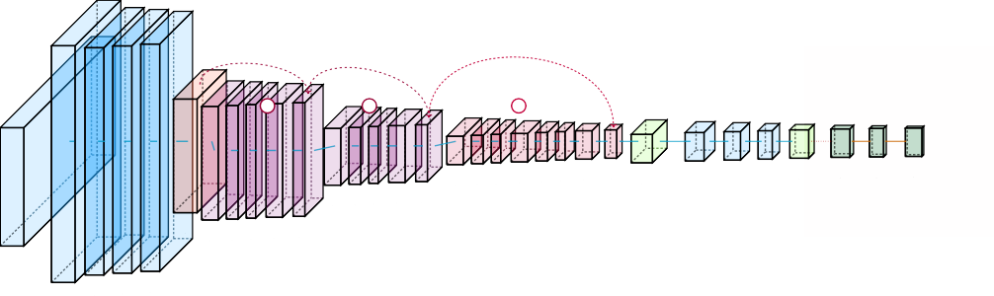
Innovation 3: Hybrid ComplexCNN-ResNet Architecture
Lightweight Hybrid Complex-ResNet Architecture
Multi-Layer Residual Blocks with Direct Skip Connections Complex Domain Processing
Real Domain Classification
skip
skip
skip
+
+
+
ComplexConv1D ComplexCCoomnpvl1e^{C}Dx^{omplex ComplexComplex}DropoutComplex Dense 256^{Dropout Dense}
ComplexCompleCxoCmopn_{A}lve_{c}1x_{t}D_{ivation BN Global}
Dense Leaky
Softmax
Magnitude ReLU 0.3
256 filters Acti₂v₅a₆ti_{fi}o_{l}n_{ter}B_{s} N 256 filters
^{0.5} 11 classes
ComplexConv1D
BN
Complex^{(s=2)}
Avg Pool 512 units ReLU
ComplexComplexConv1D
128 filters Acti₁v₂a₈ti_{fi}o_{l}n_{tersBN}
Complex Pool
ComplexComple^{C}xC^{om}on^{p}v^{le}1^{x}D
(s=2) ^{BN}
(64,6^{C}4º)^{mplexCon}A^{v}c¹t^{D}ivation _{BN}
I/Q Radio Signals
Input (2,128)
64 filtersBN ^{64 filters}
Model: 400K parameters — 4 processing stages — Simple residual skip connections
— Complex Flow — Real Flow
11 Modulation Classes
ComplexConv1^{C}D^{omplex}
→ Direct Skip Connection
+ Residual Addition
Complex_{Leaky}
Permut3e2 filters, _{BN ReLU}
(128,2) k=5
Design Principles:
Complex Domain Processing: Direct I/Q signal handling, preserving phase information
Residual Learning: Solving gradient vanishing in deep networks ModReLU Activation: Maintaining complex geometric structure Lightweight Design: Balancing performance and computational efficiency
GRCR-Net
10 / 18

Slide 9
Dataset and Experimental Setup
RML2016.10a Dataset:
11 modulation types
SNR range: -20dB to +18dB 128 complex samples per signal Data split: 72%/8%/20%
Experimental Environment:
Intel Core i9-13900K
NVIDIA GeForce RTX 4090 (24GB)
TensorFlow 2.17.0 + Keras 3.6.0
Ubuntu 24.04.2 LTS
Modulation | Samples
8PSK | 22,000
AM-DSB | 22,000
AM-SSB | 22,000
BPSK | 22,000
CPFSK | 22,000
flFSK | 22,000
PAM4 | 22,000
QAM16 | 22,000
QAM64 | 22,000
QPSK | 22,000
WBFM | 22,000
GRCR-Net
10 / 18

Slide 10
Baseline Model Performance Comparison
Key Findings:
ComplexCNN shows natural advantage for I/Q signals
ResNet’s residual connections improve training stability
GRCR-Net achieves 8.27% improvement over best baseline
Model Architecture
Accuracy (%)
FCNN CNN2D
Transformer CNN1D
ResNet ComplexCNN
42.65
47.31
47.86
54.94
55.37
57.11
Performance Breakthrough:
Surpasses existing SOTA methods
Consistent improvement across all SNR conditions
Exceptional performance in low SNR environments
GRCR-Net
65.38
GRCR-Net
10 / 18

Slide 11
Ablation Study: Component Contribution Analysis
70
65.38
65
Accuracy (%)
62.8
60.72
60
56.94
55
50
+GPR +Aug
Method Combination
+GPR+Aug
Baseline
Key Insights:
GPR denoising contributes
most: +5.86 percentage points
GRCR-Net

Slide 12
Performance Across Different SNR Conditions
100
80
60
40
Accuracy (%)
20
Baseline Hybrid GRCR-Net
10 15
0
0
SNR (dB)
−20 −15 −10 −5
5
Performance Highlights:
Low SNR (-20dB to -8dB): Average improvement of 7.25 percentage points Medium SNR (-6dB to 4dB): Average improvement of 5.12 percentage points
GRCR-Net

Slide 13
Major Technical Contributions
Adaptive Noise Suppression Technology
First SNR-adaptive GPR denoising algorithm Optimal denoising under different noise conditions
Novel approach for complex electromagnetic environments
Geometric Property Data Augmentation Strategy Exploits inherent symmetry of modulation signals Significantly improves robustness to phase offset Effective solution for data-scarce scenarios
Hybrid Neural Network Architecture Innovation First fusion of ComplexCNN and ResNet advantages Deep residual learning in complex domain
New architectural paradigm for I/Q signal processing
1
2
3
GRCR-Net

Slide 14
Comparison with State-of-the-Art Methods
Method | Accuracy(%) | Parameters | Key Technology
AMC-Net | 62.51 | Large | Frequency-domain denoising
AbFTNet | 64.59 | Large | Multimodal fusion
HFECNET-CA | ∼60 | Small | Attention mechanism
LDCVNN | ∼58 | Small | Dual-branch complex network
GRCR-Net | 65.38 | Medium | GPR+Rotation+Hybrid
Core Advantages:
Performance Leadership: Surpasses best existing method by 0.79% Technical Innovation: Organic fusion of three core technologies Practical Robustness: Stable performance in complex environments Scalability: Components can be applied independently
GRCR-Net

Slide 15
Practical Application Value and Prospects
Direct Application Domains:
Cognitive Radio: Intelligent spectrum sensing and management
Electronic Warfare: Signal reconnaissance and identification
Communication Regulation: Spectrum monitoring and compliance
5G/6G Networks: Intelligent signal processing
Technology Extension Value:
GPR denoising applicable to other signal processing tasks
Hybrid architecture extendable to other complex signal analysis
Rotational augmentation suitable for geometrically
Cognitive Radio
Electronic Warfare
GRCR-Net
Spectrum
Next-Gen Comm
Regulation
symmetric data
GRCR-Net

Slide 16
Research Summary
GRCR-Net: A Breakthrough AMC Method
Core Achievements:
Achieved 65.38% classification accuracy
Surpassed existing SOTA methods
Exceptional performance in low SNR environments
Proposed three core technical innovations
Technical Breakthroughs:
Adaptive GPR denoising algorithm
Geometric symmetry data augmentation
Hybrid ComplexCNN-ResNet architecture
Impact Significance:
Solution for complex electromagnetic environments
Advancement of cognitive radio technology
New insights for signal processing field
Important theoretical and practical value
Open Source Contribution:
Complete code open-sourced
Detailed experimental data
Comprehensive technical documentation
GRCR-Net

Slide 17
Future Research Directions
Algorithm Optimization and Extension
Explore performance in more complex channel environments Research real-time processing optimization strategies Extend to more modulation types
Technology Fusion and Innovation
Combine with emerging architectures like Transformers Explore multimodal signal fusion
Research self-supervised learning methods
Practical Deployment and Applications
Hardware acceleration and edge computing optimization Large-scale real-environment validation
Industrial application promotion
1
2
3
GRCR-Net

Slide 18
Thank You!
Questions and Discussion Welcome
Open Source Repository:
https://github.com/LJK666666666/radioML-v3
GRCR-Net

