Slide 1
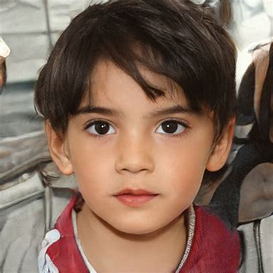
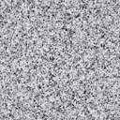
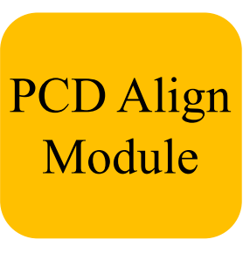

ResidualBlockNoBN × 5
Seg pretrained on Imagenet 1k
Cls pretrained on Imagenet 22k

