Slide 1
VS Install

Slide 2
Visual Studio Install
Visual Studio Community 2019
IDE (Integrated Development Environment)
Download
https://visualstudio.microsoft.com/downloads/
https://visualstudio.microsoft.com/downloads/
https://visualstudio.microsoft.com/

Slide 3
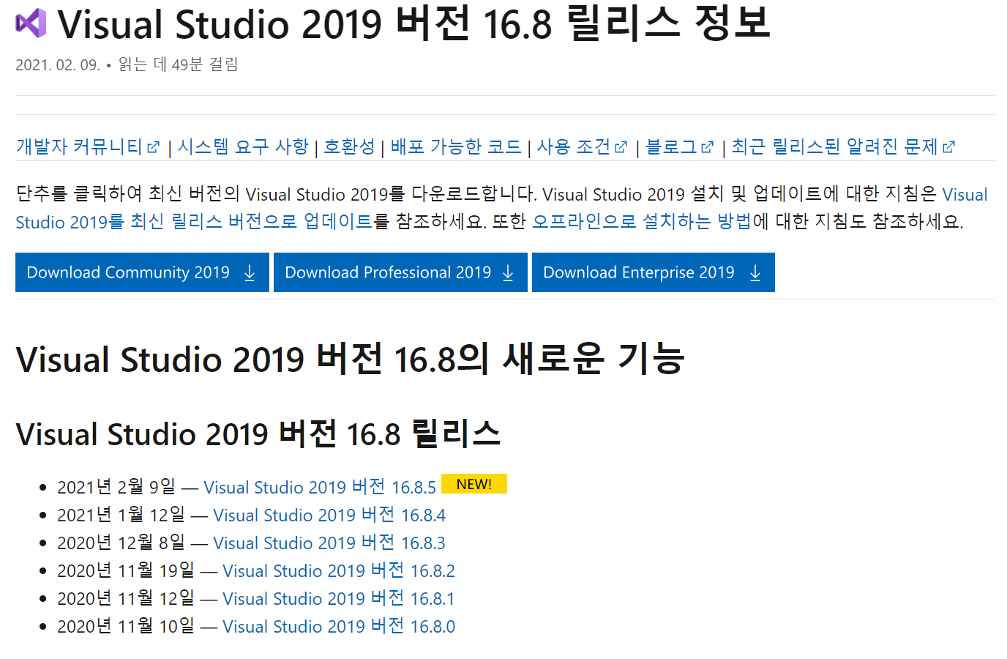
Visual Studio Install

Slide 4
Visual Studio Install
Visual Studio Community 2019
Visual Studio 2019 version 16.8.6 (as of 2021.02.25 )
If your version on your notebook is older than this version,
Uninstall first and install version of 16.8.6 or newer

Slide 5
Component files for C++ project
Project is a unit
Project file (*.vcxproj)
Can have multiple source files
Can have multiple header files
Source file (*.cpp)
Main.cpp
Account.cpp
Header file (*.h)
Account.h
Solution file (*.sln)
Can have multiple project files

Slide 6
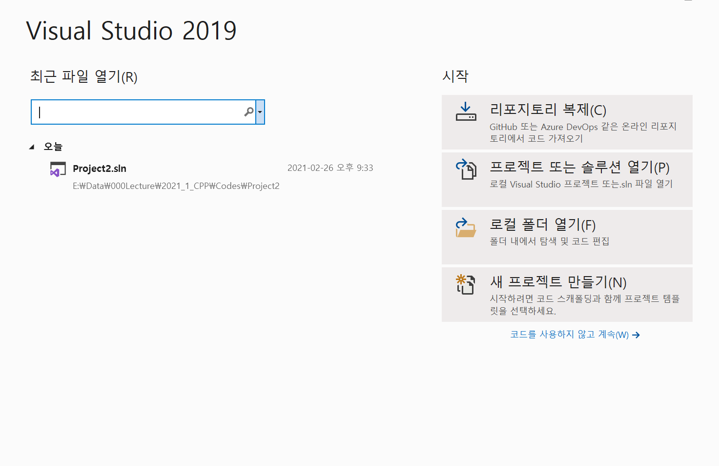
Building a new project
“새 프로젝트만들기”를 선택 (Select “New Project”)

Slide 7
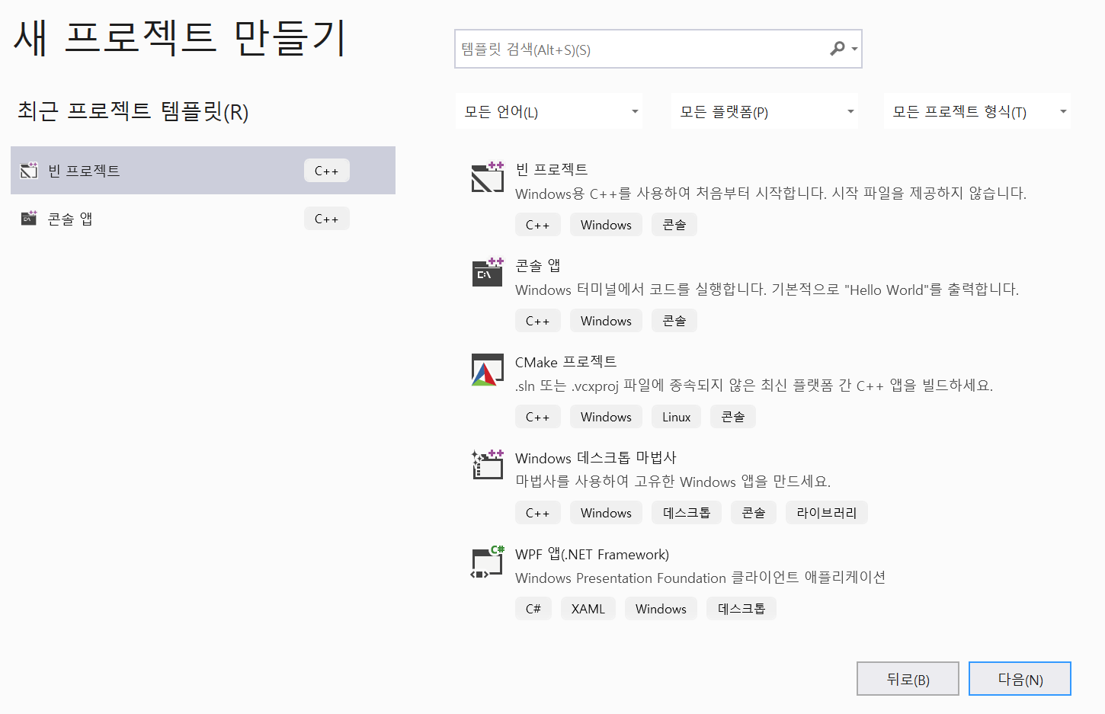
Building a new project
빈 프로젝트 C++ 선택 (Select an empty project C++)

Slide 8
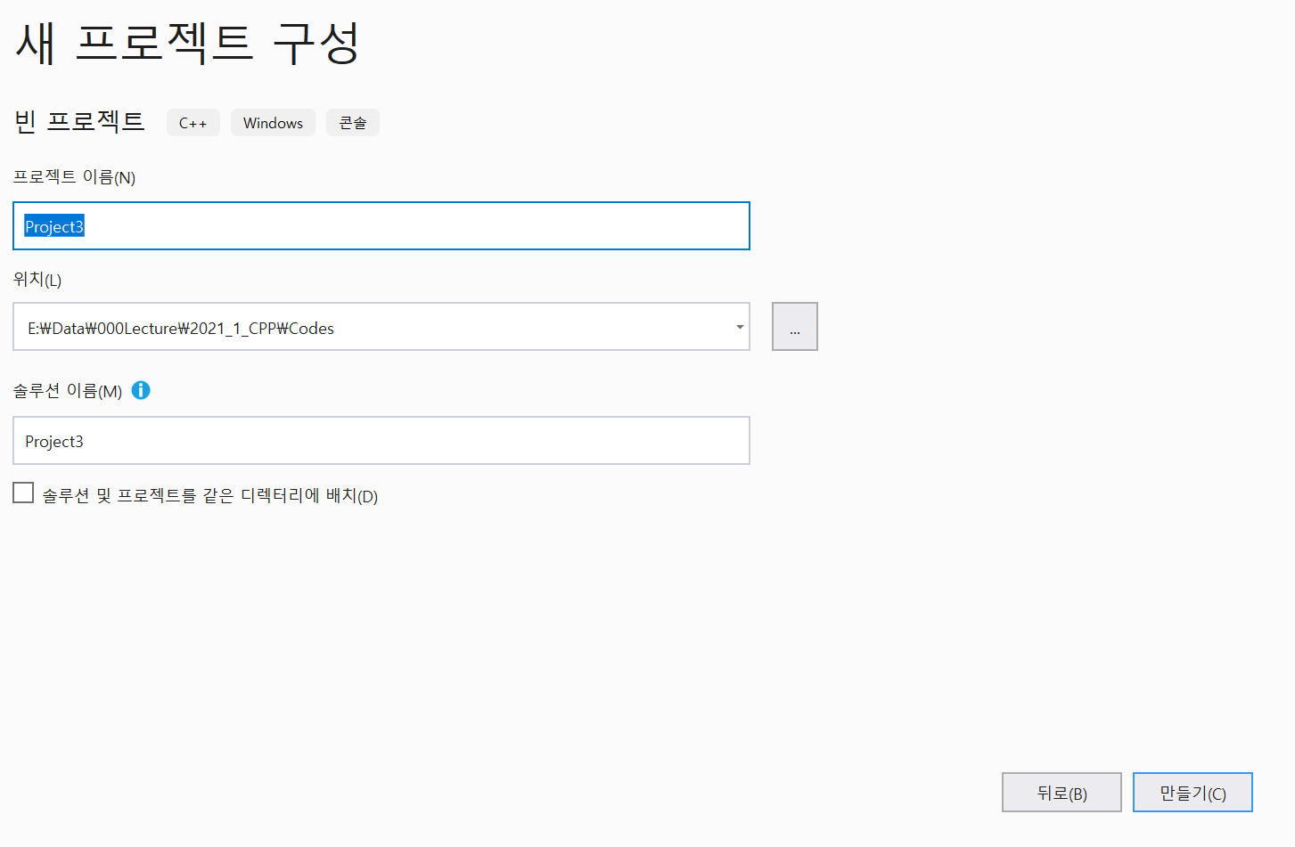
Building a new project
Enter your project name at the designated folder

Slide 9
Building a new project
Organize Your Folders
YMY // your name initial
Lecture Notes // saving ppt files
Codes //saving your codes for review
Ch01
MyFirst
MySecond
Project3
Ch02

Slide 10
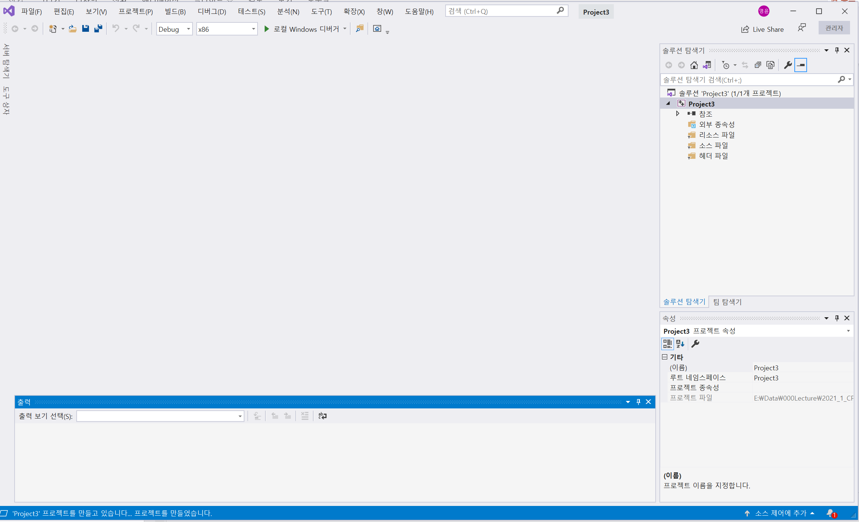
Building a new project
Click RB on the Source file

Slide 11
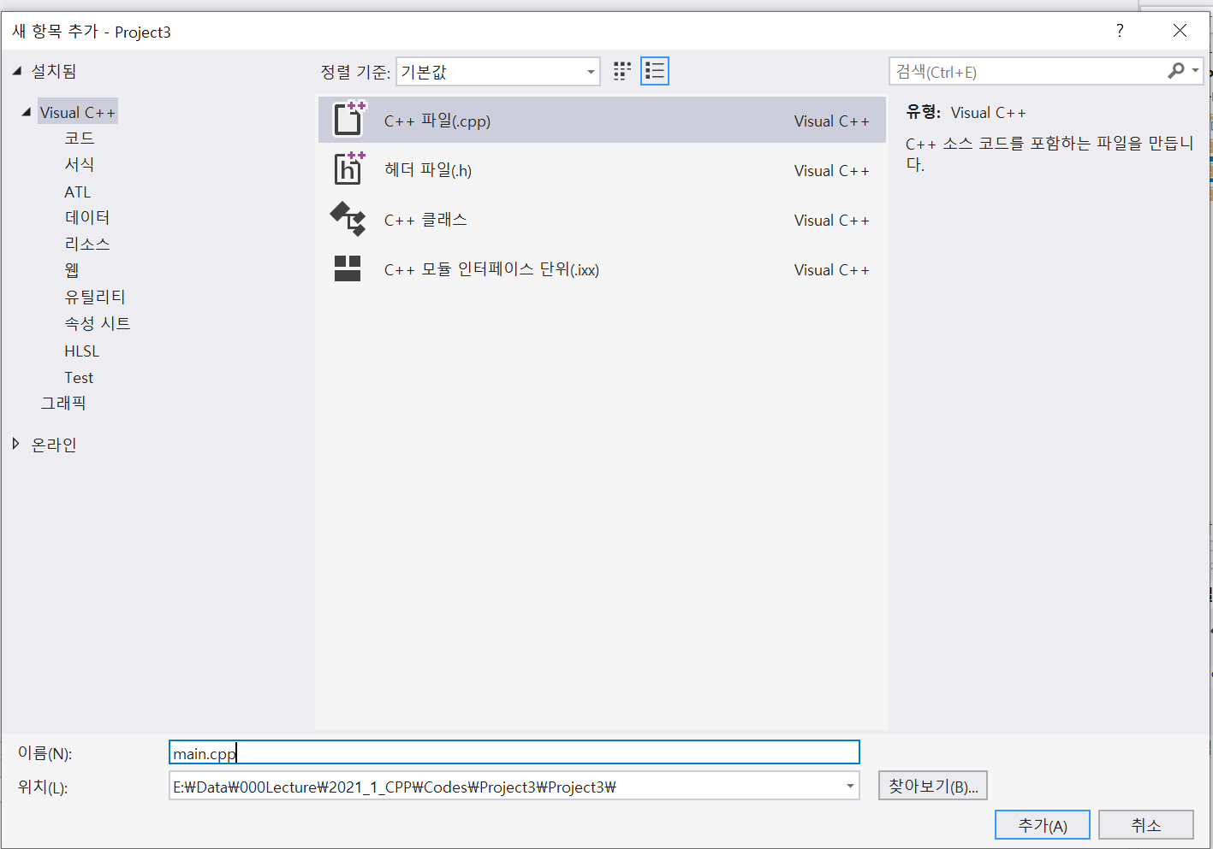
Building a new project
Select C++ file, and name it main.cpp

Slide 12
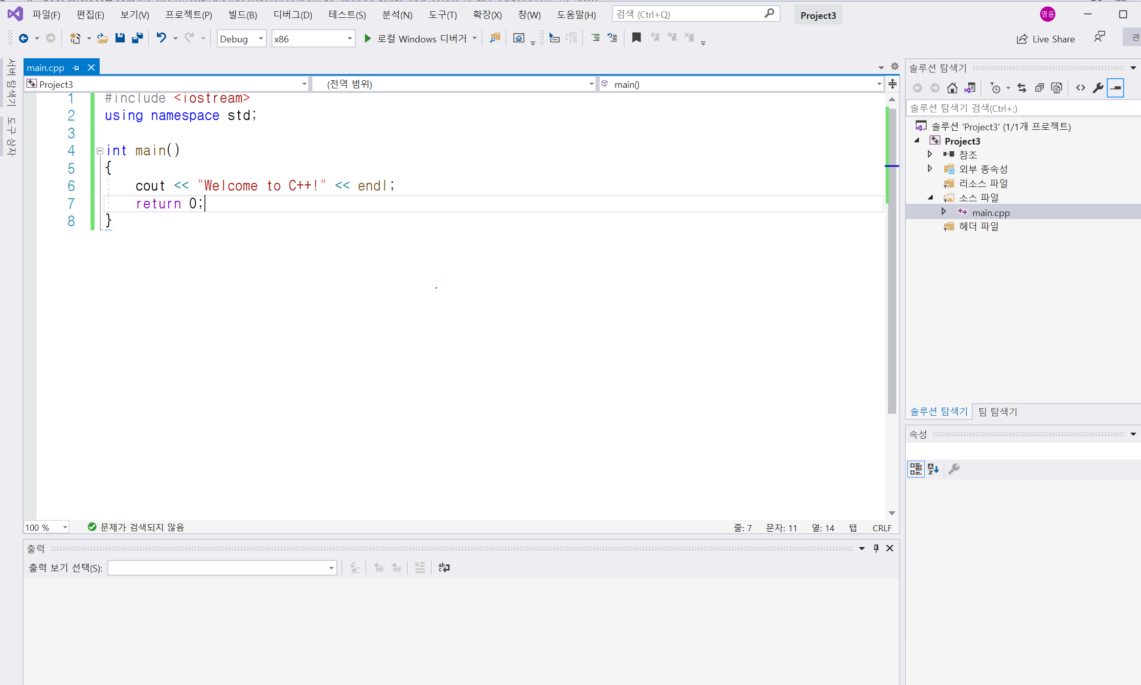
Building a new project
Write down your codes for main.cpp, and save

Slide 13
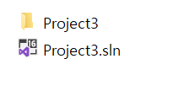
Building a new project
Check your folder under Codes
If you name a project as Project3
Under Codes\Ch01\Project3\ folder
Under Codes\Ch01\Project3\Projects folder

Slide 14
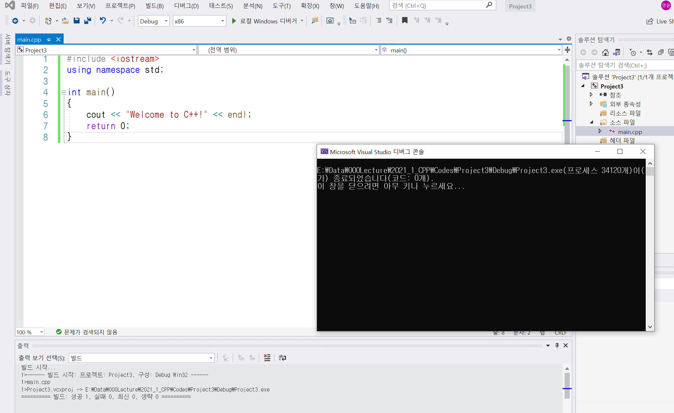
Compile and run the project
Click “Rebuild solution” under Build menu
Click “Start w/o debugging” under Debug menu
Check success meaning no syntax error

Slide 15
Building a new project
Check your folder under Codes
If you name a project as Project3
Under Codes\Ch01\Project3\
Under Codes\Ch01\Project3\Projects\
Under Codes\Ch01\Project3\Debug\

Slide 16
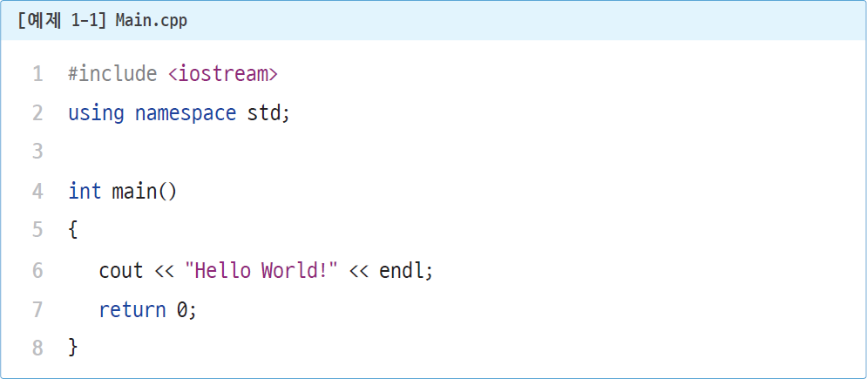
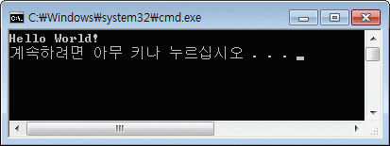
main components in main.cpp
main.cpp

