Slide 1
Chapter 1 Introduction to Computers, Programs, and C++

Slide 2
Objectives
To write a simple C++ program for console output (§1.6).
Programming Errors (§1.9)

Slide 3
A Simple C++ Program
Let us begin with a simple C++ program that displays the message “Welcome to C++!” on the console.
#include <iostream>
using namespace std;
int main()
{
// Display Welcome to C++ to the console
cout << "Welcome to C++!" << endl;
return 0;
}

Slide 4
A Simple C++ Program
#include <iostream>
Compiler preprocessor directive
Includes iostream library for console input output
iostream is a header file
#include <iostream>
using namespace std;
int main()
{
// Display Welcome to C++ to the console
cout << "Welcome to C++!" << endl;
return 0;
}

Slide 5
cout and << operator
cout object
  console output
  standard C++ output stream object
  defined in <iostream> header file
<< operator
  stream insertion operator
  Insert right operand into left output stream object
  Output to the screen connected to the cout object
  Print multiple values ​​with multiple << operators
cout << "Hello\n" << “World!";

Slide 6
cout and << operator
int n=3;
char c='#';
cout << c << 5.5 << '-' << n << "hello”;
cout << "n + 5 =" << n + 5;
cout << f(); // print return values from function f()
cout << "Hello" << '\n';
cout << "Hello" << endl;

Slide 7
#include <iostream> and preprocessor
using namespace std;
int main() {
cout << "Hello\n";
return 0;
}
...
...
...
...
<ios>header file
...
...
#include <ios>
...
...
<ostream>header file
<ios>
...
#include <ostream>
...
<ostream>
<istream>header file
...
#include <istream>
...
<iostream>header file
<istream>
<iostream>
#include <iostream>
using namespace std;
int main() {
cout << "Hello\n";
return 0;
}
preprocessor
Compile
SimpleC++.cpp
확장된 SimpleC++.cpp

Slide 8
Where is <iostream> header file?
<iostream> file is a text file
Under visual studio\..\include

Slide 9
<iostream>
<iostream> file is a text file
Under visual studio\..\include
  C:\Program Files (x86)\Microsoft Visual Studio\2019\Community\VC\Tools\MSVC\14.28.29333\include

Slide 10
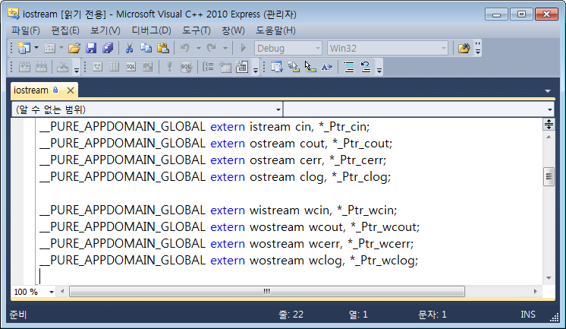
cin, cout
Where they are defined?
cout, cin are objects declared in <iostream> header

Slide 11
namespace
Name(identifier) conflicts
    large number of engineers are involved in the project
    compiling or linking by importing open source or source/object files written by others
  It takes a lot of time and effort to solve
namespace keyword
  Name conflict resolution
  Introduced in the new ANSI C++ standard in 2003
Allows developers to create their own namespaces
Names declared in a namespace are separate from other namespaces.
Creating namespaces
namespace alpha { // alpha
....... // every identifiers here is declared under namespace alpha
}

Slide 12
namespace
using namespace std;
- tells the compiler to use the std namespace
- namespace is a mechanism to avoid naming conflicts in a large program
cout, and cin are defined in the iostream library in the std namespace
#include <iostream>
using namespace std;
int main()
{
// Display Welcome to C++ to the console
cout << "Welcome to C++!" << endl;
return 0;
}

Slide 13
std::
One of the namespaces defined by the ANSI C++ standard
All C++ standard libraries are built in the std namespace
Any name declared in the <iostream> header file: in the std namespace
  cout, cin, endl
to access names declared in the std namespace
  std:: use prefix
  std::cout, std::cin, std::endl
can omit std::
  “using namespace” directive
using namespace std;
...................................
cout << "Hello" << endl; // std:: omit
std:: can be omitted

Slide 14
#include <iostream> and std
<iostream> is declared entirely within the std namespace
To use the <iostream> header file you need the following code
#include <iostream>
using namespace std;

Slide 15
Extending the Simple C++ Program
Once you understand the program, it is easy to extend it to display more messages. For example, you can rewrite the program to display three messages, as shown in Listing 1.2.
#include <iostream>
using namespace std;
int main()
{
cout << "Programming is fun!" << endl;
cout << "Fundamentals First" << endl;
cout << "Problem Driven" << endl;
return 0;
}

Slide 16
Computing with Numbers
Further, you can perform mathematical computations and displays the result to the console. Listing 1.3 gives such an example.
#include <iostream>
using namespace std;
int main()
{
cout << "(10.5 + 2 * 3) / (45 - 3.5) = ";
cout << (10.5 + 2 * 3) / (45 - 3.5) << endl;
return 0;
}

Slide 17
Programming Errors
Syntax Errors
Runtime Errors
Logic Errors

Slide 18
Syntax Errors
int main()
{
i = 30;
cout << i + 4;
cout << “Program is fun << endl;
return 0;
}

Slide 19
Common Syntax Errors
Common Error 1: Missing Braces
Common Error 2: Missing Semicolons
Common Error 3: Missing Quotation Marks
Common Error 4: Misspelling Names

Slide 20
Runtime Errors
int main()
{
int i = 30;
int j = 0;
int k = i / j;
cout << k << 두이;
int A[5] = {-1, 2, 5, -9, -10};
cout << “A[0]: ” << A[0] << “A[5]: ” << A[5];
return 0;
}

Slide 21
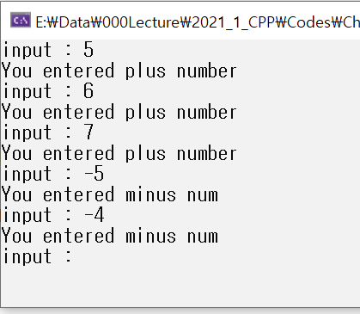
Logic Errors
int main()
{
int i = 1;
while (i = 1)
{
cout << "input : ";
int num;
cin >> num;
if (num < 0) // if user enters a num < 0 , want to exit the loop
{
cout << "You entered minus num" << endl;
i = 0;
}
else
{
cout << "You entered plus number" << endl;
}
}
return 0;
}

