Slide 1
Chapter 2 Elementary Programming

Slide 2
Objectives
To read input from the keyboard (§2.3).
To name constants using the const keyword (§2.7).
To perform operations using operator, sizeof() (§2.8.3).

Slide 3
Reading Input from the Keyboard
You can use cin object to read input from the keyboard.
#include <iostream>
using namespace std;
int main() {
cout << “Width: ";
int width;
cin >> width;
cout << “Height: ";
int height;
cin >> height;
int area = width*height;
cout << “Area " << area << "\n";
}
Width: 3
Height: 5
Area 15

Slide 4
Keyboard input using cin object, and >> operator
cin
  C++ input stream object that connects the standard input device, the keyboard
>> operator
  stream extraction operator
  read value from input stream and assign it to a variable
  multiple input in one statement with successive >> operator
cout << “Width Height : ";
cin >> width >> height;
cout << width << endl << height << endl;
Width Height: >>23 36
23
36
assign to width
assign to height

Slide 5
Assign a value to a variable when <Enter> key is typed
cin
  has input buffer
  keep keyboard input in the input buffer until <Enter> key is typed
>> operator
  When <Enter> key is typed, the key value is read from the input buffer, and assigned to a variable

Slide 6
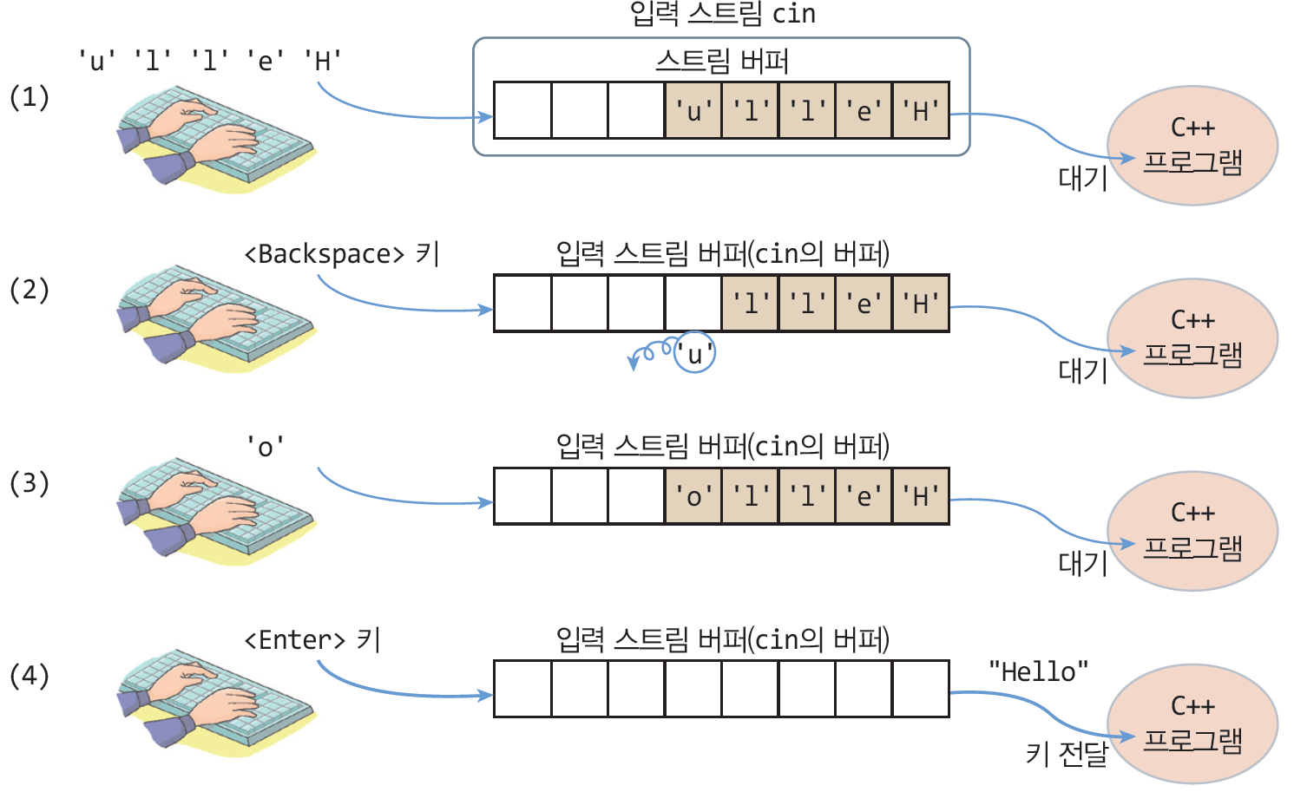
key input to buffer stream of cin

Slide 7
string, and char array
char name1[6] = {'G', 'r', 'a', 'c', 'e', '\0'}; // name1 is a string with “Grace”
char name2[5] = {'G', 'r', 'a', 'c', 'e'}; // name2 is a char array
char name5[10] = “Grace”; // “Grace” is a string literal

Slide 8
string input
문자열 입력
char name[6];
cin >> name;
Grace
key input
name [0] [1] [2] [3] [4] [5]
'G' | 'r' | 'a' | 'c' | 'e' | '\0'
“Grace” string

Slide 9
input from keyboard and output to display
#include <iostream>
using namespace std;
int main() {
cout << “Name: ";
char name[11];
cin >> name;
cout << “Your name is " << name << endl;
}
Name: Alpha
Your name is Alpha
no space
Name: Al Pha
Your name is Al
string input stops when encountering space

Slide 10
password check
#include <iostream>
#include <cstring>
using namespace std;
int main() {
char password[11];
cout << “Enter Password in order to stop the program." << endl;
while(true) {
cout << “Password: ";
cin >> password;
if(strcmp(password, "C++") == 0) {
cout << “Program exits" << endl;
break;
}
else
cout << “Wrong password" << endl;
}
}

Slide 11
Reading a string with space in it
cin.getline(char buf[], int size, char delimitChar)
  read a line by line
  Even if there is a blank space, it is recognized as a single string until the <Enter> key is pressed
  max of (size-1) chars , ‘\0’ added at the end
  when encountering delimitChar, input stops
  default of delimitChar is ‘\n’<Enter>key)

Slide 12
Reading a string with space in it using cin.getline()
#include <iostream>
using namespace std;
int main() {
cout << “Enter your address: ";
char address[100];
cin.getline(address, 100, '\n');
cout << “Your address " << address << endl;
}
주소를 입력하세요>>컴퓨터시 프로그램구 C++동 스트링 1-1
주소는 컴퓨터시 프로그램구 C++동 스트링 1-1입니다

Slide 13
Named Constants
A named constant is an identifier that represents a permanent value
const datatype CONSTANTNAME = VALUE;
const double PI = 3.14159;
const int SIZE = 3;

Slide 14
Named Constants
int main() {
const double PI = 3.14159;
// Step 1: Read in radius
double radius = 20;
// Step 2: Compute area
double area = radius * radius * PI;
// Step 3: Display the area
cout << "The area is ";
cout << area << endl;
return 0;
}

Slide 15
sizeof operator
You can use the sizeof operator to find the size of a type. For example, the following statement displays the size of int, short, and double on your machine in bytes.
cout << sizeof(int) << " " << sizeof(short) << " " << sizeof(double);

