Slide 1
Research Title Goes Here
A subtitle or brief description of the study
Presented by:
Member Name 1 · Member Name 2 · Member Name 3
BS Information Technology · College of Computing Education · University of Mindanao
0:30
Notes:
Introduce the team, study title, and adviser. Keep this within 30 seconds.

Slide 2
Problem of the Study
01
& Motivation
Context
The Gap
Motivation
Briefly describe the broader context or background of the problem. What is currently happening in this domain?
Identify what is missing, broken, or underserved. What specific problem does your study address?
Explain why this matters. Who is affected and why is it important to solve this now?
1:00 – 3:00
Notes:
Walk through context, the research gap, and your motivation. Aim for 2 minutes.

Slide 3
Research Objectives
02
General Objective
This study aims to [insert general objective — one sentence describing the overarching goal of the research].
Specific Objectives
1
To identify / assess / determine [specific aspect of the study].
2
To design / develop / implement [system, model, or framework].
3
To evaluate / test / validate [the proposed solution or output].
1:00 – 2:00
Notes:
State the general objective first, then walk through each specific objective.

Slide 4
Data Gathering
03
Participants, Instruments & Photo Evidence
Participants
[Photo 1]
Survey / Interview
[Photo 2]
Focus Group / Site
Describe who participated (e.g., 50 BSIT students, barangay officials, LGU staff). Include sampling technique (purposive, random, total population).
Instruments / Tools
Caption: Survey administration, Brgy. X, Month Year
Caption: FGD session with respondents, Month Year
e.g., Survey questionnaire (5-point Likert), structured interview guide, pre/post-test, system logs, sensor data, camera trap.
[Photo 3 — wider: deployment, testing, or observation evidence]
3:00 – 5:00
Notes:
Replace the gray placeholders with actual photos from your data gathering activities. Briefly describe who participated and what instruments were used.

Slide 5
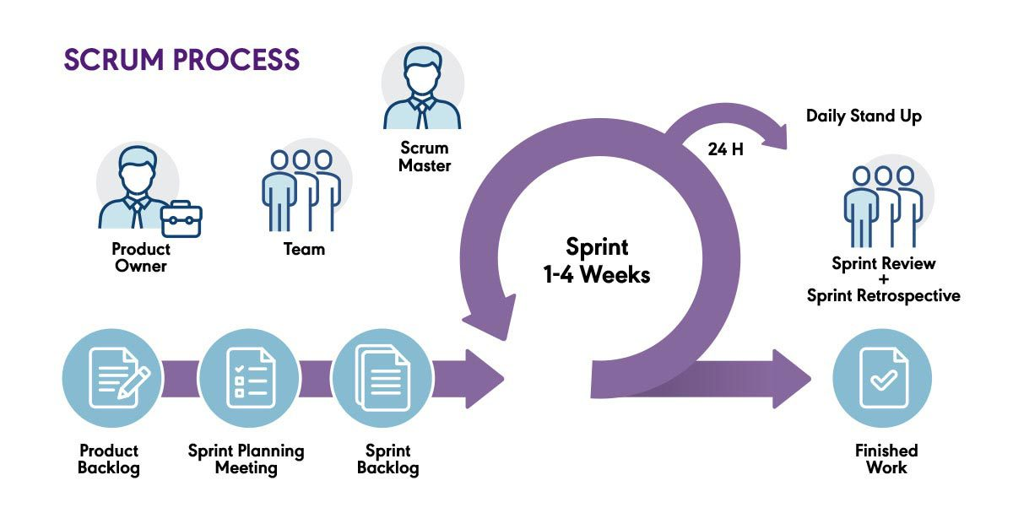
Development Methodology
04
Agile Scrum (or your chosen model)
Figure 1. Agile Scrum Model
3:00 – 5:00
Notes:
Walk through your chosen development model. If using Waterfall or V-model instead, describe the phases sequentially. Explain which sprint produces which deliverable.

Slide 6
Conceptual Framework
05
INPUT
PROCESS
OUTPUT
›
›
Figure 2. IPO Model
3:00 – 5:00
Notes:
Explain how data flows from Input through your research Process to produce the Output. Connect this to your RRL and theoretical framework if applicable.

Slide 7
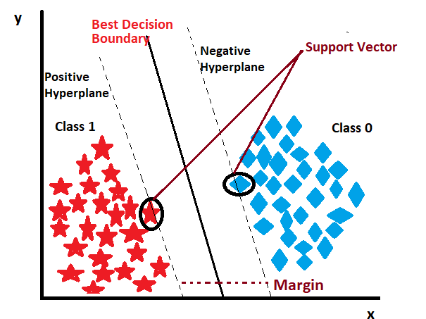
06
Fraud Detection using SVM
How does SVM works?
Collect and preprocess transaction data (e.g., amount, location, time, frequency of transactions).
Represent each transaction as a data point in a multidimensional feature space.
Identify an optimal hyperplane that separates legitimate transactions from fraudulent ones.
Maximize the margin between the two classes to improve classification accuracy and generalization.
Use kernel functions (e.g., linear, polynomial, Radial Basis Function) to handle complex, non-linear fraud patterns.
Classify new transactions by determining on which side of the hyperplane they fall.
Flag transactions predicted as fraudulent for further investigation or automatic intervention.
[1] C. Cortes and V. Vapnik, "Support-vector networks," Machine Learning, vol. 20, no. 3, pp. 273–297, 1995.
Why it's novel: No existing local system currently does this for the target context.
Benefit: Reduces false positives by ~40% vs. rule-based filters (based on related literature).
Aligned to Objective 2: Design and develop a fraud detection module integrated into the system.
3:00 – 5:00
Notes:
Clearly explain what the innovative element is, how it works, and how it maps to your specific objectives. Replace SVM with your actual algorithm or technique.

Slide 8
06
Fraud Detection using SVM
Raw Data
Input
Pre-
processing
Feature
Extraction
SVM
Classifier
Output
Flag
›
›
›
›
Transaction logs
Normalize, encode
Amount, time, type
RBF Kernel
Fraud / Legit
Figure 3: Proposed Machine Learning Pipeline
Accuracy Comparison (Literature Basis)
Rule-Based
60%
Decision Tree
74%
SVM (Proposed)
89%
3:00 – 5:00
Notes:
Clearly explain what the innovative element is, how it works, and how it maps to your specific objectives. Replace SVM with your actual algorithm or technique.

Slide 9
Software Prototype / Live Demo
07
Aligned to Specific Objectives
[Insert main prototype screenshot here]
Dashboard / Main Interface
User authentication & profile management module — addresses Objective 1 (identify and assess system requirements).
SO1
SO2
Core feature / algorithm module — addresses Objective 2 (design and develop the system).
SO3
Evaluation dashboard showing accuracy/performance metrics — addresses Objective 3 (evaluate and validate).
5:00 – 7:00
Notes:
Replace the placeholder with actual prototype screenshots. Each annotation card maps to one specific objective, showing the panel that your design is purposeful and not arbitrary.

Slide 10
Thank You
We welcome questions from the panel.
This presentation was developed with the assistance of Claude AI and reviewed by Ms. Barbosa. The material is intended solely for instructional use in
IT 22 (Sections 12810, 13367, and 13387).
Notes:
Open the floor for panel questions. Remain composed, concise, and grounded in your data. This presentation was developed with the assistance of Claude AI and reviewed by Ms. Barbosa. The material is intended solely for instructional use in IT 22 (Sections 12810, 13367, and 13387).

