Slide 1

Healthy Food Access in NYC
By Lance Roller II

Slide 2
Motivation
As a native New Yorker, I’ve been fortunate to experience the world-renowned culinary scene the city has to offer. No matter what culture it is, if you want to experience it, you can find it in New York.
Although New York has plenty of options for food when it comes to eating out, can we say the same when it comes to buying your own food to cook?
Do we have enough grocery stores around the city to meet the demand of a population of almost 9 million people?
Out of the all the grocery stores located in the city, how many of them can we say sell healthy/quality food? Is the food even affordable for everyone?

Slide 3
Questions & Predictions
Proposed Question
Hypothesis
What areas of New York City have the best and/or most options when it comes to buying healthy and fresh foods?
Are there specific boroughs and/or community districts that have significantly better options than others?
Are the locations of the better food options benefiting certain demographics more than others?
Where does the location of SNAP Centers in NYC compare to the better food options in terms of community districts?
Note: The Supplemental Nutrition Assistance Program (SNAP) is a federal program that provides food-purchasing assistance for low- and no-income people.
For community districts that don't have access to the healthy food stores, what type of restaurants are located in the area?
What’s the average health inspection grade for restaurants in those districts?
I predict the that the areas of New York City that will have the most access to healthy food will be the communities that are in the most affluent neighborhoods of the city located in Midtown and Lower Manhattan (Adjacent and below Central Park) as well as certain parts of Brooklyn.
Brooklyn will be the borough with the most access to healthy food due to it’s population and increasing popularity over the 10-15 years (In terms of desired places to live).
Brooklyn is the most populated borough in the city, most populated county (Kings County) in the state, and the second most populated county in the country.

Slide 4
Calculating which areas of NYC have the best access to Healthy Food
For this project areas that have the best access to healthy foods will be the ones that have the highest combinations of farmers markets, recognized shop healthy stores, and SNAP centers.
The borough with the highest combination of farmers markets, recognized shop healthy stores, and SNAP centers will be the borough with the best access to Healthy Food.

Slide 5
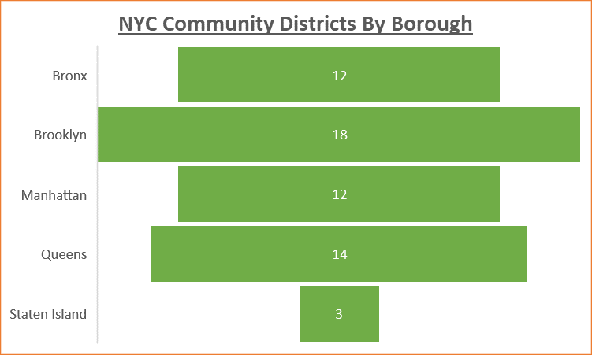
Top and Bottom Community Districts
After calculating the total number of facilities in each community districts the top 5 community districts with the most facilities are:
Manhattan Community District 11 (111), Bronx Community District 5 (205), Bronx Community District 6 (206), Brooklyn Community District 5 (305), & Brooklyn Community District 16 (316).
As for the communities with the least facilities, there were four communities with no facilities and 16 communities with a total of one facility. For the bottom community districts we will focus on the four communities that have no facilities, these community districts are:
Brooklyn Community District 18 (318), Queens Community District 10 (410), Queens Community District 11 (411), Staten Island Community District 3 (503)
Note: Community District Borough Codes : Manhattan (100), Bronx (200), Brooklyn (300), Queens (400), Staten Island (500)

Slide 7
Farmers Markets
Borough analyzation
Community District analyzation

Slide 8
Recognized Shop Healthy Stores
Borough analyzation
Community District analyzation
SNAP locations in relation to the healthy stores (Along with general SNAP information).

Slide 9
History of Recognized Shop Healthy Stores
Shop Healthy NYC (Est. 2012) is a New York City Health Department initiative, in partnership with the New York City Center for Economic Opportunity, that aims to increase access to healthy food and engage residents and organizations to support sustainable food retail change in their community.
To ensure a long-term impact on food access, Shop Healthy NYC aims to influence supply and demand by: reaching out to food retailers to increase stock and promotion of healthy foods, including intensively working with stores to meet specific goals; collaborating with distributors and suppliers to facilitate wholesale purchases and widespread promotion of healthy foods; and engaging community constituents (customers) to support participating retailers and increase neighborhood access to healthy foods.
Recognized Shop Healthy Stores are bodegas & grocery Stores receiving recognition from Borough President's Office
In order to qualify for this award a bodega and grocery store must:
Increase availability of healthier foods, such as low-sodium canned goods, healthier snacks and deli options
Promote of healthier foods by posting Shop Healthy marketing materials for healthier foods and removing unhealthy advertising from the front door
Increase visibility of healthier foods by placing them in more prominent locations, such as placing produce at the checkout counter or near the front entrance of the store, and water and other low-calorie drinks at eye-level.

Slide 10
Demographics For The Top & Bottom Community Districts
Population
Race/Ethnicity
Education
Limited English Proficiency
Unemployment
Poverty Rate
Rent Burden

Slide 11
Demographics Glossary
Poverty rate = The NYCgov poverty rate, which is a poverty measurement specific to New York City. The NYCgov poverty threshold is based on national.
Percent Bachelors degree = Percentage of residents 25 years or older that have earned a bachelor's degree or higher in the PUMA that CD roughly matches
Unemployment = Percentage of the civilian labor force that is unemployed in the PUMA that CD roughly matches
Percent Household Rent Burden: Percentage of households that spend 35% or more of their income on rent in the PUMA that CD roughly matches
Percent Foreign Born = Percentage of residents of the Community District who were not U.S. citizens at birth. This includes naturalized U.S. citizens, lawful permanent residents, temporary migrants, humanitarian migrants, and unauthorized migrants.
Limited English Proficiency Rate = Percentage of residents that self-identify as having limited English proficiency in the PUMA that roughly matches the Community District

Slide 12
Restaurants
Borough analyzation
Community District analyzation
Health Inspection Grades
Type of Restaurants

Slide 13
Conclusion
The Bronx with a slight edge over Brooklyn is the borough with the best and/or most options when it comes to buying healthy and fresh foods.
Manhattan Community District 11 (111), Bronx Community District 5 (205), Bronx Community District 6 (206), Brooklyn Community District 5 (305), & Brooklyn Community District 16 (316) are the community districts that have significantly the best options.
These districts do not include the areas/neighborhoods of the city I predicted would have the best options to by healthy food.
This is also due to the fact that the city government is having success getting underserved communities access to better food with the Shop Healthy NYC program.
The majority of SNAP centers were not in close proximity to Recognized healthy shops
When it comes to demographics, the areas with higher food access (Top community districts) are benefiting Black, Hispanic, and foreign born residents mostly. These communities also seems to have worse ratings when it comes to education, poverty, unemployment, and English proficiency compared to the bottom community districts once again reiterating that the city government is having success getting underserved communities access to better food with the Shop Healthy NYC program.
Could this also be a possibly due to the fact some of the neighborhoods are targets of gentrification and having better food options will help the desirability/value of the neighborhood go up?
For community districts that don't have access to the healthy food stores the most common restaurants were Chinese, American, Caribbean.
The average healthy inspection grade for these districts was an A which is very good.
When it comes to health inspection grades and types of violations, there were no significant differences in restaurants located in the top community districts and those at the bottom.

Slide 14
Things recommended for further investigation
Are people actually buying healthy foods if they have access to them?
If they are, how do we know if it’s having an impact on their overall health?
If they’re not, what is primary reason for not doing so?
Sustainability
How many Recognized Healthy Shops are maintaining the changes/standard once they’ve received the award (Especially since the city doesn’t have a processes in place to ensure that stores maintain the changes past one-month)?
If customers aren’t buying the healthy foods, how long will it be till owners of these stores stop selling those products and revert to what sells?
At the end of the day, these store owners are still running a business and most businesses will not spend money on a product where they wont receive a return on their investment.
Comparing food expenses by community district
What is the average price of groceries in each community district?
What is the average price for a meal at a restaurant in each community district?
What is the average food budget per month and/or year for each person and/or household in each community district?
How do those results compare to the ones in this project?
Impact of gentrification on food access within the city
Do previous neglected community districts have better access to food primarily because of gentrification?
Unreported farmers markets, healthy stores, and SNAP centers
How many farmers markets, healthy stores, and SNAP centers were unreported and didn’t make it in their respective database?

Slide 15
Data Sources
From the City of New York
CSV:
https://communityprofiles.planning.nyc.gov/
https://opendata.cityofnewyork.us/
https://data.cityofnewyork.us/dataset/DOHMH-Farmers-Markets/8vwk-6iz2
https://data.cityofnewyork.us/Social-Services/Directory-of-SNAP-Centers/tc6u-8rnp
https://data.cityofnewyork.us/Health/DOHMH-New-York-City-Restaurant-Inspection-Results/43nn-pn8j
https://data.cityofnewyork.us/Social-Services/Borough-Community-District-Report-SNAP-Population/jye8-w4d7
https://data.cityofnewyork.us/Health/Recognized-Shop-Healthy-Stores/ud4g-9x9z
GeoJSON:
https://data.cityofnewyork.us/City-Government/Community-Districts/yfnk-k7r4

Slide 16








Programs Used For Data Analysis, Visualization, & Presentation

Slide 17
Thank You!

