Slide 1
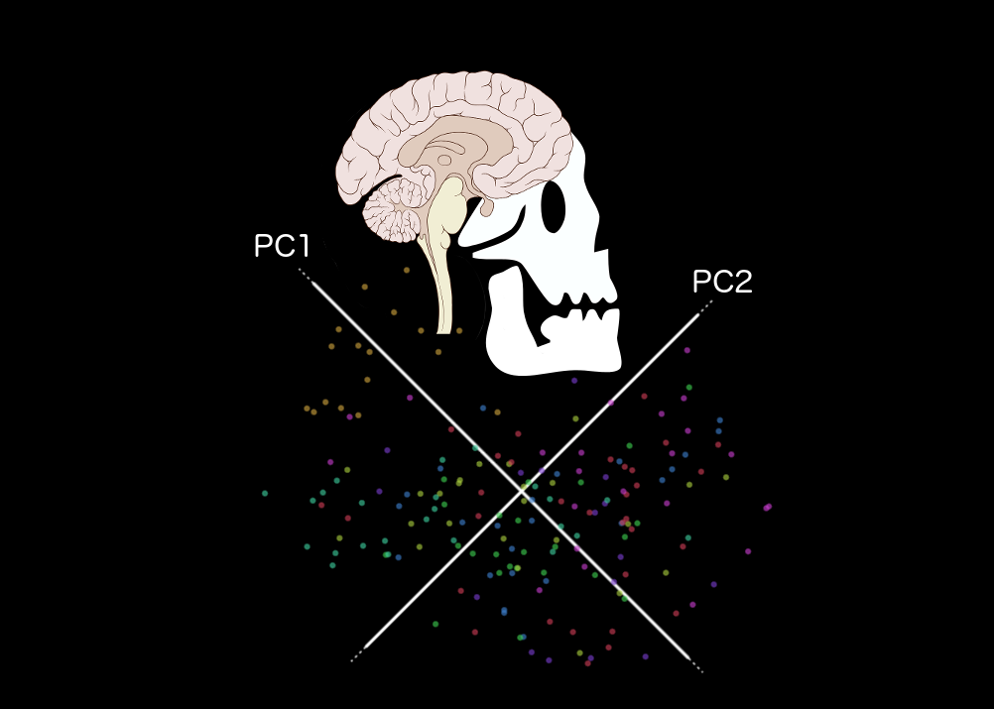
MARINeR
Multivariate Analyses and Resampling Inference for Neuroimaging in R
Jenny Rieck Derek Beaton
Rotman Research Institute, Toronto, ON

Slide 2
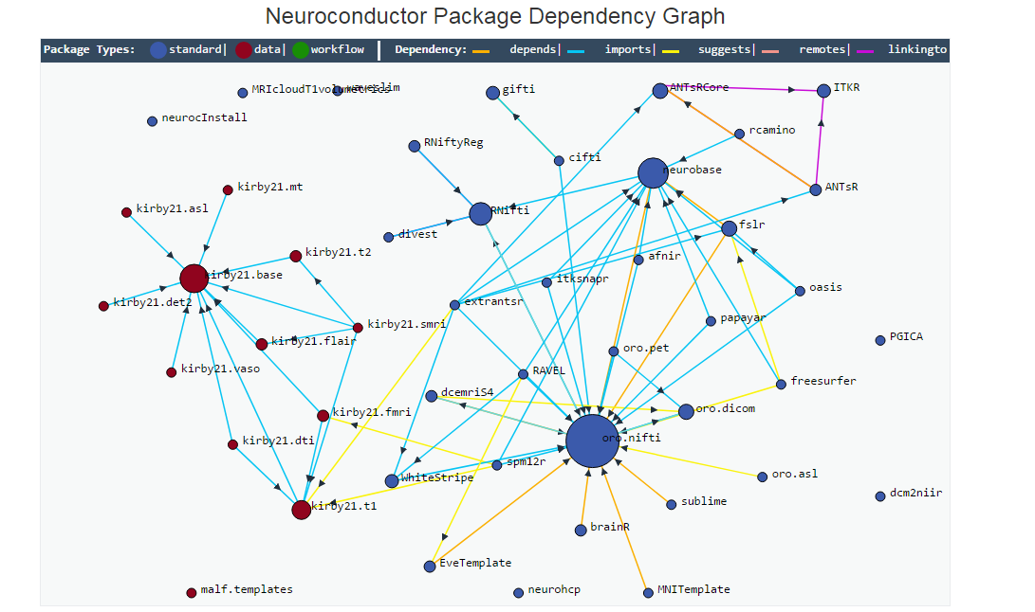
Why R?
Why multivariate?
Why resampling?

Slide 3
MARINeR: 3 Core Features
Data processing
Data masking, signal normalization
Multivariate analyses via the SVD
PCA, MDS, PLS, MFA
Resampling strategies for statistical inference
Permutation, bootstrap, split-half resampling

Slide 4
Current State
https://github.com/derekbeaton/BrainHack_TO_2017
Toy functional data from open fMRI ds107
Basic data preprocessing
gSVD & PCA
Simple descriptive output

